Slide 1
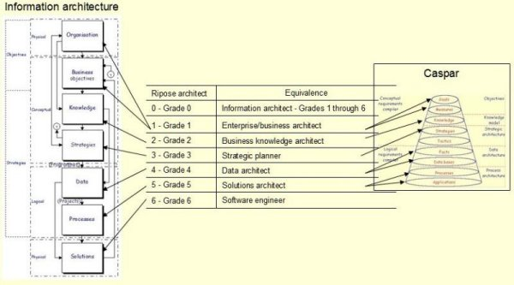
Ripose course curriculum
To become a Ripose Grade 0 Architect
(RA0)

Slide 2
Curriculum
Background reading
Concepts
  Objectives [RA1]
  Knowledge [RA2]
  Strategies [RA3]
Logic
  Facts [RA4 & RA5]
  Projects
  Applications [RA6]

Slide 3
Background Reading
How Einstein may have fixed the world – 2 pages
Are you ready to be a RA0 – 2 pages
The skills you will need – 5 pages
What is a business – 30 pages
Keywords
  What are keywords – 12 pages
  An essay – 9 pages (optional)
5 Bias Cards – 11 slides
Who am I – optional - Skip
Note: All references will open in a browser. Use Alt-Tab to switch between presentations

Slide 4
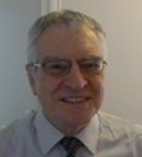
Who am I
History behind the development of Ripose
My LinkedIn Profile
My Purpose
My autobiography – a very long read

Slide 5
Concepts – Objectives [RA1]
As a Ripose Grade 1 Information architect [RA1] you will need to understand that Objectives are subdivided into 3 sections.
This course will train you how to handle the following 3 concepts:
Goals
SWOT
Measures

Slide 6
Concepts – Objectives [RA1] – Goals
Information – Reading material
Objectives – Reading material Chapter 1
Lecture 1 – The anatomy of Information
Formula
Why limit Goals to 1, 4 & 11?
  Why 1 Purpose – Self explanatory
  Why 4 Benefits – 1 Page
  Why 11 Values – 1 Page
  Finger Puppet and How to fold
Practical 1 – Develop your Goals using
  iCaspar – Print the results for future reference
  Manually – (optional) print for future reference

Slide 7
Objectives [RA1] – Goals
In a lot of cases the enterprise will have already spent time developing their objectives. Now is the time to learn how to re-engineer them into the 1-4-11 format
Lecture 2 & Practical 2 – Case Study 1
Sort the spreadsheet appropriately
  Example of a spreadsheet for Case Study 1
Do not proceed to the next slide until you have completed the assignment

Slide 8
Goals - Purpose
Solution to Case Study 1 Goals
Lecture 3 – The Purpose Statement
Practical 3
Using keywords and the 16 goals find the Purpose statement. Note it is probably the most ‘Convenient Truthful’ objective of all the ‘Goals’ - Use Tag#1 through #3 to provide other keywords (optional)
Submit your work – Only if you are a member of LinkedIn’s The Ripose Information Architecture Group (TRIAG) (optional as I will provide you with my solution)

Slide 9
Goals - Benefits
Solution to Case Study 1 - Purpose
Lecture 4 – Benefit statements
Practical 4
Use either your solution or mine, using keywords and the remaining 15 goals find the 4 Benefit statements and place them in the spreadsheet. Use Tag#3 to record a shortened description (optional)

Slide 10
Goals - Values
Solution to Case Study 1 - Benefits
Lecture 5 – Value statements
Practical 5 - Using your solution or mine & using keywords in the remaining 11 goals assign the Value statements to the appropriate Benefit statement. Use Tag#2 to record the name of the appropriate Benefit & Tag#3 to provide a shortened description
Submit your work – Only if you are a member of TRIAG
End of Case Study 1, Goals
Solution
Back Next

Slide 11
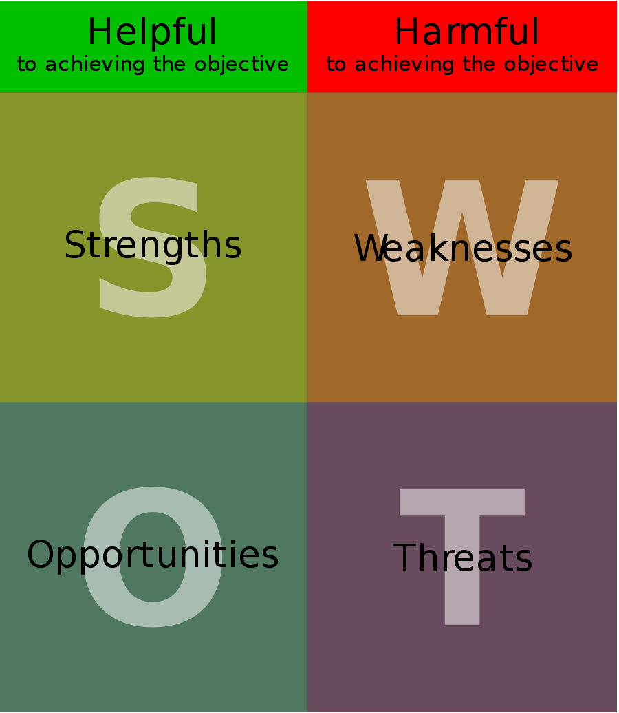
Objectives – SWOT {Work In Progress}
Reading material – 10 pages
Practical 6 – SWOT your own ‘Values’

