Slide 1
autocomp — Demand Planning Demo
Actuals Upload · Outlier Management · Forecasting · Overrides
Client: autocomp

Slide 2
01 Actuals Upload
Bring in actual sales from Excel/CSV, review status and roll up the hierarchy.
autocomp — Demand Planning Demo

Slide 3
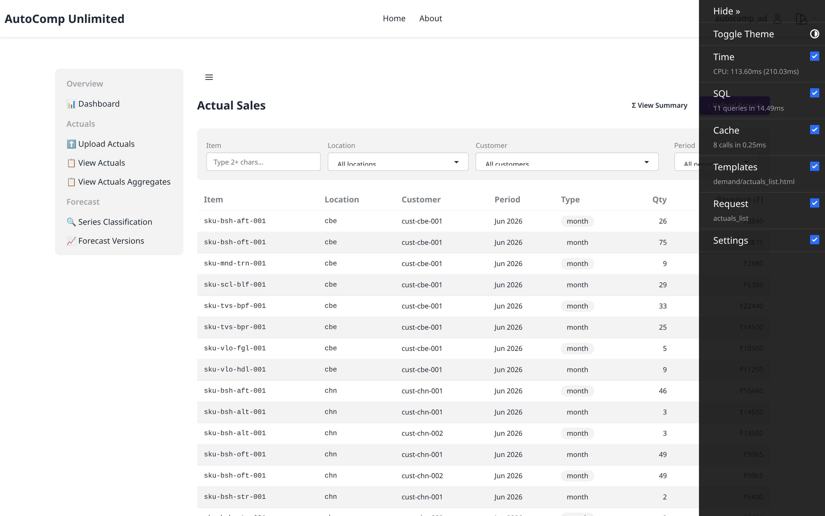
Actuals — List
/autocomp/demand/actuals/
Imported actual-sales records with status.

Slide 4
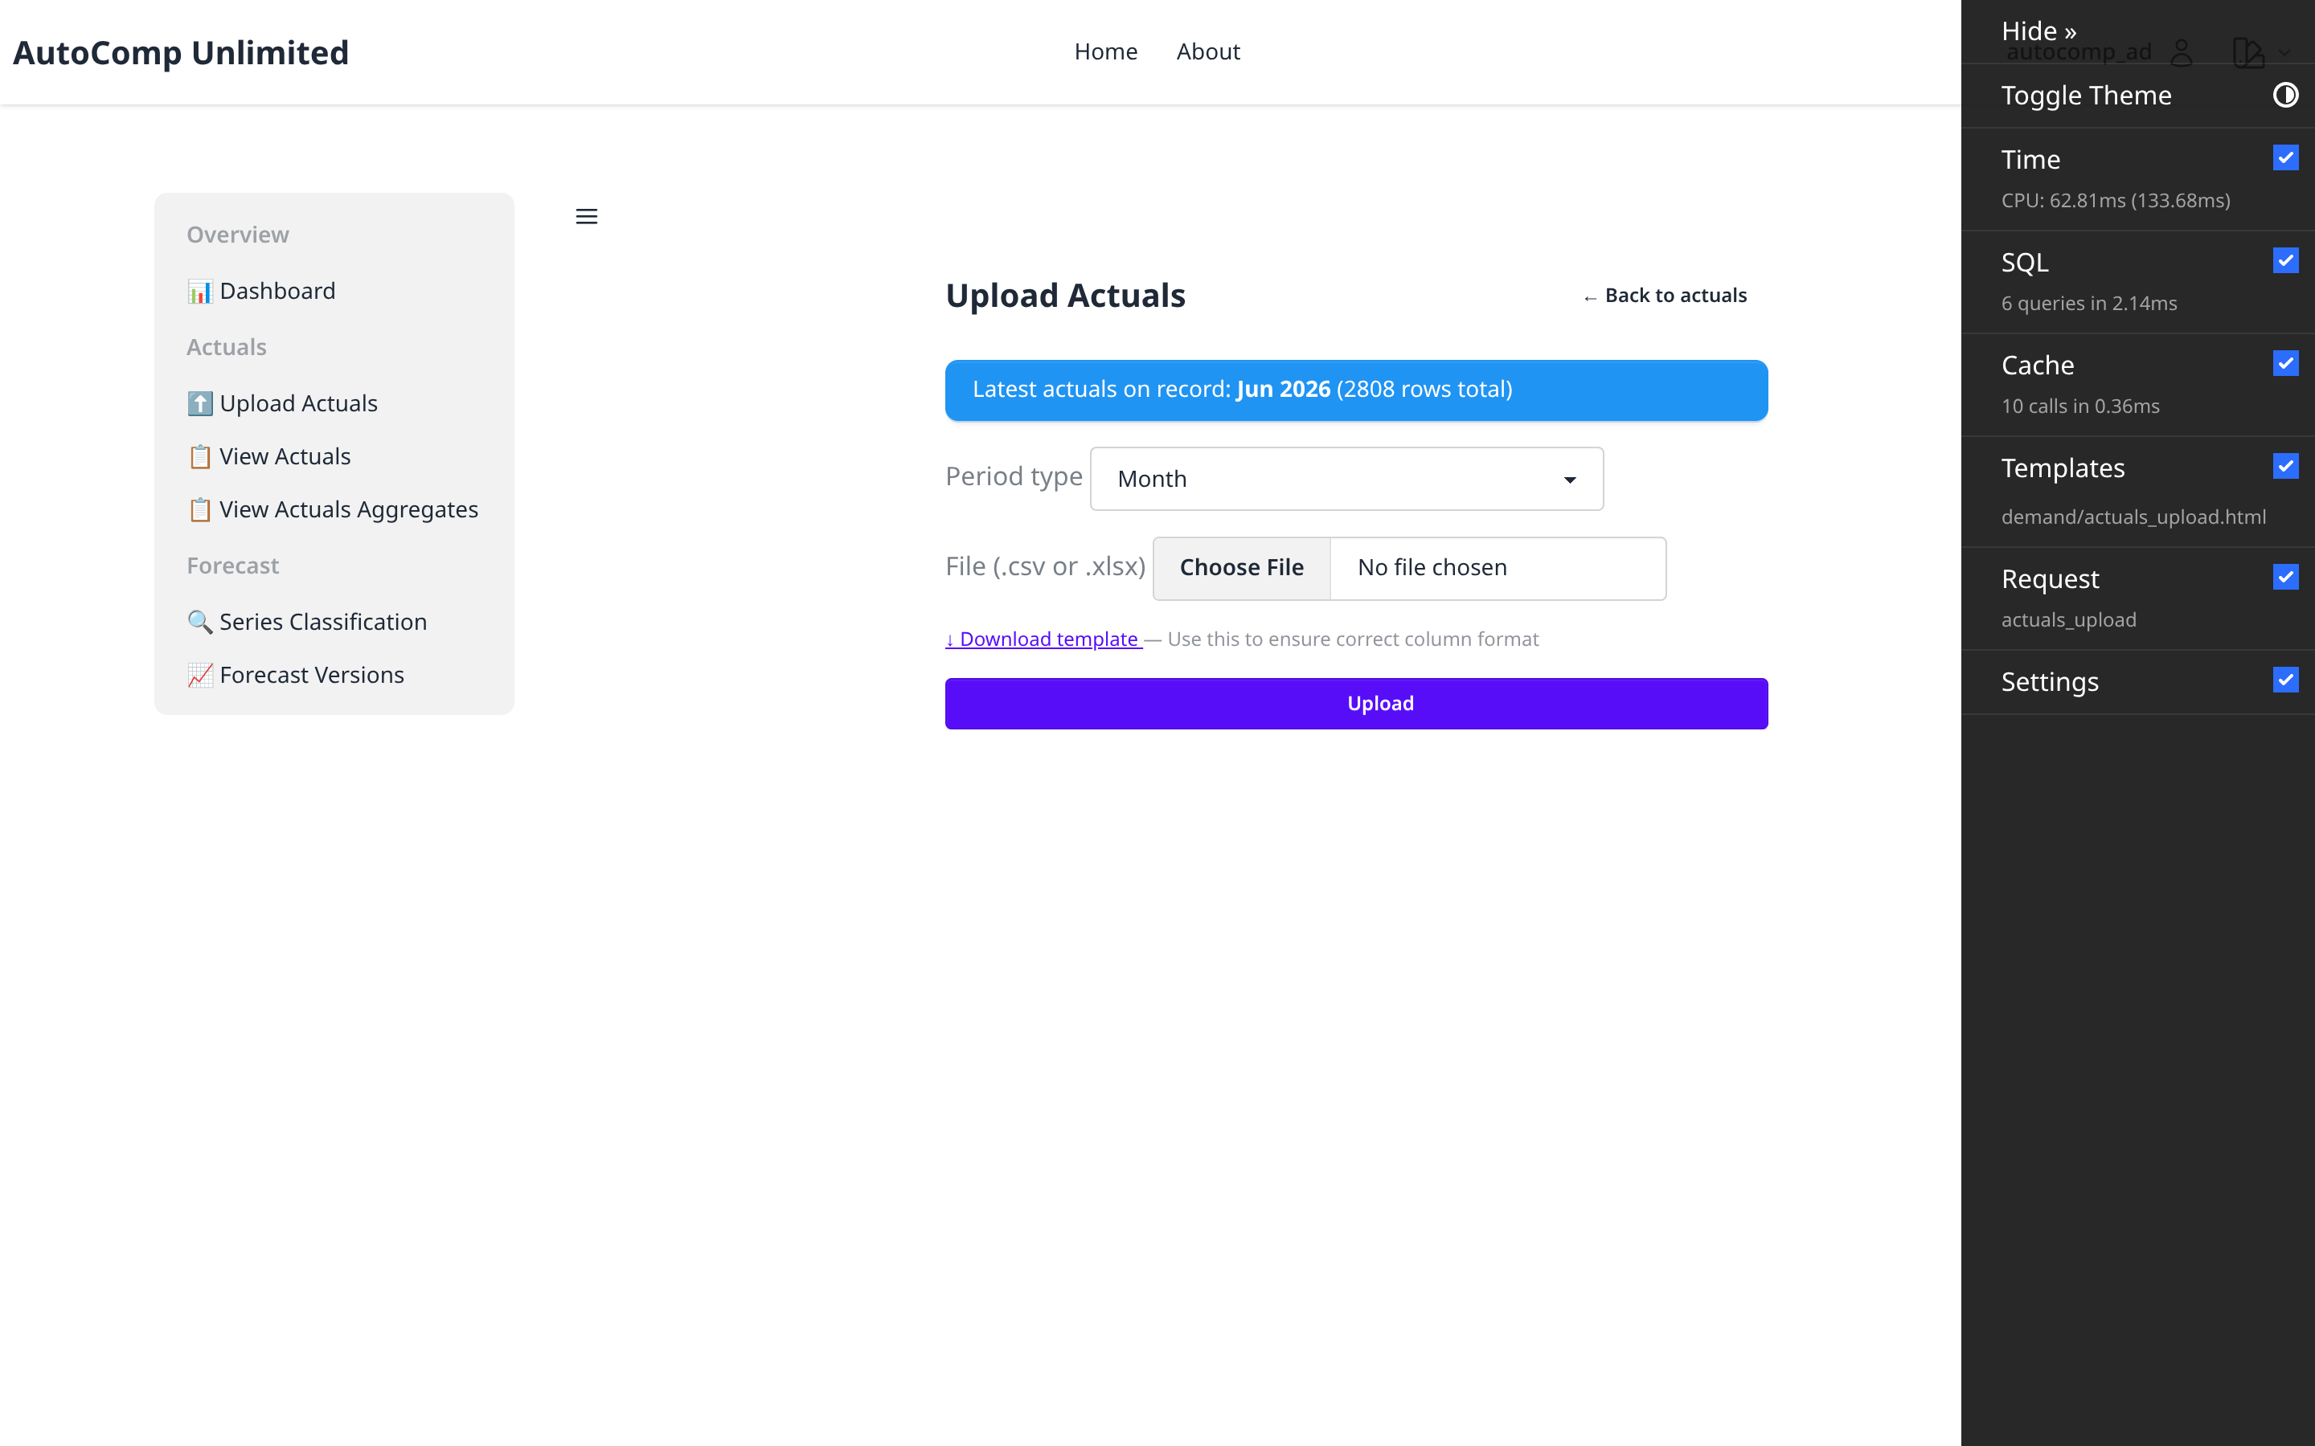
Actuals — Upload
/autocomp/demand/actuals/upload/
Upload actuals via Excel/CSV template.

Slide 5
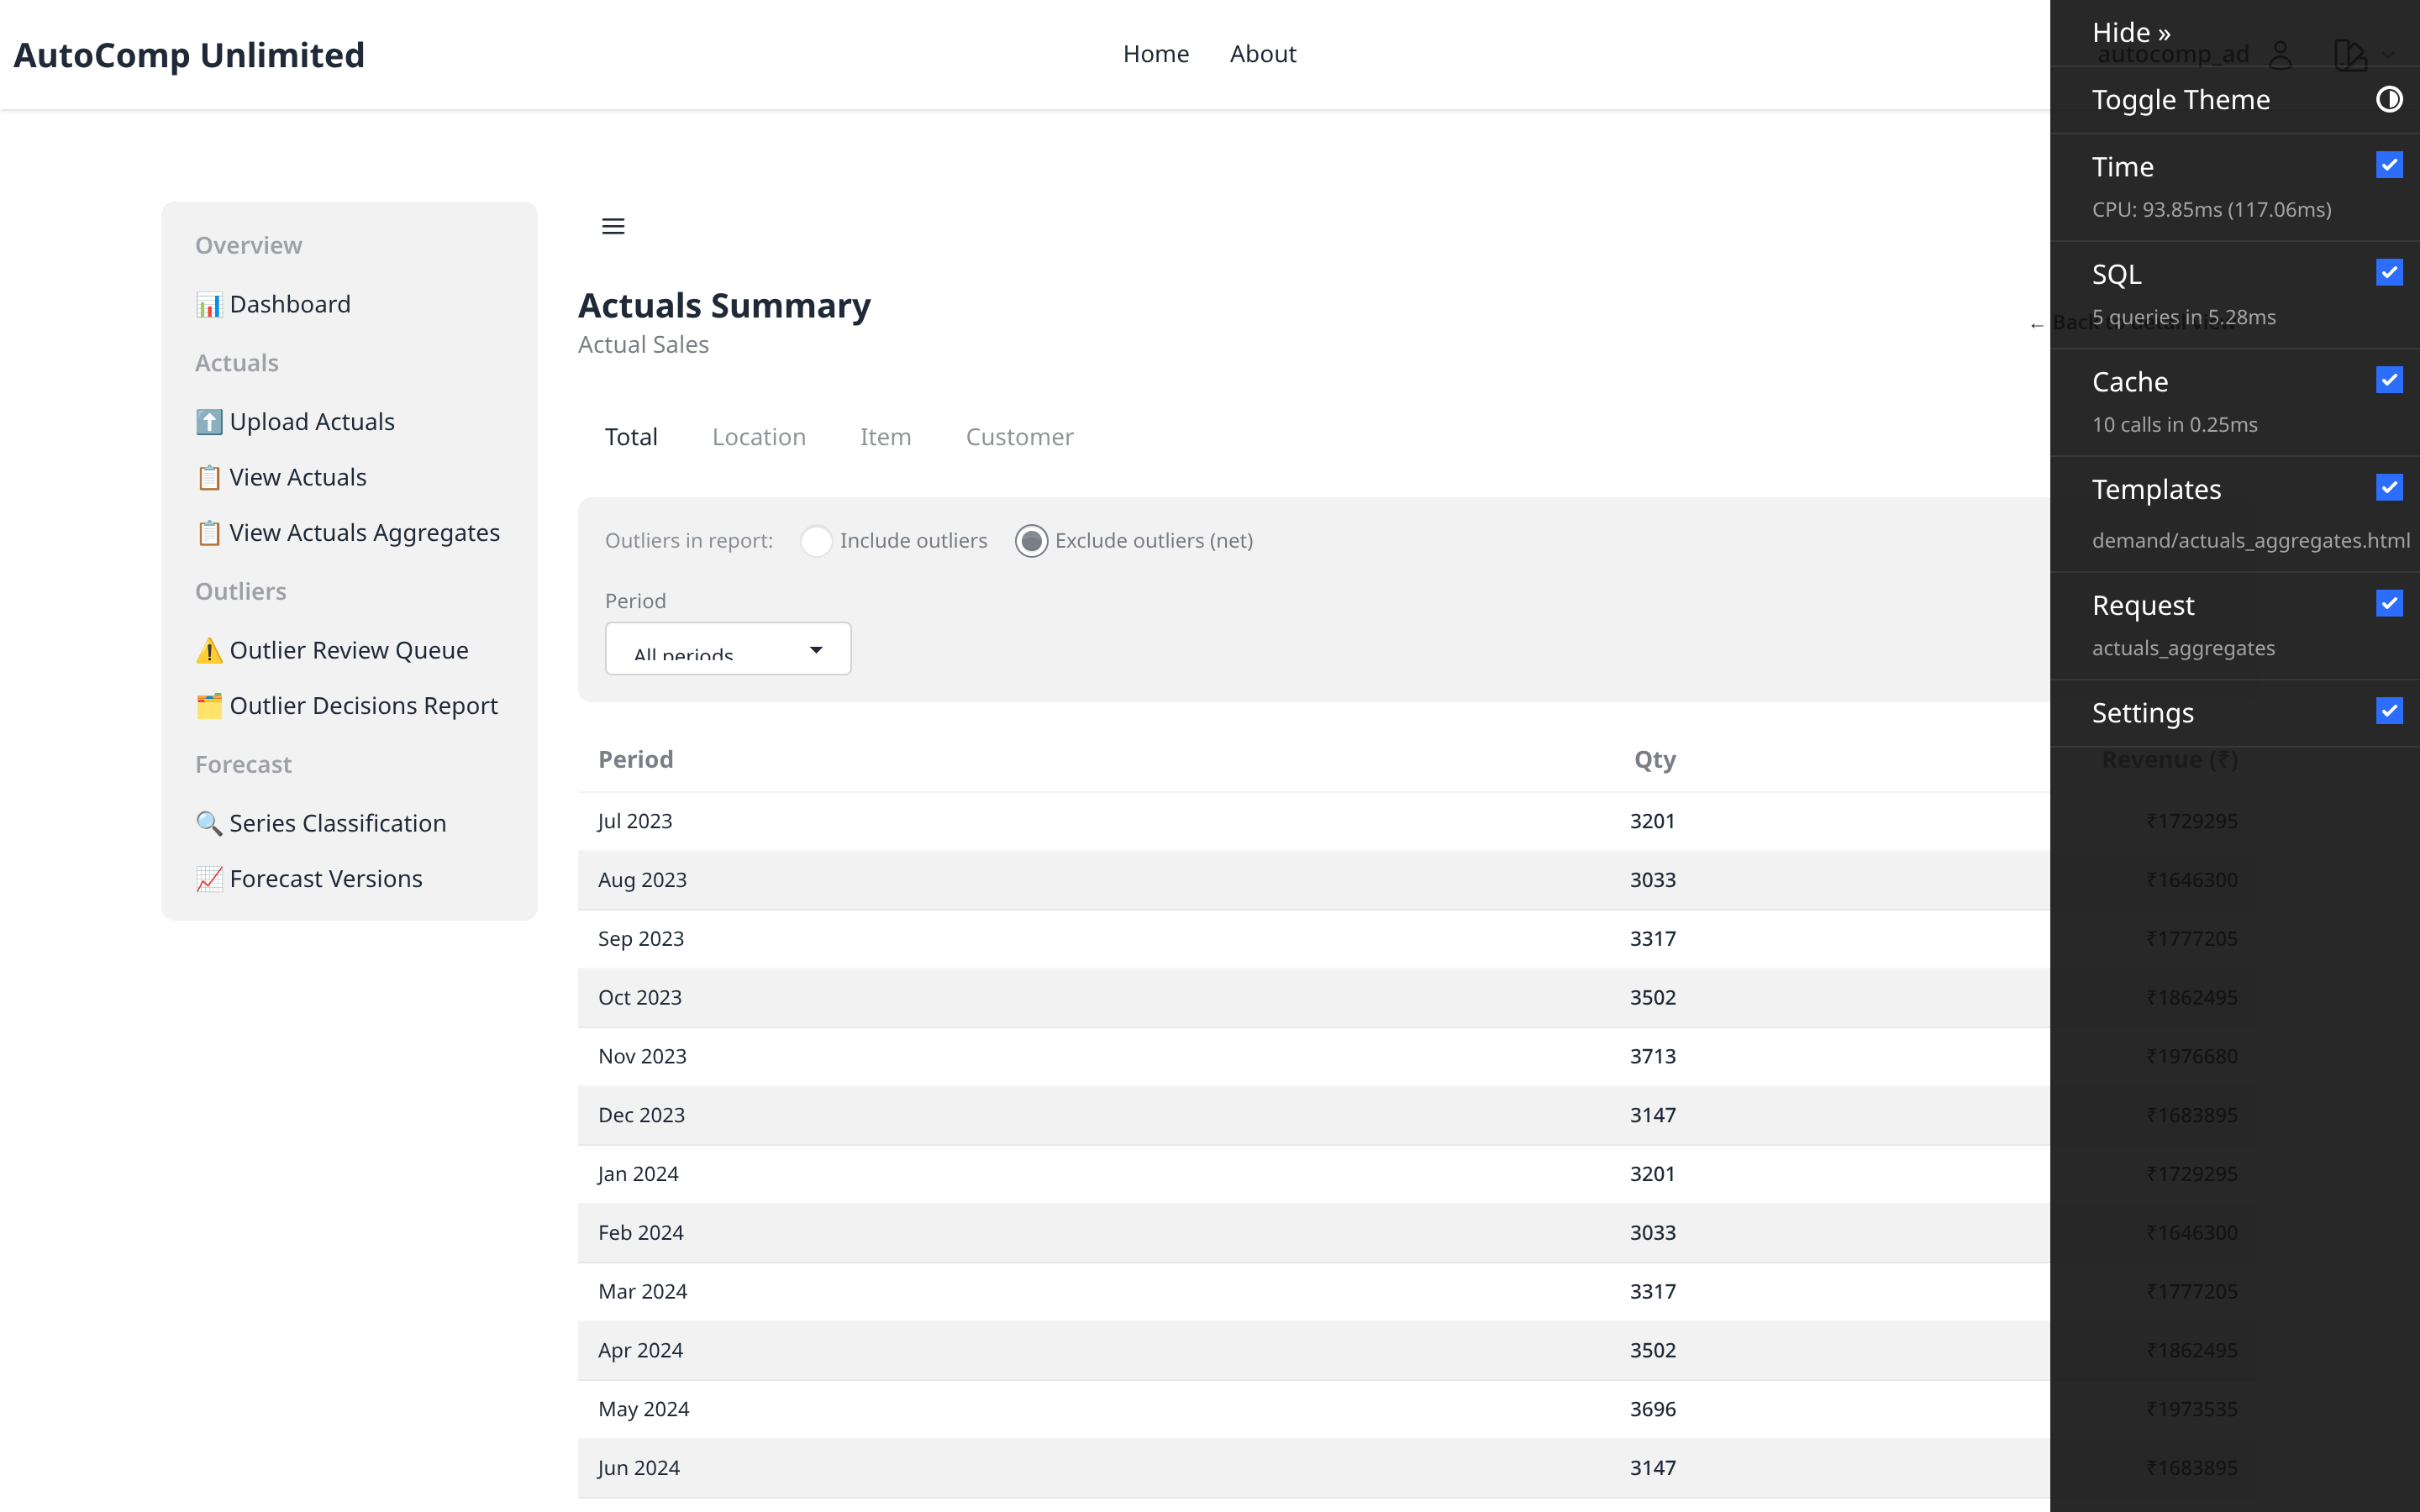
Actuals — Aggregates
/autocomp/demand/actuals/aggregates/
Net actuals rolled up by location/item/channel.

Slide 6
02 Outlier Management
Review the candidate queue, trigger detection and audit planner decisions.
autocomp — Demand Planning Demo

Slide 7
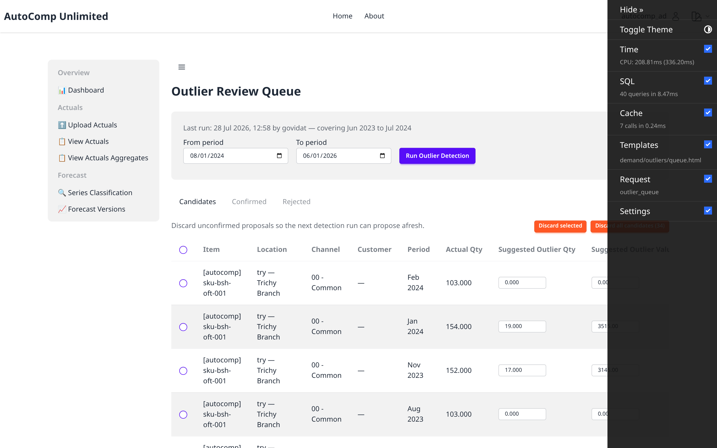
Outlier — Queue
/autocomp/demand/outliers/
Planner review queue of CANDIDATE outliers with system-suggested reasons.

Slide 8

Outlier — Detection
/autocomp/demand/outliers/detection-form/
Planner-triggered outlier detection for a per-series basis.

Slide 9
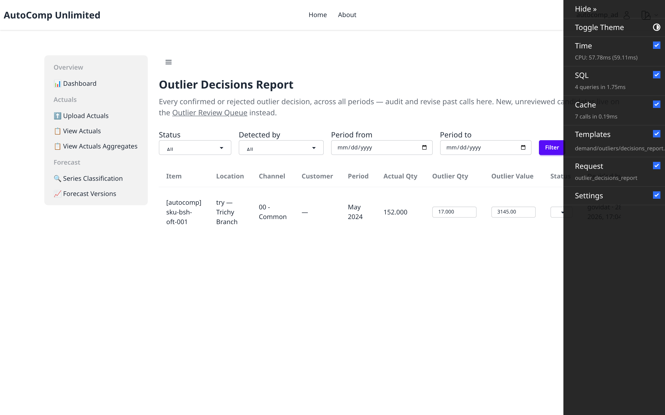
Outlier — Decisions
/autocomp/demand/outliers/decisions/
Audit report of confirmed/rejected/revised outlier decisions.

Slide 10
03 Forecasting
Versions, engine config, forecast lines, roll-ups, drill-down and accuracy.
autocomp — Demand Planning Demo

Slide 11
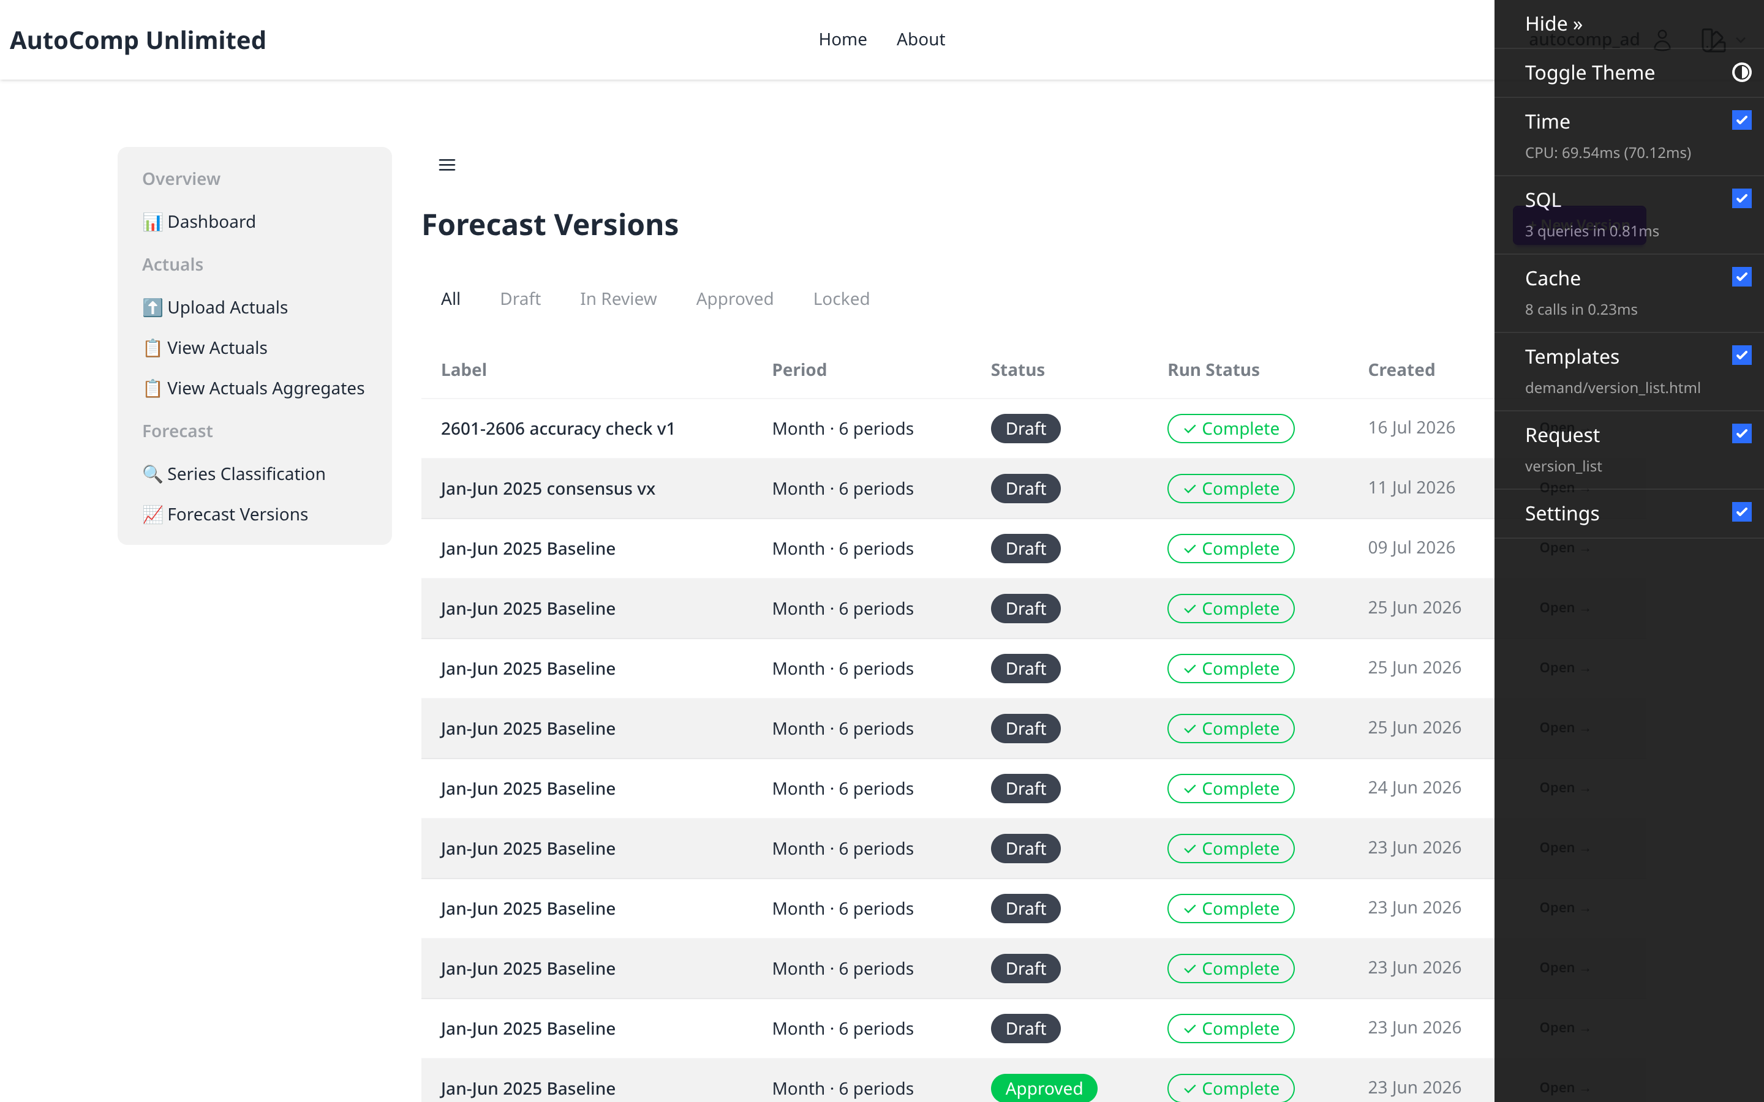
Forecast Versions — List
/autocomp/demand/versions/
All forecast versions with status (DRAFT/IN_REVIEW/APPROVED/LOCKED).

Slide 12
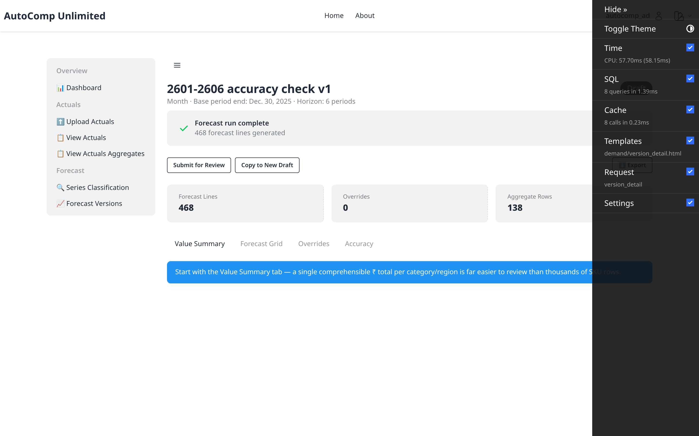
Forecast Version — Detail
/autocomp/demand/versions/24/
Version header, period range, engine config and status controls.

Slide 13
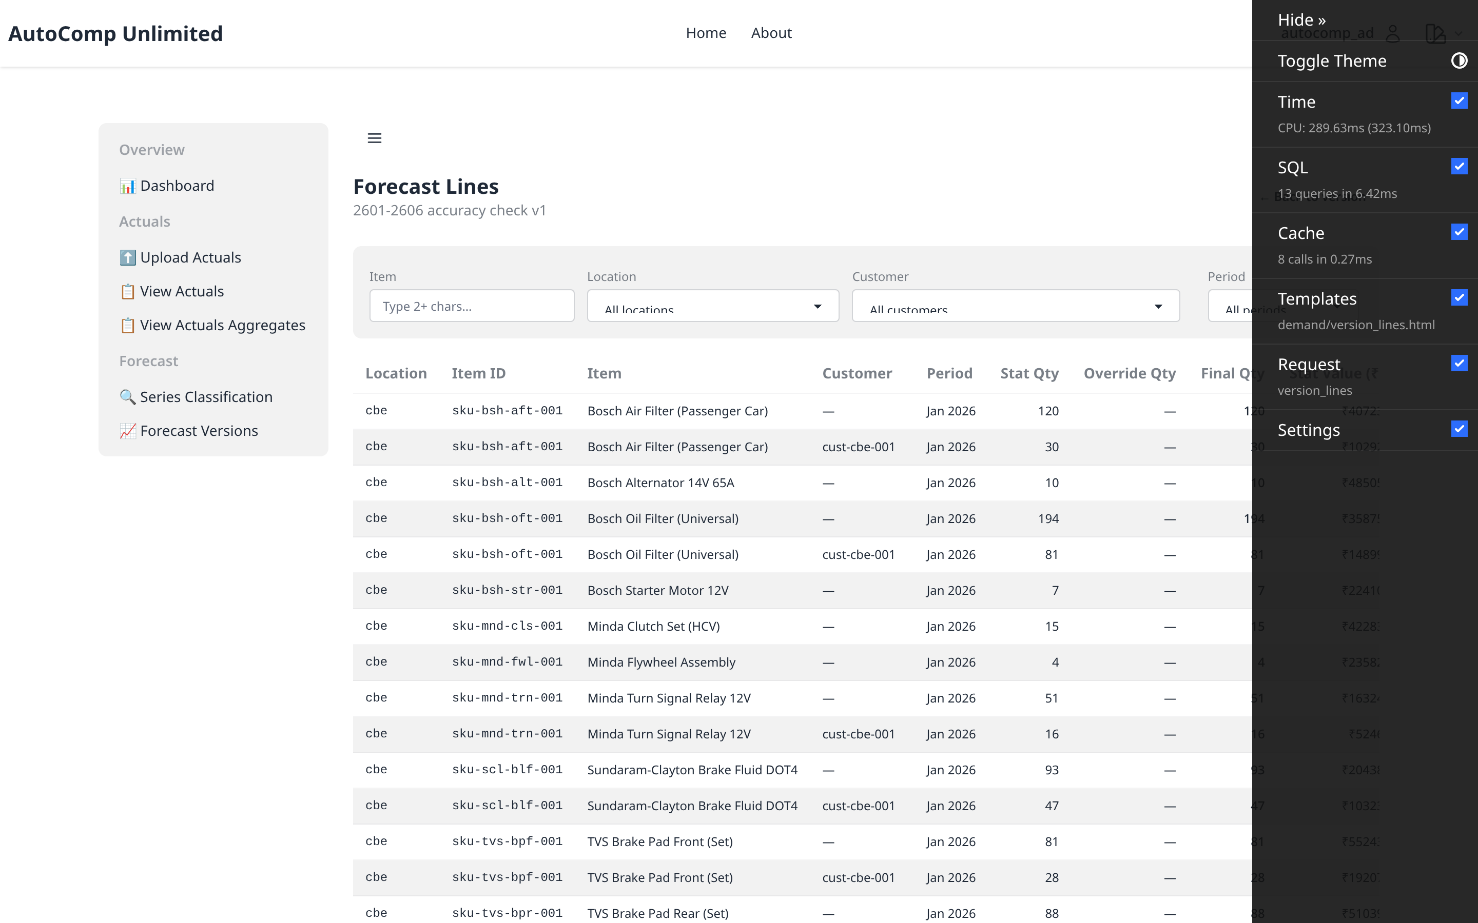
Forecast Grid — Lines
/autocomp/demand/versions/24/lines/
SKU-level forecast lines per planning location, item and distribution channel.

Slide 14
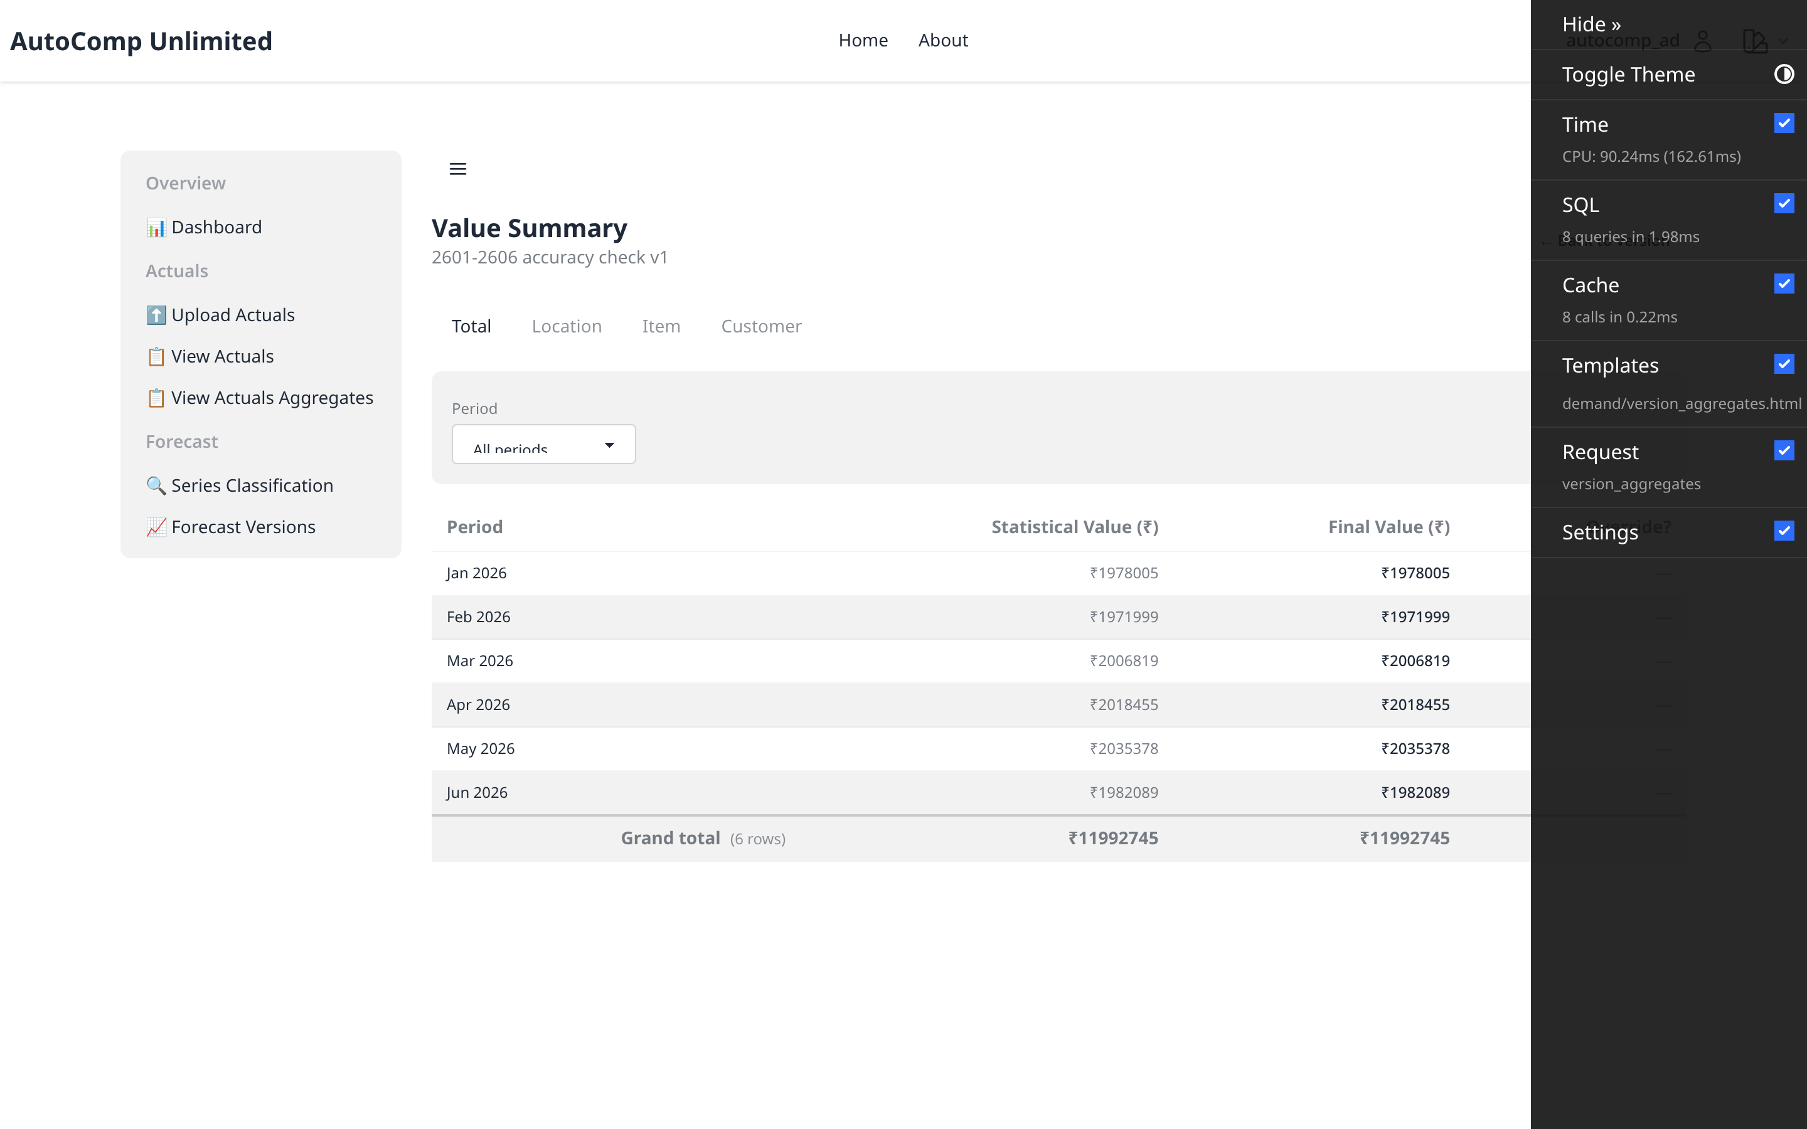
Forecast Aggregates
/autocomp/demand/versions/24/aggregates/
Rolled-up value summary across the hierarchy.

Slide 15
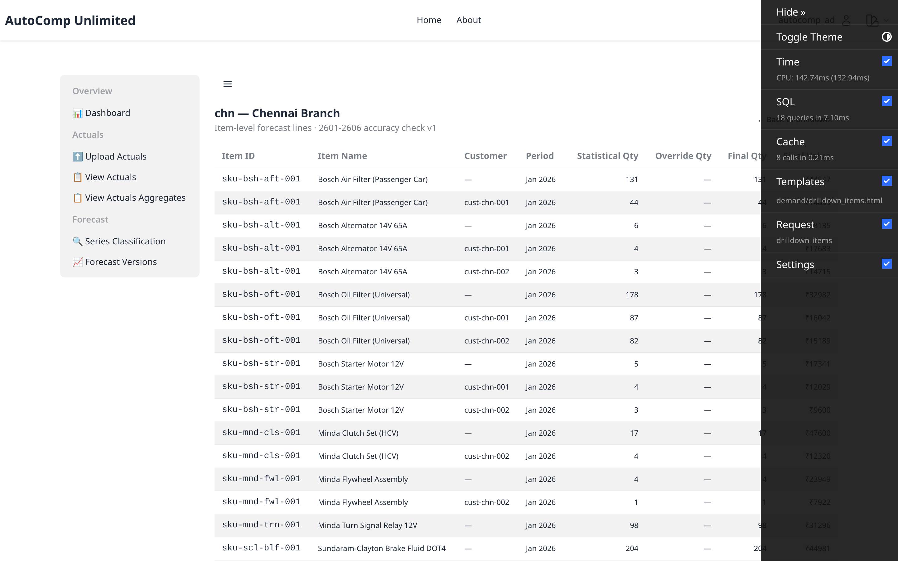
Forecast Drilldown — Items
/autocomp/demand/versions/24/drilldown/6/items/
SKU-level lines at a leaf location (chn).

Slide 16
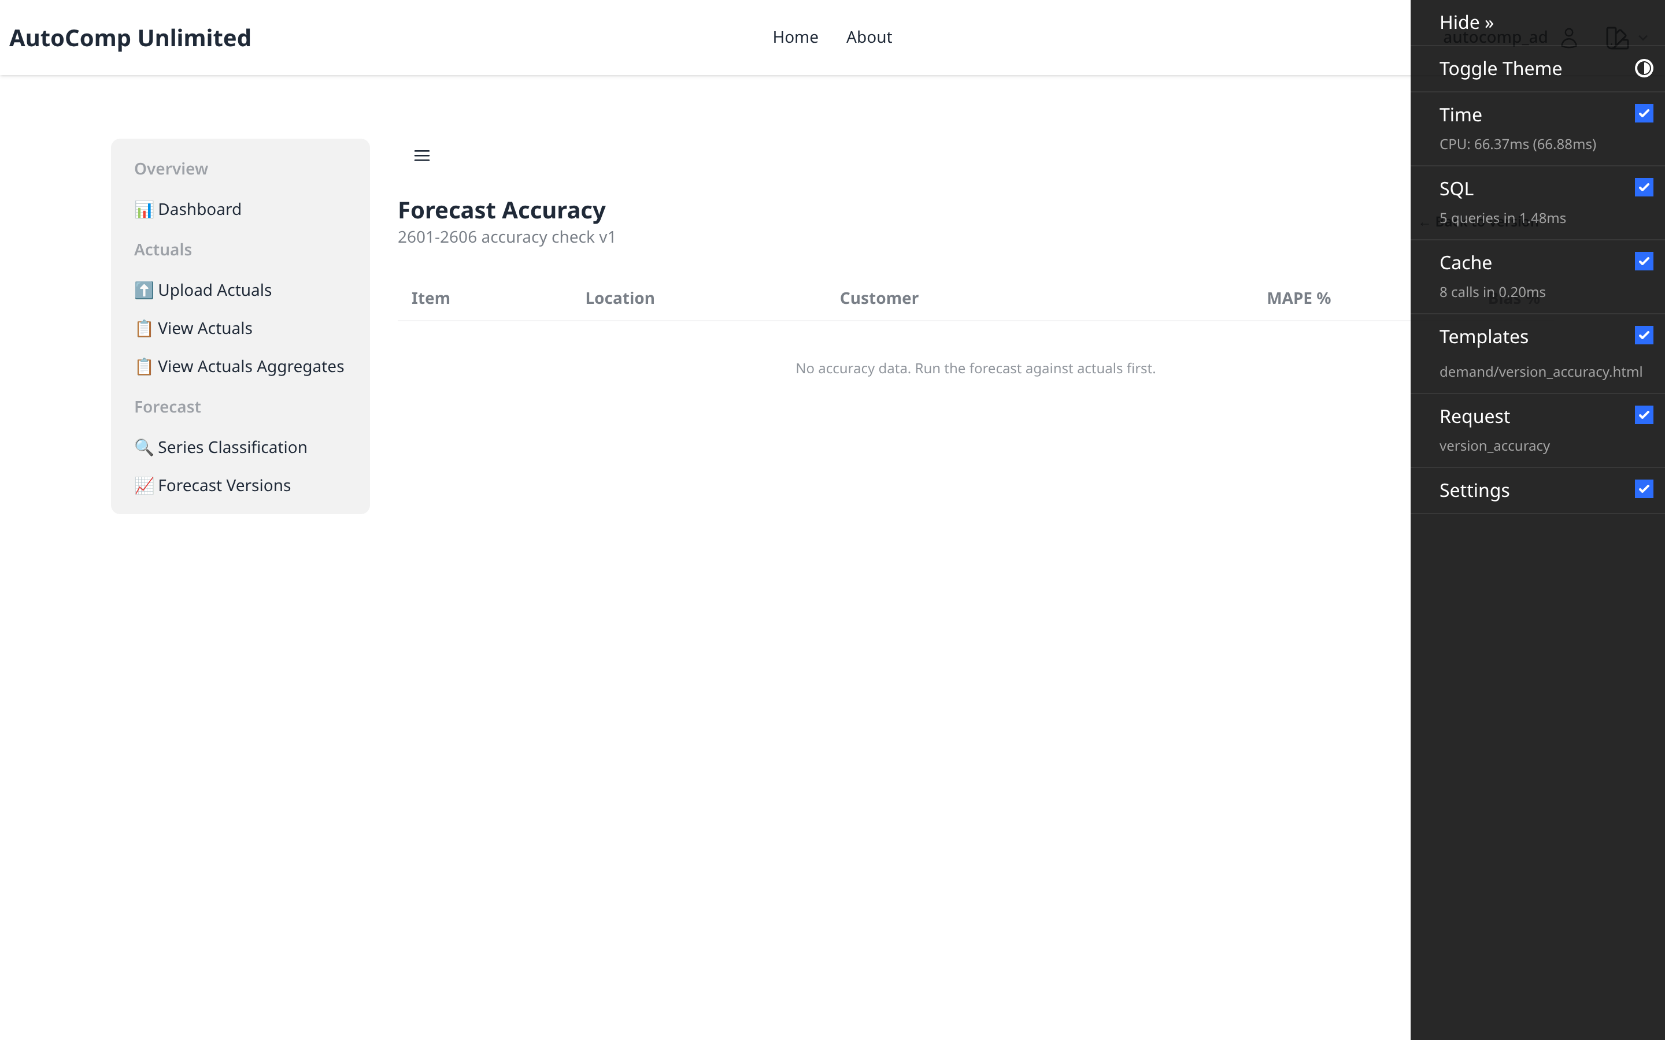
Forecast Accuracy
/autocomp/demand/versions/24/accuracy/
Accuracy vs net actuals for the version.

Slide 17
04 Overrides
Planner consensus adjustments on top of the forecast.
autocomp — Demand Planning Demo

Slide 18
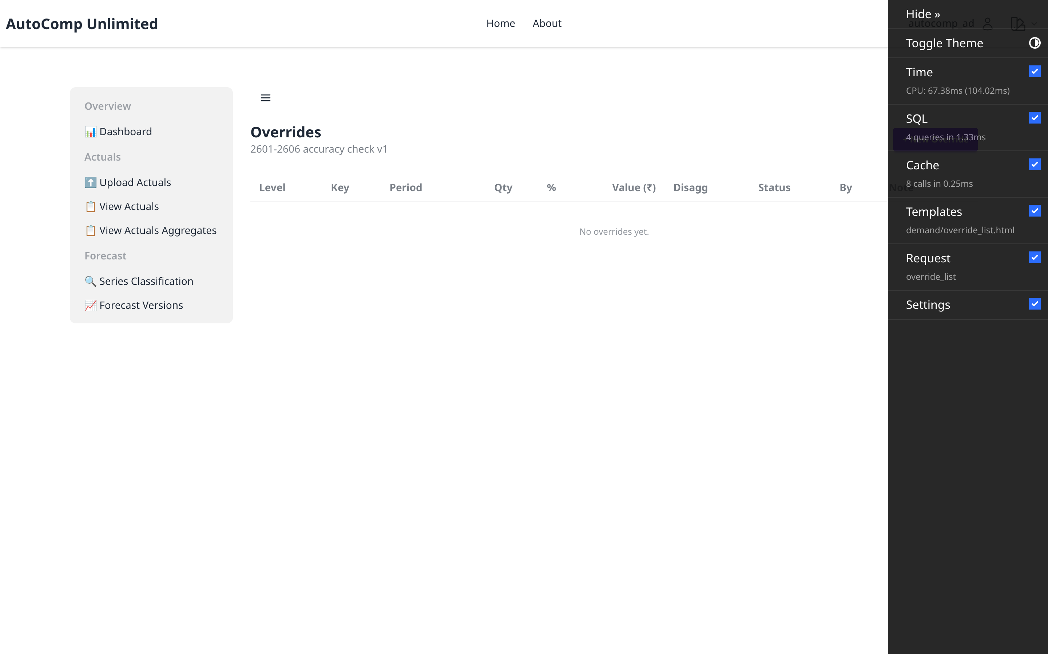
Overrides — List
/autocomp/demand/versions/24/overrides/
Planner consensus overrides on the forecast.

