Slide 1
autocomp — Demand Planning Demo
Item Catalogue & Dashboard Sub-Screens
Client: autocomp

Slide 2
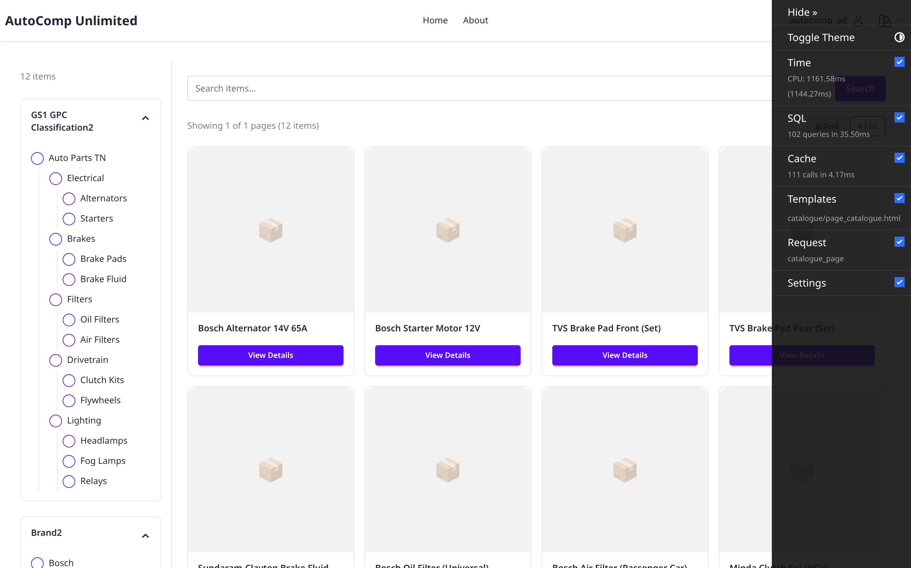
Item Catalogue — List
/autocomp/catalogue/
Full catalogue of SKUs for the autocomp client with search/filter and item links.

Slide 3
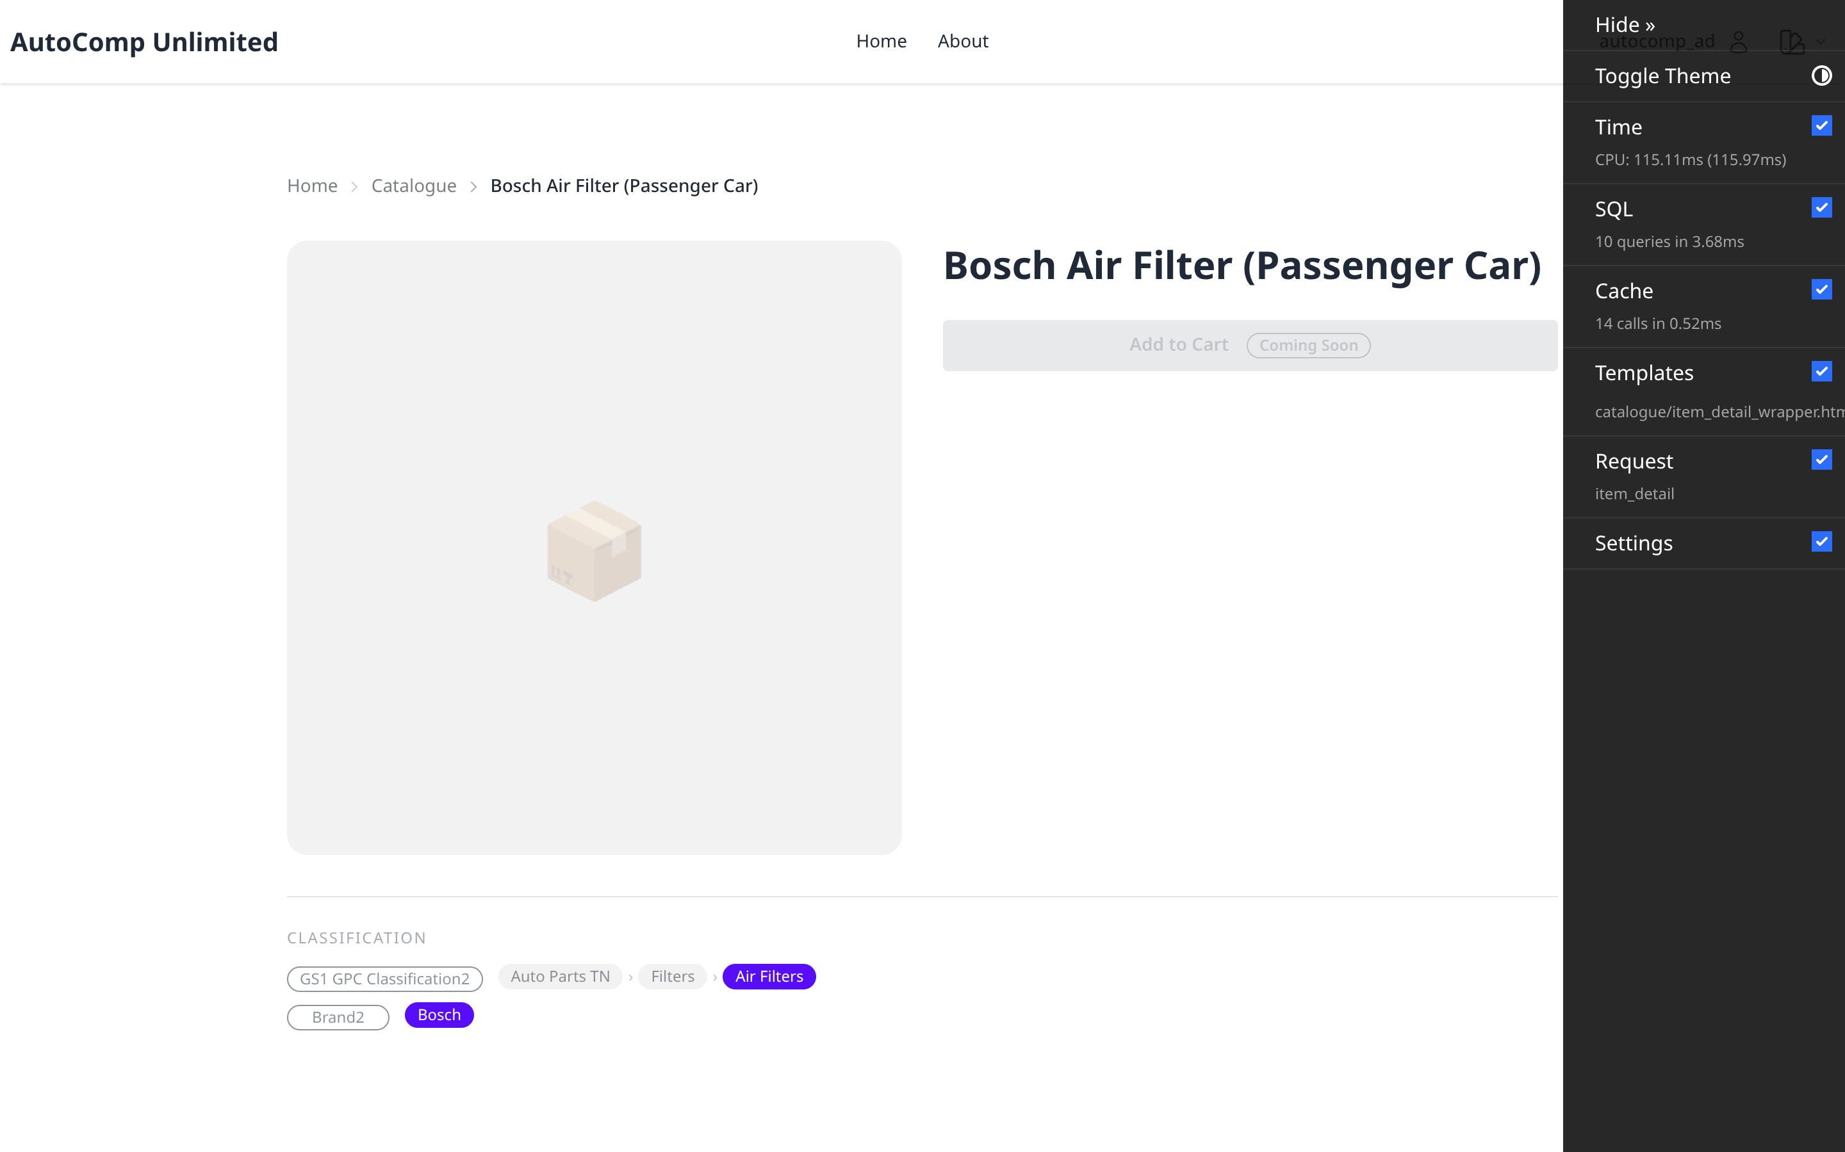
Item Catalogue — Detail
/autocomp/catalogue/sku-bsh-aft-001/
Item master details: attributes, hierarchy and catalogue metadata.

Slide 4
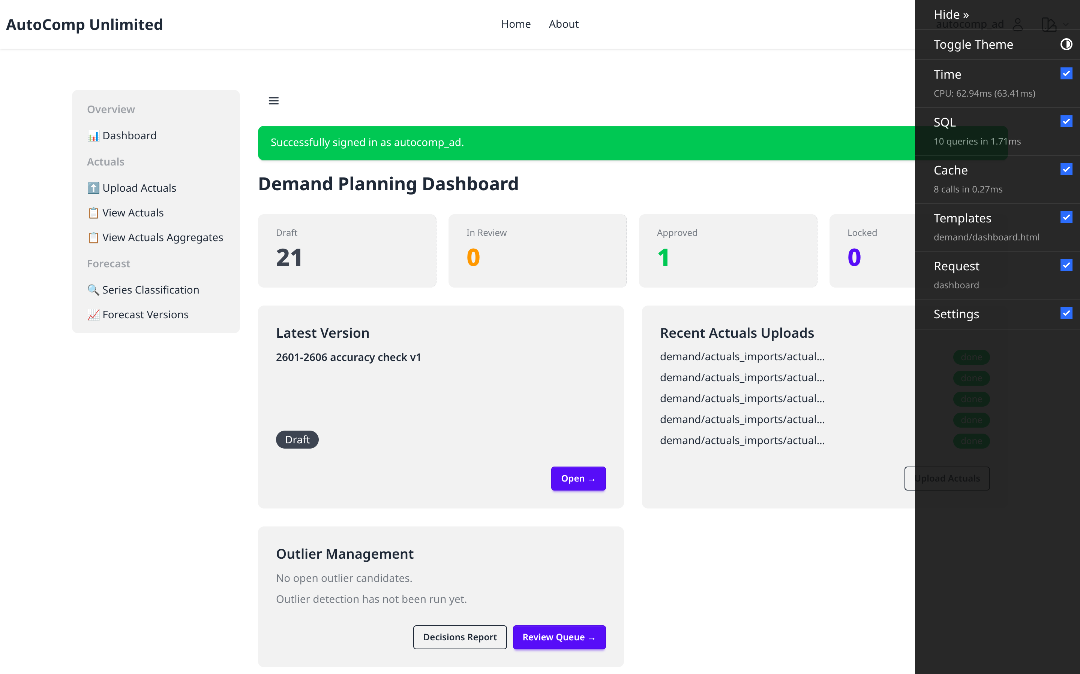
Demand Planning Dashboard
/autocomp/demand/
Version status counts, latest forecast version, recent actuals imports and quick actions.

Slide 5
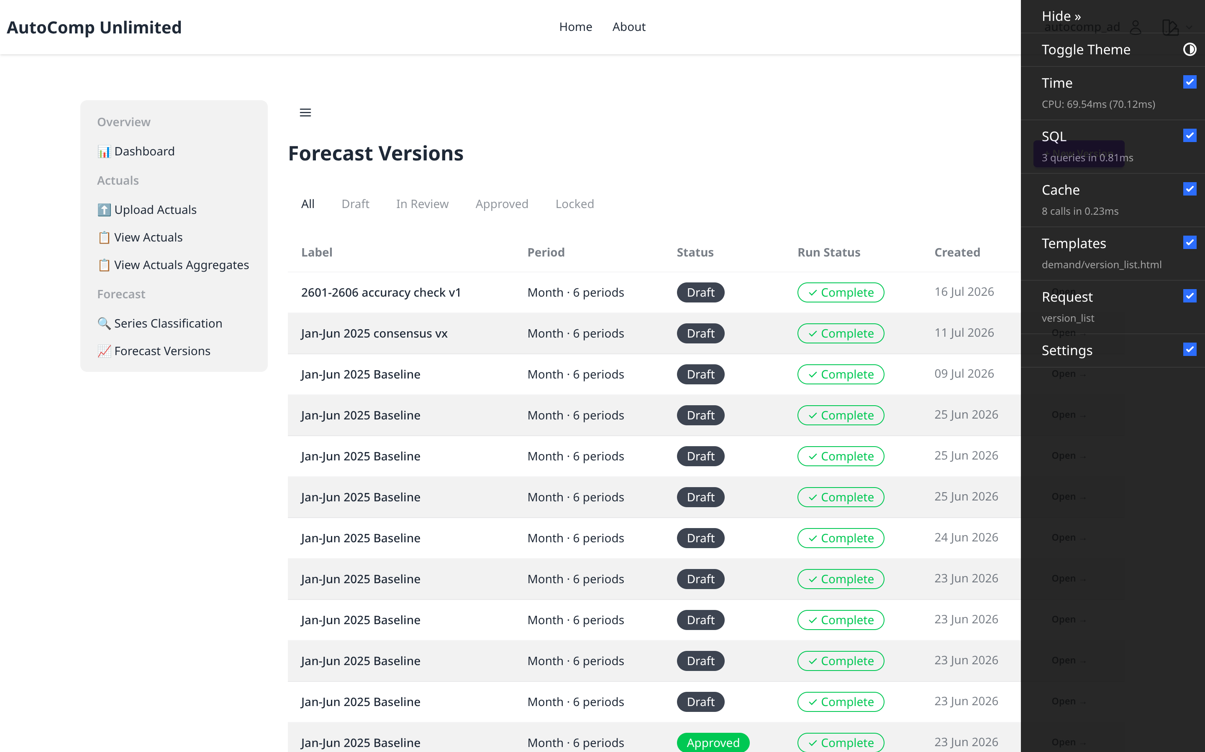
Forecast Versions — List
/autocomp/demand/versions/
All forecast versions with status (DRAFT/IN_REVIEW/APPROVED/LOCKED) and run status.

Slide 6
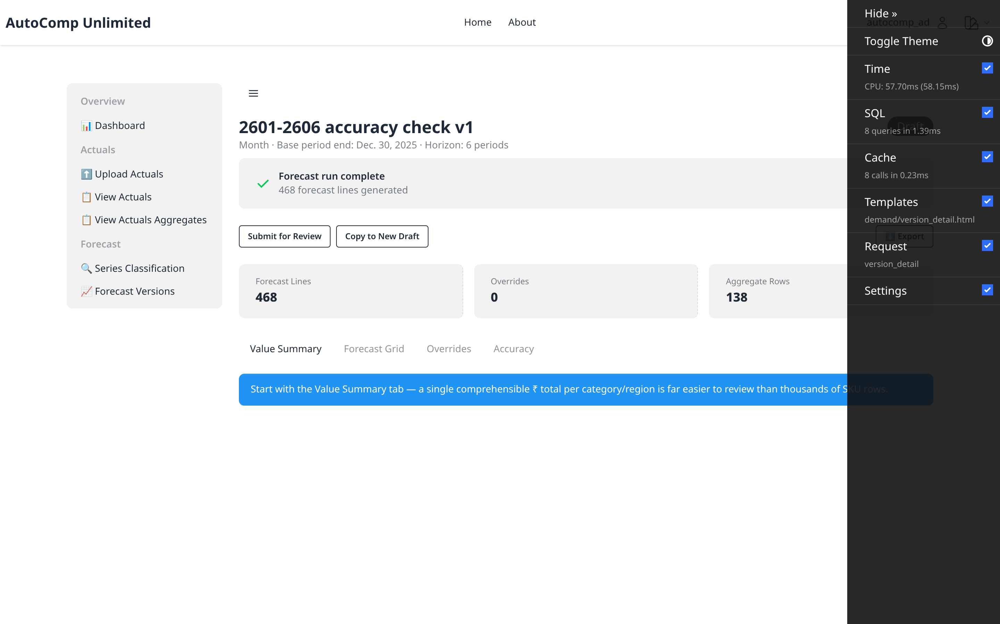
Forecast Version — Detail
/autocomp/demand/versions/24/
Version header, period range, engine config and status controls.

Slide 7
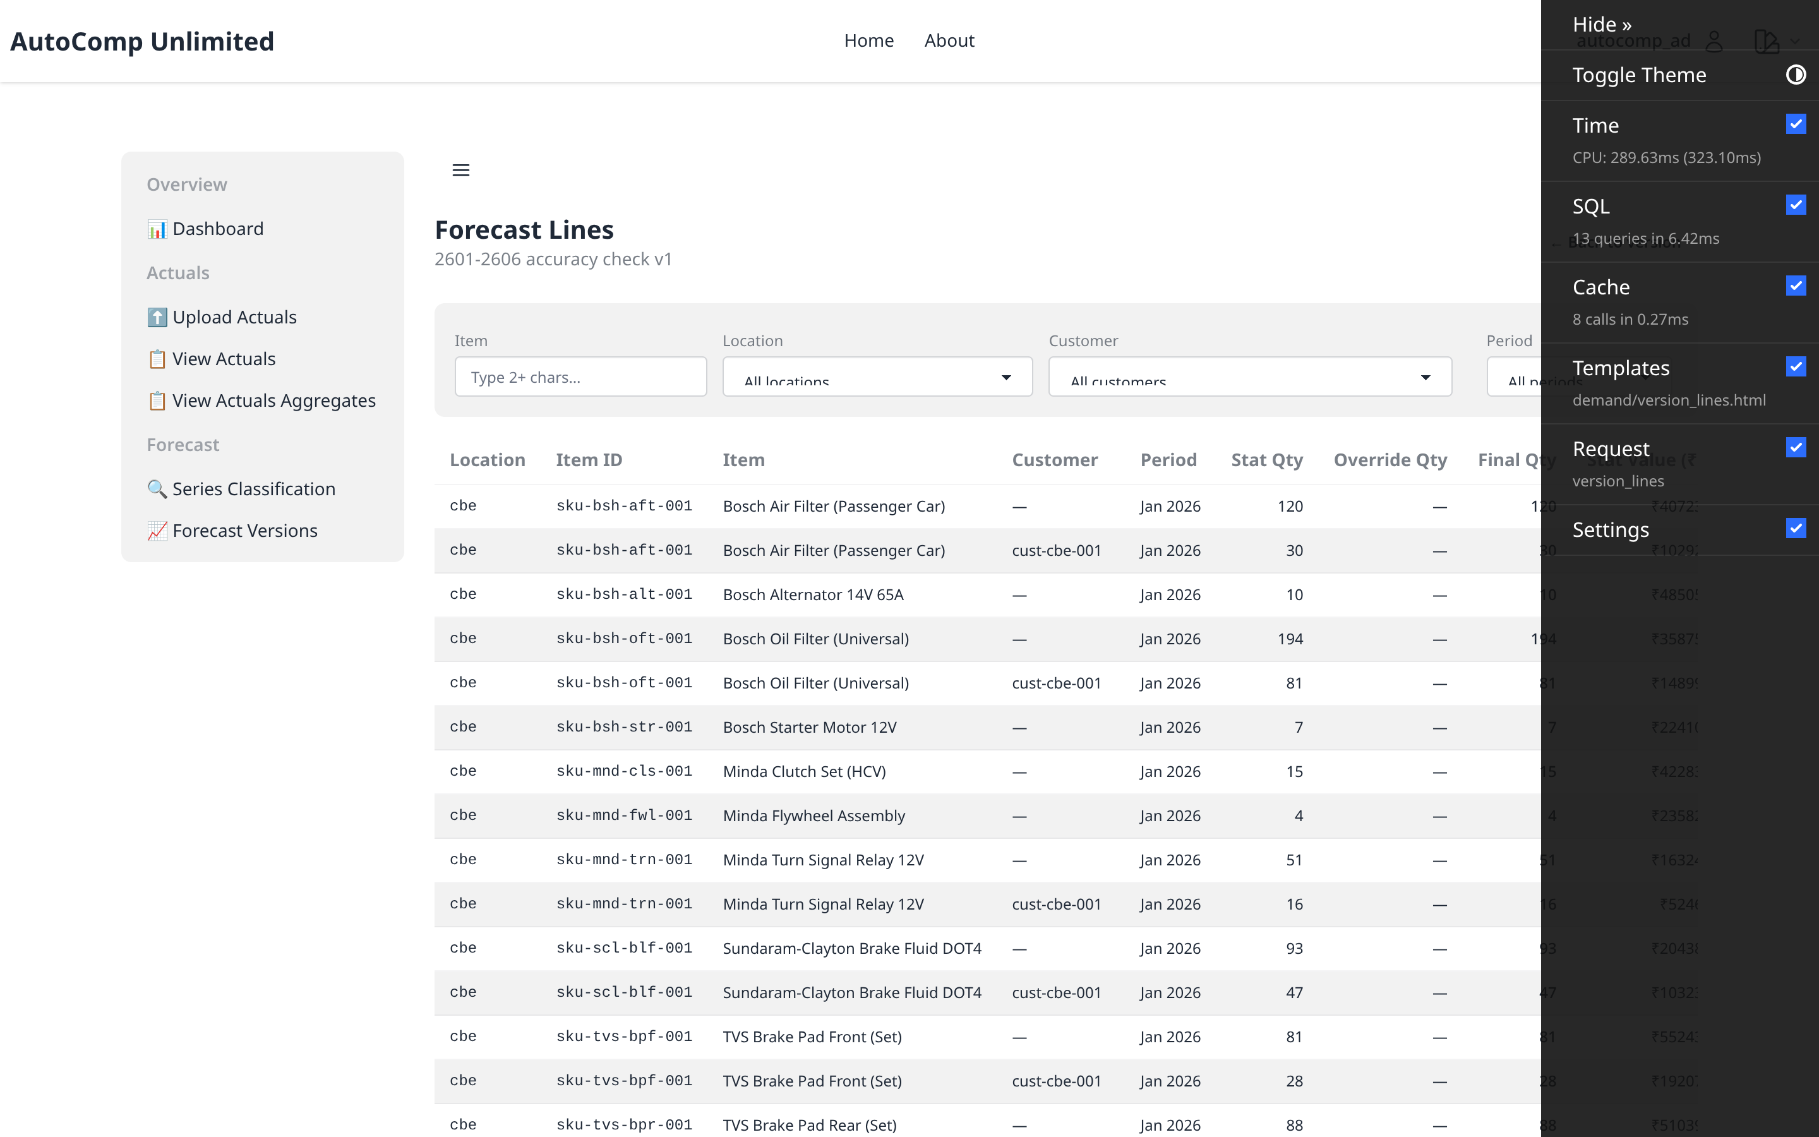
Forecast Grid — Lines
/autocomp/demand/versions/24/lines/
SKU-level forecast lines per planning location, item and distribution channel.

Slide 8
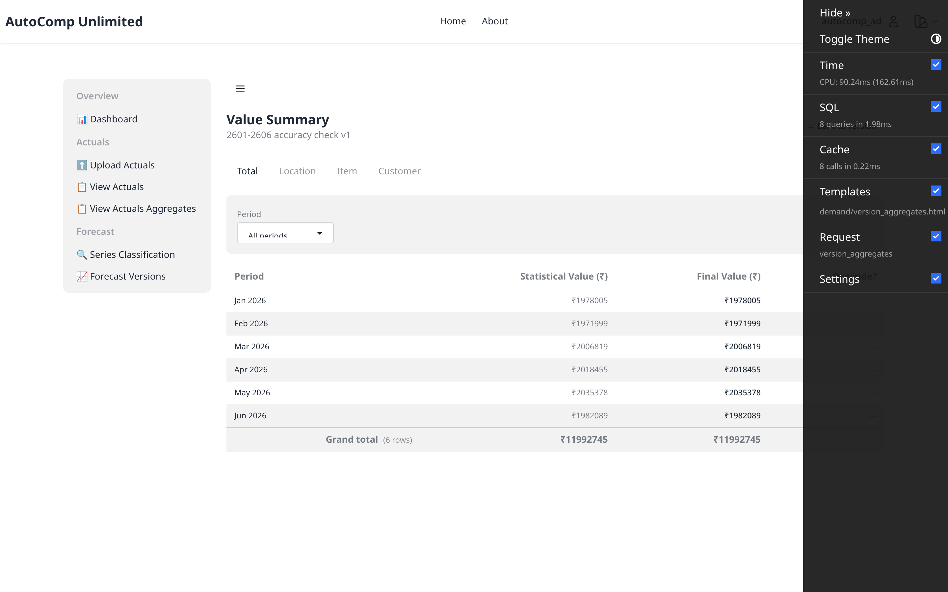
Forecast Aggregates
/autocomp/demand/versions/24/aggregates/
Rolled-up value summary across the hierarchy.

Slide 9
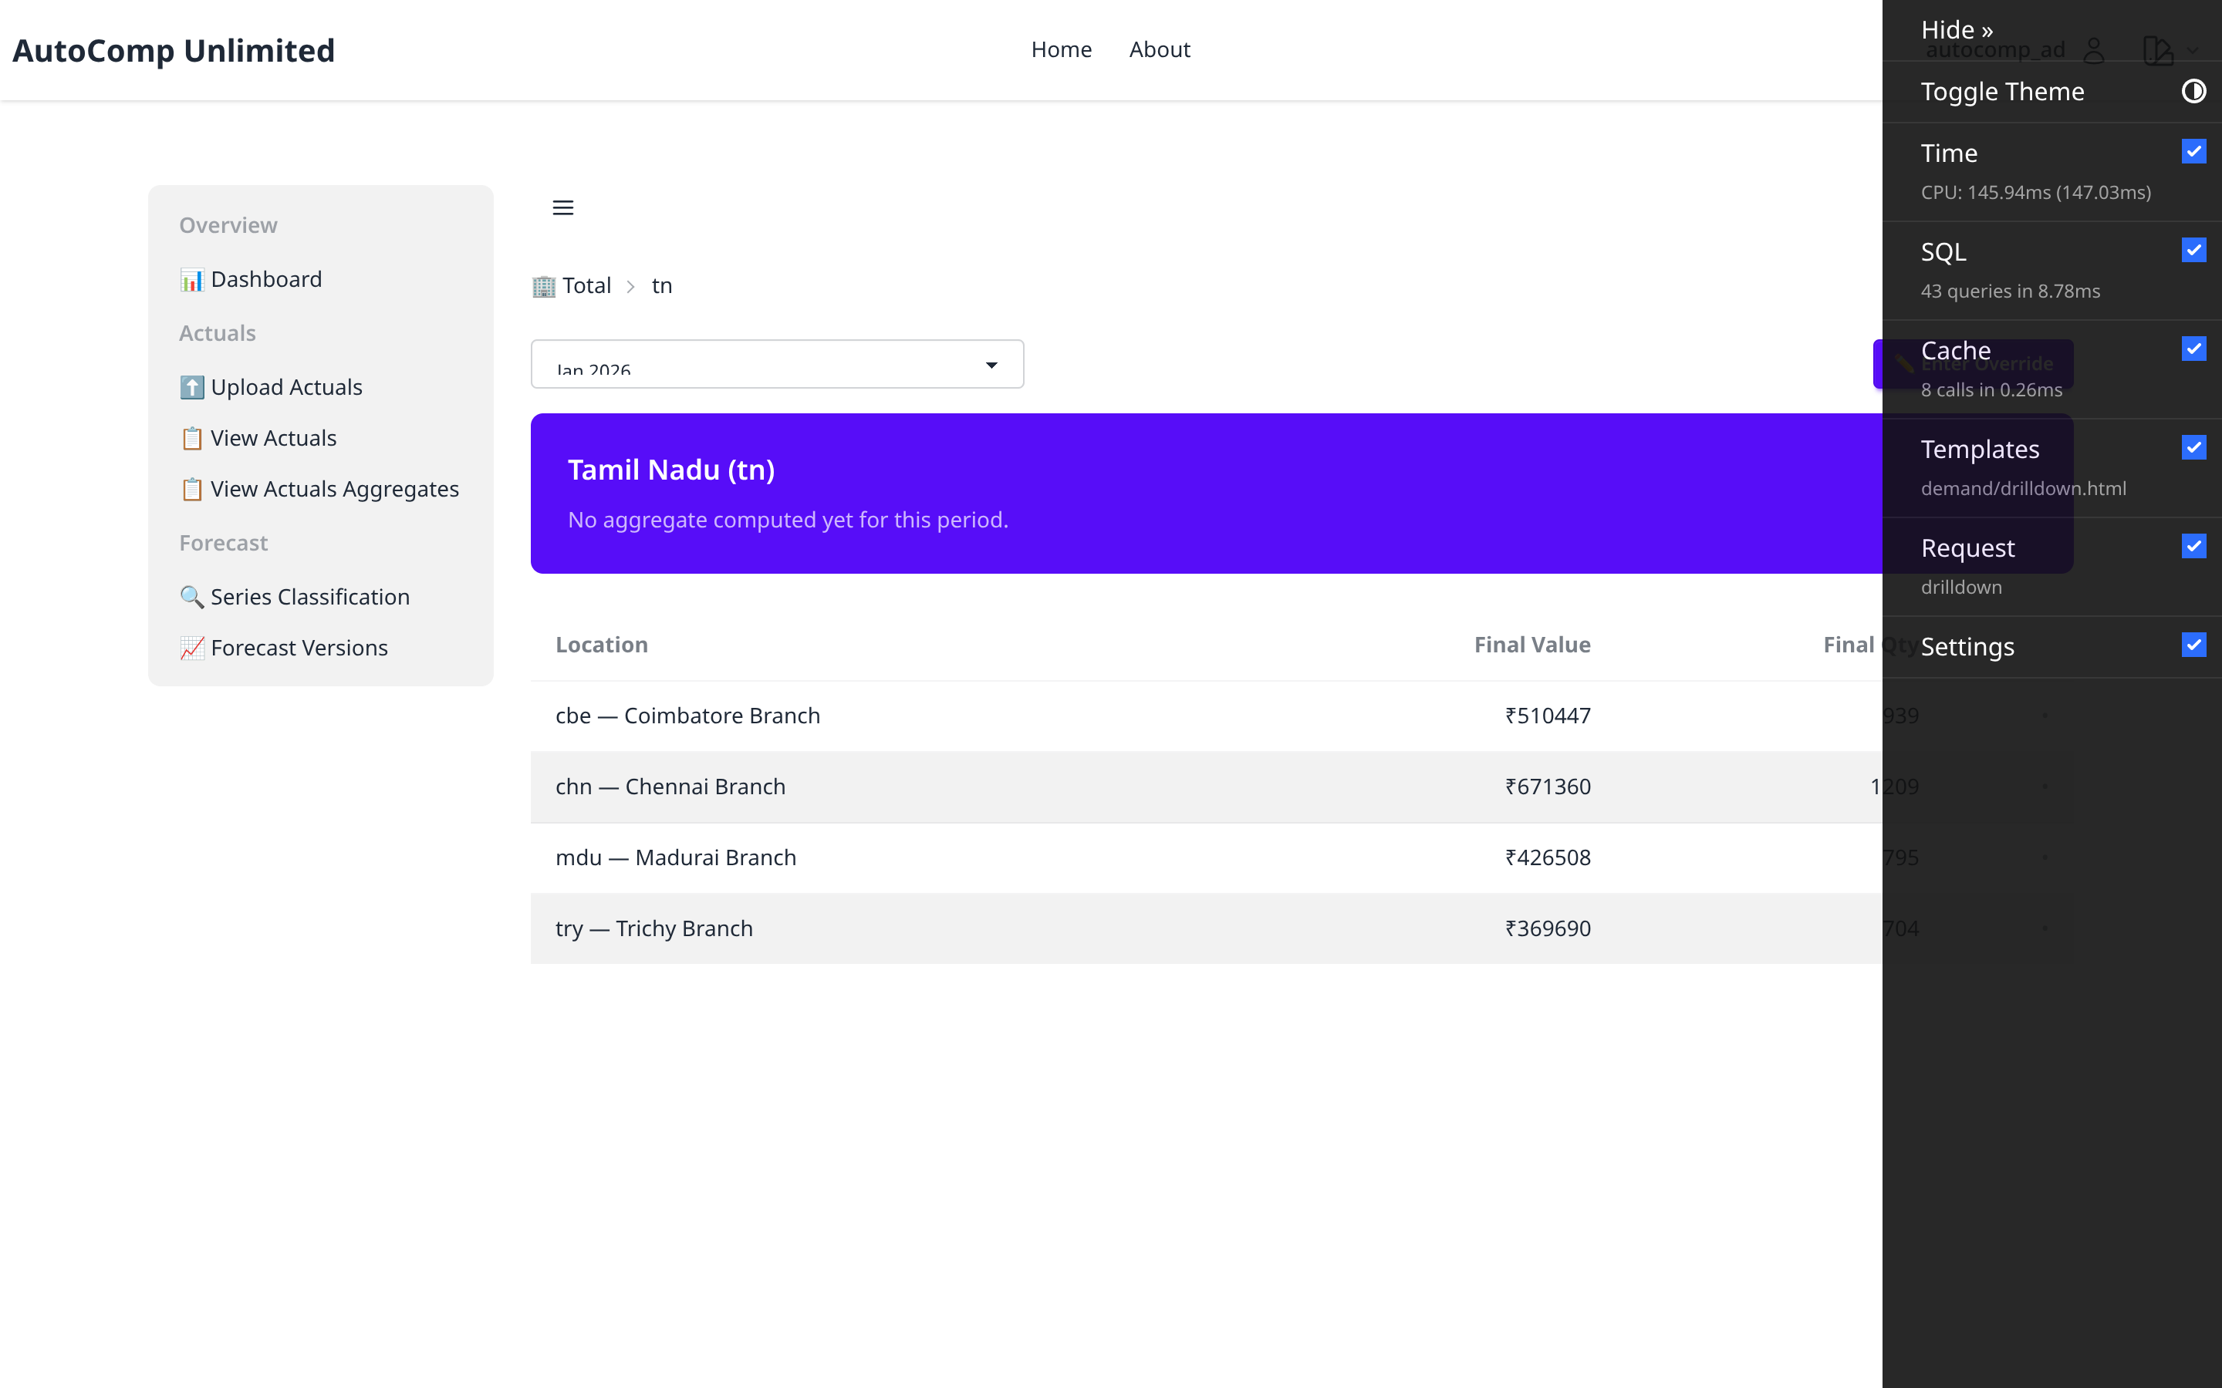
Drilldown — Locations
/autocomp/demand/versions/24/drilldown/
Value-aggregate rollup by planning location with clickable drill-down rows.

Slide 10
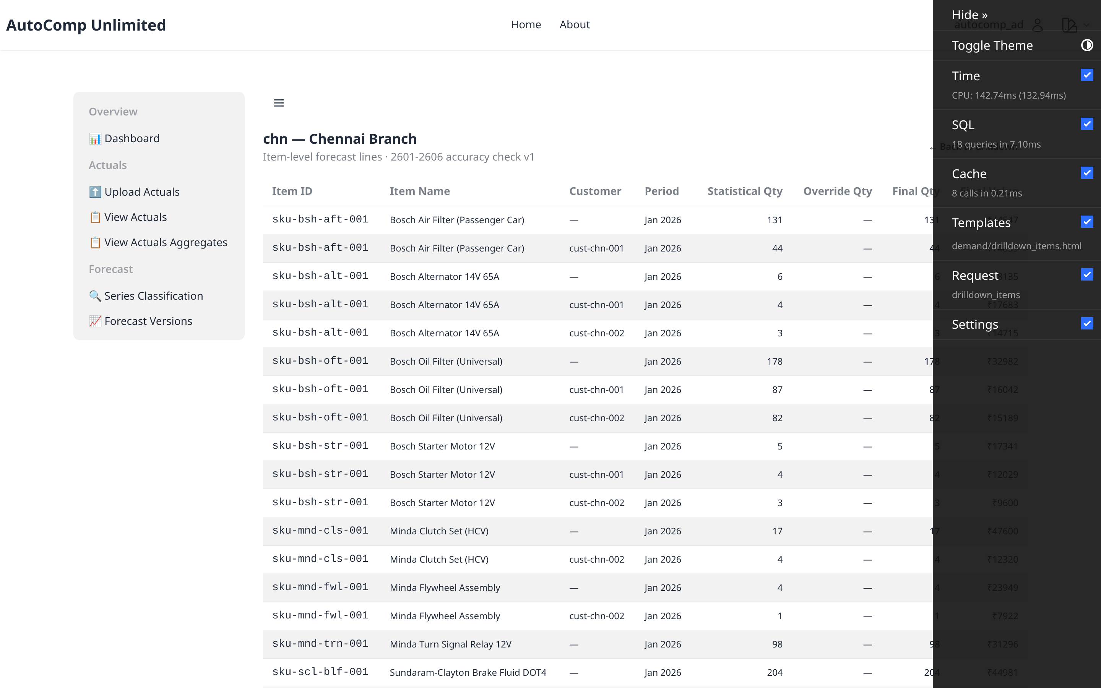
Drilldown — Location Items
/autocomp/demand/versions/24/drilldown/6/items/
SKU-level lines at a leaf location (chn).

Slide 11
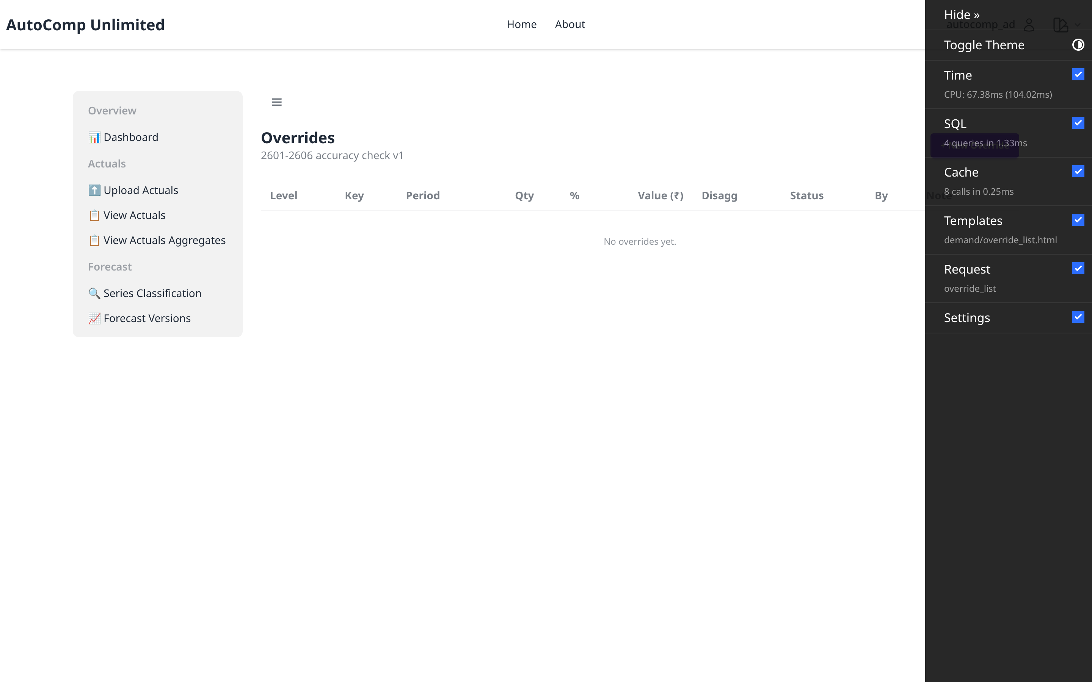
Overrides — List
/autocomp/demand/versions/24/overrides/
Planner consensus overrides on the forecast.

Slide 12
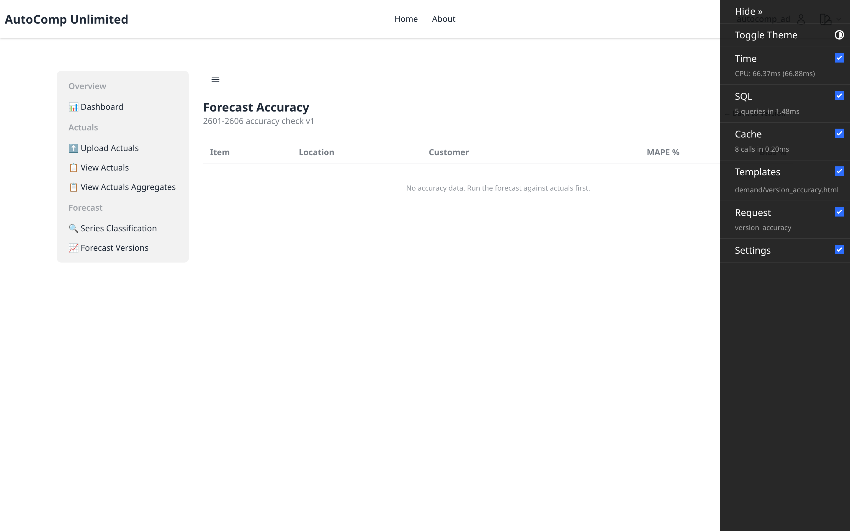
Forecast Accuracy
/autocomp/demand/versions/24/accuracy/
Accuracy vs net actuals for the version.

Slide 13
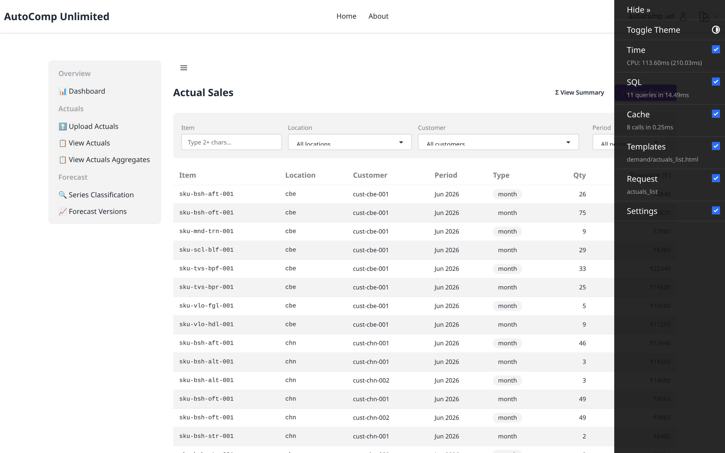
Actuals — List
/autocomp/demand/actuals/
Imported actual-sales records with status.

Slide 14
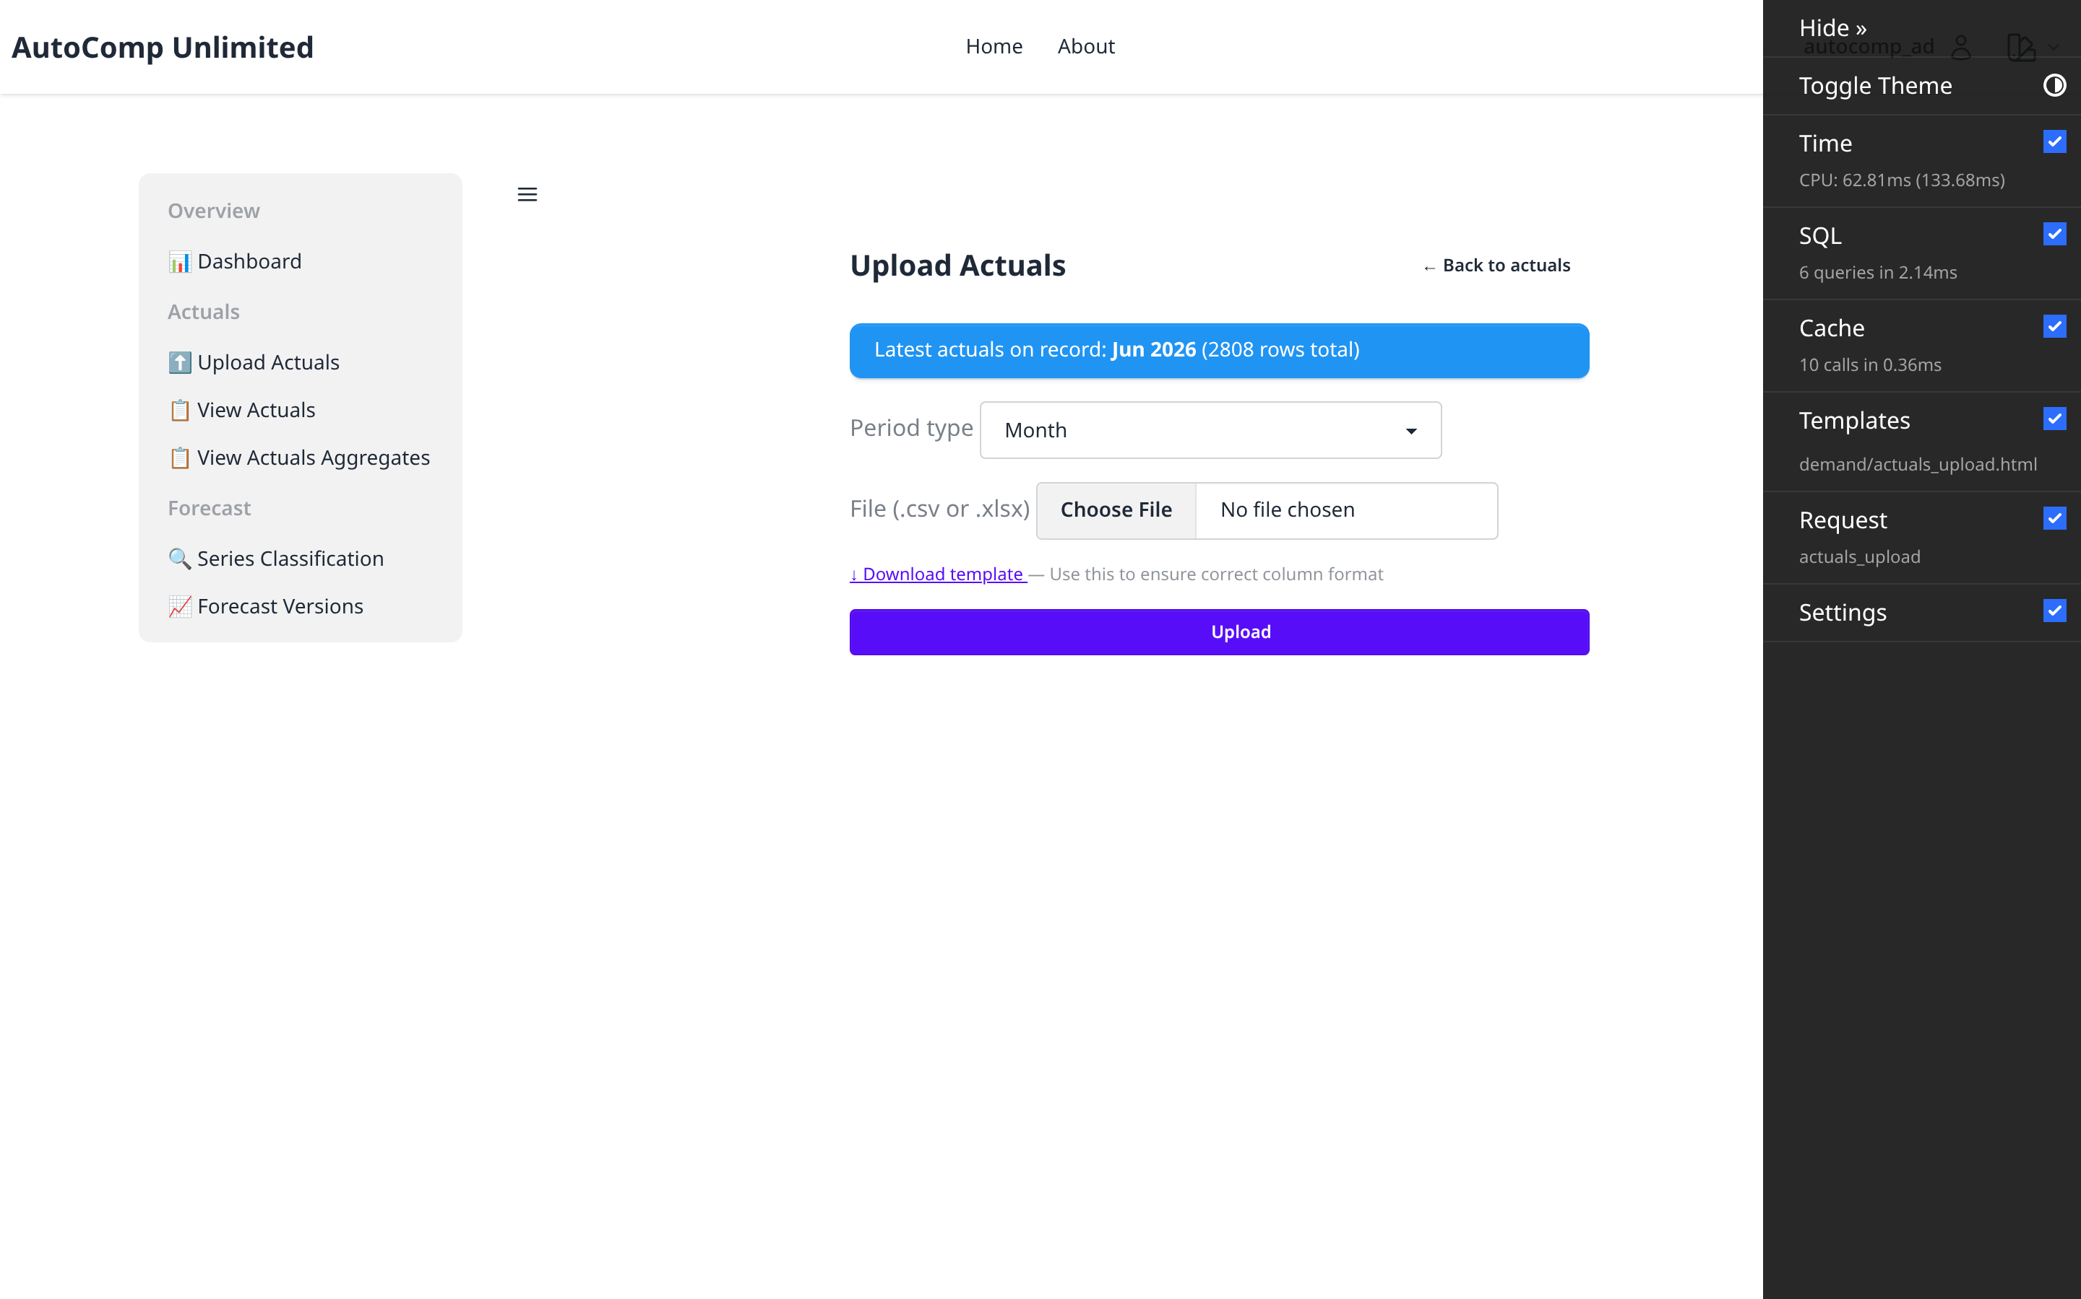
Actuals — Upload
/autocomp/demand/actuals/upload/
Upload actuals via Excel/CSV template.

Slide 15
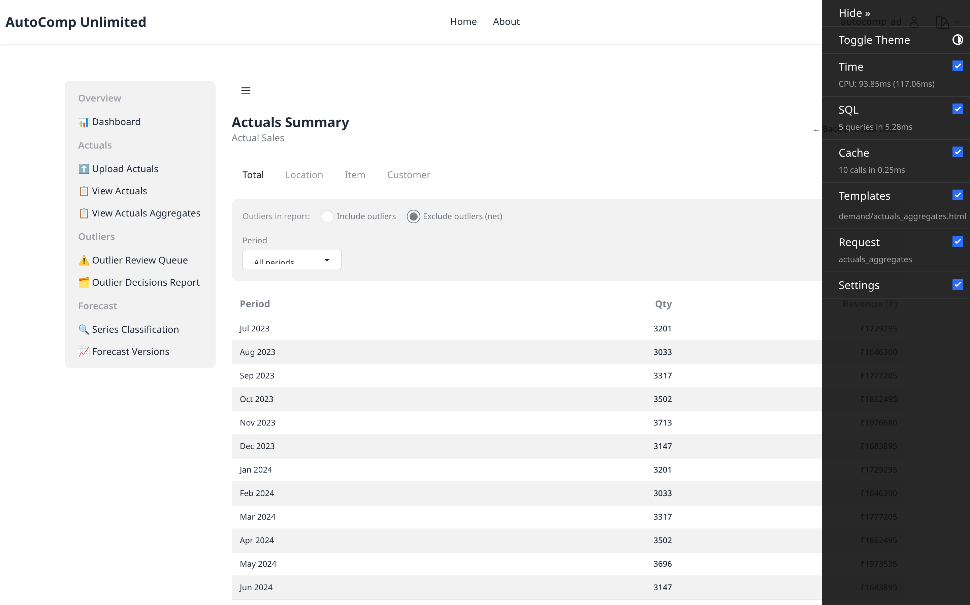
Actuals — Aggregates
/autocomp/demand/actuals/aggregates/
Net actuals rolled up by location/item/channel.

Slide 16
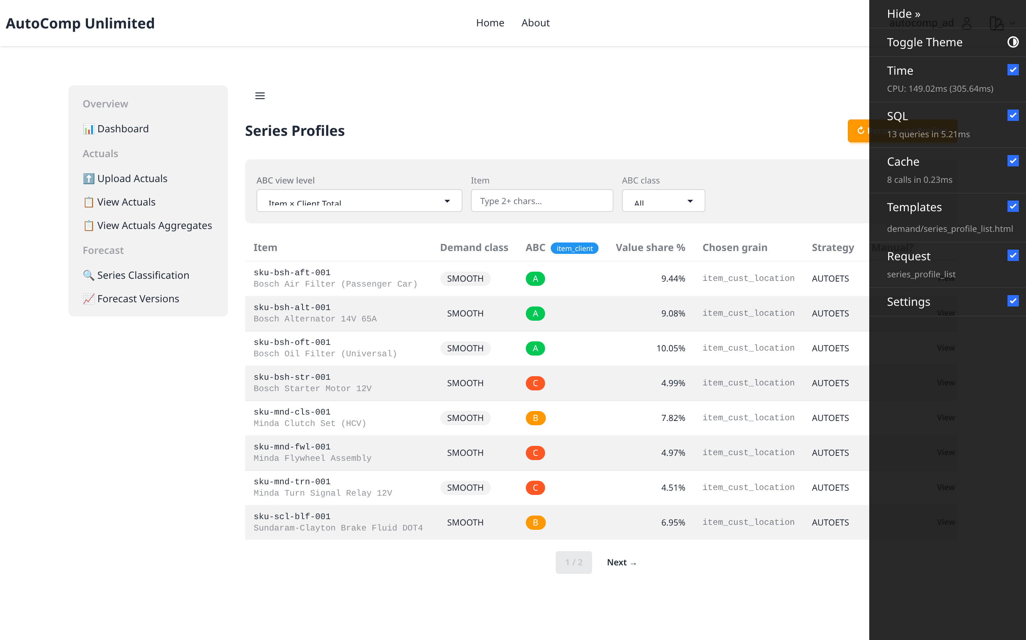
Series Profiles — List
/autocomp/demand/series-profiles/
Statistical profiles per planning series.

Slide 17
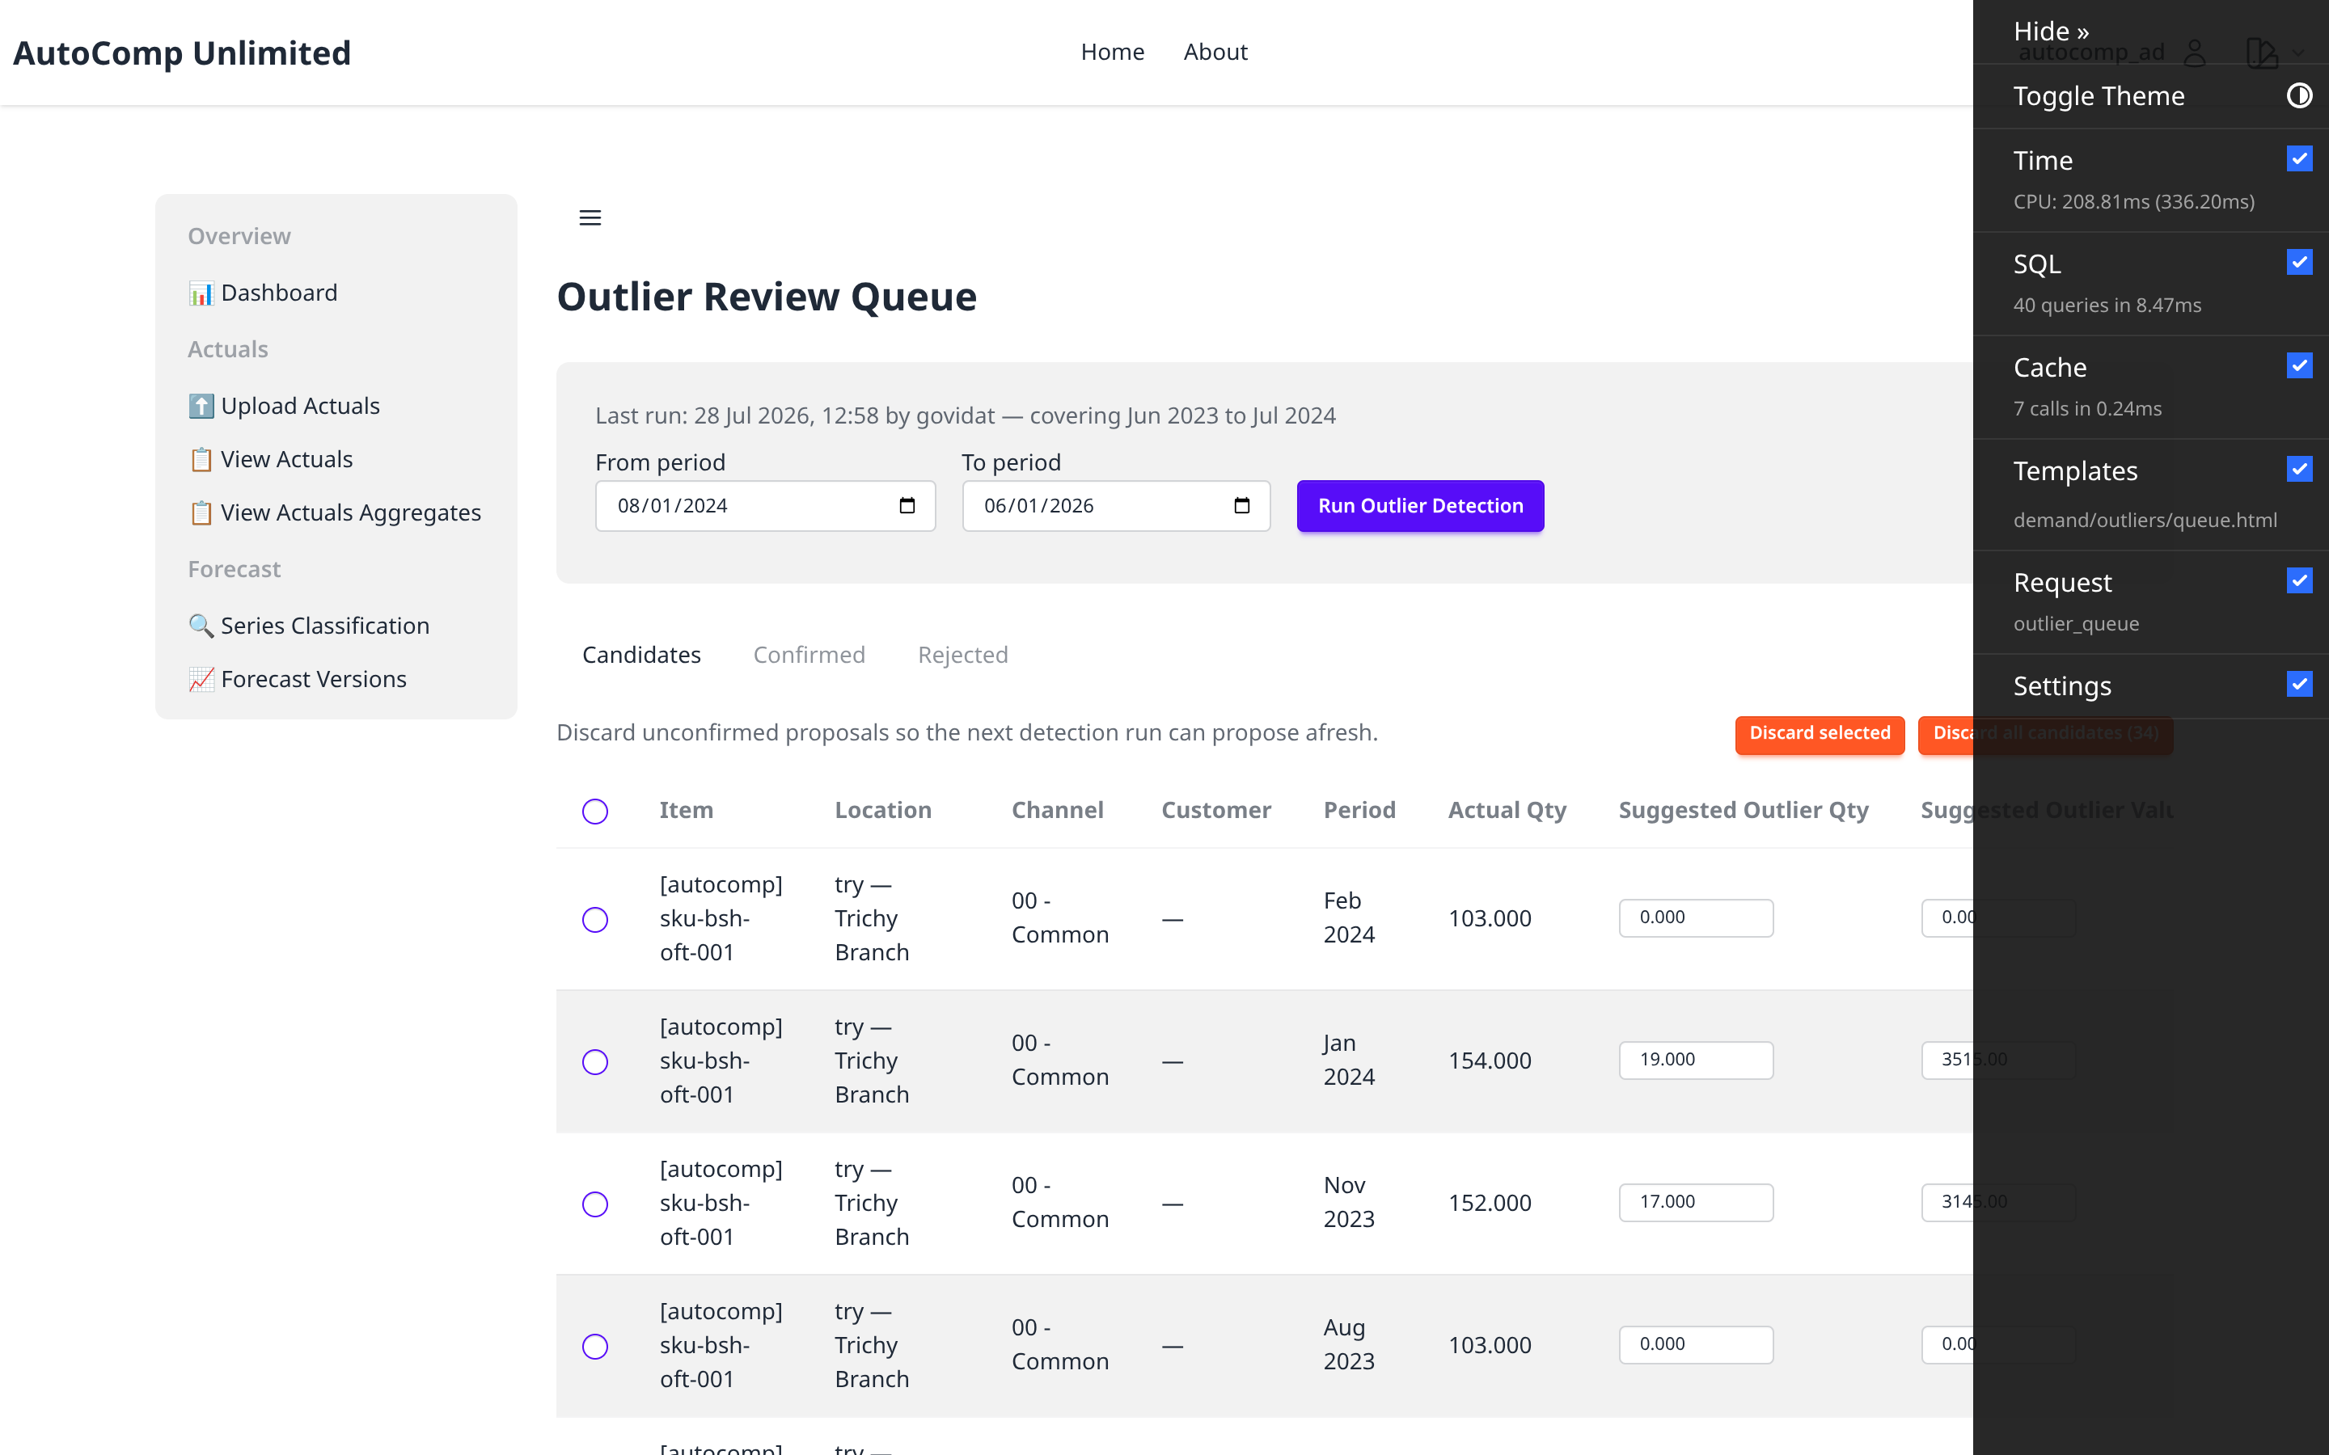
Outlier Management — Queue
/autocomp/demand/outliers/
Planner review queue of CANDIDATE outliers with system-suggested adjustments.

Slide 18

Outlier Management — Detection
/autocomp/demand/outliers/detection-form/
Planner-triggered outlier detection for a period range.

Slide 19
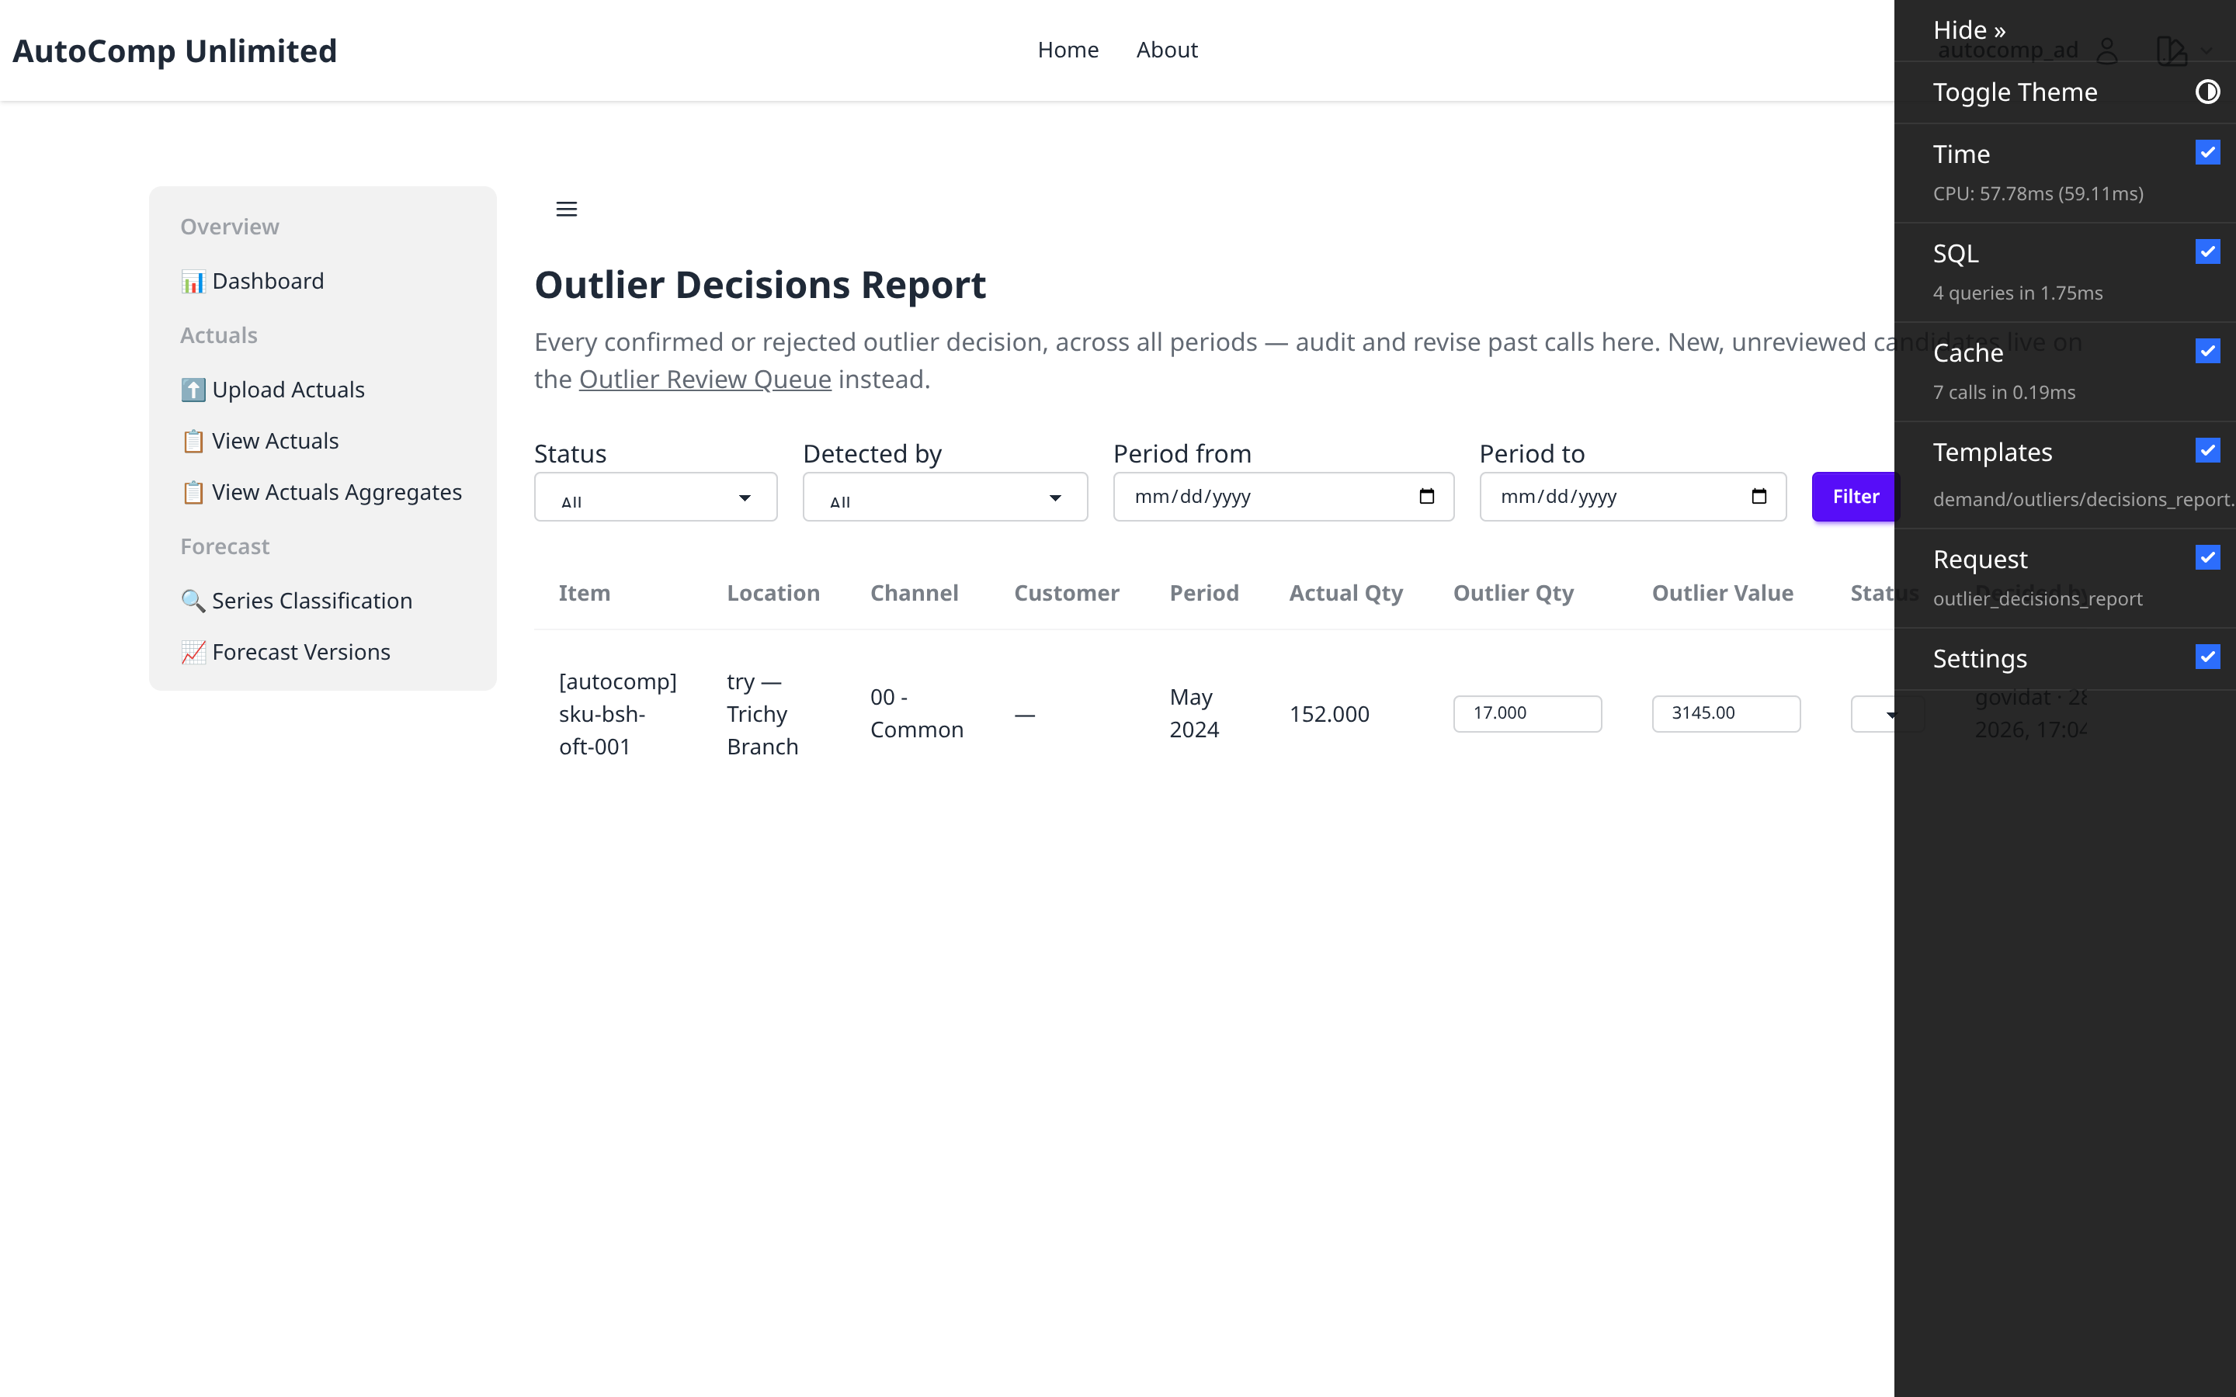
Outlier Management — Decisions
/autocomp/demand/outliers/decisions/
Audit report of confirmed/rejected/revised outlier decisions.

