Slide 1
dataset
170k recipes
25k user
700k interactions
Additional informations for recipes and users

Slide 2
Cosine Signature Approximation
- | Index 1 | Index 2 | Index 3
Plane 1 | -1 | 1 | 1
Plane 2 | -1 | -1 | 1
- | Plane 1 | Plane 2
Recipe 1 | 1 | 1
Recipe 2 | 1 | -1
Recipe 3 | 1 | -1
Recipe 4 | 1 | -1
Recipe 5 | 1 | -1
- | User 1 | User 2 | User 3
Recipe 1 | 1 | 3 | 5
Recipe 2 | 2 | 4 | 4
Recipe 3 | 1 | 5 | 5
Recipe 4 | 3 | 2 | 3
Recipe 5 | 1 | 4 | 4
sign(recipe * plane)

Slide 3
Approximation Evaluation

Slide 4
Approximation Evaluation

Slide 5
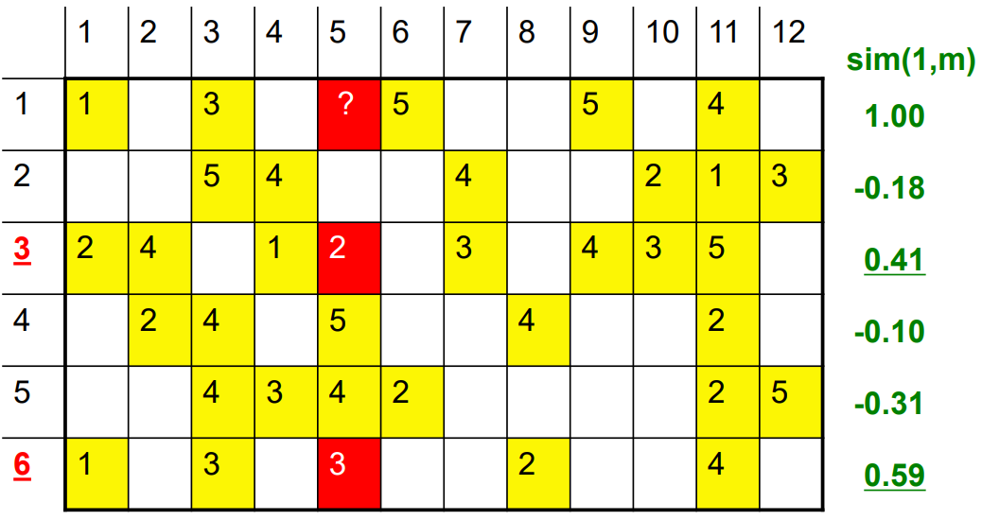
CF Algorithm

Slide 6
CF Evaluation
Goes up because of less samples
2k samples

Slide 7
CF Evaluation
170k recipes => 28 Billion pairs, LSH filters down to 66 Million
Flattens out at 20 because the distance approximation also flattens out

Slide 8
CF Evaluation
Too many candidates = program aborts, no prediction
21, 3 because we want to have clean division
More candidates, same time, idk what happenes here

Slide 9
Evaluation
Rmse, avg err so low because most users have low variance in the rating
More planes => less candidates => worse approximation
centralized rmse/me, 20,1: 0.59 / 0.45
Uncentralized rmse/me, 20,1: 0.054 / 0.61

Slide 10
Improved CF: Item profile from date
Just for the memes, predict rating only based on the date the recipe was published. we use the hyperplane approach, but this does not matter since all dates are >> 0 and therefore have the same signature. So this is basically a compare all approach.
short: prediction = summary of rated recipes that were uploaded in the same week or so
RMSE: 1.4
ME: 0.9
Runtime: FASSSSSST (12 sec)
rating | date
5 | 27/03/2019
3 | 01/01/2011

Slide 11
Improved CF: Item profile from date
Prediction based in nutrition
RMSE: 0.77
ME: 0.62
Runtime: FASSSSSST (15 sec)
rating | Calorie | Fat | Suggar | Sodium | Protein | Sat. fat | idk
4 | 269 | 22 | 32 | 48 | 39 | 27 | 5
3 | 315 | 0 | 202 | 9 | 6 | 0 | 21

Slide 12
Improved CF: Item profile from stemming

Slide 13
User Profiles

Slide 14
Content Based

Slide 15
Tobi

Slide 16
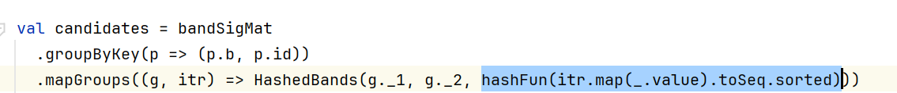

Ls Hashing
Notes:
Hashe alle Daten z.B. Ingedience oder TI.DF

Slide 17
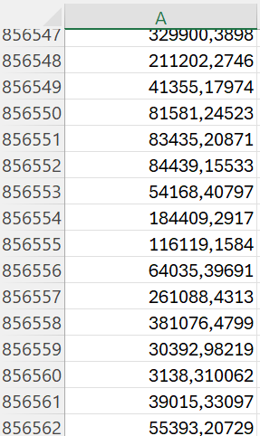
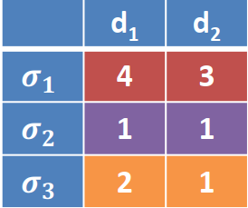

Jaccard Approximation
 | 1 - 2
p(h(d1) = h(d2)) | 0,33
Notes:
98 MB Canidaten Paare
Berechne die Approximierte Jaccard Ähnlichkeit für alle Kandidatenpaare und behalte nur Paare >= des Thresholds

Slide 18
Bänder und Rows sowie Hashfunktionen
Hashfunktionen, Bänder , rows | Ergebniss
150 Hashfunktionen mit b = 30 und row = 5 | Low Disk Space
36 Hashfunktionen mit b = 9 und row = 4 | c.a 10 Minutes Laufzeit
27 Hashfunktionen mit b = 9 und row = 3 | Low Disk Space
8 Hashfunktionen mit b = 4 und row = 2 | Nach c.a 38 Minuten immer noch kein Ergebnis
Notes:
c.a. 30 Gigabyte SSD Festplattenspeicher

