Slide 1

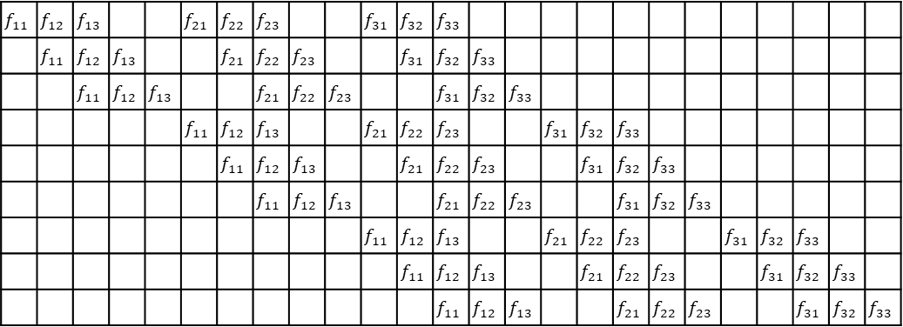



$$x_{11}$$
$$x_{12}$$
$$x_{13}$$
$$x_{14}$$
$$x_{15}$$
$$x_{21}$$
$$x_{22}$$
$$x_{23}$$
$$x_{24}$$
$$x_{25}$$
$$x_{31}$$
$$x_{32}$$
$$x_{33}$$
$$x_{34}$$
$$x_{35}$$
$$x_{41}$$
$$x_{42}$$
$$x_{43}$$
$$x_{44}$$
$$x_{45}$$
$$x_{51}$$
$$x_{52}$$
$$x_{53}$$
$$x_{54}$$
$$x_{55}$$
$$f_{11}$$ | $$f_{12}$$ | $$f_{13}$$ |  |  | $$f_{21}$$ | $$f_{22}$$ | $$f_{23}$$ |  |  | $$f_{31}$$ | $$f_{32}$$ | $$f_{33}$$
 | $$f_{11}$$ | $$f_{12}$$ | $$f_{13}$$ |  |  | $$f_{21}$$ | $$f_{22}$$ | $$f_{23}$$ |  |  | $$f_{31}$$ | $$f_{32}$$ | $$f_{33}$$
 |  | $$f_{11}$$ | $$f_{12}$$ | $$f_{13}$$ |  |  | $$f_{21}$$ | $$f_{22}$$ | $$f_{23}$$ |  |  | $$f_{31}$$ | $$f_{32}$$ | $$f_{33}$$
 |  |  |  |  | $$f_{11}$$ | $$f_{12}$$ | $$f_{13}$$ |  |  | $$f_{21}$$ | $$f_{22}$$ | $$f_{23}$$ |  |  | $$f_{31}$$ | $$f_{32}$$ | $$f_{33}$$
 |  |  |  |  |  | $$f_{11}$$ | $$f_{12}$$ | $$f_{13}$$ |  |  | $$f_{21}$$ | $$f_{22}$$ | $$f_{23}$$ |  |  | $$f_{31}$$ | $$f_{32}$$ | $$f_{33}$$
 |  |  |  |  |  |  | $$f_{11}$$ | $$f_{12}$$ | $$f_{13}$$ |  |  | $$f_{21}$$ | $$f_{22}$$ | $$f_{23}$$ |  |  | $$f_{31}$$ | $$f_{32}$$ | $$f_{33}$$
 |  |  |  |  |  |  |  |  |  | $$f_{11}$$ | $$f_{12}$$ | $$f_{13}$$ |  |  | $$f_{21}$$ | $$f_{22}$$ | $$f_{23}$$ |  |  | $$f_{31}$$ | $$f_{32}$$ | $$f_{33}$$
 |  |  |  |  |  |  |  |  |  |  | $$f_{11}$$ | $$f_{12}$$ | $$f_{13}$$ |  |  | $$f_{21}$$ | $$f_{22}$$ | $$f_{23}$$ |  |  | $$f_{31}$$ | $$f_{32}$$ | $$f_{33}$$
 |  |  |  |  |  |  |  |  |  |  |  | $$f_{11}$$ | $$f_{12}$$ | $$f_{13}$$ |  |  | $$f_{21}$$ | $$f_{22}$$ | $$f_{23}$$ |  |  | $$f_{31}$$ | $$f_{32}$$ | $$f_{33}$$
$$y_{11}$$
$$y_{12}$$
$$y_{13}$$
$$y_{21}$$
$$y_{22}$$
$$y_{23}$$
$$y_{31}$$
$$y_{32}$$
$$y_{33}$$
×
＝
$$F$$
$$X$$
$$Y$$

