Slide 1

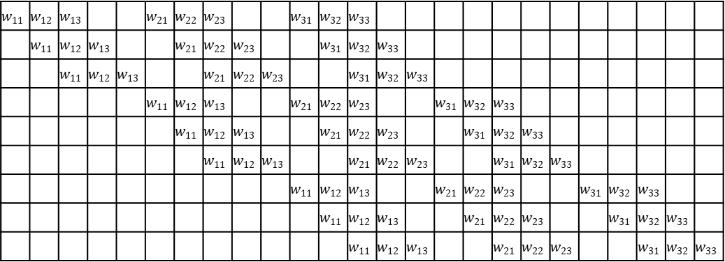



$$x_{11}$$
$$x_{12}$$
$$x_{13}$$
$$x_{14}$$
$$x_{15}$$
$$x_{21}$$
$$x_{22}$$
$$x_{23}$$
$$x_{24}$$
$$x_{25}$$
$$x_{31}$$
$$x_{32}$$
$$x_{33}$$
$$x_{34}$$
$$x_{35}$$
$$x_{41}$$
$$x_{42}$$
$$x_{43}$$
$$x_{44}$$
$$x_{45}$$
$$x_{51}$$
$$x_{52}$$
$$x_{53}$$
$$x_{54}$$
$$x_{55}$$
$$w_{11}$$ | $$w_{12}$$ | $$w_{13}$$ |  |  | $$w_{21}$$ | $$w_{22}$$ | $$w_{23}$$ |  |  | $$w_{31}$$ | $$w_{32}$$ | $$w_{33}$$
 | $$w_{11}$$ | $$w_{12}$$ | $$w_{13}$$ |  |  | $$w_{21}$$ | $$w_{22}$$ | $$w_{23}$$ |  |  | $$w_{31}$$ | $$w_{32}$$ | $$w_{33}$$
 |  | $$w_{11}$$ | $$w_{12}$$ | $$w_{13}$$ |  |  | $$w_{21}$$ | $$w_{22}$$ | $$w_{23}$$ |  |  | $$w_{31}$$ | $$w_{32}$$ | $$w_{33}$$
 |  |  |  |  | $$w_{11}$$ | $$w_{12}$$ | $$w_{13}$$ |  |  | $$w_{21}$$ | $$w_{22}$$ | $$w_{23}$$ |  |  | $$w_{31}$$ | $$w_{32}$$ | $$w_{33}$$
 |  |  |  |  |  | $$w_{11}$$ | $$w_{12}$$ | $$w_{13}$$ |  |  | $$w_{21}$$ | $$w_{22}$$ | $$w_{23}$$ |  |  | $$w_{31}$$ | $$w_{32}$$ | $$w_{33}$$
 |  |  |  |  |  |  | $$w_{11}$$ | $$w_{12}$$ | $$w_{13}$$ |  |  | $$w_{21}$$ | $$w_{22}$$ | $$w_{23}$$ |  |  | $$w_{31}$$ | $$w_{32}$$ | $$w_{33}$$
 |  |  |  |  |  |  |  |  |  | $$w_{11}$$ | $$w_{12}$$ | $$w_{13}$$ |  |  | $$w_{21}$$ | $$w_{22}$$ | $$w_{23}$$ |  |  | $$w_{31}$$ | $$w_{32}$$ | $$w_{33}$$
 |  |  |  |  |  |  |  |  |  |  | $$w_{11}$$ | $$w_{12}$$ | $$w_{13}$$ |  |  | $$w_{21}$$ | $$w_{22}$$ | $$w_{23}$$ |  |  | $$w_{31}$$ | $$w_{32}$$ | $$w_{33}$$
 |  |  |  |  |  |  |  |  |  |  |  | $$w_{11}$$ | $$w_{12}$$ | $$w_{13}$$ |  |  | $$w_{21}$$ | $$w_{22}$$ | $$w_{23}$$ |  |  | $$w_{31}$$ | $$w_{32}$$ | $$w_{33}$$
$$y_{11}$$
$$y_{12}$$
$$y_{13}$$
$$y_{21}$$
$$y_{22}$$
$$y_{23}$$
$$y_{31}$$
$$y_{32}$$
$$y_{33}$$
×
＝
$$W$$
$$X$$
$$Y$$

