Slide 1








사건 발생 1
사건 발생 2
사건 발생 3
$$S_{1}$$
$$S_{2}$$
$$S_{3}$$
$$t$$
사건 발생 1
사건 발생 2
사건 발생 3
$$t$$
$$X_{1}$$
$$X_{2}$$
$$X_{3}$$

Slide 2








사건 발생 1
사건 발생 2
사건 발생 3
0
1
2
3
4
5
6
7
8
$$t$$
$$N_{1}=0$$
$$N_{2}=1$$
$$N_{3}=1$$
$$N_{4}=1$$
$$N_{5}=2$$
$$N_{6}=2$$
$$N_{7}=3$$
$$N_{8}=3$$

Slide 3





$$E\left[\#arrivals\right]=λ$$
0
1
$$t$$
$$E\left[\#arrivals\right]=\frac{λ}{m}$$
0
$$\frac{k−1}{m}$$
$$\frac{k}{m}$$
1
$$t$$

Slide 4
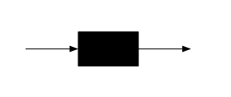
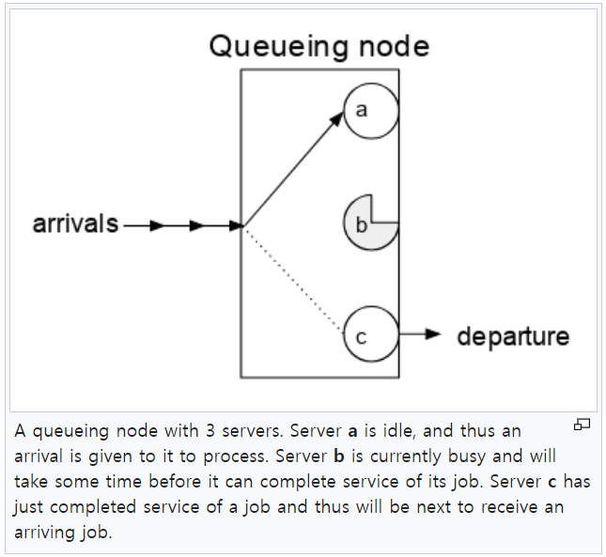
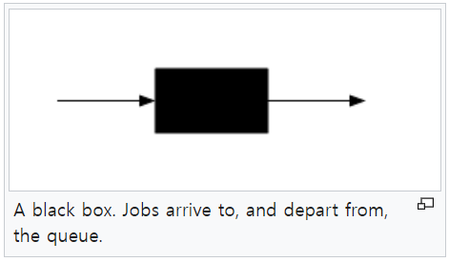
arrival
departure
arrival
server
departure

Slide 5











arrival($λ$)
arrival($λ$)
arrival($λ$)
arrival($λ$)
0
1
2
3
· · ·
departure($μ$)
departure($μ$)
departure($μ$)
departure($μ$)
arrival$\left(\frac{λ}{m}\right)$
arrival$\left(\frac{λ}{m}\right)$
arrival$\left(\frac{λ}{m}\right)$
arrival$\left(\frac{λ}{m}\right)$
0
1
2
3
· · ·
departure$\left(\frac{μ}{m}\right)$
departure$\left(\frac{μ}{m}\right)$
departure$\left(\frac{μ}{m}\right)$
departure$\left(\frac{μ}{m}\right)$

