Slide 1
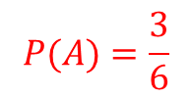
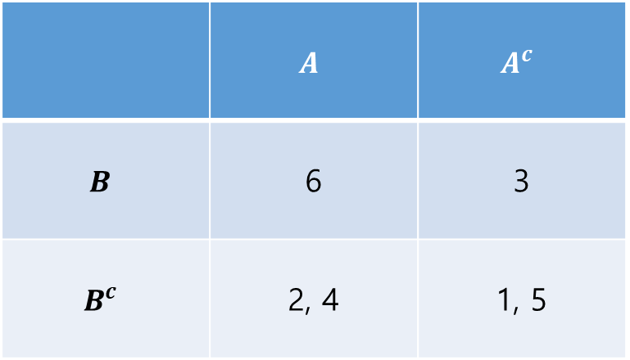
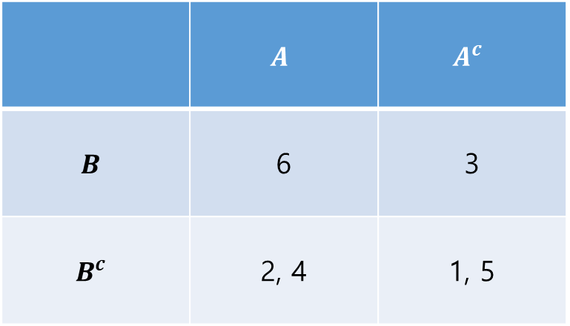
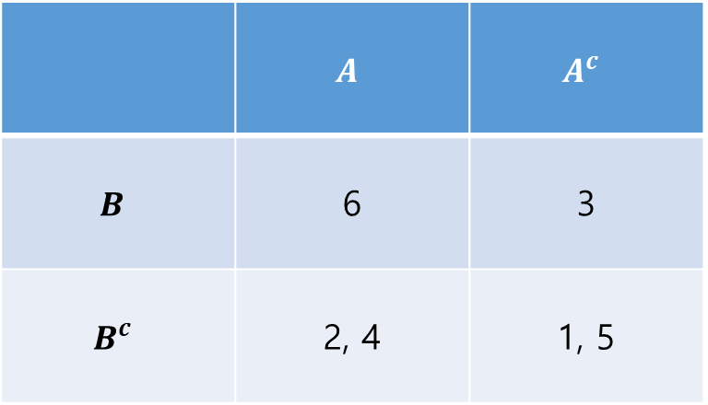
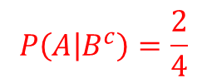
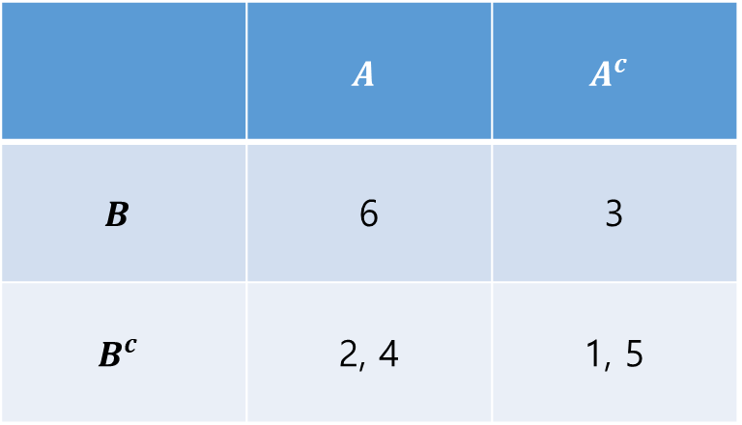
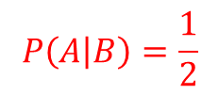
 | $$A$$ | $$A^{c}$$
$$B$$ | 6 | 3
$$B^{c}$$ | 2, 4 | 1, 5
 | $$A$$ | $$A^{c}$$
$$B$$ | 6 | 3
$$B^{c}$$ | 2, 4 | 1, 5
1개
2개
$$P\left(A | B\right)=\frac{1}{2}$$
 | $$A$$ | $$A^{c}$$
$$B$$ | 6 | 3
$$B^{c}$$ | 2, 4 | 1, 5
 | $$A$$ | $$A^{c}$$
$$B$$ | 6 | 3
$$B^{c}$$ | 2, 4 | 1, 5
2개
4개
2개
6개
$$P\left(A | B^{c}\right)=\frac{2}{4}$$
$$P(A)=\frac{3}{6}$$

Slide 2
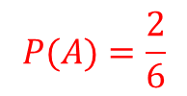
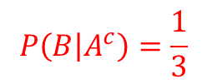

 | $$A$$ | $$A^{c}$$
$$B$$ | 6 | 3
$$B^{c}$$ | 2, 4 | 1, 5
 | $$A$$ | $$A^{c}$$
$$B$$ | 6 | 3
$$B^{c}$$ | 2, 4 | 1, 5
1개
3개
$$P\left(B | A\right)=\frac{1}{3}$$
 | $$A$$ | $$A^{c}$$
$$B$$ | 6 | 3
$$B^{c}$$ | 2, 4 | 1, 5
 | $$A$$ | $$A^{c}$$
$$B$$ | 6 | 3
$$B^{c}$$ | 2, 4 | 1, 5
1개
2개
3개
6개
$$P\left(B | A^{c}\right)=\frac{1}{3}$$
$$P(A)=\frac{2}{6}$$

Slide 3
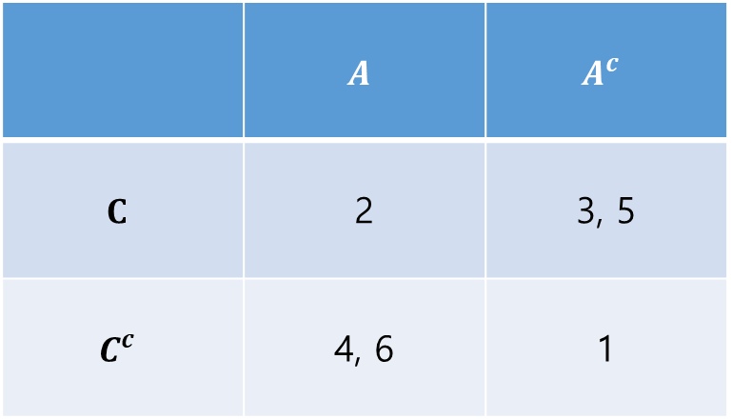
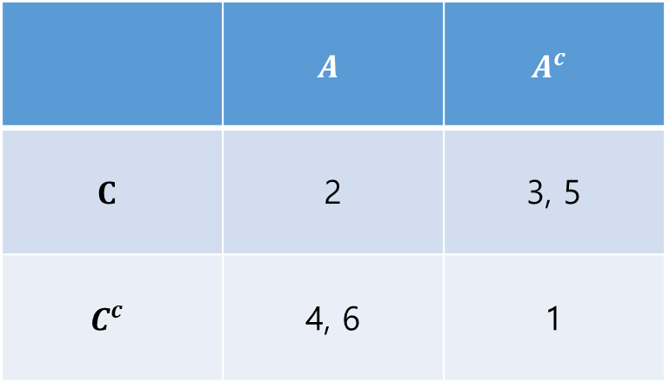
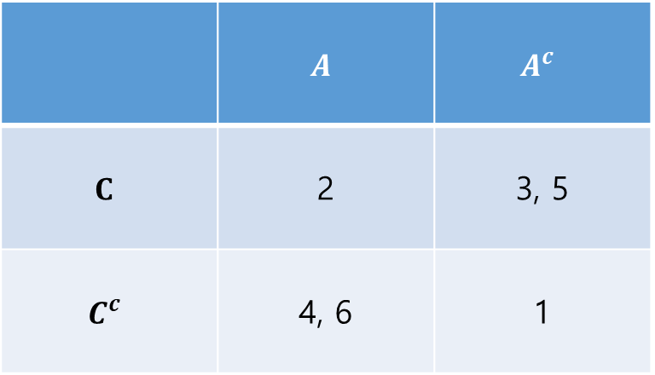
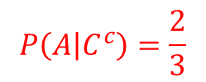
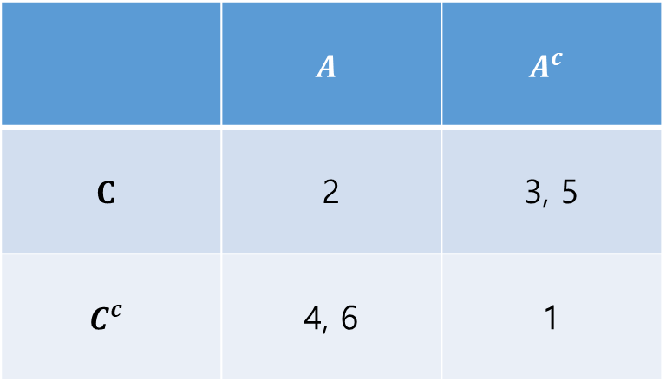
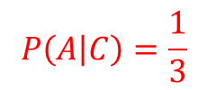
 | $$A$$ | $$A^{c}$$
$$C$$ | 2 | 3, 5
$$C^{c}$$ | 4, 6 | 1
 | $$A$$ | $$A^{c}$$
$$C$$ | 2 | 3, 5
$$C^{c}$$ | 4, 6 | 1
1개
3개
$$P\left(A | C\right)=\frac{1}{3}$$
 | $$A$$ | $$A^{c}$$
$$C$$ | 2 | 3, 5
$$C^{c}$$ | 4, 6 | 1
 | $$A$$ | $$A^{c}$$
$$C$$ | 2 | 3, 5
$$C^{c}$$ | 4, 6 | 1
2개
3개
3개
6개
$$P\left(A | C^{c}\right)=\frac{2}{3}$$
$$P(A)=\frac{3}{6}$$

Slide 4










$$S$$
$$A_{1}$$
$$A_{2}$$
$$A_{3}$$
$$A_{4}$$
$$A_{5}$$
$$A_{6}$$
$$A_{7}$$
$$A_{8}$$
$$A_{9}$$

Slide 5

$$S$$
$$B$$

Slide 6






$$S$$
$$A_{1}$$
$$A_{2}$$
$$A_{3}$$
$$A_{4}$$
$$A_{2}∩B$$
$$A_{3}∩B$$
$$A_{5}$$
$$A_{6}$$
$$A_{1}∩B$$
$$A_{5}∩B$$
$$A_{6}∩B$$
$$A_{7}$$
$$A_{8}$$
$$A_{8}∩B$$
$$A_{9}$$

