Slide 1
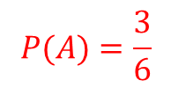
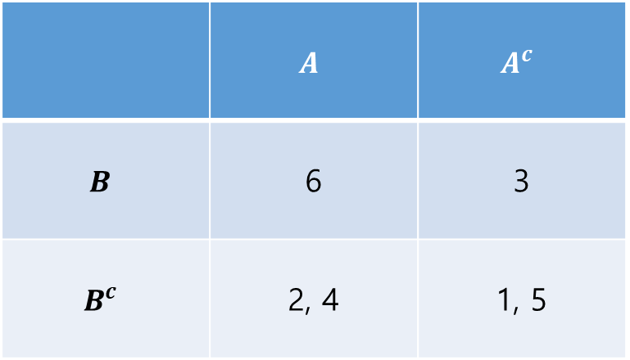
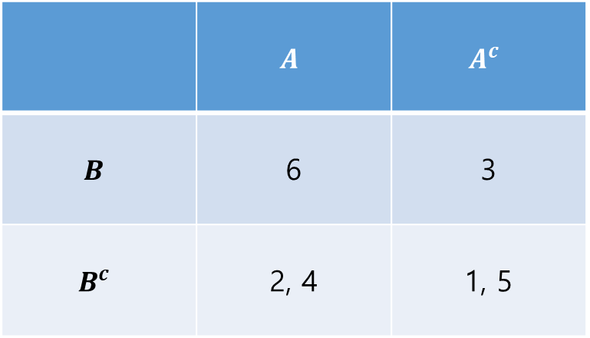
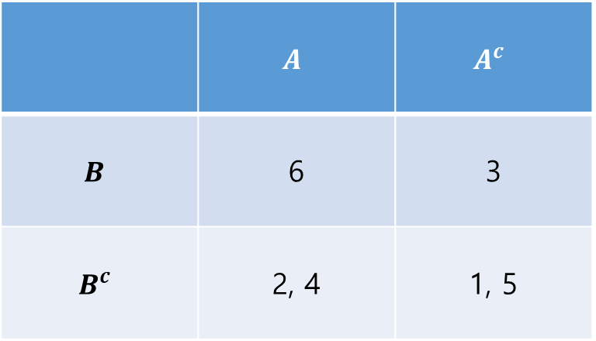
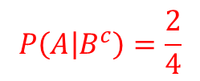
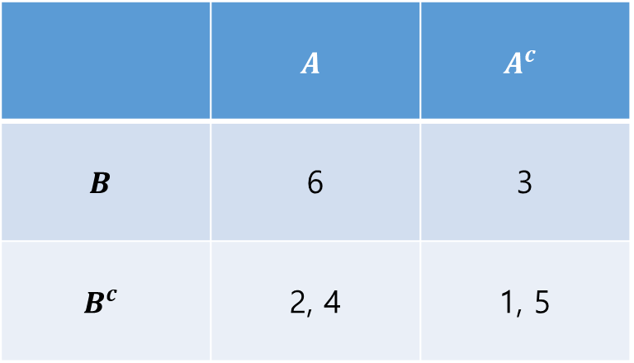
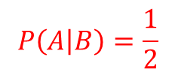
 | $$A$$ | $$A^{c}$$
$$B$$ | 6 | 3
$$B^{c}$$ | 2, 4 | 1, 5
 | $$A$$ | $$A^{c}$$
$$B$$ | 6 | 3
$$B^{c}$$ | 2, 4 | 1, 5
$$P\left(A | B\right)=\frac{1}{2}$$
 | $$A$$ | $$A^{c}$$
$$B$$ | 6 | 3
$$B^{c}$$ | 2, 4 | 1, 5
 | $$A$$ | $$A^{c}$$
$$B$$ | 6 | 3
$$B^{c}$$ | 2, 4 | 1, 5
$$P\left(A | B^{c}\right)=\frac{2}{4}$$
$$P(A)=\frac{3}{6}$$

Slide 2
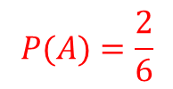
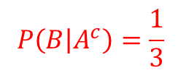

 | $$A$$ | $$A^{c}$$
$$B$$ | 6 | 3
$$B^{c}$$ | 2, 4 | 1, 5
 | $$A$$ | $$A^{c}$$
$$B$$ | 6 | 3
$$B^{c}$$ | 2, 4 | 1, 5
$$P\left(B | A\right)=\frac{1}{3}$$
 | $$A$$ | $$A^{c}$$
$$B$$ | 6 | 3
$$B^{c}$$ | 2, 4 | 1, 5
 | $$A$$ | $$A^{c}$$
$$B$$ | 6 | 3
$$B^{c}$$ | 2, 4 | 1, 5
$$P\left(B | A^{c}\right)=\frac{1}{3}$$
$$P(A)=\frac{2}{6}$$

