Slide 1
Serverless Architecture & Cloud Automation

Slide 2
Assignment 1: Automated Instance Management Using AWS Lambda and Boto3
Overview: What You're Building
Tools You'll Use
You're going to:
Create two EC2 virtual machines.
Add tags to identify which one should auto-start and which should auto-stop.
Write a Python script using Boto3 (in a Lambda function.
This script will start or stop EC2 instances based on those tags.
AWS Console (web interface)
EC2 – to create virtual machines
Lambda – to run your automation code
IAM – to give your Lambda function the right permissions
Boto3 – Python library to interact with AWS

Slide 3
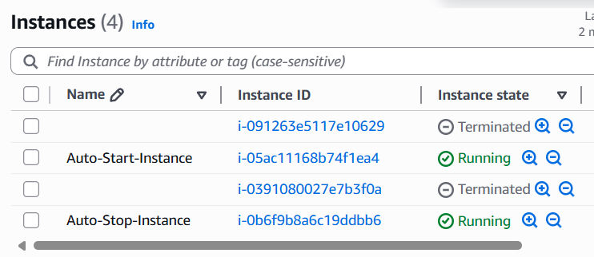
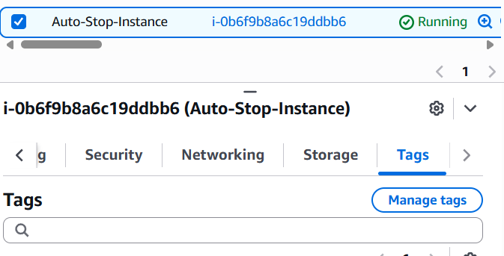
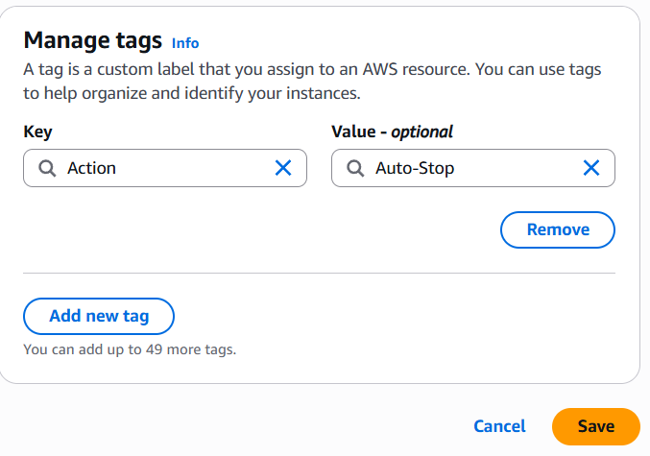
STEP 1: Create Two EC2 Instances
Go to: EC2
Click “Launch Instance”
Fill the following:
Name: Auto-Stop-Instance
AMI: Use Ubuntu (Free tier)
Instance type: t2.micro
Launch instance
Scroll to “Tags” → Add tag:
Key: Action
Value: Auto-Stop
Launch instance
Repeat the above steps again:
Name: Auto-Start-Instance
Tag: Action = Auto-Start

Slide 4
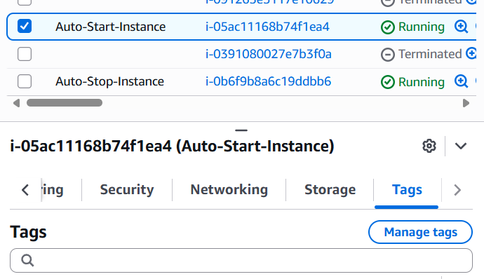
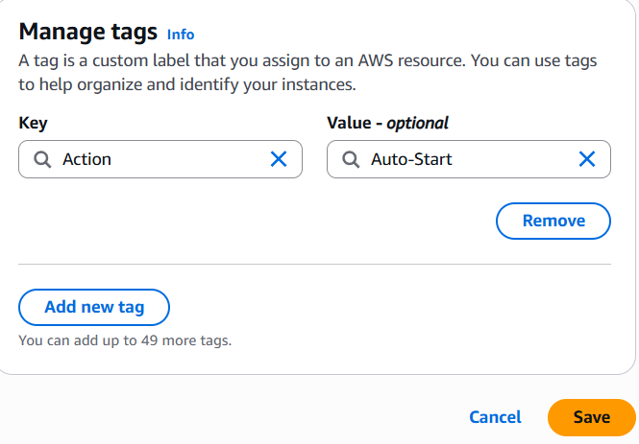

Slide 5
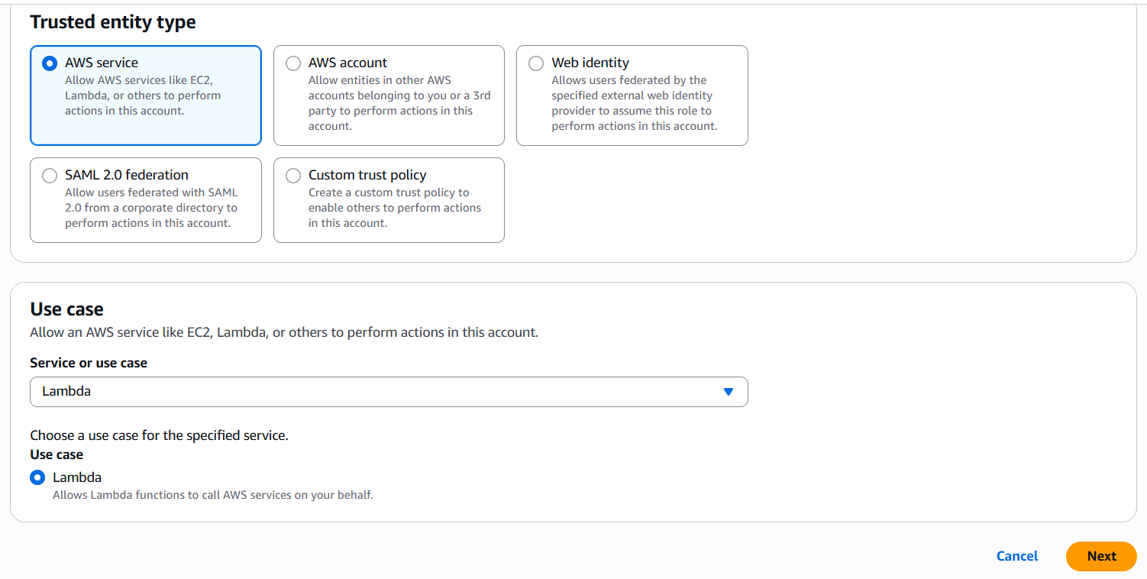
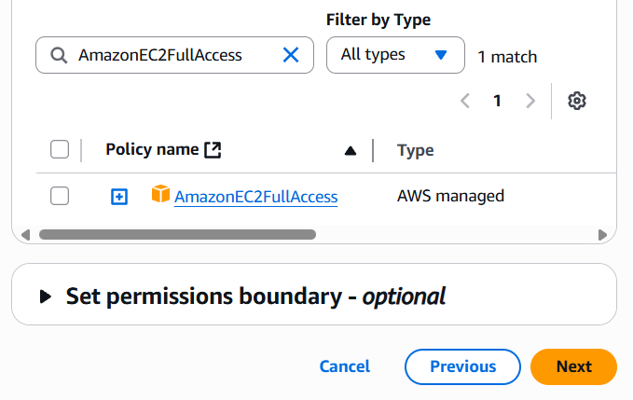
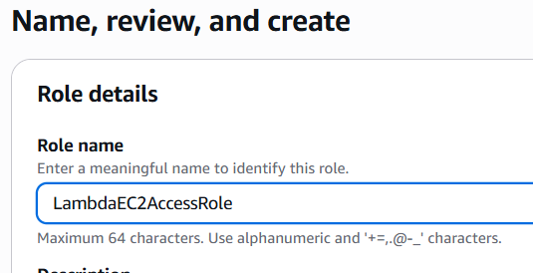
STEP 2: Create IAM Role for Lambda
Go to: IAM
On left menu, click Roles → Create Role
Choose Trusted entity mark “AWS service” Use case Select Lambda
Click Next → Search for AmazonEC2FullAccess
Select it, click Next, name the role: LambdaEC2AccessRole
Click Create Role

Slide 6
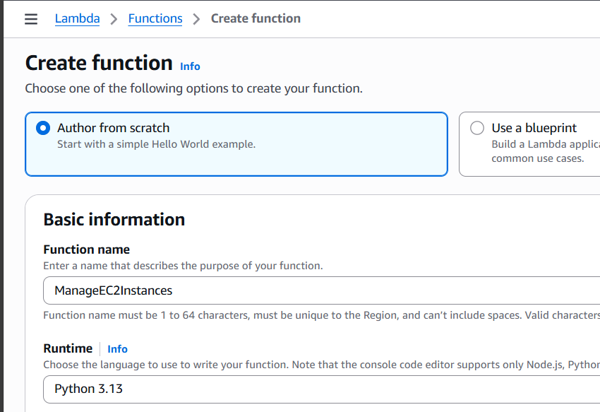
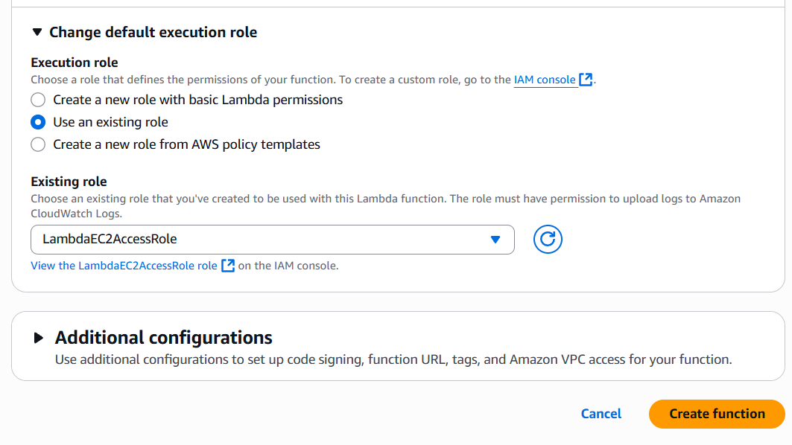
STEP 3: Create Lambda Function
Go to: Lambda
Click Create function
Function name: ManageEC2Instances
Runtime: Python 3.12 (or latest 3.x)
Permissions → Choose existing role → Select LambdaEC2AccessRole
Click Create Function

Slide 7
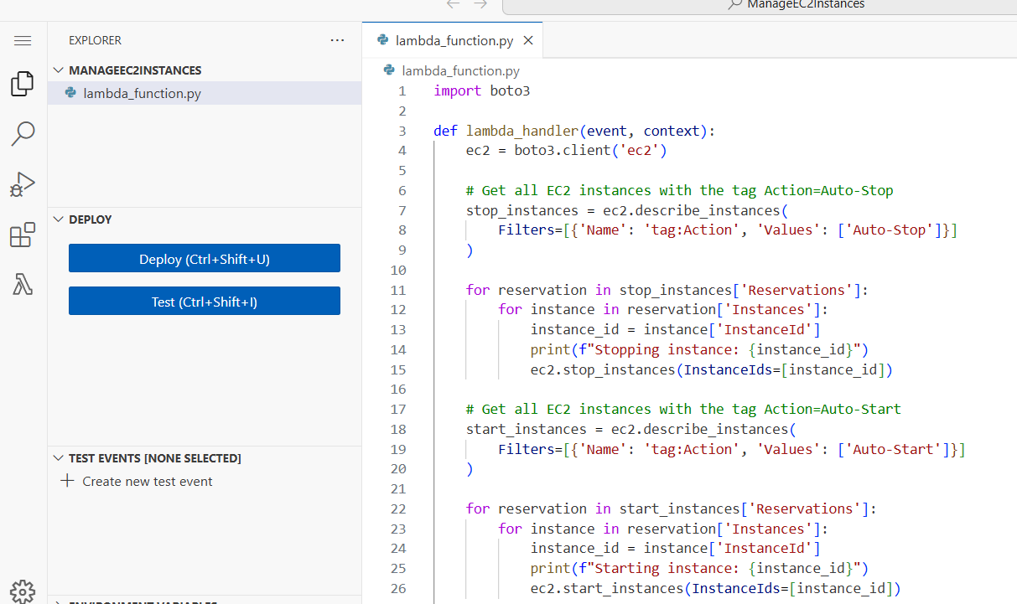
STEP 4: Write Python Code Using Boto3
Edit code tab and deploy

Slide 8
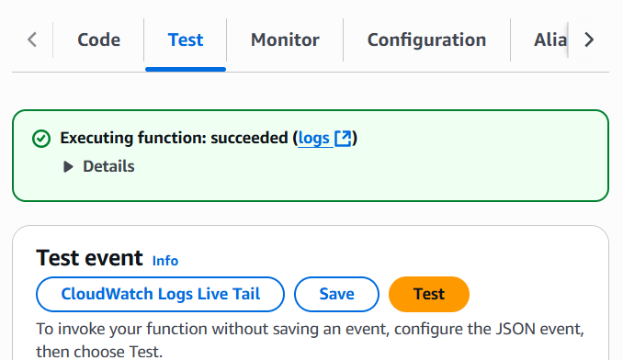
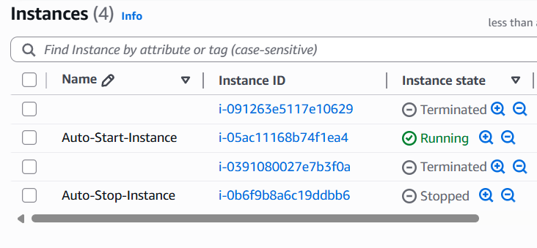
STEP 5: Manually Invoke the Lambda Function
Go to the Lambda function page → Click Test
Configure a new test event (leave defaults) → Click Test
Watch the logs and EC2 Dashboard:
The Auto-Start instance should start.
The Auto-Stop instance should stop.

Slide 9
Summary
Task | Status
2 EC2 instances created | ✅
Tags added (Auto-Stop/Start) | ✅
IAM Role with EC2 Access | ✅
Lambda function created | ✅
Boto3 script added | ✅
Lambda manually tested | ✅

Slide 10
Assignment 2: Automated S3 Bucket Cleanup Using AWS Lambda and Boto3
Overview: What You're Building
Tools You'll Use
Create an S3 bucket and upload multiple files to it.
Write a Python script using Boto3 that will run inside a Lambda function.
This script will find and delete files older than 30 days from the bucket.
You’ll manually trigger the Lambda function and verify that only recent files remain.
AWS Console - To access S3, Lambda, IAM via a web interface
S3 – to store and manage your files
Lambda - To run your automated Python script in the cloud
IAM – to give Lambda permission to use S3
Boto3 - Python SDK to access AWS services programmatically inside Lambda
Python 3.x - Language used to write the cleanup logic inside the Lambda function

Slide 11
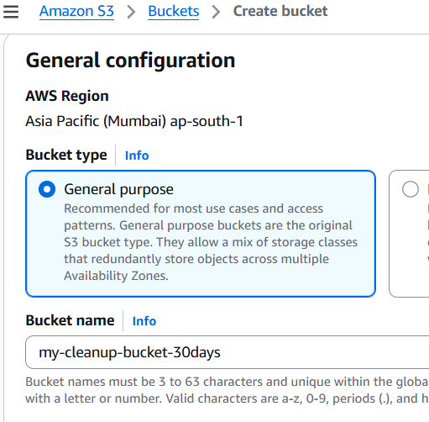
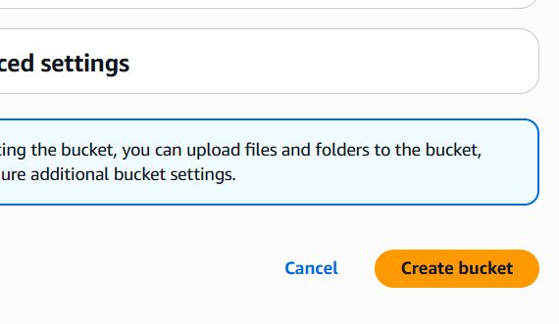
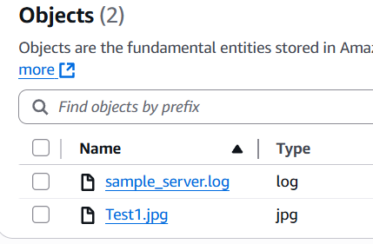
STEP 1: Create an S3 Bucket and Upload Files
Go to: S3 Dashboard
Click Create bucket
Bucket name: my-cleanup-bucket-30days
Region: Choose closest to you
Click Create bucket
Upload files:
Upload a few test files (PDF, TXT, JPG etc.)
Try to upload at least one file with a modified date older than 30 days

Slide 12
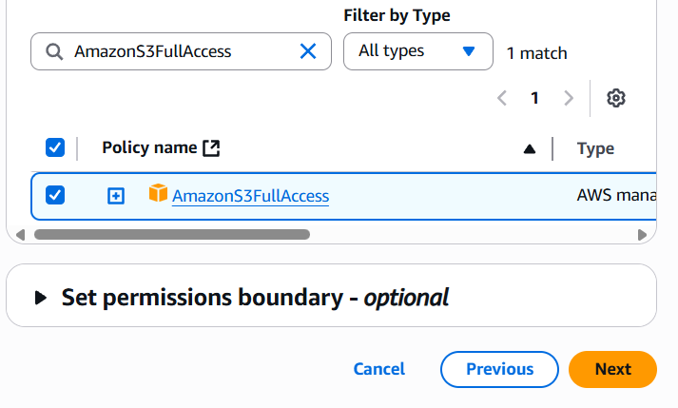
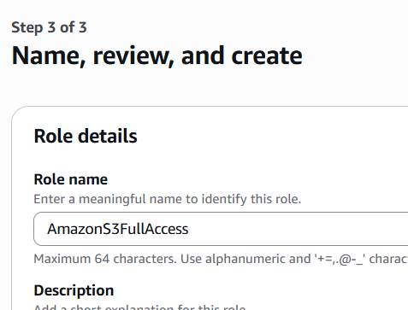
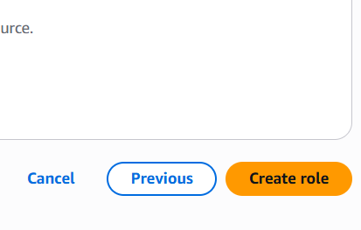
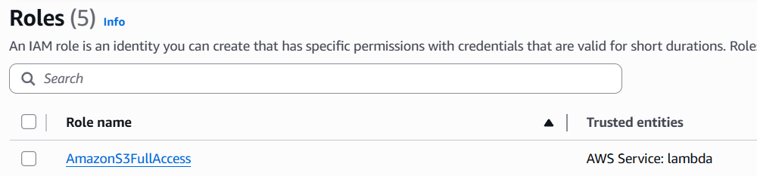
STEP 2: Create IAM Role for Lambda
Go to: IAM Console
In left menu → Roles → Click Create role
Trusted entity: Choose Lambda
Click Next, then attach policy: AmazonS3FullAccess
Name the role: LambdaS3CleanupRole
Click Create Role

Slide 13
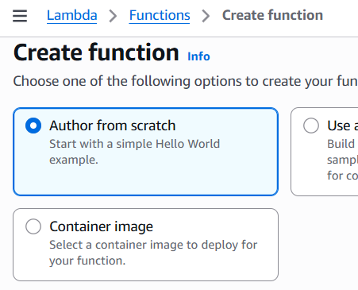
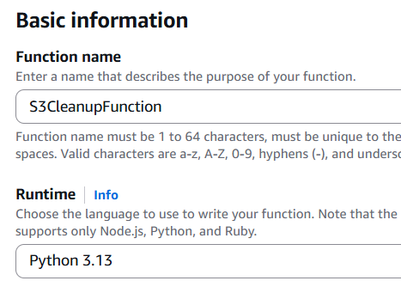
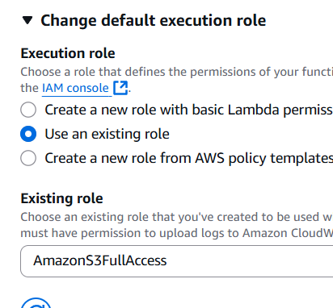
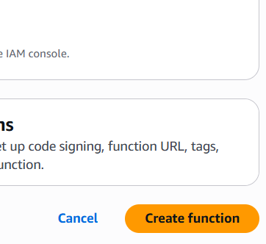
STEP 3: Create Lambda Function
Go to: Lambda Console
Click Create function
Function name: S3CleanupFunction
Runtime: Python 3.12 (or latest)
Permissions: Use existing role → Select LambdaS3CleanupRole
Click Create Function

Slide 14
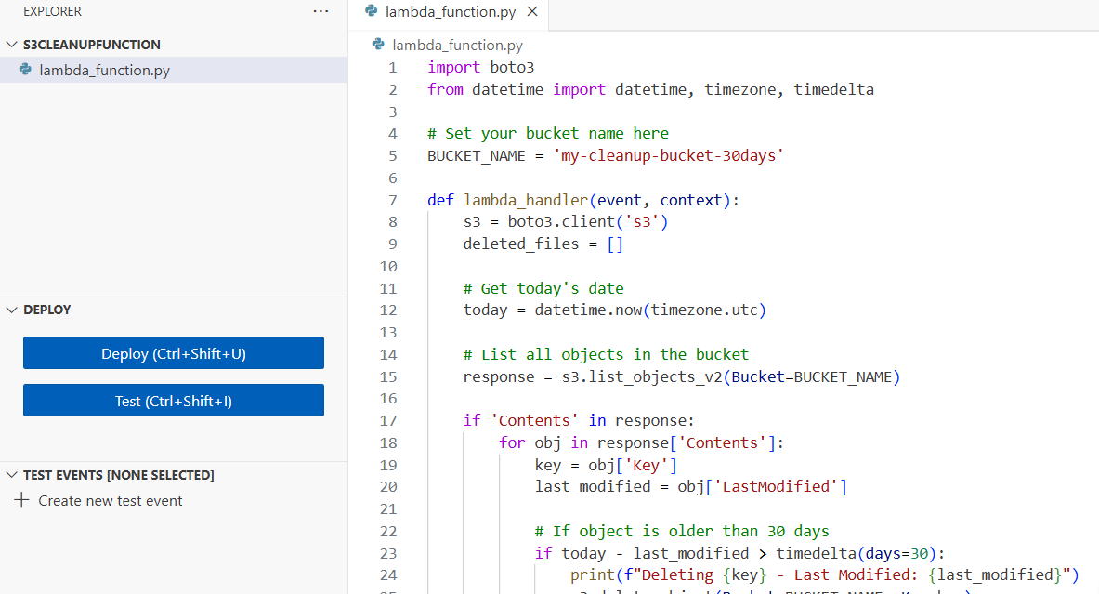
STEP 4: Add Python Code (Boto3 Script)
Edit code tab and deploy

Slide 15
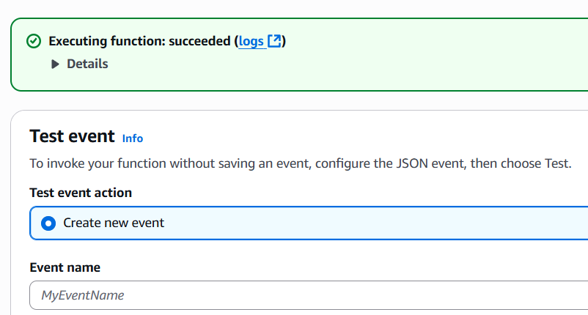
STEP 5: Test It Manually
On the Lambda function page → Click Test
Configure test event → Use default values → Click Test
Watch the logs → Files older than 30 days should be deleted
Verify S3 Bucket
Go to your S3 bucket in AWS console
Only recent files should remain
Older ones (based on LastModified) should be gone

Slide 16
Summary
Task | Status
S3 bucket created + files uploaded | ✅
IAM Role with AmazonS3FullAccess | ✅
Lambda function created with Python code | ✅
Files older than 30 days deleted | ✅

Slide 17
Assignment 18: Autosave EC2 Instance State Before Shutdown
Overview: What You're Building
Tools You'll Use
Detect the shutdown event
Remotely access the EC2 instance
Copy important files to an S3 bucket
AWS Console - To access S3, Lambda, IAM via a web interface
EC2 – The instance being backed up
S3 – Destination to store instance data
Lambda – The automation logic (Python + Boto3)
IAM – To allow Lambda to access EC2 and S3
CloudWatch Events – To trigger the Lambda function before shutdown

Slide 18
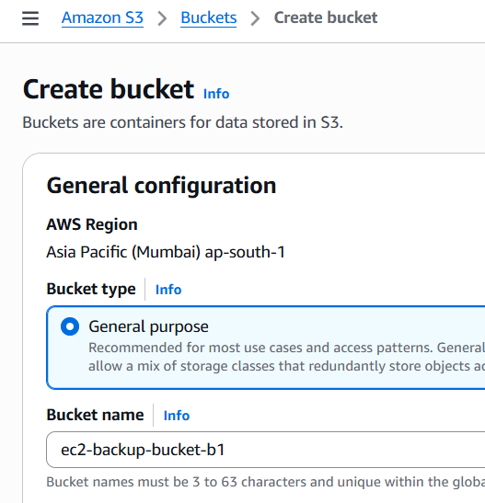
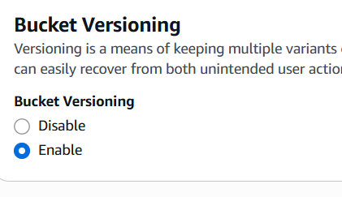
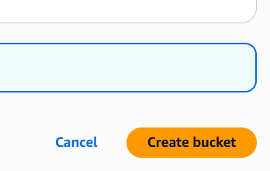
Step 1: Create an S3 Bucket for Backup
Go to: S3 Dashboard
Click Create Bucket
Name: ec2-backup-bucket-b1
Enable versioning
Click Create

Slide 19
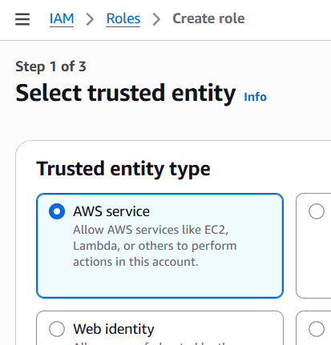
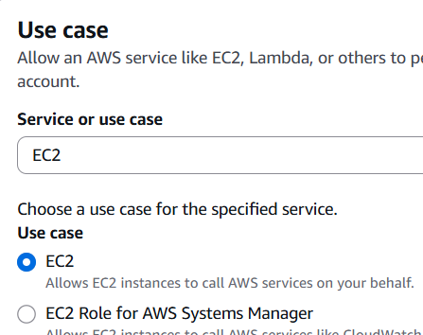
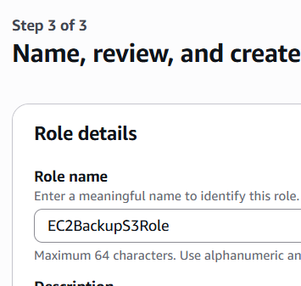
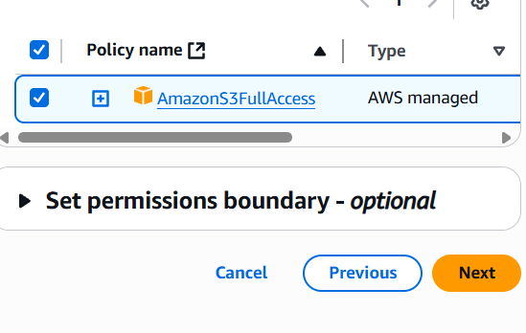
Step 2: Create and Attach IAM Role to EC2
Go to: IAM Console
Create a new role:
Trusted entity: EC2
Attach policy:
AmazonS3FullAccess
Name the role: EC2BackupS3Role
Go to EC2 Dashboard
Select your EC2 instance → Actions → Security → Modify IAM Role
Attach EC2BackupS3Role

Slide 20
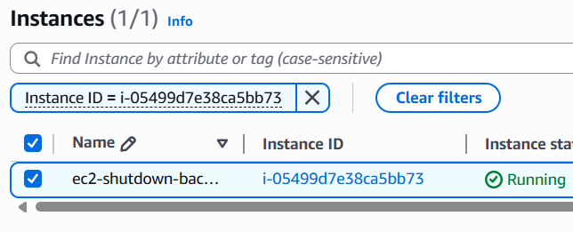
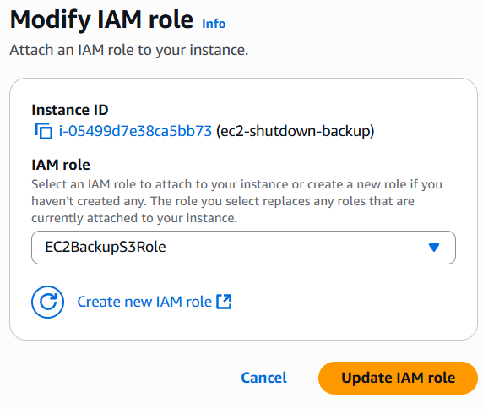
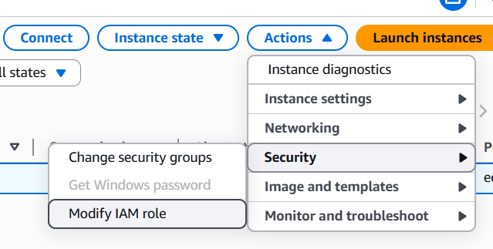

Slide 21
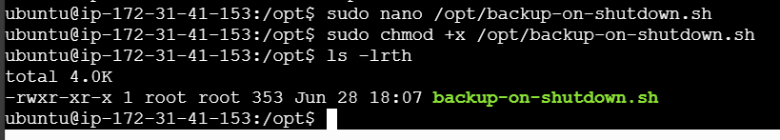
Step 3: Write Backup Script Inside EC2
SSH into your EC2 instance:
Create backup script:
sudo nano /opt/backup-on-shutdown.sh
Make it executable:
sudo chmod +x /opt/backup-on-shutdown.sh

Slide 22
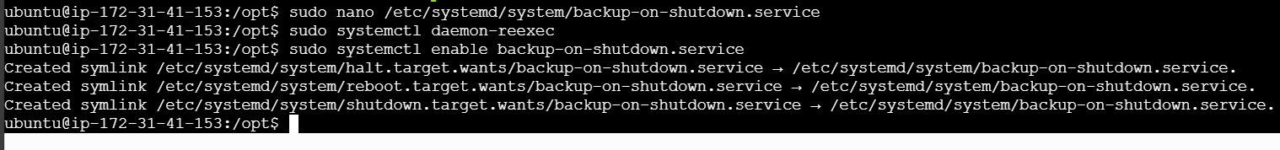
Step 4: Register the Script to Run on Shutdown
Create a systemd service:
sudo nano /etc/systemd/system/backup-on-shutdown.service
Enable and reload systemd:
sudo systemctl daemon-reexec
sudo systemctl enable backup-on-shutdown.service

Slide 23
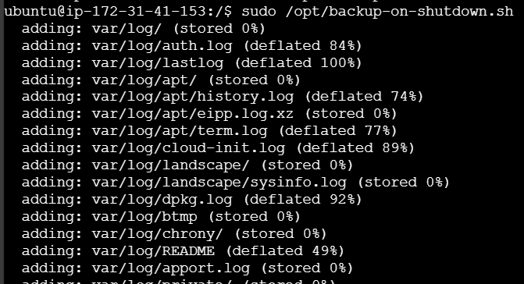
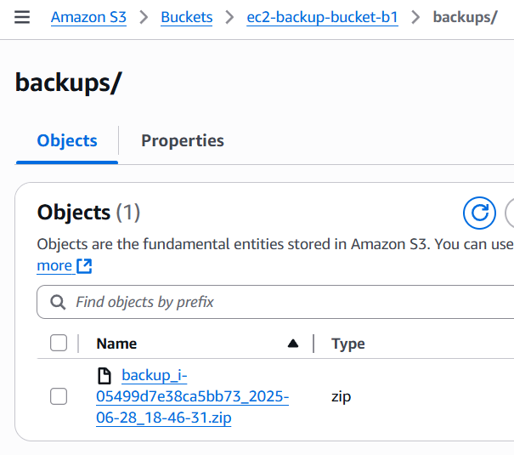
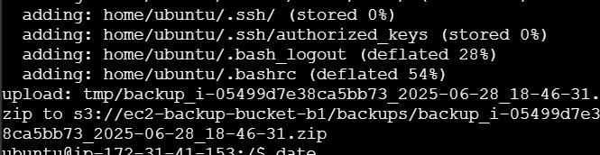
Step 5: Test the Backup Script
Run it manually (optional test):
sudo /opt/backup-on-shutdown.sh
Go to your S3 bucket → Check if the zip file appears inside the backups/ folder.

Slide 24
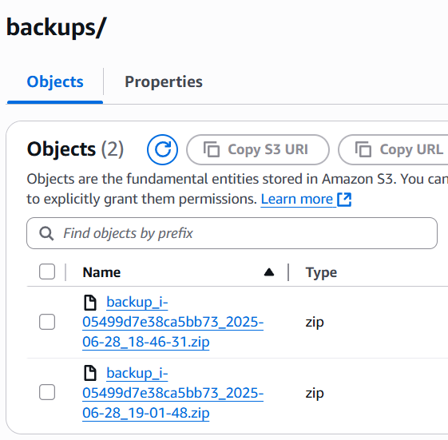
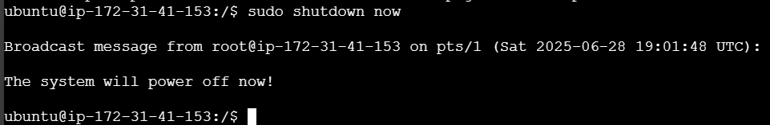
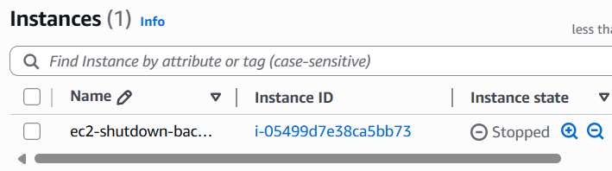
2. Test full shutdown-triggered backup: sudo shutdown now

Slide 25
Summary
Task | Status
S3 Bucket created | ✅
IAM Role for EC2 with S3 access | ✅
Backup script created in EC2 | ✅
systemd service runs on shutdown | ✅
Verified backup in S3 | ✅

Slide 26
Assignment 15: Implement a Log Cleaner for S3
Overview: What You're Building
Tools You'll Use
Create a Lambda function that:
Scans a specific S3 bucket
Deletes log files older than 90 days
Runs automatically once per week using EventBridge (CloudWatch Scheduler)
AWS Console - To access S3, Lambda, IAM via a web interface
S3 – Destination to store instance data
Lambda – The automation logic (Python + Boto3)
IAM – To allow Lambda to access EC2 and S3
CloudWatch Events – To trigger the Lambda function before shutdown

Slide 27
Step 1: Create (or Identify) S3 Bucket for Logs
Go to: S3 Console
Click Create Bucket
Name: log-cleanup-bucket-b1
Upload some test .log or .txt files
Upload files with different timestamps for testing
You can simulate "older" files by editing the LastModified date in code during testing

Slide 28
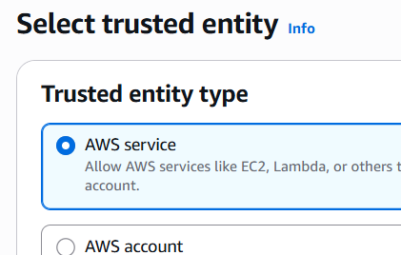
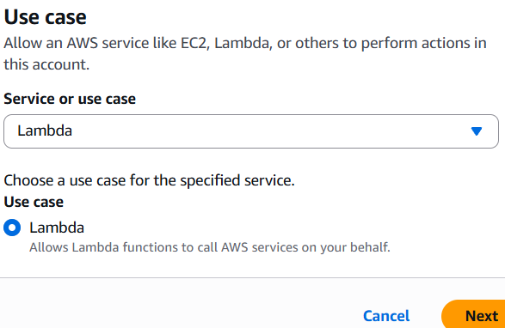
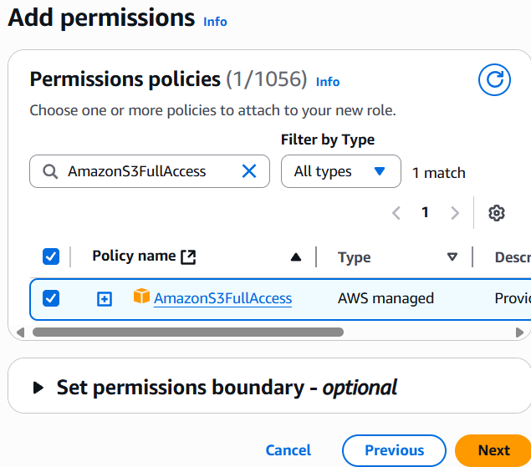
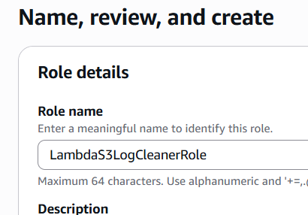
Step 2: Create IAM Role for Lambda
Go to: IAM Console
Create a new IAM Role for Lambda
Attach the policy: AmazonS3FullAccess
Name it: LambdaS3LogCleanerRole

Slide 29
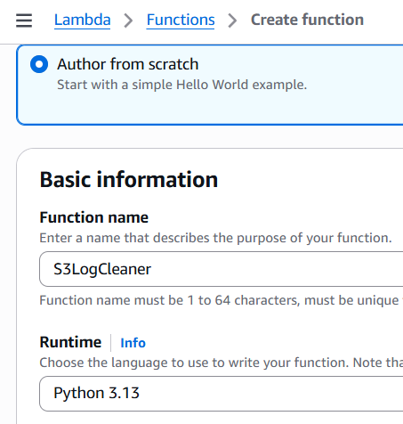
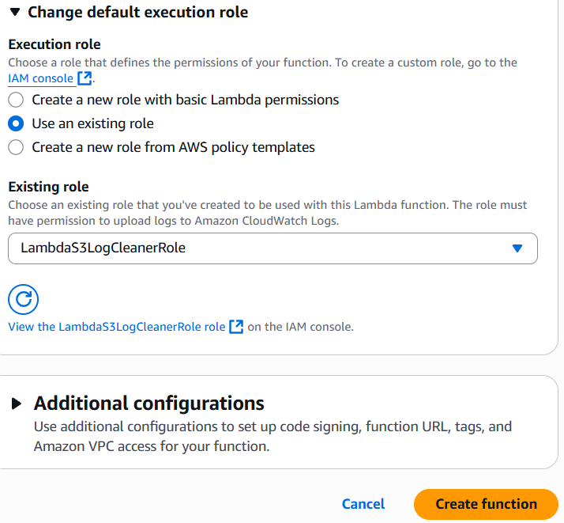
Step 3: Create Lambda Function
Go to: Lambda Console
Click Create Function
Name: S3LogCleaner
Runtime: Python
Execution Role: Use existing role → Select LambdaS3LogCleanerRole
Click Create Function

Slide 30

Step 4: Add Python Code (Boto3 Script)
Edit code tab and deploy

Slide 31

Step 5: Manually Test the Function
Go to the Lambda function → Click Test
Create a test event with default values → Click Test
Check:
Logs in Monitor > CloudWatch Logs
Files in your S3 bucket — old files should be deleted

Slide 32



Step 6: Schedule with EventBridge (Weekly)
Go to: EventBridge Console
Click Create Rule
Name: WeeklyS3LogCleanup
Rule type: Schedule
Pattern: rate(7 days) → runs weekly
Target:
Lambda Function → Select S3LogCleaner
Click Create

Slide 33





Slide 34
Summary
Task | Status
S3 Bucket with logs | ✅
Lambda IAM Role with S3 permissions | ✅
Lambda function created with cleanup code | ✅
Code deletes logs older than 90 days | ✅
Scheduled to run weekly via EventBridge | ✅
Manual test verified in logs and S3 | ✅

