Slide 1
The nightly reports already carry the warning signs. The hard part is separating them from broken data, weather and chronic noise
Exploratory data analysis · Harbor Table Foods, Plants A–C · Apr–Sep 2026
Team SEC02_Contextual_Odyssey · Client: Contextual IO · November 2026
Notes:
June 2026 controller data is real; Apr–May and Jul–Sep are simulated and come with operations records.

Slide 2
Four habits separate real faults from noise, and the data to build them already exists
715,440
117
309/309
26.6
hourly readings, 3 plants
measured sensors
review numbers traced
alarms a week today
1 Flag bad data first
9,238 readings are dead or stuck sensors and outages
2 Learn normal per point and hour
3 rooms hold 83% of cold-room hours above 41 °F
3 Read the summary line for slow trends
hourly data misses the 02:45 peak by 3 °F
4 Explain with context
70% of alarms come from 3 chronic rooms

Slide 3
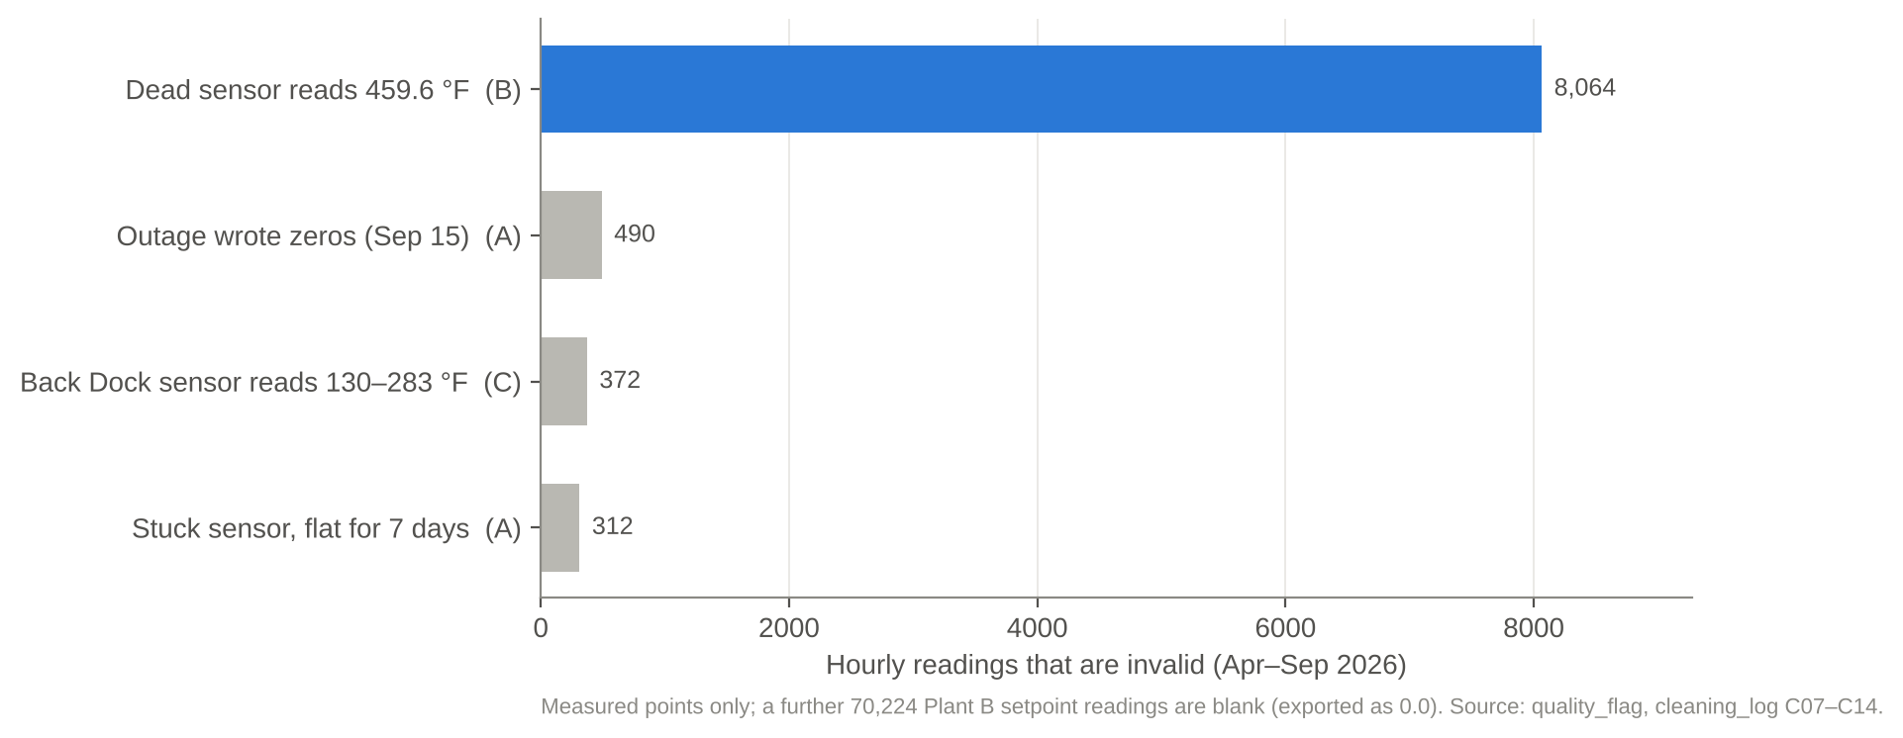
9,238 hourly readings are broken sensors or outages, not plant conditions
TAKEAWAY
Unflagged, Plant B's dead sensor alone would fire a 459.6 °F emergency every hour for months.
8,064
dead-sensor hours, Plant B
34
report groups missing (never filled)
Source: quality_flag in Plant?_hourly_long.csv; cleaning_log.csv C07–C14

Slide 4
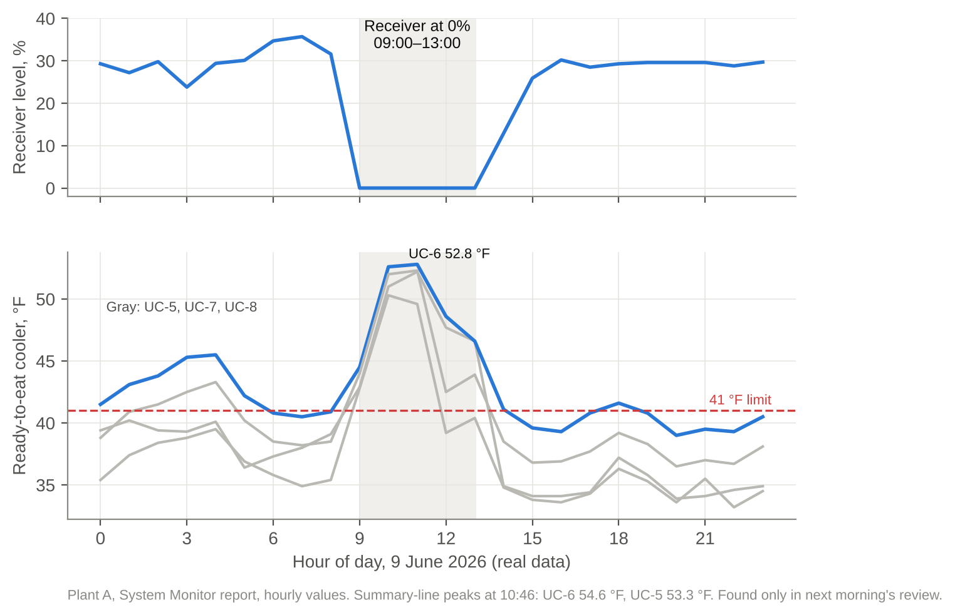
June 9: the receiver emptied and four ready-to-eat coolers crossed 41 °F within an hour
TAKEAWAY
A same-day rule (receiver ≤1% for 2 h in production) fires at 09:00. Today it surfaces in the next morning's review.
5 h
receiver at 0% during production
154→77
discharge pressure, psig (08:00→10:00)
Source: PlantA_hourly_long.csv, 9 June 2026 (real data), System Monitor report

Slide 5
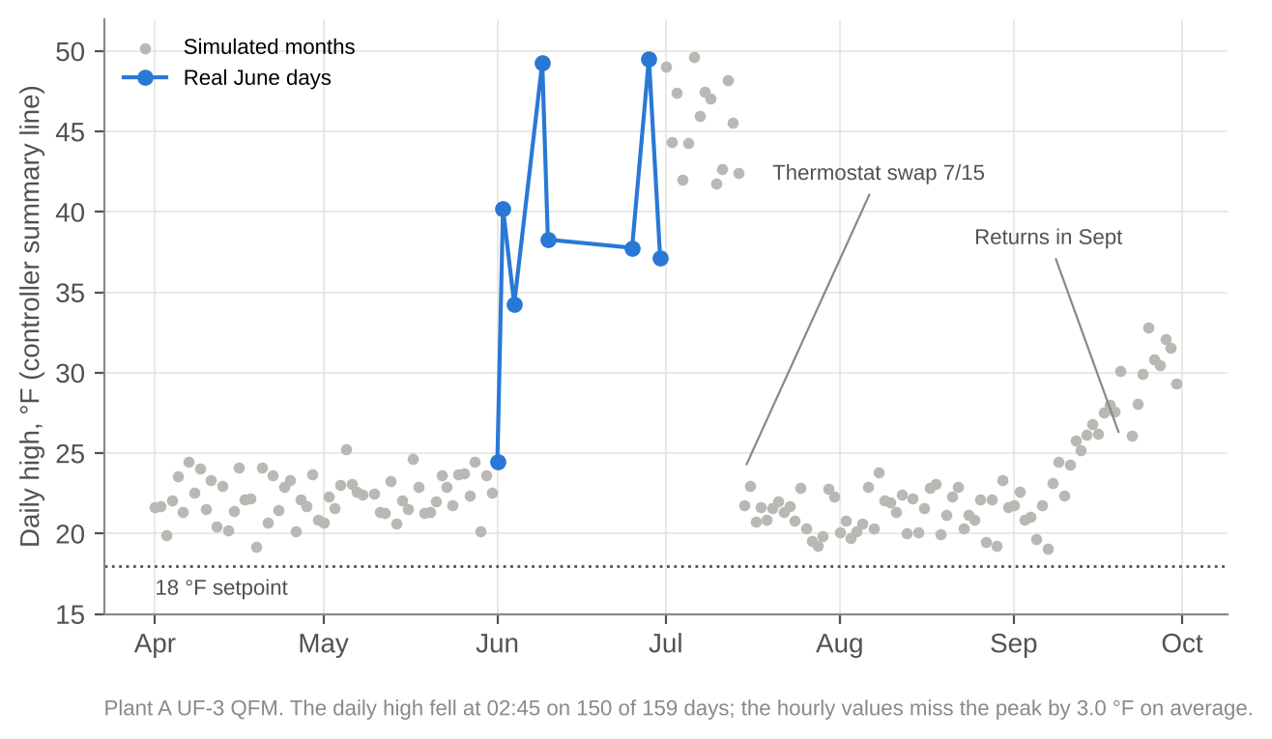
The 02:45 freezer spike doubled in June and crept back after the fix
TAKEAWAY
Slow faults live in the 15-minute summary line. A trend rule on daily highs catches them; an hourly threshold does not.
150/159
days whose high fell at 02:45
3 °F
peak missed by hourly values
Source: PlantA_daily_summary.csv, UF-3 QFM high_raw / high_time

Slide 6
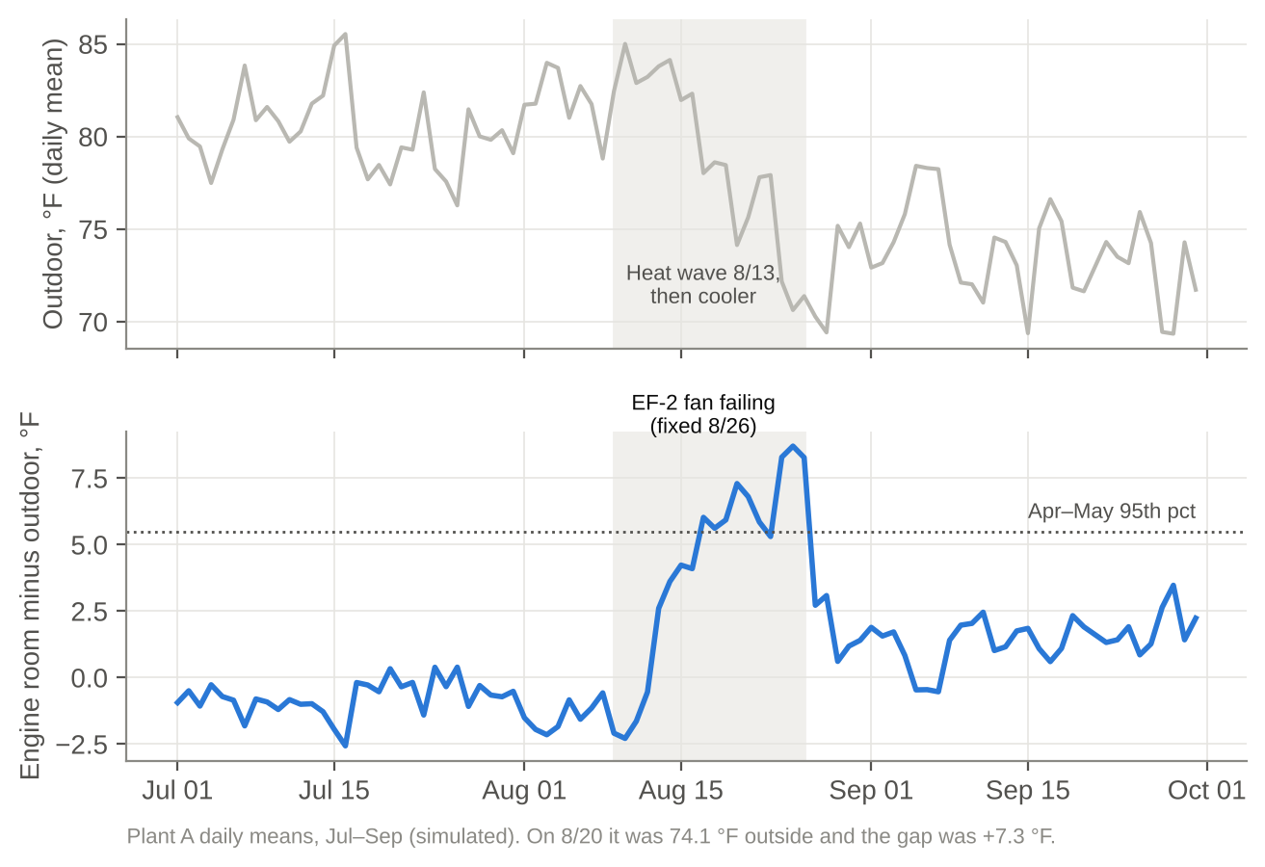
Engine room heat is a fault only when it outruns the weather
TAKEAWAY
The hottest day had a normal gap (+2.6 °F). The EF-2 fan fault showed on cooler days (+7.3 °F). Model the gap, not the raw temperature.
0.99
engine room vs outdoor correlation, Apr–May
+8.3 °F
peak gap before the 8/26 repair
Source: PlantA_hourly_long.csv daily means; WO-26499; shift log 8/9–8/20

Slide 7
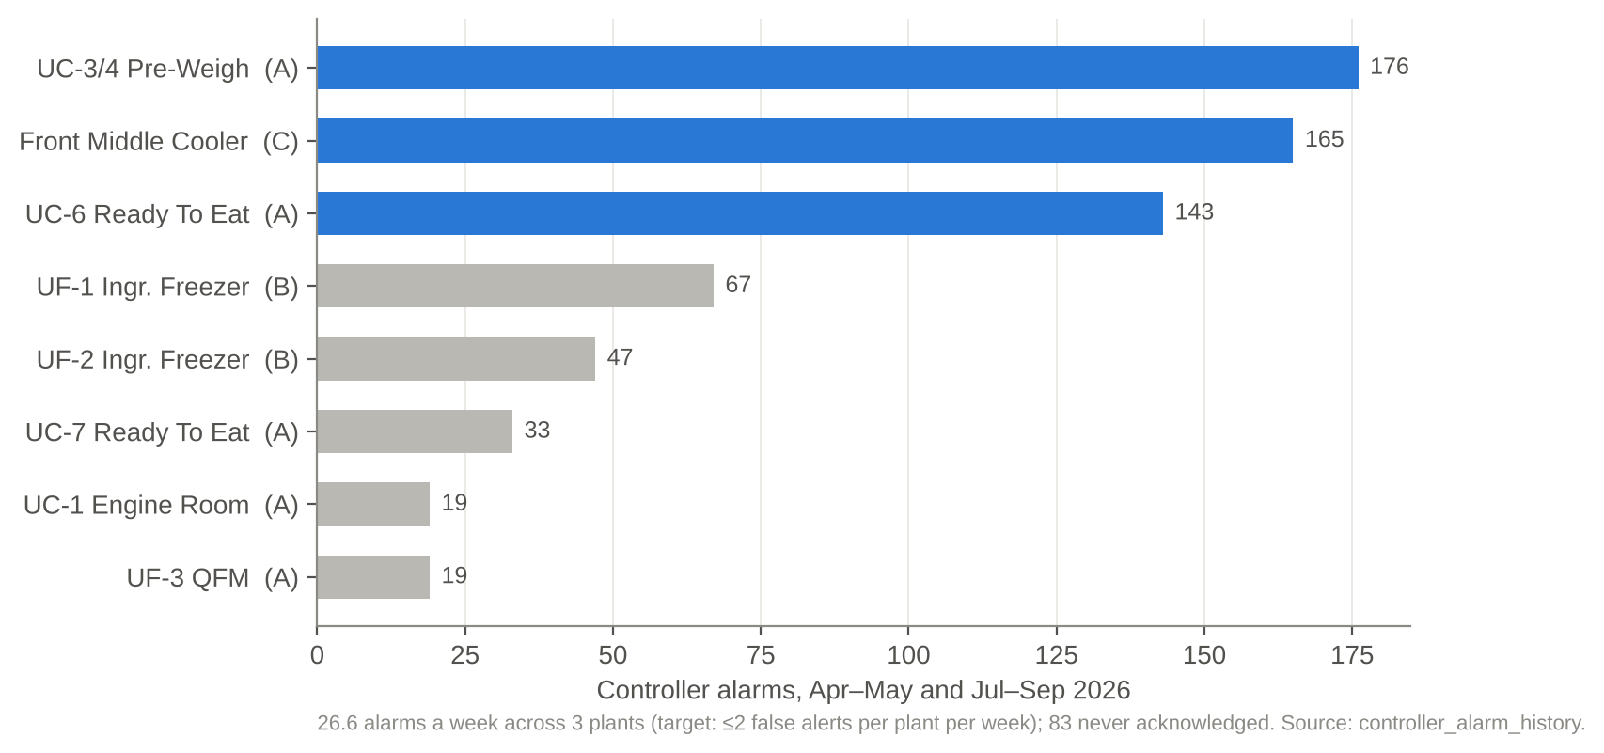
Three chronic rooms raise 70% of the 695 controller alarms
TAKEAWAY
Staff see 26.6 alarms a week and ignored 83. Yet 6 of 12 logged faults never alarmed on their own point.
83
alarms never acknowledged
6 of 12
faults with no alarm, incl. E10 refrigerant loss
Source: controller_alarm_history; known_events_from_ops_records.csv

Slide 8
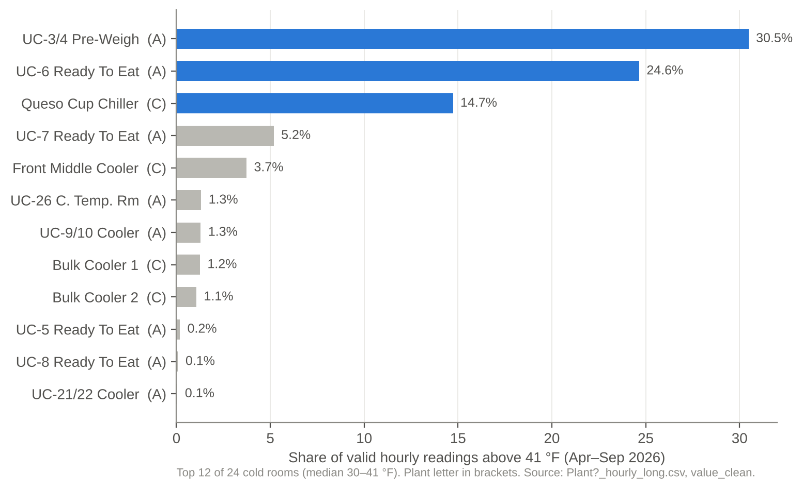
Three rooms hold 83% of all cold-room hours above 41 °F
TAKEAWAY
Food-safety risk is concentrated, not spread. A 'normal' learned from history would absorb these rooms, so keep the 41 °F rule beside it.
3.5%
of hours above 41 °F, 24 cold rooms
7
cold rooms never above 41 °F
Source: Plant?_hourly_long.csv value_clean; cold room = median 30–41 °F

Slide 9
Next: turn these four habits into Plant B and C baselines and score them against the 26 known events
Nov 9–13
Client check-in: thresholds, Plant B/C setpoints, faster data feed
Nov 16–20
Plant B and C baselines; washdown suppression for Plant A
Nov 23–Dec 4
Daily review generator, forecast baseline, full replay and scoring
Early Dec
Final presentation and demo on the Contextual platform

