Slide 1

GROUP LOCATION TRACKER Application IN ANDROID
Mentor :
Mr. Saurabh Ranjan Shrivastava
Senior Lecturer
Swami Keshvanand Institute of Technology, Jaipur.
Submitted by :
Govind Rander 12ESKCS042
Harpreet Singh 12ESKCS045

Slide 2
What is Group Location Tracker…
The application “Group Location Tracker" is developed in android. The aim of application is locating friends (or group members added in a group) using Location Based Services (LBS), which uses the GPS as location provider through geographic location for mobile network. The application is supported on every android device having minimum API level 15(4.0.3 Ice Cream Sandwich). It is an android application package (.apk) that you can download and use. The requirements to run the application is you need an internet connection and a mobile device having android as a platform.

Slide 3
Location Based Services (LBS)
Location based service can be elaborate as the services which uses the users geographical location which consist of X and Y coordinates, which is generated by GPS which acts as positioning device. The purpose of LBS is to find the physical location of the device. Access to the LBS is handled by the LocationManager system Service. LBS uses the Global Positioning System (GPS) as location provider through geographic location for mobile network.

Slide 4
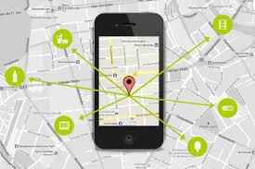
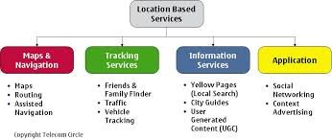
LBS Continued…

Slide 5
GPS and GPS Tracking System
The Global Positioning System (GPS) is actually a constellation of 27 Earth-orbiting satellites (24 in operation and three extras in case one fails). The U.S. military developed and implemented this satellite network as a military navigation system, but soon opened it up to everybody else.
A GPS tracking system is a device that uses the Global Positioning System to determine the precise location of a vehicle, person, or other asset to which it is attached and to record the position of the asset at regular intervals. The recorded location data can be stored within the tracking unit, or it may be transmitted to a central location data base, or internet-connected computer, using a cellular (GPRS), radio, or satellite modem embedded in the unit. This allows the asset's to be displayed against a map backdrop either in real-time or when analyzing the track later, using customized software.

Slide 6
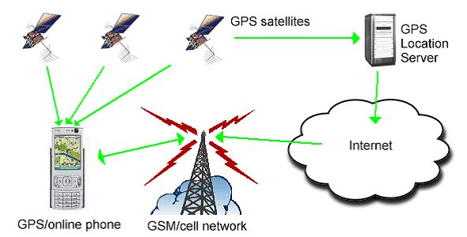
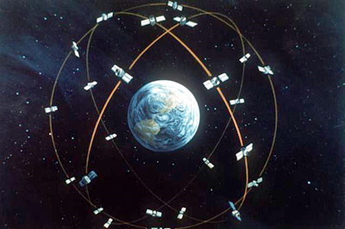
GPS Continued…
Fig. Architecture of a GPS system.
Figure. Artist's concept of the GPS
satellite constellation

Slide 7
Aim of Group Location Tracker
The App “GPS based Group Location Tracker” is a GPS service based application which would help us in locating the exact geo-position of people (any single entity of a large set) depending upon their current location/whereabouts. Geo-position would be displayed on the map view on our android set and display functioning can analogue to the current usage of Google Maps service.

Slide 8
Features
All users’ locations would be retrieved from an online database so as to centrally control the permissions for viewing.
For restricting user access, user authentication would be supported.
Periodic refreshing has to be present so that each time the geo–location changes or after a fixed interval of time the values in database should be updated.
All devices would be having a unique ID (UID) and this would be used for searching for the user.

Slide 9
Working of Application
The application makes use of a mobile phone which is provided with GPS receptor and GSM network. This application enables the user to track a mobile device from the current GSM cell and GPS position. LocationTracker also maintains a record of the positions which are already monitored. This allows the users to check when and where the mobile device was located using Google maps. We will use Web Services to send and receive location of a group member on the server and then we will use this location to pinpoint the group member location on the map.

Slide 10
Proposed System
The application facilitates mobile users in finding services available in specific location. Mobile phone tracking tracks the current position of a mobile phone even on the move. The main aim of this is to design and implement a client server system that helps users to locate their friends and family members through mobile. It tracks the user location information using GPS. Using GPS the user can know his present location coordinates and as user changes his location automatically the coordinates will update and changes the location information in user mobile device.

Slide 11
Challenges in Determining User Location
Multitude of location sources – GPS, Cell-ID, and Wi-Fi can each provide a clue to users location. Determining which to use and trust is a matter of trade-offs in accuracy, speed, and battery-efficiency.
User movement – Because the user location changes, we must account for movement by re-estimating user location every so often.
Varying accuracy – Location estimates coming from each location source are not consistent in their accuracy. A location obtained 10 seconds ago from one source might be more accurate than the newest location from another or same source.

Slide 12

Screenshots of project…

Slide 13
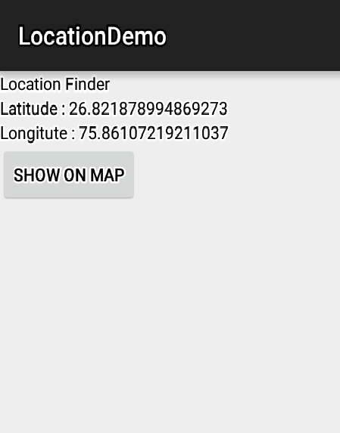
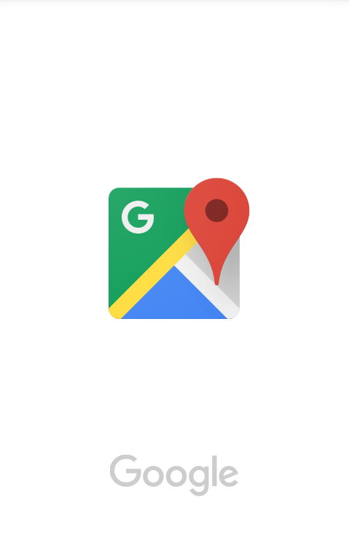
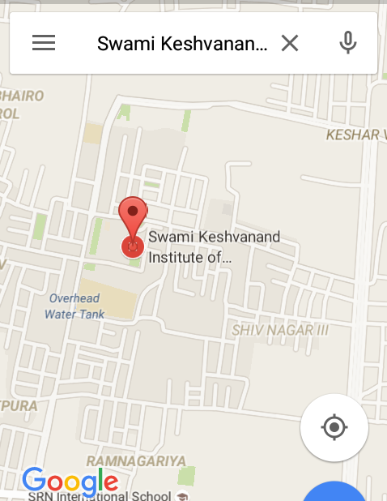
Screenshots
Fig. Latitude and Longitude using GPS.

Slide 14
Conclusion
Location Based Services are those services which provide both information and entertainment and are accessible with mobile devices through the mobile network. They utilize ability to make use of the geographical position of the mobile device. They can utilize multiple technologies such as the GPS satellite network, cellular networks, Wi-Fi networks and other technologies. Android provides a very nice platform for developing LBS applications. It provides separate methods and classes for each and every separate entity involved in the development of the application.

Slide 15
THANK YOU
Any
Queries
???

