Slide 1


Introduction, Definition of Software Engineering
Session No.: 1
Course Name: Software Engineering
Course Code: R1UC542B
Instructor Name: Dr. Monalisa Panigrahi
Duration: 50 minutes
Date of Conduction of Class:

Slide 2


What do you understand about Software ?? Give some examples ?
Opening Question:

Slide 3
At the end of this session students will be able to By the end of this lesson, you should be able to
LO: Explain Software Engineering and it basic Terminology .
Write a Simple Java Program – Create and save a basic Java program (HelloWorld.java).

Slide 4
Session Outline
1 Introduction
2 Types of Software
3 Activity -1
4 Importance of Software Engineering and scope
5 Software Process and S/W Engineering Approaches.
6 Activity -2
7 Reflection of Activity-2

Slide 5
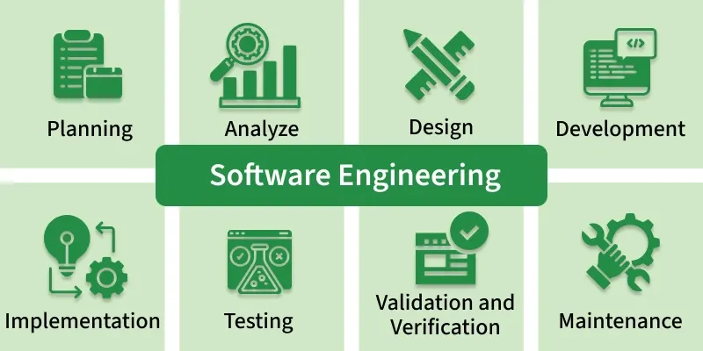
Introduction
Computer Program: A computer program is a collection of step-by-step instructions given to a computer to solve a problem or perform a task.
Software: Software is a program or set of programs containing instructions that provide the desired functionality.
Software Engineering: Engineering is the process of designing and building something that serves a purpose efficiently and cost-effectively.

Slide 6
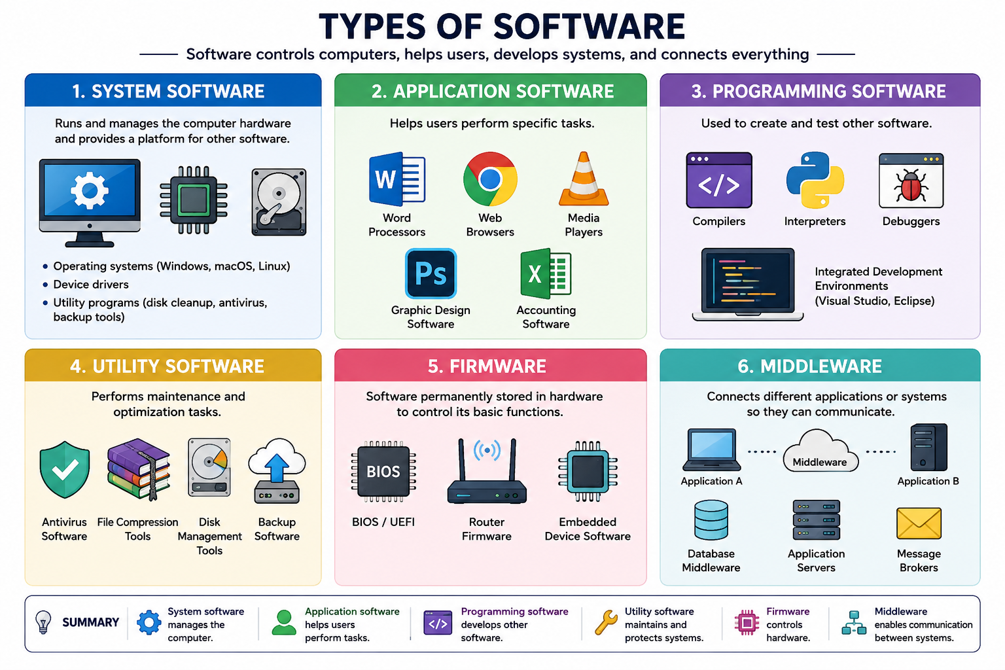
Types of Software's
System Software
System software controls and manages the computer hardware and provides a platform for other software to run.
Examples:
Operating Systems (Windows, Linux, macOS)
Device Drivers
Utility Programs (Disk cleanup, antivirus)
Application Software
Application software is designed to help users perform specific tasks.
Examples:
MS Word – document writing
Excel – calculations
Web browsers – Chrome, Firefox
Mobile apps
Programming Software
Programming software helps developers create other software.
Examples:
Compilers (GCC)
Interpreters (Python interpreter)
IDEs (Visual Studio, Code::Blocks)

Slide 7
Learning Activity 1 (Quiz)
1. What is Software Engineering?
a) Writing programs without planning
b) A systematic approach to developing and maintaining software
c) Using only hardware components
d) Installing operating systems
3. Which of the following is Application Software?
a) Linux
b) MS Word
c) Compiler
d) Device Driver
2. Windows Operating System is an example of:
a) Application Software
b) Programming Software
c) System Software
d) Utility Software
4. A compiler is an example of:
a) System Software
b) Application Software
c) Programming Software
d) Utility Software

Slide 8
Reflection Learning Activity 1
1-b
2-c
3-b
4-c

Slide 9
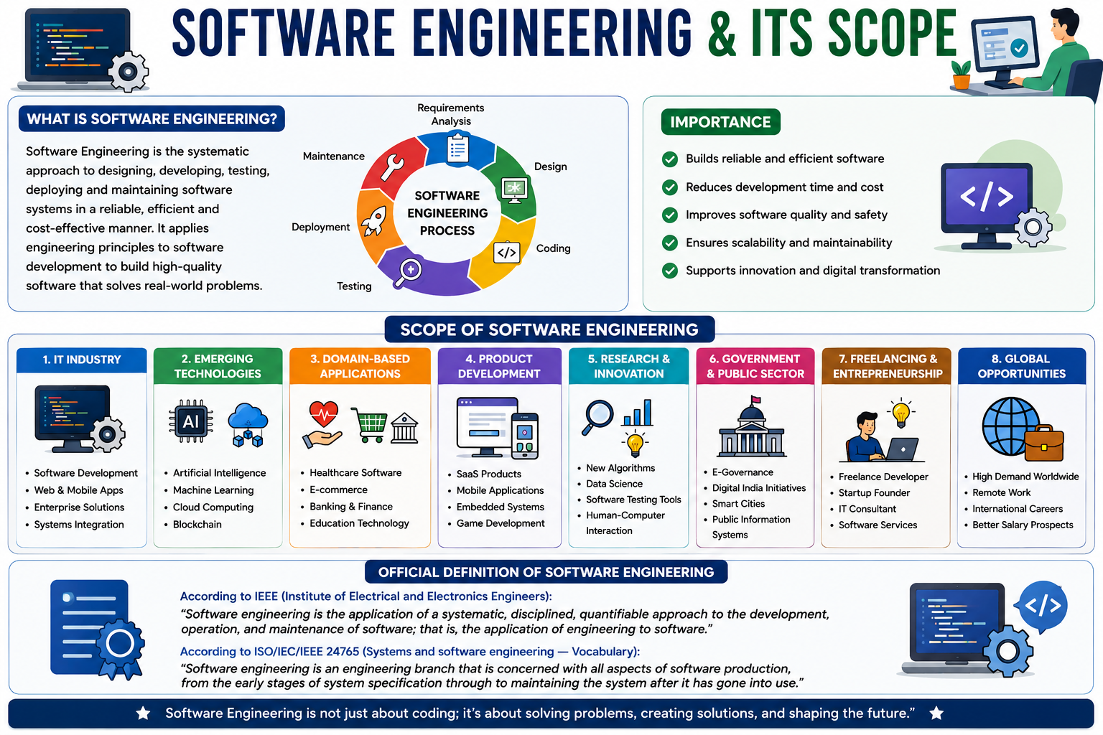
Software Engineering
=
.

Slide 10
Software process
The systematic approach that is used in software engineering is sometimes called a software process. A software process is a sequence of activities that leads to the production of a software product. There are four fundamental activities that are common to all software processes.
These activities are:
Software specification, where customers and engineers define the software that is to be produced and the constraints on its operation.
Software development, where the software is designed and programmed.
Software validation, where the software is checked to ensure that it is what the customer requires.
Software evolution, where the software is modified to reflect changing customer and market requirements.

Slide 11
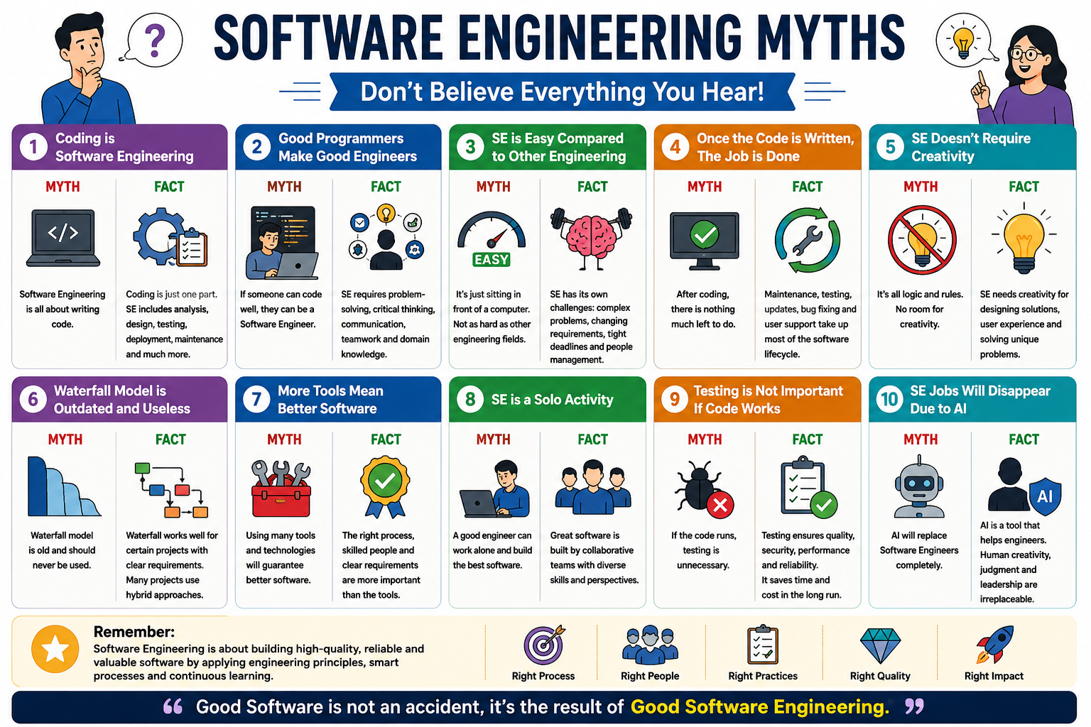
Why Software Engineering Required
Why we are learning Software Engineering?
Reduce Complexity
To minimize software cost
To decrease time
Handling big projects
Reliable softwares
Effectiveness

Slide 12
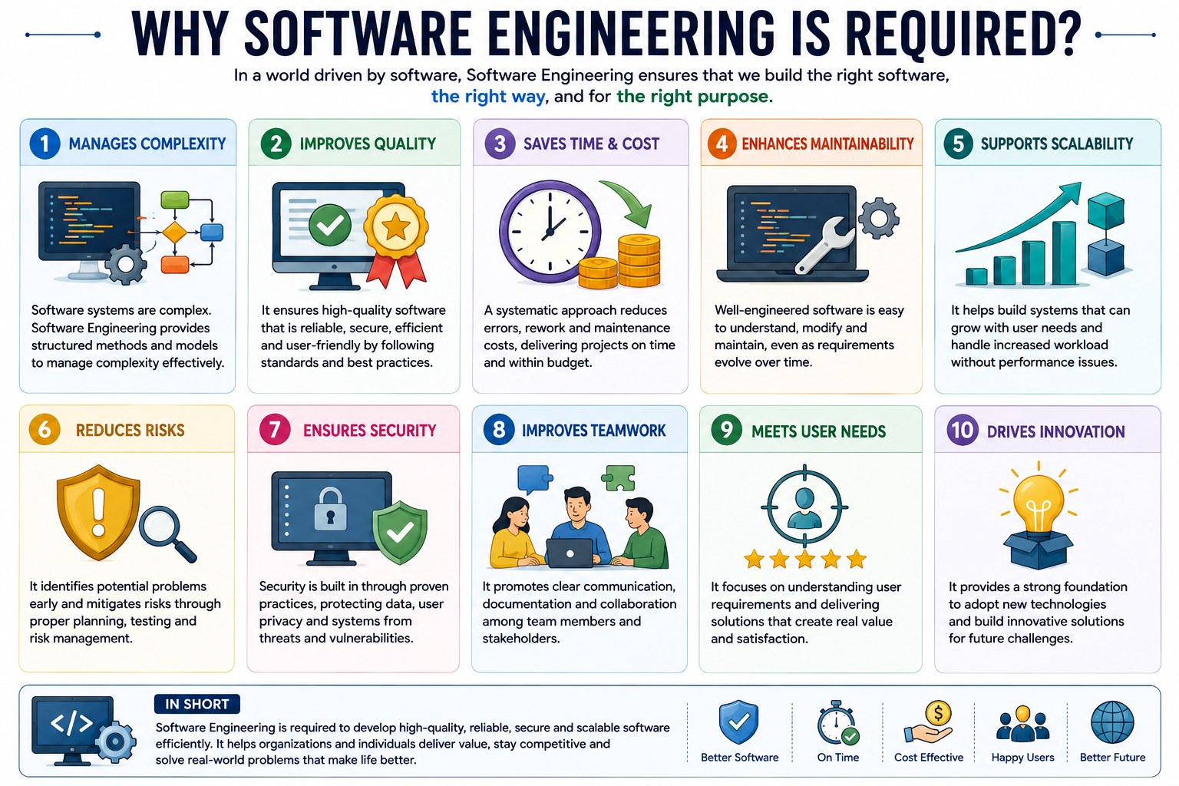
Why Software Engineering Required
Why we are learning Software Engineering?
Reduce Complexity
To minimize software cost
To decrease time
Handling big projects
Reliable softwares
Effectiveness
Software engineering principles use two important techniques to reduce problem complexity:
Abstraction
Decomposition.

Slide 13
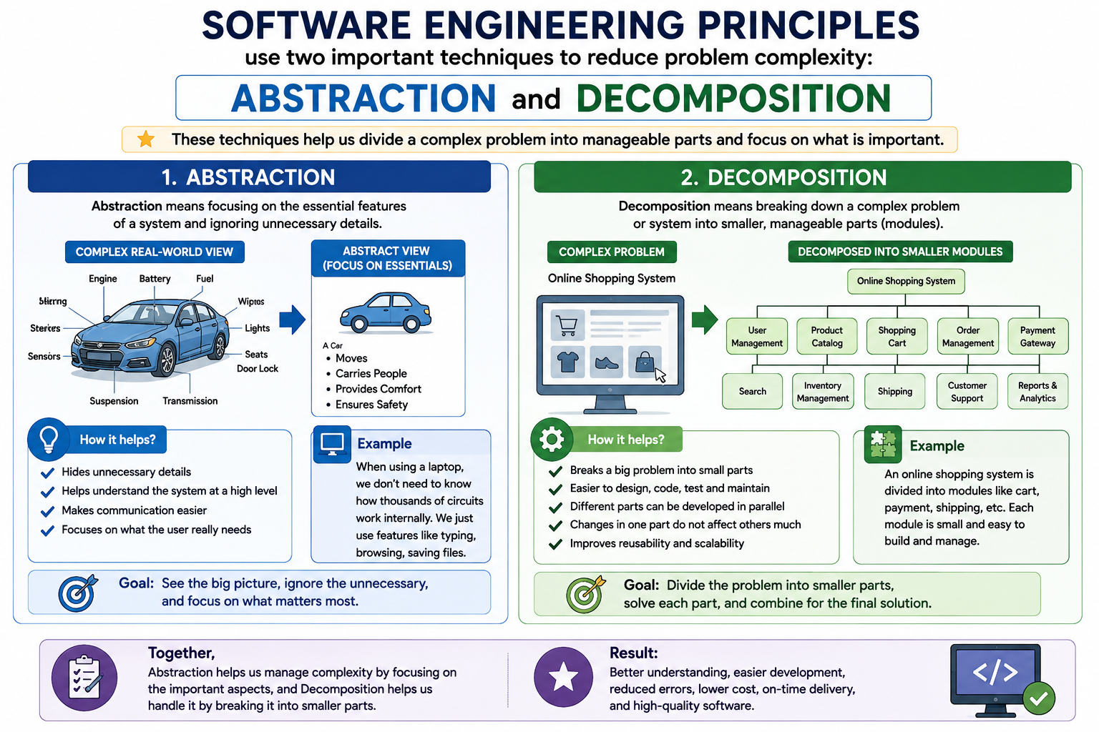
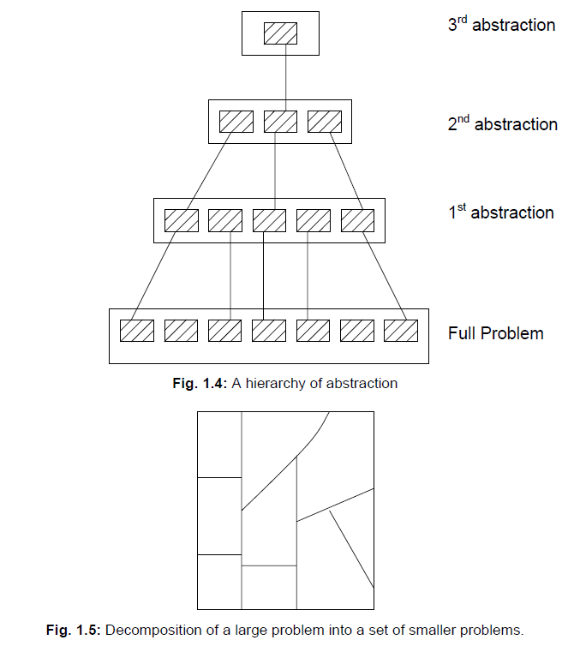

Slide 14
Activity-2 (Think pair share)
Think – About given scenario of software failure
Pair- Pair with your peers
Share- What went wrong??
Case Study: Online Exam Registration System Failure
A university launched a new online exam registration portal. On the last date of registration:
Thousands of students tried to log in at the same time.
The website became very slow and then completely crashed.
Some students’ payments were deducted, but registration was not confirmed.
Many students missed the deadline.
The university had to extend the deadline and faced complaints from students and parents.

Slide 15
Reflection- Learning Activity 2
The system was not able to handle heavy user traffic.
Server capacity was insufficient.
No proper load or stress testing was conducted.
Payment gateway integration was poorly handled.
Lack of backup or recovery mechanism.
Poor error handling and system monitoring.

Slide 16
Conclusion:
Why Software Engineering Required .
Software Process
Software Engineering basic principals

Slide 17
Ensure attainment of LOs in alignment to the learning activities: outcomes (1-2)
Explain Software Engineering and it basic terminology.

Slide 18

Review and Reflection from students
Thank You

Slide 19
Information about the next lesson
SDLC

