Slide 1

AI-Driven Multi-Vendor Network Security Compliance Auditor
AI Engine
Analyze policies, detect deviations, and suggest fixes.
CyberConfig AI
Team : Enterprise Network Security Automation
Network Devices
Security Shield
Collect multi-vendor configuration and telemetry data.
Automate remediation and enforce compliance across devices.
THEME: BLOCKCHAIN & CYBERSECURITY
CATEGORY: SOFTWARE
Govind Kushwaha : Frontend Developer
Abhishek Yadav : Backend Developer
Sunny Kumar : UI/UX & Research
Deepanshu : Cybersecurity & AI/ML
Detect → Explain → Fix → Verify → Learn

Slide 2



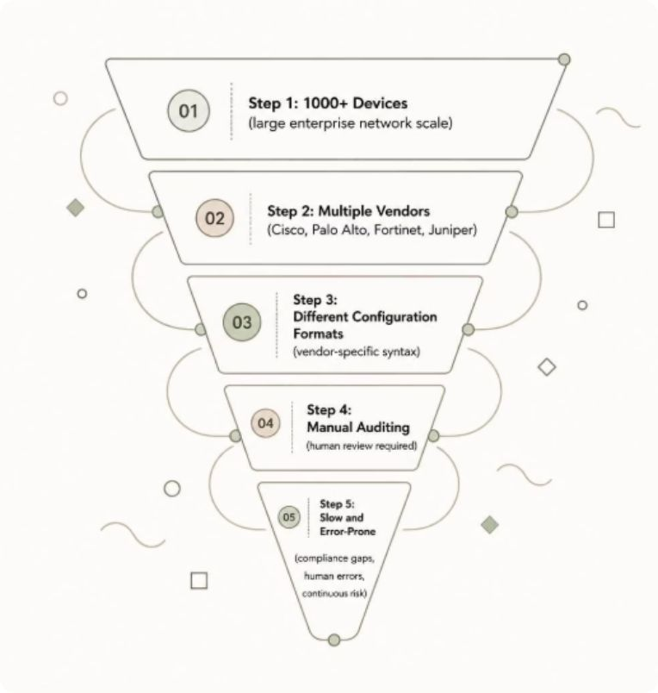

THE PROBLEM
Why This Is Needed
Scale
Vendor Diversity
Manual Auditing
Manual auditing of multi-vendor network devices is slow, complex, error-prone, and difficult to scale.”
1,000+ branches with a huge device footprint.
Cisco, Palo Alto, Fortinet, and Juniper each use different syntax.
Slow, error-prone, and unsustainable.
Security Policy: "Public SSH access should not be allowed." A device exposes SSH publicly → NON-COMPLIANT — HIGH PRIORITY

Slide 3
Research and Rule-Based Checking
Strong research and clear security rules help us find real configuration problems in different network devices.
1. Our Research Sources
2. What We Study
CIS
NIS
DIS
Ven
Org
Common network security problems
Different vendor configuration formats
CIS
NIST
DISA STIG
Vendor
Organization
Important security settings and best practices
Benchmarks
Guidelines
where applicable
Documentation
Security Policies
Real configuration examples
Best practices and security policies
Create and test security rules
3. Example: Network Device Configuration
4. Security Rule (Example)
5. Rule Check Result
router-config.conf
Rule ID
NET-TELNET-001
⚠ NON-COMPLIANT
system {
Policy
Telnet should be disabled
services {
Observed
Telnet is enabled
Finding
Telnet Enabled
telnet {
Expected
Non-compliant
disable no;
Risk
HIGH
Severity
High
port 23;
Evidence
disable no; port 23
}
Why risk?
Telnet sends data in plain text
}
Suggested fix
Disable Telnet; use SSH
Recommendation
Disable Telnet and use SSH
}
6. From Research to Verified Rules
Research and Study
→
Collect Examples
→
Create Rules
→
Test Rules
→
Verified Rules
Understand standards and vendor configs
Gather sample configs from vendors
Define checks and expected results
Use compliant, non-compliant and edge cases
Ready to use in CyberConfig AI

Slide 4
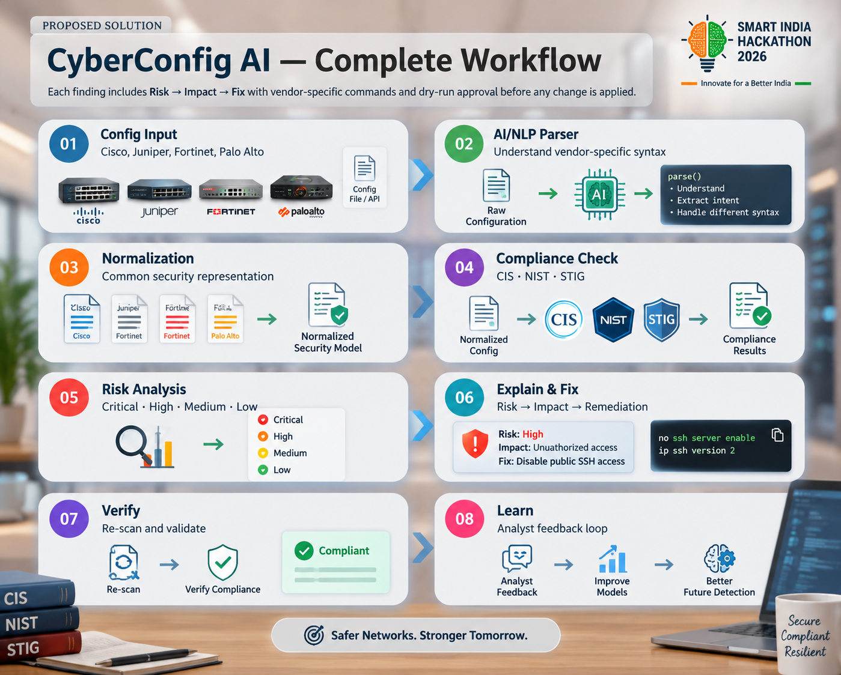

Slide 5
How CyberConfig AI Is Different
A focused, explainable configuration-auditing prototype, compared with established enterprise policy platforms.
COMPARISON
CYBERCONFIG AI
TUFIN
FIREMON
Main focus
Configuration checks with clear findings
Enterprise-wide policy visibility, compliance and change automation
Multi-vendor policy normalization, monitoring and compliance
How checks work
Rule-based checks in current demo; AI/ML layer is planned
Centralized policy and compliance workflows
Normalized policy data, rule processing and risk/compliance modules
Results for users
Risk/severity, evidence and suggested fix in the prototype
Dashboards, compliance evidence and automated policy workflows
Unified policy view, alerts, reporting and policy optimization
Project stage / scope
Working demo completed; AI/ML integration remains in development
Established commercial enterprise platform
Established commercial enterprise platform
OUR FOCUS
Simple workflow • Explainable rule findings • Evidence + suggested remediation • AI/ML assistance planned • Student-built, modular prototype
CYBERCONFIG AI TECH STACK
Frontend
Backend
AI support
Core audit
React + TypeScript + Vite
Node.js + Express + TypeScript
Gemini integration + offline heuristic fallback
Custom configuration parser + rule checks
User interface & dashboard
API and application logic
Explanations / fallback support
Parse configs and flag findings
AI/ML module and advanced integrations are planned work. Competitor descriptions are summarized from official product pages.

Slide 6
Project Timeline & Roadmap
Started on 8–9 September 2026 | Research and working demo are complete; AI/ML development is the next focus.
CURRENT PROJECT STATUS
01
Project Kick-off
02
Research
03
Working Demo
04
AI / ML Module
8–9 Sep 2026
Standards, rules & vendor configs
Core demo model is functional
Model research & development
Started
COMPLETED
COMPLETED
IN PROGRESS / NEXT
UPCOMING ROADMAP
OCT 2026
NOV 2026
DEC 1–15
DEC 16–31
AI / ML Development
→
AI + Demo Integration
→
Testing & Validation
→
Finalization & Demo
Explore suitable methods, prepare data, and build the AI/ML module.
Connect AI/ML outputs with rule checks, findings, and dashboard.
Test different configurations, review results, and improve reliability.
Complete remaining work, documentation, presentation, and final demo.
NEXT FOCUS
Build the AI/ML capability, integrate it with the existing working demo, then validate the complete workflow.
Status reflects the project progress shared by the team. Upcoming dates are planned targets, not completed milestones.

