Slide 1

C U S T O D I
Think before you trust.
Verify before you act.
An on-device check that tells students whether a placement, internship or recruiter message is safe to act on — and shows exactly why.
TEAM · ANTRIKSH · DARSH · KUSHAGRI
PS 5 · THE FAKE HR EMAIL
ARTHAKRAM RAPID PROTOTYPING HACKATHON
Notes:
Think before you trust. Verify before you act. We're team CUSTODI, solving PS 5, The Fake HR Email. CUSTODI is an on-device check that tells a student whether a placement message is safe to act on — and shows exactly why.

Slide 2
A fake offer is designed to be believed
01 — UNDERSTANDING THE PROBLEM STATEMENT
PS 5 — THE FAKE HR EMAIL · AS WORDED IN OUR BRIEF
“A student pastes a suspicious message and instantly receives:
1. Low, Medium or High risk.
2. Reasons why the message looks suspicious.
3. A clear next step.
4. A recommendation to verify suspicious real offers through the official placement cell.”
From hr.northwind.careers@gmail.com¹
Subject Congratulations — confirm your selection
Dear Candidate,
Congratulations! You have been shortlisted for the Graduate Analyst role at Northwind Analytics. To confirm your selection, please share the OTP² you receive on your registered mobile number within 15 minutes³. Failure to respond means your offer will be cancelled³.
Regards, Talent Team
Target users: college students seeking placements and college placement cells.
Specific warnings: OTP theft, ignored training and alert fatigue.
REAL CUSTODI RESULT: 65/100 · HIGH (SUSPICIOUS) · TEST LAB CASE M01
WHY “BE CAREFUL” ISN'T ENOUGH
Training is forgotten under deadline pressure.
Constant warnings get ignored — alert fatigue.
Between receiving and verifying, the student has only the message.
1
Personal Gmail for official hiring
2
Asks the student to share an OTP
3
Deadline plus a threat
+20 · impersonation
+35 · critical: always High
+10 · artificial urgency
Notes:
This is PS 5, quoted as it appears in our brief. A student pastes a message and must get a risk level, the reasons, a clear next step, and a nudge to verify through the placement cell. The brief warns about OTP theft, ignored training and alert fatigue. On the right is a fictional fake HR email. It looks professional, but it comes from a personal Gmail address, asks the student to share an OTP, and adds a 15-minute deadline with a threat. CUSTODI scores it 65 out of 100, High — and the OTP request alone forces High. The real gap is the moment between receiving a message and being able to check it: the student only has the message itself.

Slide 3
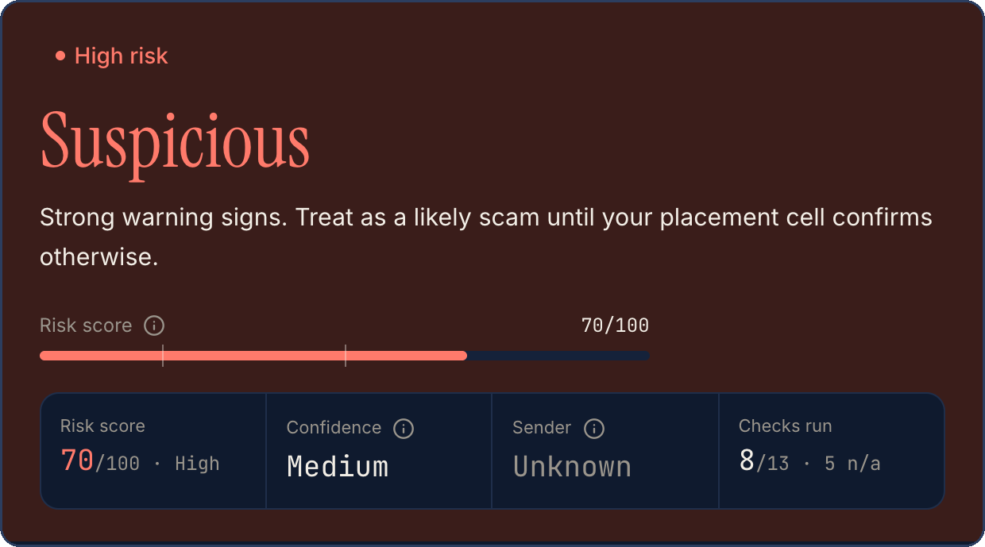
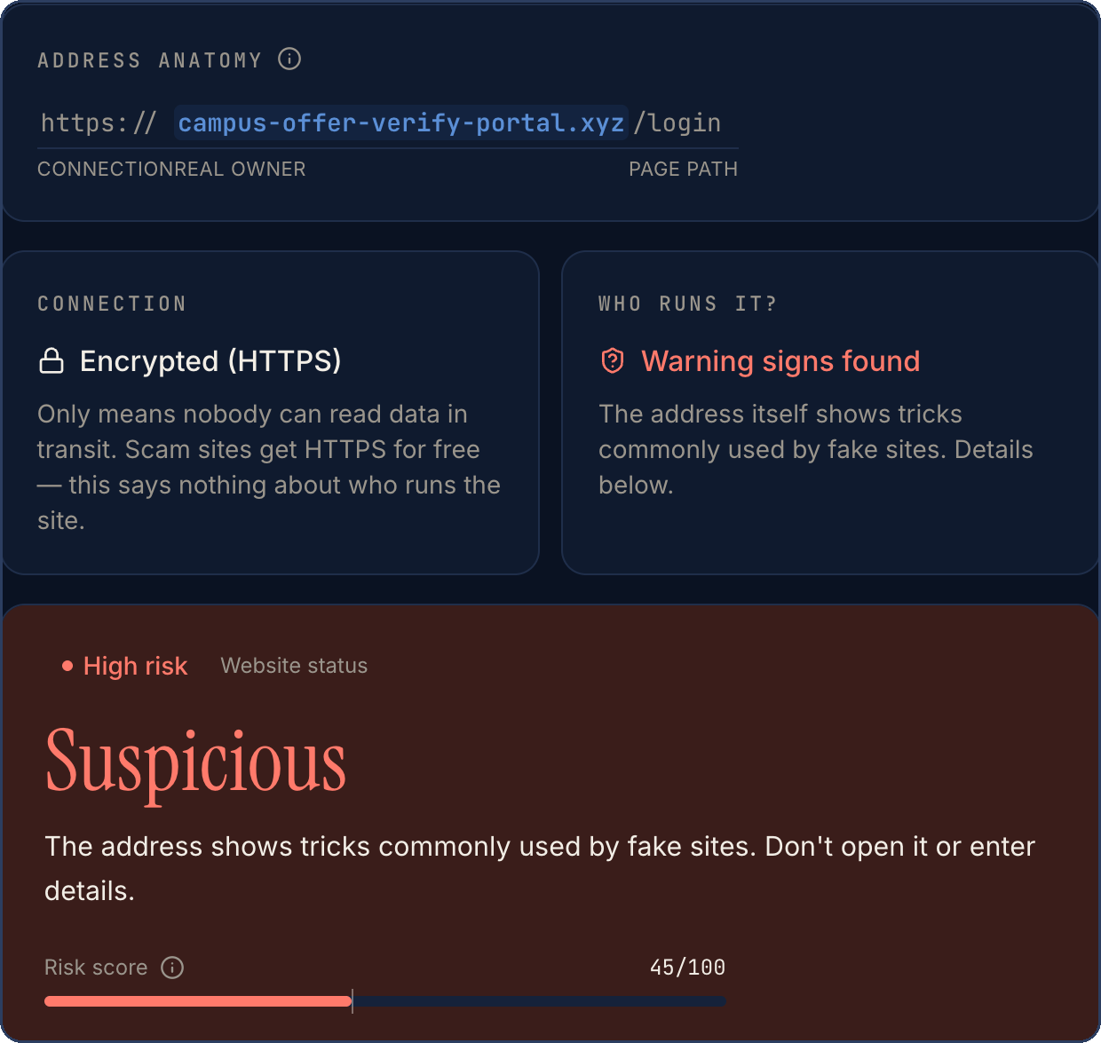
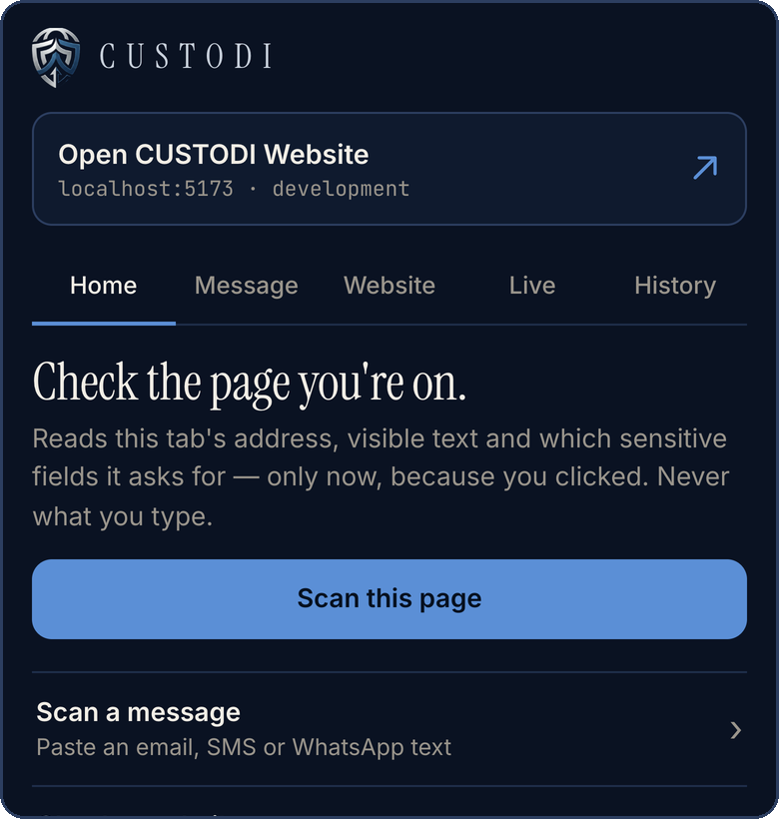
CUSTODI: check first, then decide
02 — OUR SOLUTION
Message received
CUSTODI analysis
Explainable assessment
Recommended action
email · SMS · WhatsApp · a link
on the device, in seconds
risk, quoted evidence, every point
verify via the placement cell
01 MESSAGE SCANNER
02 WEBSITE CHECKER
03 CHROME EXTENSION
Paste email, SMS or WhatsApp text. Get a risk score, the exact words behind it, and what to do next.
Reads an address without opening it. Flags structural tricks; unknown reputation is shown as “unavailable”.
Scans the page you're on only when you click. Message and website checks in the popup.
CUSTODI helps students decide. It never guarantees a message is safe — or proves it is a scam.
Notes:
CUSTODI is a defensive verification tool with three ways in. The message scanner takes any pasted text and returns a risk score, the exact words behind it and a next step. The website checker reads an address without ever opening it, flags structural tricks, and says honestly when reputation is unknown. The Chrome extension scans the page you're on only when you click. The journey is always the same: a message arrives, CUSTODI analyses it, explains its assessment, and recommends one safe action. It informs a decision — it never guarantees safety.

Slide 4
One deterministic engine, shared by every surface
03 — HOW CUSTODI WORKS · TECHNICAL APPROACH
01
02
03
04
05
06
07
Input
Parse
Indicators
Context & negation
Scoring
Classification
Report
Message, channel, optional sender + 3 answers (≤ 10,000 chars)
Split text, extract links and sender domain; normalise addresses
13 checks · rules in English and common Hinglish
“never share”, “no fee”, quoted warnings, official portals → notes
Weighted categories, each counted once, capped at 100
Low · Caution · Suspicious; critical override; confidence
Quoted evidence, every point, next steps — saved locally
ARCHITECTURE · IMPLEMENTED TODAY
WHY THIS IS PRACTICAL
Website + installable PWA
Chrome extension
No mandatory AI API
Nothing to pay for per scan, nothing to leak.
React 19 · Vite 7 · TypeScript · Tailwind
Manifest V3 · popup + service worker
Predictable
Same input, same result — so it can be tested.
@custodi/core shared TypeScript analyzer — the pipeline above
Low infrastructure
Static hosting; analysis runs in the browser.
One shared engine
Local storage · browser storage / chrome.storage.local · results only, full text opt-in
Website, app and extension can't disagree.
Notes:
Here is how it is actually built. Every check runs through a seven-stage pipeline: input, parsing, thirteen indicator checks written for English and common Hinglish, then context and negation handling, scoring, classification and an explainable report. The website and the Chrome extension both import the same TypeScript package, custodi-core, so they always agree. Results are kept in local browser storage. There is no server and no AI API — so it costs nothing per scan, nothing leaves the device, and the same input always gives the same, testable result.

Slide 5
Context changes the verdict — not just keywords
04 — THE INTELLIGENCE · SCORING & CONTEXT
POINTS PER WARNING · EACH COUNTED ONCE
WHATSAPP · BEFORE ANY OFFER
EMAIL · AFTER ACCEPTING · GMAIL
AFTER ACCEPTING · OFFICIAL PORTAL
OTP / PIN / password
+35
“…send your bank account number and IFSC code on WhatsApp to this number today…”
“Now that you have accepted our offer, please email us your bank account number and IFSC…”
“…add your bank account number and IFSC on the official onboarding portal… Do not email these details.”
Payment or fee
+30
App / remote access
+30
Bank-detail request
+20
Off the record
+20
70 /100
40 /100
0 /100
Impersonation
+20
Urgency
+10
High · Suspicious
Medium · Caution
Low
+20 bank-detail request
+20 informal channel
+30 by message, no accepted offer
+20 bank-detail request
+20 personal email for hiring
no +30: offer already accepted
Request becomes a 0-point note:
official portal, not asked back
by message
0–19 Low · 20–49 Caution · 50+ Suspicious
Critical override → High: OTP/PIN/password, remote access, .apk/.exe
DEMO MESSAGE
TEST LAB R10
TEST LAB M42
HOW CONTEXT & NEGATION WORK · REAL TEST CASES
Negation
Not a fee
Quoted warning
Official channel
“Never share your OTP” is advice, not a request → 0 (M14)
Stipends and salaries aren't fees; “no fee” stays calm (M15)
Scam text quoted in a placement-cell alert → note (R07)
Bank details for an official portal, not by message → note (M42)
LIMIT: CUSTODI READS THE WORDING — IT CANNOT CONFIRM THAT A PORTAL OR WEBSITE IS GENUINELY OFFICIAL.
Notes:
This is what makes CUSTODI technically different. Every kind of warning has a fixed weight and counts once, so repeating a phrase can't inflate the score. But the real intelligence is context. All three messages ask for the same bank details. On WhatsApp before any offer: 70, High. By email after accepting, but from a Gmail address: 40, Caution. Directed to the official onboarding portal after accepting: zero, Low — that's normal payroll onboarding. Negation matters too: 'never share your OTP' is advice, not a request; a stipend isn't a fee; scam text quoted inside a placement-cell warning becomes a note. One honest limit: CUSTODI reads the wording — it can't confirm that a portal is genuinely official.

Slide 6
Built, tested and runnable today
05 — FEASIBILITY
Technical
Operational
Privacy
React, Vite and TypeScript — mature, open tooling
One shared analyzer for website and extension
Chrome Manifest V3 extension
Deterministic local analysis — no model to host
No cloud infrastructure required
No paid API, no per-scan cost
Static hosting — deployment config included
Plain-language results; no security training needed
Scans only when the student acts
Never reads WhatsApp, SMS or email inboxes
Analysed on the device; nothing uploaded
Stored locally: results + short quotes; full text opt-in
VALIDATION EVIDENCE · VERIFIED IN THE CURRENT REPOSITORY
120/120
83/83
110
Chrome
automated unit tests pass (Vitest)
Test Lab cases behave as designed · 49 TP · 34 TN · 0 FP · 0 FN
production page loads — 11 routes × 5 widths × 2 themes: 0 overflow, 0 console errors
extension loaded and driven for real: scans, links, history — 0 errors
THE TEST LAB CASES ARE FICTIONAL AND WRITTEN BY US — THEY ARE NOT A REAL-WORLD ACCURACY CLAIM.
Notes:
Is it feasible? Technically, it's built on mature open tooling — React, Vite, TypeScript and Chrome's Manifest V3 — with one shared engine. Operationally, it needs no cloud and no paid API, and the results are in plain language. On privacy, it only scans when the student acts, never reads inboxes, and keeps results on the device. And it's validated: 120 of 120 unit tests pass, all 83 Test Lab cases behave as designed, the production build was checked across 110 page loads with no errors, and the extension was loaded and driven in real Chrome. One honest caveat: these are our own fictional cases — not a real-world accuracy figure.

Slide 7
Free for students. Funded by institutions.
06 — VIABILITY · BUSINESS MODEL
ILLUSTRATIVE MODEL · NOTHING HERE IS VALIDATED YET
Colleges & universities
Students & job seekers
pay an institutional subscription
free core checks, private by default
CUSTODI
Preventing even one student from losing money or identity documents can justify a college's subscription.
B2C · STUDENTS
B2B · COLLEGES
B2B · RECRUITERS
Who Students and first-time job seekers
Gets Free message and website checks; extension
Pays Free core; optional premium features later
Who Placement cells and universities
Gets Institution tools*, awareness campaigns, consented anonymised trends*
Pays Institutional subscription
Who Recruitment firms and placement partners
Gets Verification workflows*, applicant awareness tools*
Pays Enterprise licence · custom integrations
* Not built yet. No paying customers, partnerships, pricing or willingness to pay have been validated.
Notes:
Can CUSTODI survive beyond the hackathon? This is an illustrative model, and we say so clearly — nothing here is validated yet. Students get the core checks free and private. The payer is the institution: colleges and universities, through an annual subscription, in return for placement-cell tools, awareness campaigns and, only with consent, anonymised trends. Recruitment firms and placement partners are a second B2B segment, through enterprise licences and integrations. The argument is simple: preventing even one student from losing money or identity documents can justify a college's subscription. The starred features aren't built yet, and we have no customers or pricing to show — that's what a pilot is for.

Slide 8
Grows along four dimensions — from a working base
07 — SCALABILITY & ROADMAP
WORKING TODAY
PLANNED NEXT
LONG-TERM POSSIBILITIES
Product
13-check message engine, website checker, extension, installable app · English + Hinglish
More rules and contexts, more message formats, better website analysis
More Indian languages; other browsers where feasible
Technical
Shared core, modular checks, fully local, static hosting
Optional, opt-in backend for institutional deployments
Scalable storage and analytics for consented, aggregate trends
Adoption
Public GitHub repo, installable app, unpacked extension
Placement-cell pilot · Chrome Web Store release
University partnerships and recruitment ecosystems
Geographic
Indian student recruitment scams
Wider job-seeker protection in India
Other languages and regions
Only the highlighted column exists today. Everything else is a plan, not a feature.
Notes:
CUSTODI can grow in four directions, and we separate what works today from what's planned. The highlighted column exists now: the 13-check engine, website checker, extension and installable app, with a shared core that runs fully locally. Next: more rules and formats, an optional opt-in backend for institutions, a placement-cell pilot and a Chrome Web Store release. Longer term: more languages, university and recruiter partnerships, and other regions. We start where the problem is sharpest — Indian students facing recruitment scams — and widen from there.

Slide 9
A fair comparison: what each approach is built for
08 — WHY CUSTODI? · COMPETITIVE DIFFERENTIATION
 | Spam filters | Antivirus / browser security | URL reputation checkers | Placement cell (manual) | CUSTODI
Built for recruitment scams | Not the focus | Not the focus | Not the focus | Yes | Yes
Reads what a message asks you to do | Partly | Not the focus | Not the focus | Yes | Yes
Checks web addresses | Often | Yes | Yes | Manually | Structure only
Known-bad reputation data | Yes | Yes | Yes | Partly | No
Explains each point | Rarely | Rarely | Partly | Yes | Yes
Context-aware bank / payroll reading | Not the focus | Not the focus | Not the focus | Yes | Yes
Instant, at any hour | Yes | Yes | Yes | No | Yes
Local-first — nothing uploaded | Varies | Varies | No | n/a | Yes
BASED ON EACH CATEGORY'S TYPICAL PURPOSE — INDIVIDUAL PRODUCTS VARY. CUSTODI COMPLEMENTS THESE TOOLS; IT DOESN'T REPLACE THEM.
Other tools ask “is this sender or link known to be bad?”
CUSTODI asks “what is this message asking me to do — and does that make sense here?”
Notes:
Why should CUSTODI exist when other tools do? We tried to be fair. Spam filters, antivirus and URL reputation checkers are good at one thing CUSTODI deliberately doesn't do: knowing which senders and links are already known to be bad. A placement cell can verify anything — but not instantly, at midnight. CUSTODI's distinctive combination is a recruitment-scam focus, context-aware reading rather than keyword matching, explanations for every point, message and website checks in one experience, one shared engine across web and extension, and a local-first design. Other tools ask whether a sender is known to be bad. CUSTODI asks what the message is asking you to do — and whether that makes sense here.

Slide 10
09 — IMPACT, EXECUTION & NEXT STEPS
From prototype to every placement cell
Now
Working prototype: website, installable app, extension and Test Lab — open on GitHub.
Next
Deploy the website, point the extension at it, submit to the Chrome Web Store.
C U S T O D I
Pilot
One placement cell: introduce CUSTODI at placement orientation and pin the link in official groups.
Think before you trust.
Verify before you act.
Measure
False alarms on genuine messages, scams reported to the cell, time taken to verify.
Because the cost of trusting the wrong message can be much greater than the time it takes to verify it.
Scale
Recruiter lists verified by placement cells; more colleges and languages.
Intended impact: fewer students acting on fake offers before they verify — measured in the pilot, not assumed.
github.com/govindanidarsh/Custodi
Open source · runs on your device · every example is fictional
TEAM CUSTODI · ANTRIKSH · DARSH · KUSHAGRI
Notes:
Here's how this becomes real. Today, it's a working prototype, open on GitHub. Next, we deploy the website, point the extension at it and submit it to the Chrome Web Store. Then a pilot with one placement cell — introduced at placement orientation and pinned in the official groups — where we measure false alarms on genuine messages, scams reported, and how long verification takes. Then we scale through recruiter lists verified by placement cells. Our goal is fewer students acting on fake offers before they verify — and we'll measure it, not assume it. CUSTODI. Think before you trust. Verify before you act. Because the cost of trusting the wrong message can be much greater than the time it takes to verify it. Thank you.

