Slide 1
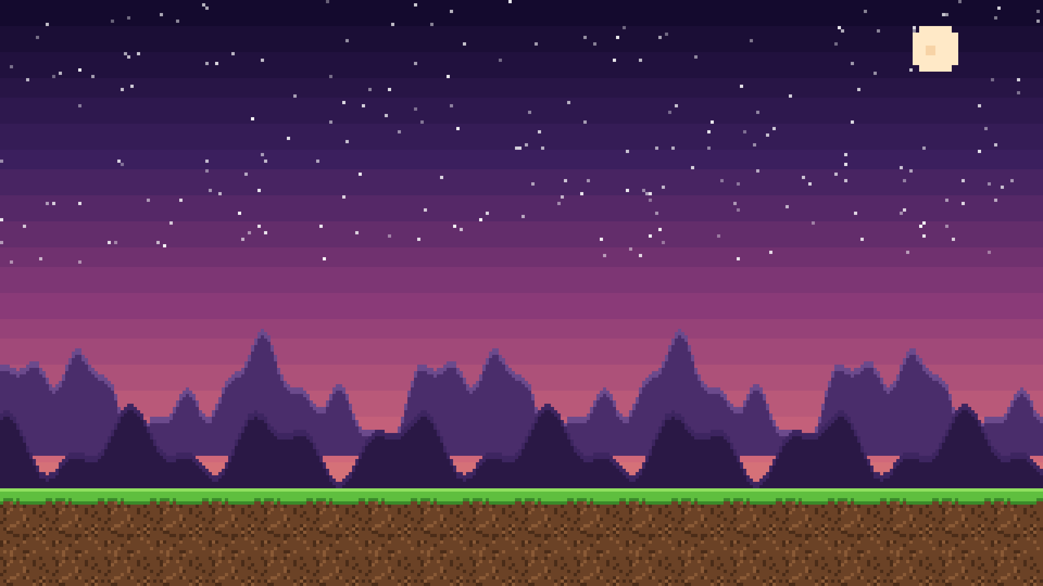




Slash. Loot. Forge. Repeat.
A pixel action RPG for iOS & Android · by High Devs
Notes:
Pixel Adventure: a 2D pixel action RPG for phones. Metal Slug-style fights with Diablo-style loot. The knight and kobold here are the actual sprites already running in the Unity build.

Slide 2

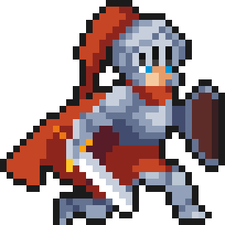



THE GAME
Fights like Metal Slug, Loot like Diablo
Run, jump and slash through waves of monsters on your phone. Then chase the perfect drop, forge it, and gem it up.
Fight
Loot
Build
Side-scrolling combat with combos, dodge rolls and screen-shaking ults.
5 rarities, 10 gear slots, and drops that glow when they matter.
Skill trees, gems and crafting: shape your hero your way.
Notes:
Three pillars: fight, loot, build. Short, punchy stage fights feed a deep loot and build system. Landscape, touch controls, offline first.

Slide 3





HOW IT PLAYS
Built for thumbs.
Joystick
Move left and right. Flick up to jump.
Attack
A 3-hit combo. Every hit lands with a punch.
Roll
SKILL
ULT
Dodge through danger with a moment of invincibility.
ATK
Skill + Ult
ROLL
Each hero’s signature moves, on cooldown.
Notes:
Landscape, one thumb on the joystick, one on four buttons. Already playable in the Unity build with the Knight: move, jump, roll, combo, Shield Bash and Holy Slam.

Slide 4
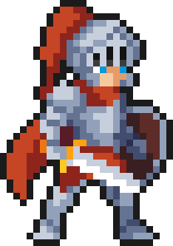





HEROES
Six heroes. Six ways to fight.
Knight
Priest
Gunslinger
Tank, DPS, or both
Damage + healing
Ranged crit shots
Sword + Shield
Staff + Tome
Guns + Bullets
ULT Holy Slam
FREE
ULT Judgment Beam
FREE
ULT Dead Eye
FREE
Slayer
Sorcerer
Monk
Rage + life leech
Huge elemental crits
Lightning-fast combos
Axe + Axe
Wand + Orb
Fists + Beads
ULT Red Frenzy
PREMIUM
ULT Starfall
PREMIUM
ULT Hundred Fists
COMING
Notes:
Start free with Knight, Priest or Gunslinger. Slayer and Sorcerer are premium unlocks. Monk arrives later. Every hero levels to 50 with its own skill tree, passives, skill and ult.

Slide 5
LOOT
Every drop could be the one.
Rarity sets the color and how many gem slots an item gets.
Oathkeeper
Oathkeeper
Exotic
Oathkeeper
Legendary
2 Enchant
2 Engrave
1 Inscribe
Oathkeeper
Epic
2 Enchant
2 Engrave
Oathkeeper
Rare
2 Enchant
1 Engrave
Normal
2 Enchant
No slots
Notes:
Five rarities: Normal (ash), Rare (blue), Epic (purple), Legendary (orange), Exotic (red). The item name stays the same; the rarity changes its color and its gem slots. Players read the value of a drop instantly.

Slide 6






GEMS
Gems that change everything.
Chipped
Cut
Polished
Brilliant
Flawless
Lv 1–10
Lv 11–20
Lv 21–30
Lv 31–40
Lv 41–50
One Chipped Ruby, three outcomes
Enchant
Raw stats: ATK, crit, elements
Engrave
In a weapon
In armor
In an accessory
Powers up your skill
+5 Fire damage
+5% Fire resist
Attack speed or Move speed
Inscribe
Sigils power up your ult
Notes:
Gems come in five grades tied to level brackets. The same gem does different things depending on where you socket it, and accessories roll between options. Three systems: Enchant for stats, Engrave for the skill, Inscribe with sigils for the ult. Gems can be removed and re-rolled.

Slide 7


THE LOOP
One more run. Always.
Fight
The crafting gamble
Enchant
Loot
Drop in Wood, hit Craft, and out comes a weapon for any hero: sword, axe, staff, wand, gun or fists.
stronger
hero
Wrong one? Salvage it for gold and materials, and roll again.
Lv 1 → 50 Crafting and Salvage level up too. Higher level, better odds.
Craft
Salvage
Notes:
The core loop: fight, loot, salvage, craft, enchant, repeat. Crafting outputs are random across classes, which keeps players rolling. Crafting and salvage have their own levels up to 50, so daily play pays off.

Slide 8



THE WORLD
A world built for farming.
90
Stage 1
1-1
1-2
1-3
1-4
1-5
nodes at launch
1-6
1-7
1-8
1-9
3 difficulties × 3 stages × 10 nodes
1-10 BOSS
Every node ends with a mini-boss.
Normal
Hard
Nightmare
=
Farm 5 key fragments to face the stage boss.
Hell
Torment
coming later
Notes:
Three difficulties, three stages each, ten nodes per stage. Nodes 1 to 9 end with a mini-boss. Node 10 is the stage boss, locked behind a key built from fragments that drop in that stage. Players farm at their own pace.

Slide 9






BIG MOMENTS
Boss fights are events.
GROK THE OGRE
Butcher of the Pass
Boss Intro
Ground shakes
Camera pans
Roar + flash
Flight!
Complete Cinema
3 to 5 seconds of theater before every stage boss. Skippable after the first time.
Notes:
Boss intros turn a fight into an event: arena locks, ground shakes, camera pans to the boss, roar and flash, the name card slides in, HP bar fills, music drops. Phase changes and boss deaths get their own moments: slow motion, flash, loot rain.

Slide 10
Play free. Farm at your pace.
3
50
5
free heroes
levels per hero
loot rarities
Now: Knight playable in Unity · Next: enemies, waves, first boss
Notes:
Free to start with three heroes, deep enough to play for months. Today the Knight is playable in Unity; next up are enemies, waves and the first boss.

