Slide 1
PSCS_7: Developing a Blockchain-Based eVault for Legal Records
VIVA-VOCE
Batch Number: CBC-03
Under the Supervision of,
Mr. Ramamurthy Ketha
Assistant Professor
School of Computer Science and Engineering
Presidency University
Roll Number | Student Name
20211CBC0006 20211CBC0029 20211CBC0048 20221LBC0003 | GOVIND CHAUDHARY YASH SINGH AMITH GOWDA M SHOAIB ABDULLA KHAJI
Name of the Program: Bachelor of Technology
Name of the HoD: Dr. S. Pravinth Raja
Name of the Program Project Coordinator: Mr. Ramamurthy Ketha
Name of the School Project Coordinators: Mr. Md Ziaur Rahman and Dr. Sampath A K

Slide 2
Introduction
Legal records are crucial documents that require high security, transparency, and accessibility.
Traditional legal record management systems rely on centralized databases, making them vulnerable to tampering, loss, and unauthorized access.
A blockchain-based eVault system ensures immutability, decentralization, and secure document sharing among legal stakeholders.
The system aims to provide efficient document management by integrating with legal databases and case management systems.
Smart contracts will automate access control, permission management, and transaction logging for legal documents.
The proposed system will enhance trust, reduce costs, and streamline legal processes.
The solution is particularly relevant in India, where digitalization of legal records can improve access to justice.
The platform will be scalable and adaptable, supporting future enhancements and compliance regulations.

Slide 3
Literature Review
Blockchain-Based eVault Framework for Legal Records
Ismail et al. (2024) propose a blockchain-based eVault framework ensuring secure and transparent management of legal records, leveraging decentralized storage.
Rajesh et al. (2024) discuss blockchain’s role in eliminating unauthorized access while ensuring verifiability and traceability of legal documents.
Decentralized Legal Record Storage and Management
Abhishek et al. (2024) present a system integrating blockchain and IPFS for decentralized legal record storage, improving data integrity and accessibility.
Yeshwantrao et al. (2024) highlight blockchain’s ability to automate record verification, reducing dependency on intermediaries.
Smart Contracts for Secure Access Control
Kumar et al. (2024) introduce CourtSafe, a legal record storage platform utilizing smart contracts to enforce access permissions.
Vijayaraj et al. (2024) explore the integration of smart contracts with IPFS, ensuring immutability and controlled sharing of legal documents.

Slide 4
Literature Review
Enhanced Security and Privacy with Cryptographic Techniques
Patil et al. (2024) propose a blockchain and lattice-cryptography-based document storage platform, enhancing confidentiality.
Zuo et al. (2021) present a blockchain-based ciphertext-policy attribute-based encryption (CP-ABE) mechanism to protect sensitive legal data.
Privacy-Preserving Mechanisms in Blockchain Systems
Guo et al. (2020) discuss privacy-preserving blockchain mechanisms, using encryption techniques to protect legal records from unauthorized disclosure.
Zheng et al. (2020) provide an overview of smart contract security challenges and advancements, ensuring secure execution in legal record management.
Advantages and Challenges of Blockchain in Legal Applications
Existing studies highlight blockchain’s potential in streamlining legal documentation, reducing fraud, and ensuring data transparency.
Challenges such as scalability, regulatory compliance, and interoperability with legacy systems are discussed across various research works.

Slide 5
Existing method Drawback
Centralized Storage Risks: Traditional legal document management relies on centralized databases that are prone to data breaches and corruption.
Lack of Transparency: Current systems lack transparent tracking of document changes, leading to disputes and inefficiencies.
High Risk of Tampering: Legal documents can be altered or forged, affecting case proceedings and judicial trust.
Inefficient Document Retrieval: Retrieving legal documents is often time-consuming due to manual record-keeping.
Limited Accessibility: Stakeholders like lawyers, judges, and clients face accessibility issues in viewing and managing legal records.
Integration Challenges: Existing systems lack interoperability with modern digital platforms and case management tools.
High Operational Costs: Maintaining secure centralized databases requires significant resources and cost.
Data Loss Possibilities: In cases of server crashes or cyberattacks, legal records can be permanently lost.

Slide 6
Proposed Method
A blockchain-based eVault system will securely store and manage legal documents using Ethereum smart contracts.
Smart contracts will govern access control, ensuring only authorized users can retrieve or modify records.
Decentralized storage (IPFS) will ensure that legal records remain accessible and tamper-proof.
The system will provide a user-friendly web interface using React.js for easy document upload, retrieval, and sharing.
Web3.js or Ethers.js will facilitate seamless interaction between the frontend and blockchain.
Integration with legal databases will ensure interoperability and adoption by existing case management systems.
End-to-end encryption will secure sensitive legal data, ensuring privacy compliance.
Automated version tracking will allow stakeholders to track modifications with timestamps.

Slide 7
Objectives
Develop a secure and transparent eVault system for legal records using blockchain technology.
Eliminate unauthorized alterations to legal records through smart contract-based access control.
Provide a user-friendly interface for legal professionals, clients, and court officials.
Ensure privacy and security using cryptographic techniques for document storage and retrieval.
Enable decentralized storage with IPFS, reducing reliance on centralized legal repositories.
Enhance integration capabilities with existing legal systems for seamless adoption.
Improve data integrity and trust in legal proceedings by maintaining an immutable ledger of records.
Make the system scalable and adaptable to future upgrades and regulatory requirements.

Slide 8
Methodology/Modules
Requirement Analysis: Identifying stakeholder needs, security concerns, and blockchain requirements.
System Architecture Design: Defining smart contract logic, database structures, and frontend-backend interaction.
Smart Contract Development: Writing Solidity-based smart contracts for document authentication and access control.
Frontend & Backend Implementation: Developing a React.js UI with a Python (FastAPI/Flask) backend integrated with Web3.
Decentralized Storage Setup: Using IPFS to store legal records securely.
Integration with Legal Databases: Ensuring interoperability with existing legal and case management systems.
Testing & Security Audits: Performing smart contract audits, penetration testing, and user acceptance testing.
Deployment & User Training: Launching the system on Ethereum Testnet/Mainnet, followed by user training for adoption.

Slide 9
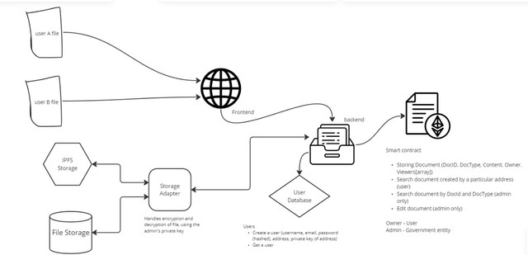
Architecture

Slide 10
Software components
Blockchain Platform: Ethereum (for smart contract execution).
Smart Contract Development: Solidity for writing and deploying smart contracts.
Backend Framework: FastAPI or Flask (Python) for API development.
Frontend Framework: React.js for building user interfaces.
Web3 Libraries: Web3.js or Ethers.js for blockchain interaction.
Database: PostgreSQL or MongoDB for metadata storage.
Storage System: IPFS (InterPlanetary File System) for decentralized document storage.
Authentication & Security: JWT (JSON Web Tokens) for authentication and encryption mechanisms.
Version Control: Git & GitHub for collaborative development and source code management.

Slide 11
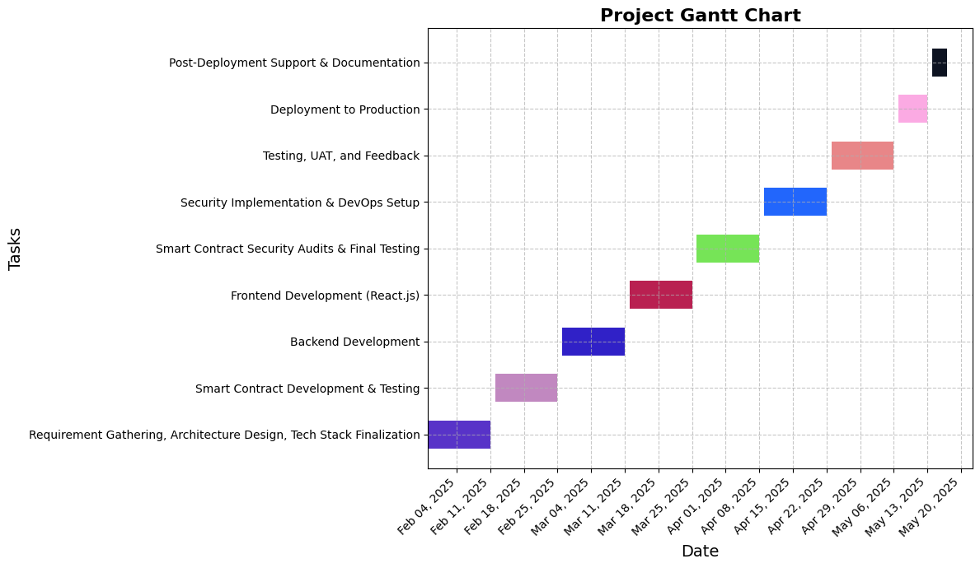
Timeline of Project

Slide 12
Expected Outcomes
A fully functional blockchain-based eVault prototype with key features like document upload, retrieval, and sharing.
Smart contracts that ensure automated access control and document authentication.
A user-friendly React.js frontend that allows lawyers, judges, and clients to interact with legal records easily.
A detailed design document outlining system architecture, smart contract logic, and integration mechanisms.
A business plan highlighting market potential, revenue models, and legal industry impact.
Improved transparency and trust in the legal system by eliminating document tampering.
Enhanced accessibility of legal documents, reducing delays in case proceedings.
A secure and scalable solution ready for real-world implementation and expansion.

Slide 13
Conclusion
The blockchain-based eVault system will revolutionize legal record-keeping, ensuring security, transparency, and accessibility.
By leveraging Ethereum and smart contracts, the system will provide immutable record storage and access control.
The integration of IPFS for decentralized storage ensures that legal documents remain tamper-proof and accessible.
Smart contract-based permissions will prevent unauthorized access, enhancing security and privacy.
The React.js and FastAPI-based UI will offer an intuitive interface for all stakeholders.
The system’s interoperability with existing legal databases ensures seamless adoption and efficiency improvements.
It has the potential to reduce legal processing times and costs, making legal services more accessible and efficient.
Overall, the eVault system represents a significant advancement in legal technology, driving digital transformation in the justice sector.

Slide 14
Github Link
E-vault

Slide 15
References
Ismail, F. S. M., Baheti, J., Kurani, S., Sharma, O., Goyal, S., & Thakur, Y. (2024, November). Blockchain-based eVault for legal records: A framework for review. AIP Conference Proceedings, 3214(1). AIP Publishing. https://doi.org/10.1063/5.0239090
Rajesh, M. V., Navya, V., Konjarla, R., & Birada, M. (2024, June). Blockchain-based e-vault for Legal Records. In 2024 3rd International Conference on Applied Artificial Intelligence and Computing (ICAAIC) (pp. 1389-1392). IEEE. https://ieeexplore.ieee.org/document/10574924
Abhishek, S., Anas, S., Anuragav, R., & Sachin, K. (2024). eVault for Legal Records. https://doi.org/10.48550/arXiv.2403.01186
Yeshwantrao, S. A., Satpute, K. C., Patil, T. H., & Shinde, S. B. (2024). eVault in blockchain to store and manage legal records. International Journal of Pure and Applied Research in Engineering and Management Studies, 4. https://www.ijprems.com/uploadedfiles/paper/issue_4_april_2024/33256/final/fin_ijprems1713160202.pdf
Kumar, R., Agarwal, H., Tayal, A., & Nagaraja, H. (2024, August). Courtsafe: Legal records storage & management using blockchain. In Proceedings of the 2024 Sixteenth International Conference on Contemporary Computing (pp. 726-734). ACM. https://dl.acm.org/doi/abs/10.1145/3675888.3676140

Slide 16
References (IEEE Paper format)
Vijayaraj, A., Prahalathan, P., Reddy, V. G., Dinesh, S., & DV, A. R. (2024, April). Legal documentation system using blockchain and interplanetary file system. In 2024 International Conference on Computing and Data Science (ICCDS) (pp. 1-6). IEEE. https://doi.org/10.1109/ICCDS60734.2024.10560457
Patil, M., Shah, R., Shinde, S., Pareek, J., Chauhan, D., & Shekokar, N. (2024, July). Doc Vault: A blockchain and lattice-cryptography based secure document storage platform. In 2024 International Conference on Emerging Trends in Networks and Computer Communications (ETNCC) (pp. 1-7). IEEE. https://doi.org/10.1109/ETNCC63262.2024.10767517
Zuo, Y., Kang, Z., Xu, J., & Chen, Z. (2021). BCAS: A blockchain-based ciphertext-policy attribute-based encryption scheme for cloud data security sharing. International Journal of Distributed Sensor Networks, 17(3), 1550147721999616. https://doi.org/10.1177/1550147721999616
Guo, L., Xie, H., & Li, Y. (2020). Data encryption based blockchain and privacy preserving mechanisms towards big data. Journal of Visual Communication and Image Representation, 70, 102741. https://doi.org/10.1016/j.jvcir.2019.102741
Zheng, Z., Xie, S., Dai, H. N., Chen, W., Chen, X., Weng, J., & Imran, M. (2020). An overview on smart contracts: Challenges, advances and platforms. Future Generation Computer Systems, 105, 475-491. https://doi.org/10.1016/j.future.2019.12.019

Slide 17
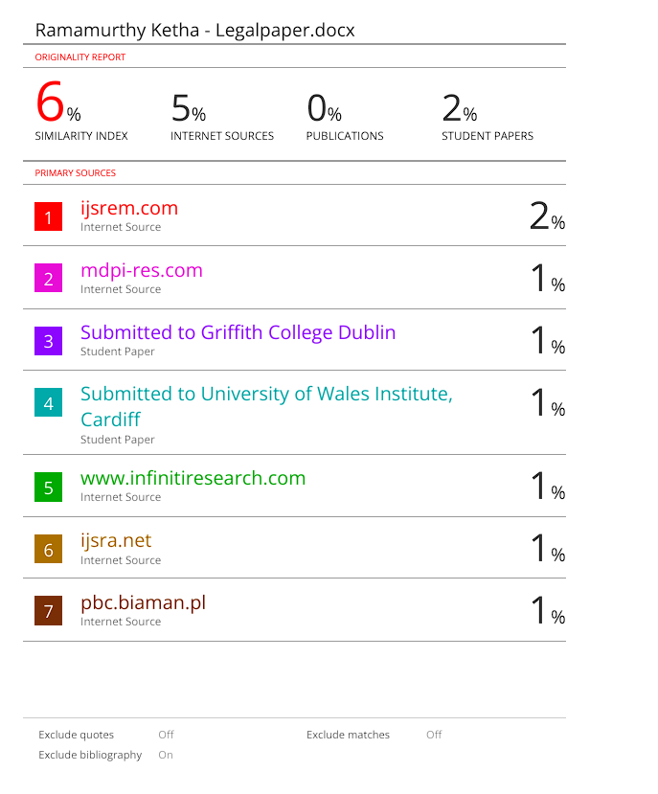
Plagiarism Report

Slide 18

Project work mapping with SDG
The project is mapped to :
SDG 16 (Peace, Justice, and Strong Institutions): Ensures secure, transparent, and tamper-proof legal records to enhance trust in the judicial system.
SDG 9 (Industry, Innovation, and Infrastructure): Leverages blockchain technology to improve digital infrastructure for legal record management.
SDG 10 (Reduced Inequalities): Provides equitable access to legal records, reducing barriers to justice for marginalized communities.
SDG 17 (Partnerships for the Goals): Encourages collaboration between legal institutions, technology providers, and governments for digital transformation.

Slide 19
Thank You

