Slide 1

Agricultural Yield Prediction and Optimization
Predicting Crop Yield Using Machine Learning
Presented by: Govindev Eyyani Pradeesh

Slide 2
Project Objective
- Predict crop yield based on farm input parameters
- Develop a user-friendly app using Streamlit
- Support farmers with data-driven decision-making

Slide 3
Dataset Overview
- Source: Local agricultural dataset
- Total Features: 8, Target Variable: Yield (tons)
- Key Features:
• Crop Type (Categorical)
• Irrigation Type (Categorical)
• Soil Type (Categorical)
• Season (Categorical)
• Farm Area (acres), Fertilizer Used (tons)
• Pesticide Used (kg), Water Usage (cubic meters)

Slide 4

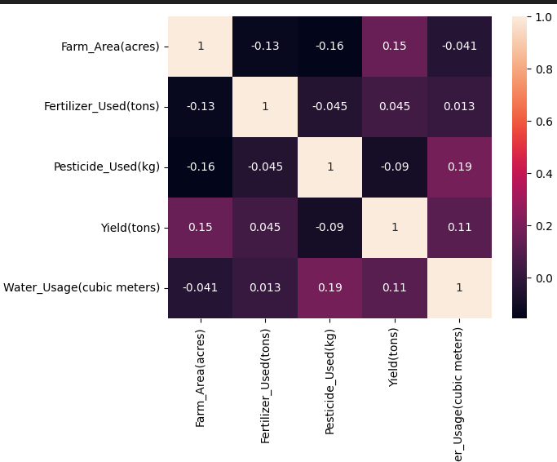
Exploratory Data Analysis
- Applied label encoding and scaling
- Train-test split used: 80-20
- Observed feature correlations (below):

Slide 5
Model Selection & Evaluation
Tested Models:
- Linear Regression: MAE = 10.63, RMSE = 12.63
- Random Forest: MAE = 10.91, RMSE = 13.43
- Gradient Boosting: MAE = 14.27, RMSE = 16.45
✔ Selected: Linear Regression (Best performance on test data)

Slide 6
Model Optimization
- Hyperparameter tuning with RandomizedSearchCV
- Final model saved using pickle
- Encoders and scaler saved for deployment

Slide 7
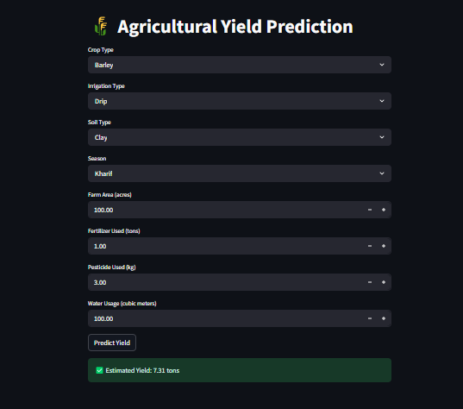
Deployment with Streamlit
- Simple interface with dropdowns & sliders
- User enters farm inputs to predict yield
- Output: Estimated yield in tons

Slide 8
Results & Insights
- Better planning of irrigation and fertilizers
- Crop selection made easier
- Yield prediction improves farm productivity

Slide 9
Challenges & Learnings
- Weak correlations made prediction harder
- Categorical encoding had major influence
- Learned ML pipelines, deployment, and feature engineering

Slide 10
Future Enhancements
- Integrate weather and soil sensor data
- Experiment with deep learning techniques
- Develop multi-crop advisory system

Slide 11
Thank You!
Connect on LinkedIn:www.linkedin.com/in/govindev-eyyani-pradeesh-675b0426a
GitHub:https://github.com/govindeveyyani

