Slide 1

Medical Store Management System
ST ALOYSIUS INSTITUTE OF MANAGEMENT AND INFORMATION TECHNOLOGY (AIMIT)
ST ALOYSIUS COLLEGE (DEEMED TO BE UNIVERSITY)
Under the Guidance of Mr. Rakesh Kumar
St. Aloysius institute of Management and IT
Govind Kulkarni
2317081
II MCA ‘B’

Slide 2
Content
Introduction
Objectives
Scope of the Project
Technologies and Tools Used
Hardware requirements and Software requirement
Design Documents
Conclusion

Slide 3
Introduction
The Medicine Store Management System is a web-based application that helps manage a medical store's inventory, sales, customer details, and orders. The system is built with React for the frontend and Django for the backend. It allows the store to keep track of medicine stock, process customer orders, and handle sales more easily and accurately. Store managers can quickly update products, track sales, and provide better service to customers with this simple and efficient system

Slide 4
Objectives
1) Provide a Seamless Online Medicine Shopping Experience – Enable users to browse and purchase medicines easily.
2) User-Friendly Interface – Ensure a smooth and intuitive UI for both users and admins.
3) Efficient Medicine Management – Allow the admin to add, update, and manage medicines.
4)Secure User Authentication – Implement a secure login and registration system.
5) Cart & Order Management – Enable users to add products to the cart and place orders.
6) Admin Control Panel – Provide an admin dashboard for managing orders and users.
7) Order Processing & Management – Allow users to place orders, and admins to manage order status.
8) Integrated Payment System – Provide a secure payment method for users to complete their purchases.
9) Ensure Data Security & Privacy – Protect user and transaction data with authentication and encryption.

Slide 5
Scope of the Project
The Medical Store Management System streamlines the process of purchasing and managing medical products. It aims to save time and reduce costs for both customers and store administrators. Operating 24/7, the system allows users to purchase medicines and related products at any time and from anywhere. The proposed system serves two primary user roles: Admin: The admin, typically the owner or manager of the medical store, oversees the online platform. They are responsible for managing products, tracking payments, and monitoring overall system operations. Customers: Customers are regular users who can browse, search, and purchase various categories of medical products through the platform

Slide 6
Technologies and Tools Used
Hardware requirements and Software requirement
Front-End:
React.js
HTML
CSS
Back-End
Django
SQLite
Development Tools
Visual Studio Code
Hardware requirements
Processor: Intel dual core or above
Processor speed: Minimum 2 GHz
Hard disk: Minimum 40GB
RAM: 4GB or above
Software requirements
Operating system: Windows 7 or above
Web Browsers: Google Chrome/ Mozilla Firefox/ Internet explorer

Slide 7
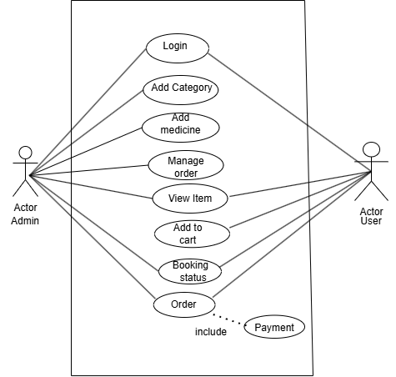
Use case Diagram

Slide 8
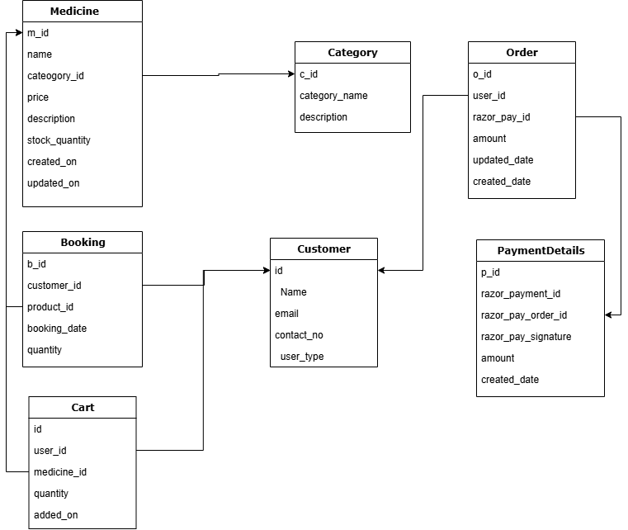
Class Diagram

Slide 9
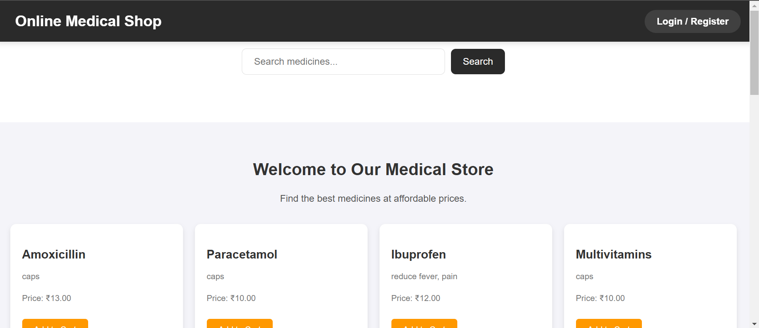
Home page

Slide 10
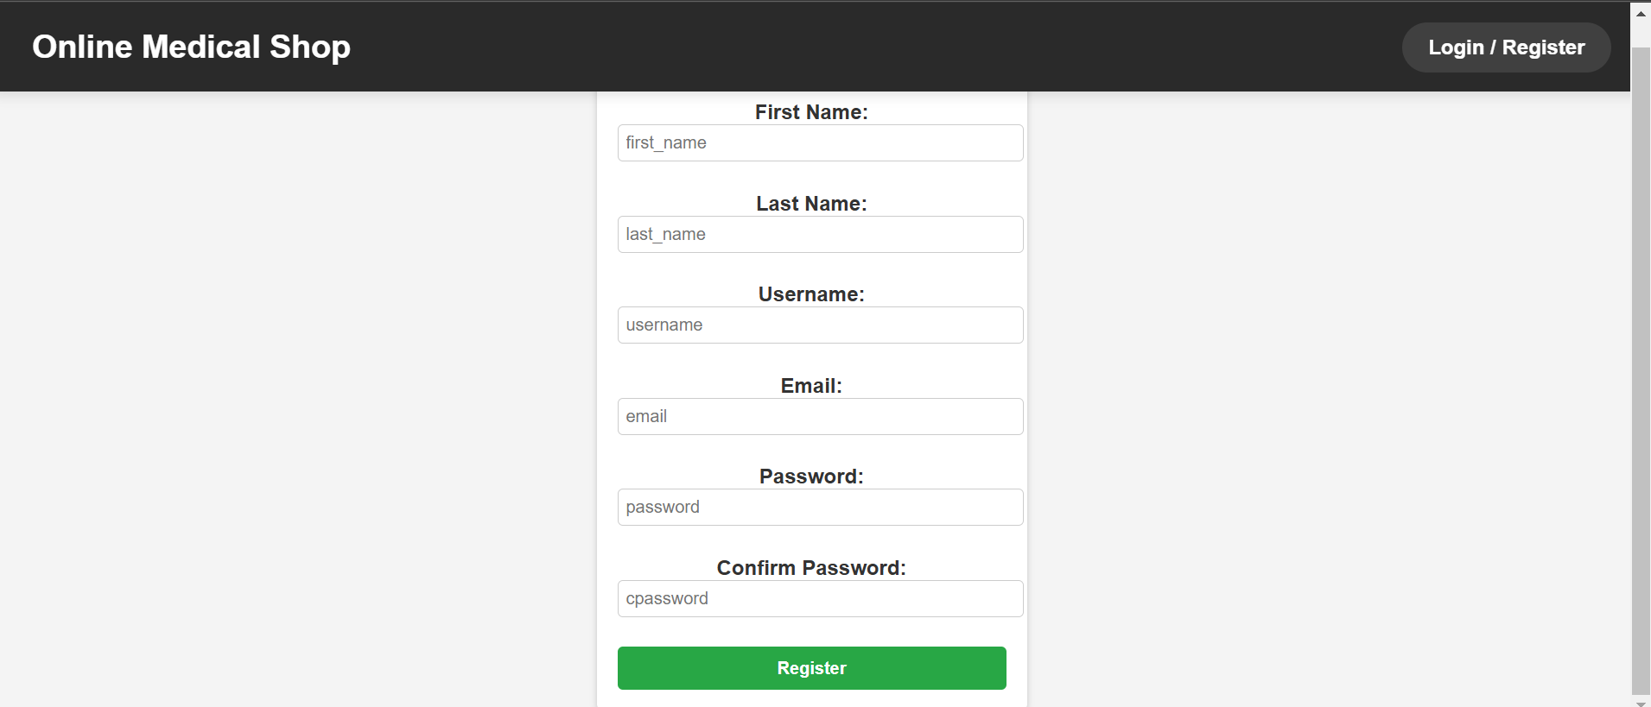
Registration Page

Slide 11
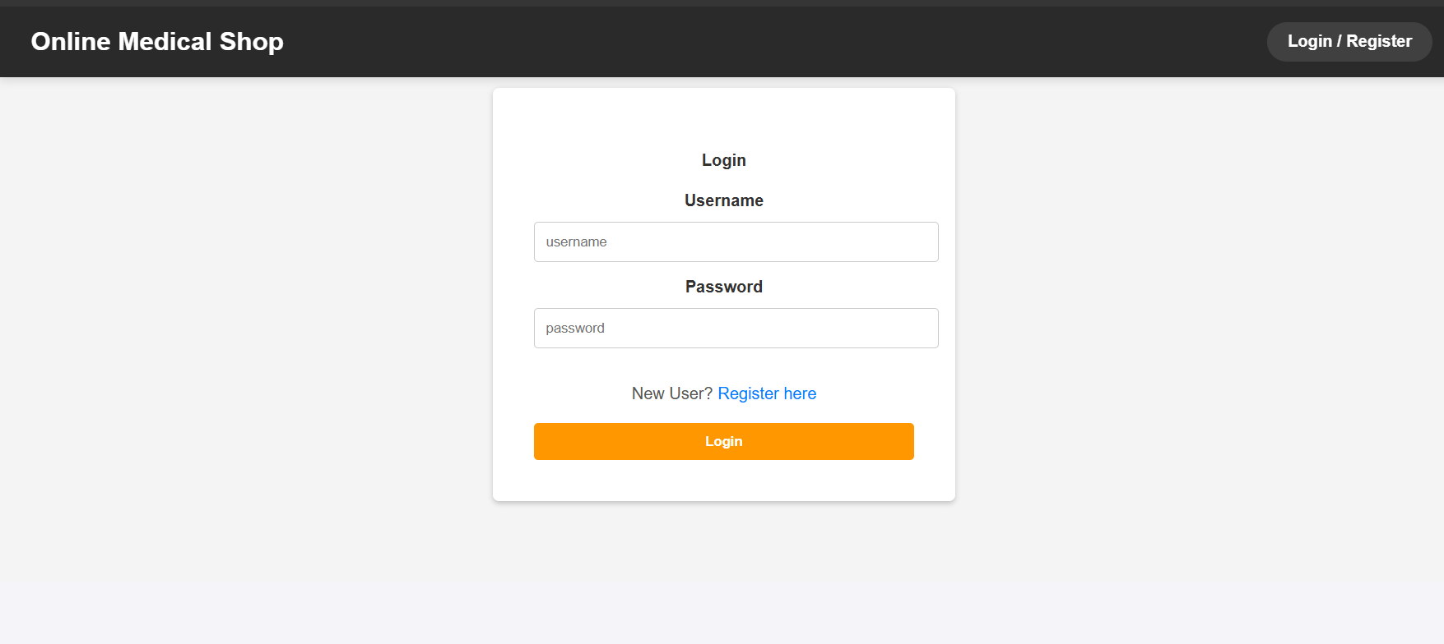
Login page

Slide 12
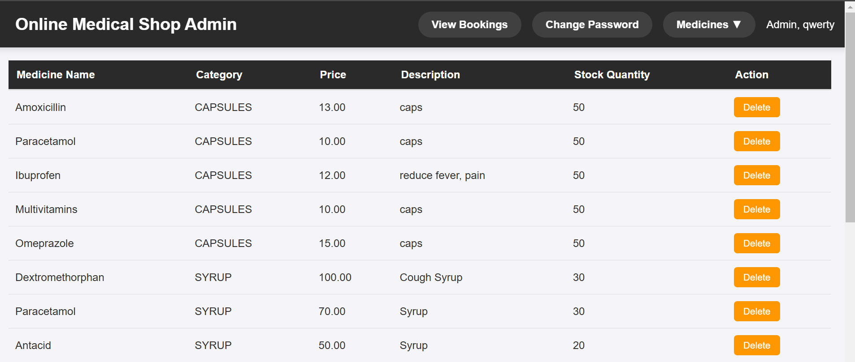
Medicine list

Slide 13
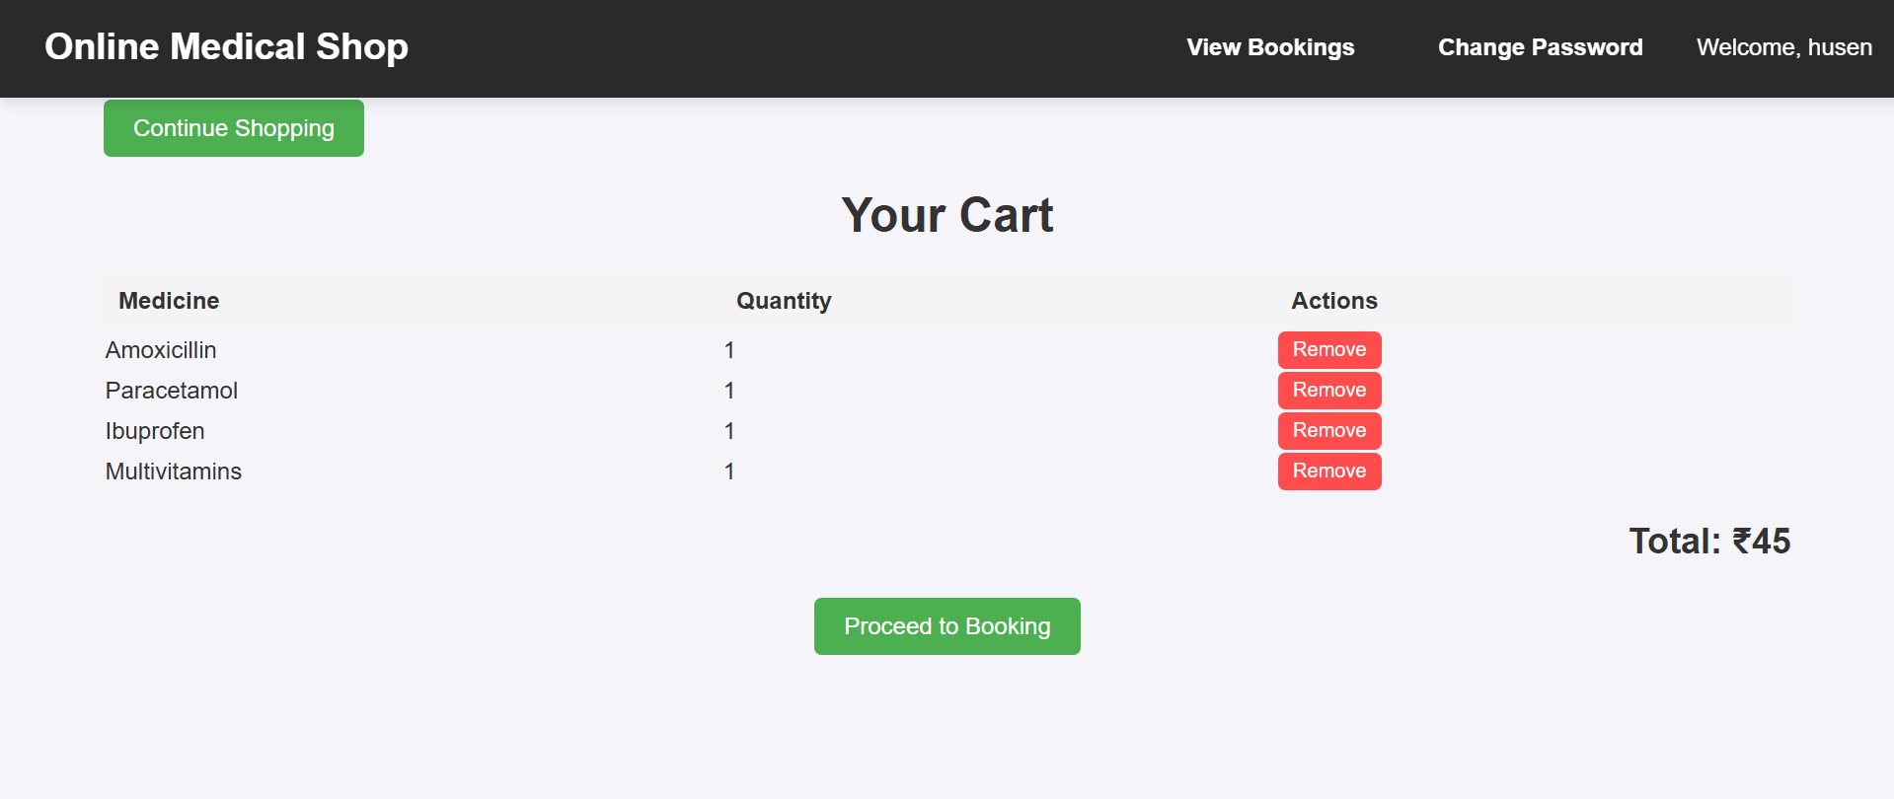
Add to cart

Slide 14
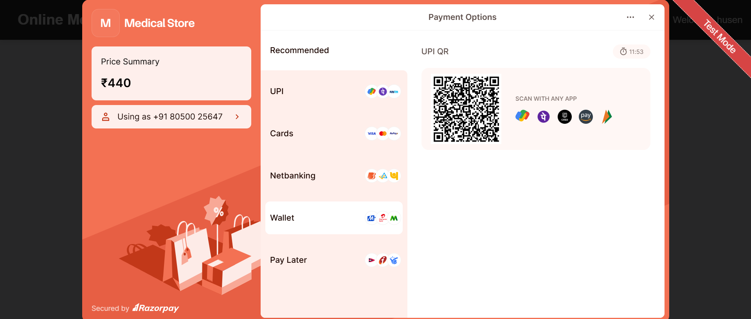
Payment page

Slide 15
Add to cart

Slide 16
Conclusion
The Medical Store Management System provides an efficient platform for both customers and admins to manage and access medical products. Customers can browse products, view their details, and place orders seamlessly. The system allows customers to access the latest product information, while the admin has control over the management of the store’s inventory, including adding, updating, and deleting products.

Slide 17
THANK YOU

