Slide 1



AA
Smart Discounting Strategy for Clutches sales in USA market
Presenter: Govind Kishore, Consultant
TIGER Analytics
Classified - Confidential

Slide 2
  Exceutive Summary- Key Questions & Our Proposal
What is the Problem? | In AA Auto parts retailers, transactions are price negotiated between the customer & the store associate. Therefore, selling price vs base / recommended price being different due to unscrupulous discounting which results into serious impact on the margins.
Who has this Problem? | Sales Professionals, Director of Analytics, Director of Pricing, CEO, CFO, Customers
Why should this Problem be solved? | To design an analytics driven discounting strategy which will lead to smart pricing that results in a win-win for both customers & AA such that the sales revenues are not impacted
Our Solutions | Analytics Driven Discounting Strategy Safe Discount Margin Strategy What-If Simulator Tool to help salespersons make rational decisions and inflict behavioural change

Slide 3
Project Plan
Project: Data Driven Discount Strategy | 10th Nov, '25 | 14th Nov, '25 | 17th Nov, '25 | 21st Nov, '25 | 17th Nov, '25 | 21st Nov, '25
 | Week 1 |  | Week 2 |  | Week 3
Data Cleaning & Data Manipulation
Company Overview
Exploratory Data Analysis
Discount & Margin Distribution
Price Cluster Wise Summary
Customer Analysis
Sales Team Analysis
Incorporate Suggestions from Sprint 1
Regression Modelling between Discount & Quantity
Time Series Based Analysis
Incorporate Suggestions from Sprint 2
Safe Discount Margin Identification
Streamlit Web App for What-if Analysis
Final Recommendations Summary
 |  | Sprint 1 |  | Sprint 2 |  | Final Presentation

Slide 4
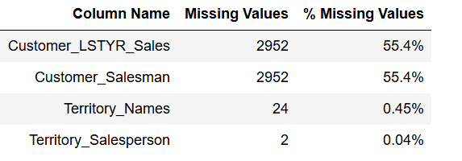
Data Profiling: Issues due to Missing Values
1. Customer_LSTYR_Sales (55.4% missing):
- Business Interpretation: Sale from Previous year - missing which means these customers are new customers.
- Treatment? replacing the null values with 0 (since these are new customers, last year sales are 0)
2. Customer_Salesman (55.4% missing):
- Business Interpretation: Salesperson assigned to customer. Missing means new customers or unassgined accounts
- Treatment? replacing the null values with 'Unassigned'
3. Territory_Names (0.45% missing):
- Business Interpretation: Very small number, it doesn't affect the overall analysis.
- Treatment? replace the null values with 'Unknown Territory'
4. Territory_Salesperson (0.04% missing):
- Business Interpretation: very very small values, insignificant
- Treatment? replace null values with ''Unknown_TS'

Slide 5
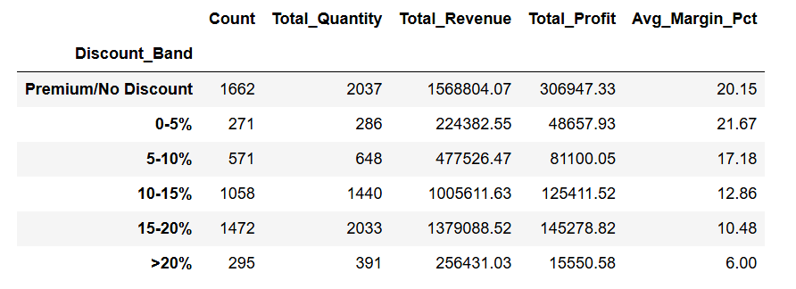
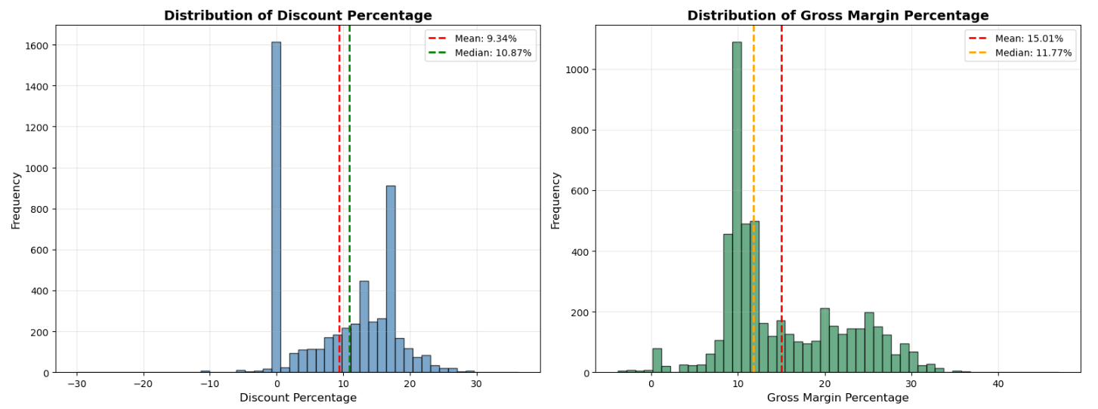
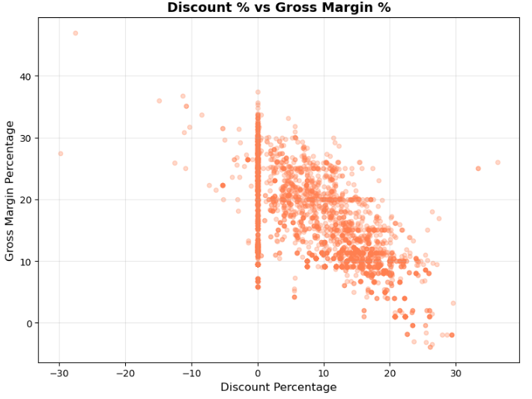
Current discounting strategy: Higher discounts directly erode gross margins- Clear need for guardrails
Negative Correlations (R = -0.7) between Discount % and Gross Margin %
Margins fall sharply beyond the 10-15% discount band
Indicates absence of pricing discipline across regions and reps
Sets the foundation for “Safe Discount Zones”

Slide 6
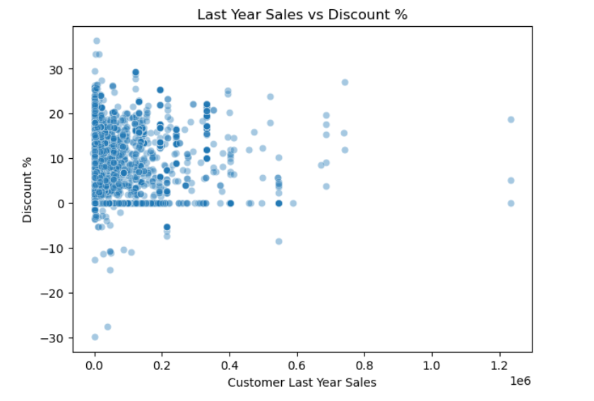
Relationship between past Sales and Discount: Need to balance profitability & customer acquisition
New customers (0 prior sales) often receive steeper discounts — thus we need to check acquisition vs profitability balance.

Slide 7
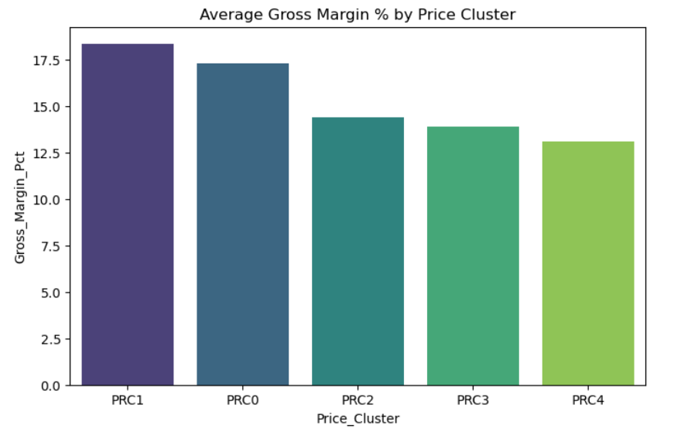
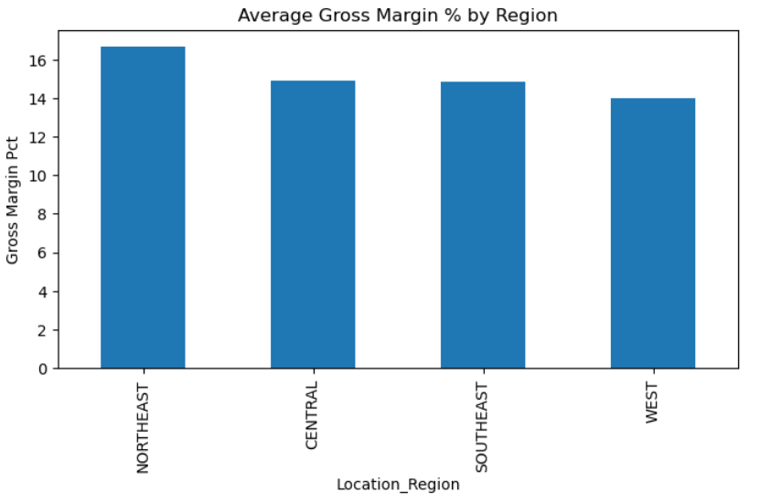
Average Gross Margin % by Price Cluster & Regions
Price Cluster differ sharply in average margin - potential lever for pricing optimization
Some regions (like WEST or CENTRAL) may show margin variations — candidate for regional pricing

Slide 8
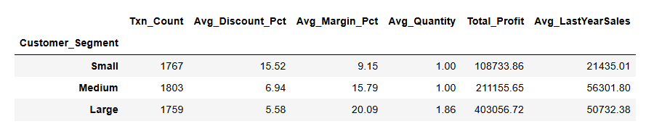
Customer Segmentation Analysis
Small customer segment (contributing less than 33% to the total revenue) receive high discounts, leading to margin leak (meagre ~9%)
Actionable recommendation: Introduce segment-based rules with approval tiers

Slide 9
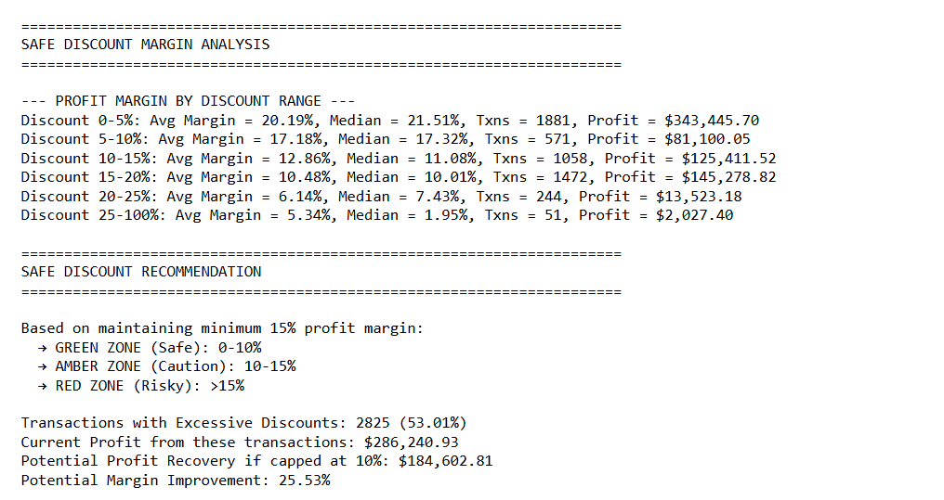
Proposed Solution: Safe Discount Margin Identification
Actionable Next Step: Incorporate Three Tier Discount Policy:
Green / Amber / Red

Slide 10
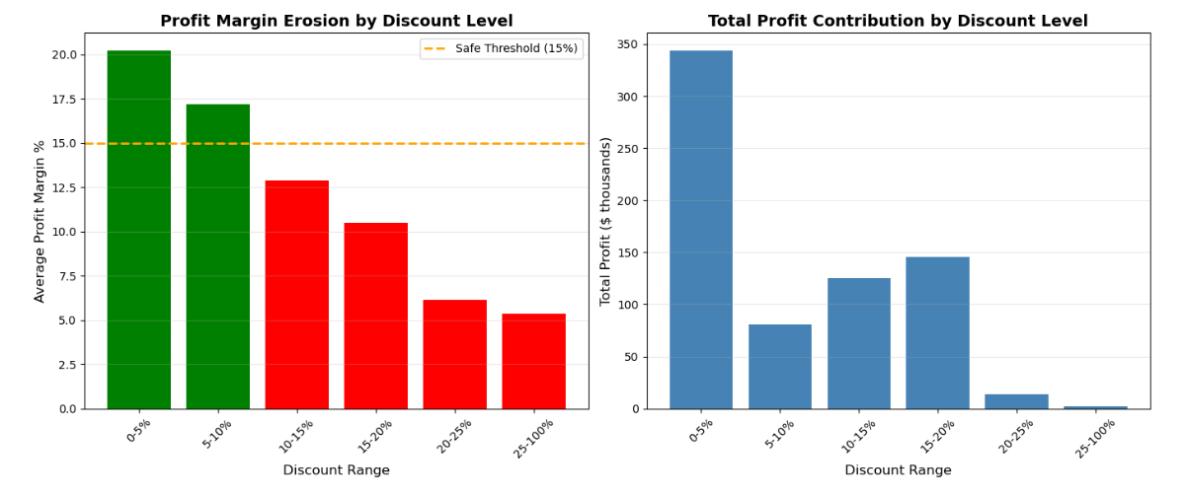
Proposed Solution: Safe Discount Margin Identification
WHY?
Policy derived from historical discount-margin relationship
Ensures quick decisions for low-risk (green) while controlling high impact ones
Introduces accountability and simplifies decision-making for sales associates
Thresholds to be validated during pilot and refined post-rollout

Slide 11
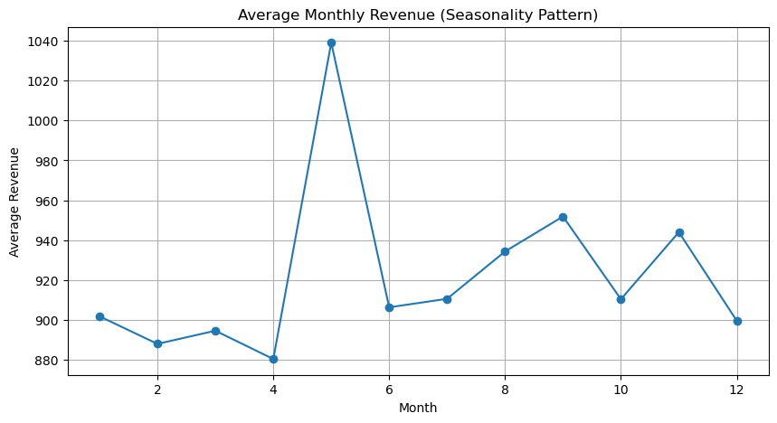
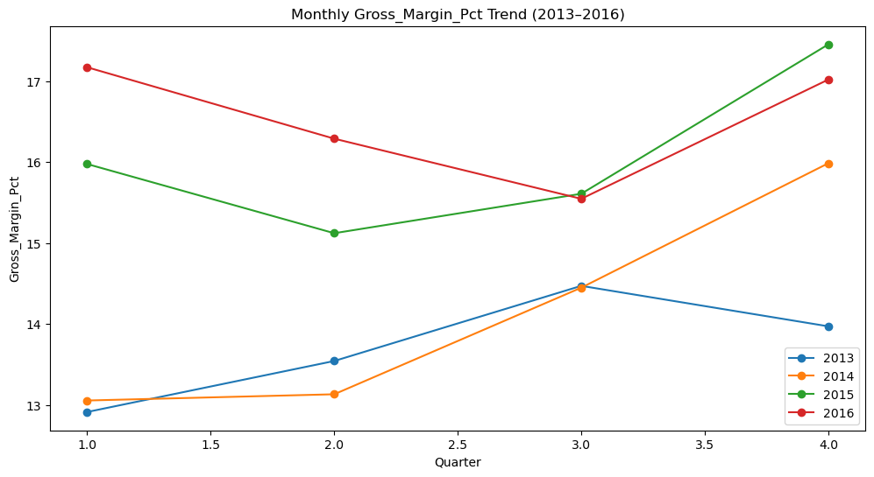
Seasonality of Sales: Align discounting with seasonal sales
This shows seasonal peaks (May Month) independent of specific years, i.e., overall pattern of which months perform better across 2013–2016.
2014 was the year where the gross margin % increased every year.
However, in recent years we have seen uneven performance of gross margin % in different quarters
Quarterly trends identify best windows for promotions
Actionable Next Step: Align discounting with seasonal peaks

Slide 12
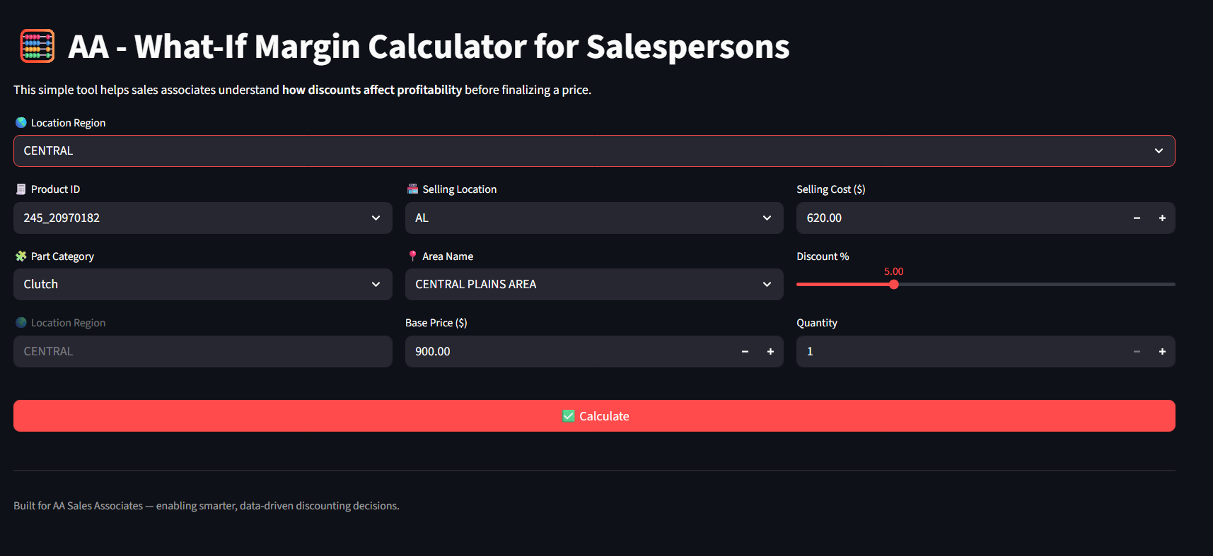
What-If Margin Calculator & Quick Rules
Rationale:
1. Simple UI tool: input discount % → shows net margin impact
2. Integrates into CRM; routes approvals automatically
3. Behavioural nudge for smarter pricing decisions

Slide 13
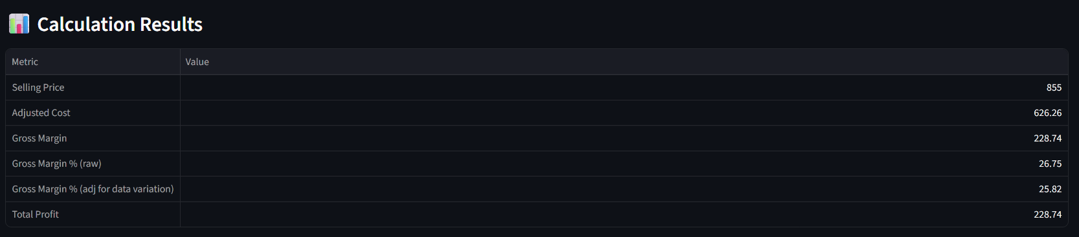
What-If Margin Calculator & Quick Rules
Rationale:
1. Simple UI tool: input discount % → shows net margin impact
2. Integrates into CRM; routes approvals automatically
3. Behavioural nudge for smarter pricing decisions
Link to the tool:
AA Autoparts - What-If Margin Calculator

Slide 14
Assumptions
Data & timeframe | Missing entries in Customer_LSTYR_Sales treated as 0 and it is assumed that they are new customers Customer and salesperson mappings assumed correct post-cleaning
Revenue & Margin Calculations | Gross Margin assumed consistent with company’s cost structure (no dynamic cost fluctuations modeled) Discounts are treated as absolute % off list price, applied uniformly across SKUs
Analytical Approach | Seasonality insights drawn from aggregated monthly and quarterly revenue trends Forecasting models assume no major external shocks (e.g. policy, competitor moves,GDP)
Business & Behavioural Assumptions | Sales associate behaviour and customer response remain consistent with historical data Implementation of new discount rules expected to have minimal initial resistance post-training Safe discount zones derived for pilot purposes – thresholds to be validated and fine-tuned during rollout.

Slide 15
Actionable Recommendations
1. Discount Guidelines:
- Green Zone (0-10%) : Healthy margins, standard approval
- Amber Zone (10-15%) : Requires supervisor approval
- Red Zone (>15%): Senior Management approval only
2. Customer Specific Strategies
- Large Customers: More flexibility, volume justifies lower margins
- Medium Customers: Standard guidelines with growth potential assessment
- Small Customers: Minimize discounts as it leads to margin leakage
3. Sales Team Analysis:
- Link compensation to profit margins, not just revenue
- Recognize salesman who maintain margins while growing volume
- Provide real-time feedback on pricing decisions
4. Behavioural change of Sales professionals to use What-If tool before discounting
5. Monitoring & Control:
- Monthly reviews of salesman performance
- Quarterly strategy refinement based on data

Slide 16
Next steps to make the Solution scalable & refined
1. Discounts given by salespersons are reflective of:
- Competitors presence in the market to make the client’s product competitive
- To meet their personal sales targets which can be sometimes too much to achieve esp. in the current times of inflation and falling personal income
2. Extra Data needed:
- Third Party Retail Audit Data (Nielsen / Canadean / Euromonitor)
3. Elasticity Modelling:
- to understand the price sensitivity of the product and how change in prices impact the volume sales

