Slide 1



GobbleCube
Product Matching Algorithm Assignment
- Govind Kishore
Classified - Confidential

Slide 2
Problem Statement
What is the Problem? | Develop product matching algorithm to map the products available on Blinkit with those on Zepto and Instamart
Who has this Problem? | Analysts/ Product Managers/ Sales Professionals may face this inconsistency of distribution of products and thus would want to understand the coverage of their products across Q-comms
Why should this Problem be solved? | Enable seamless product comparisons across platforms and optimize. Reduce manual effort in brand harmonization
Success Criteria? | Brand Mapping success rate Product Matching Accuracy Coverage compared to Blinkit platform

Slide 3
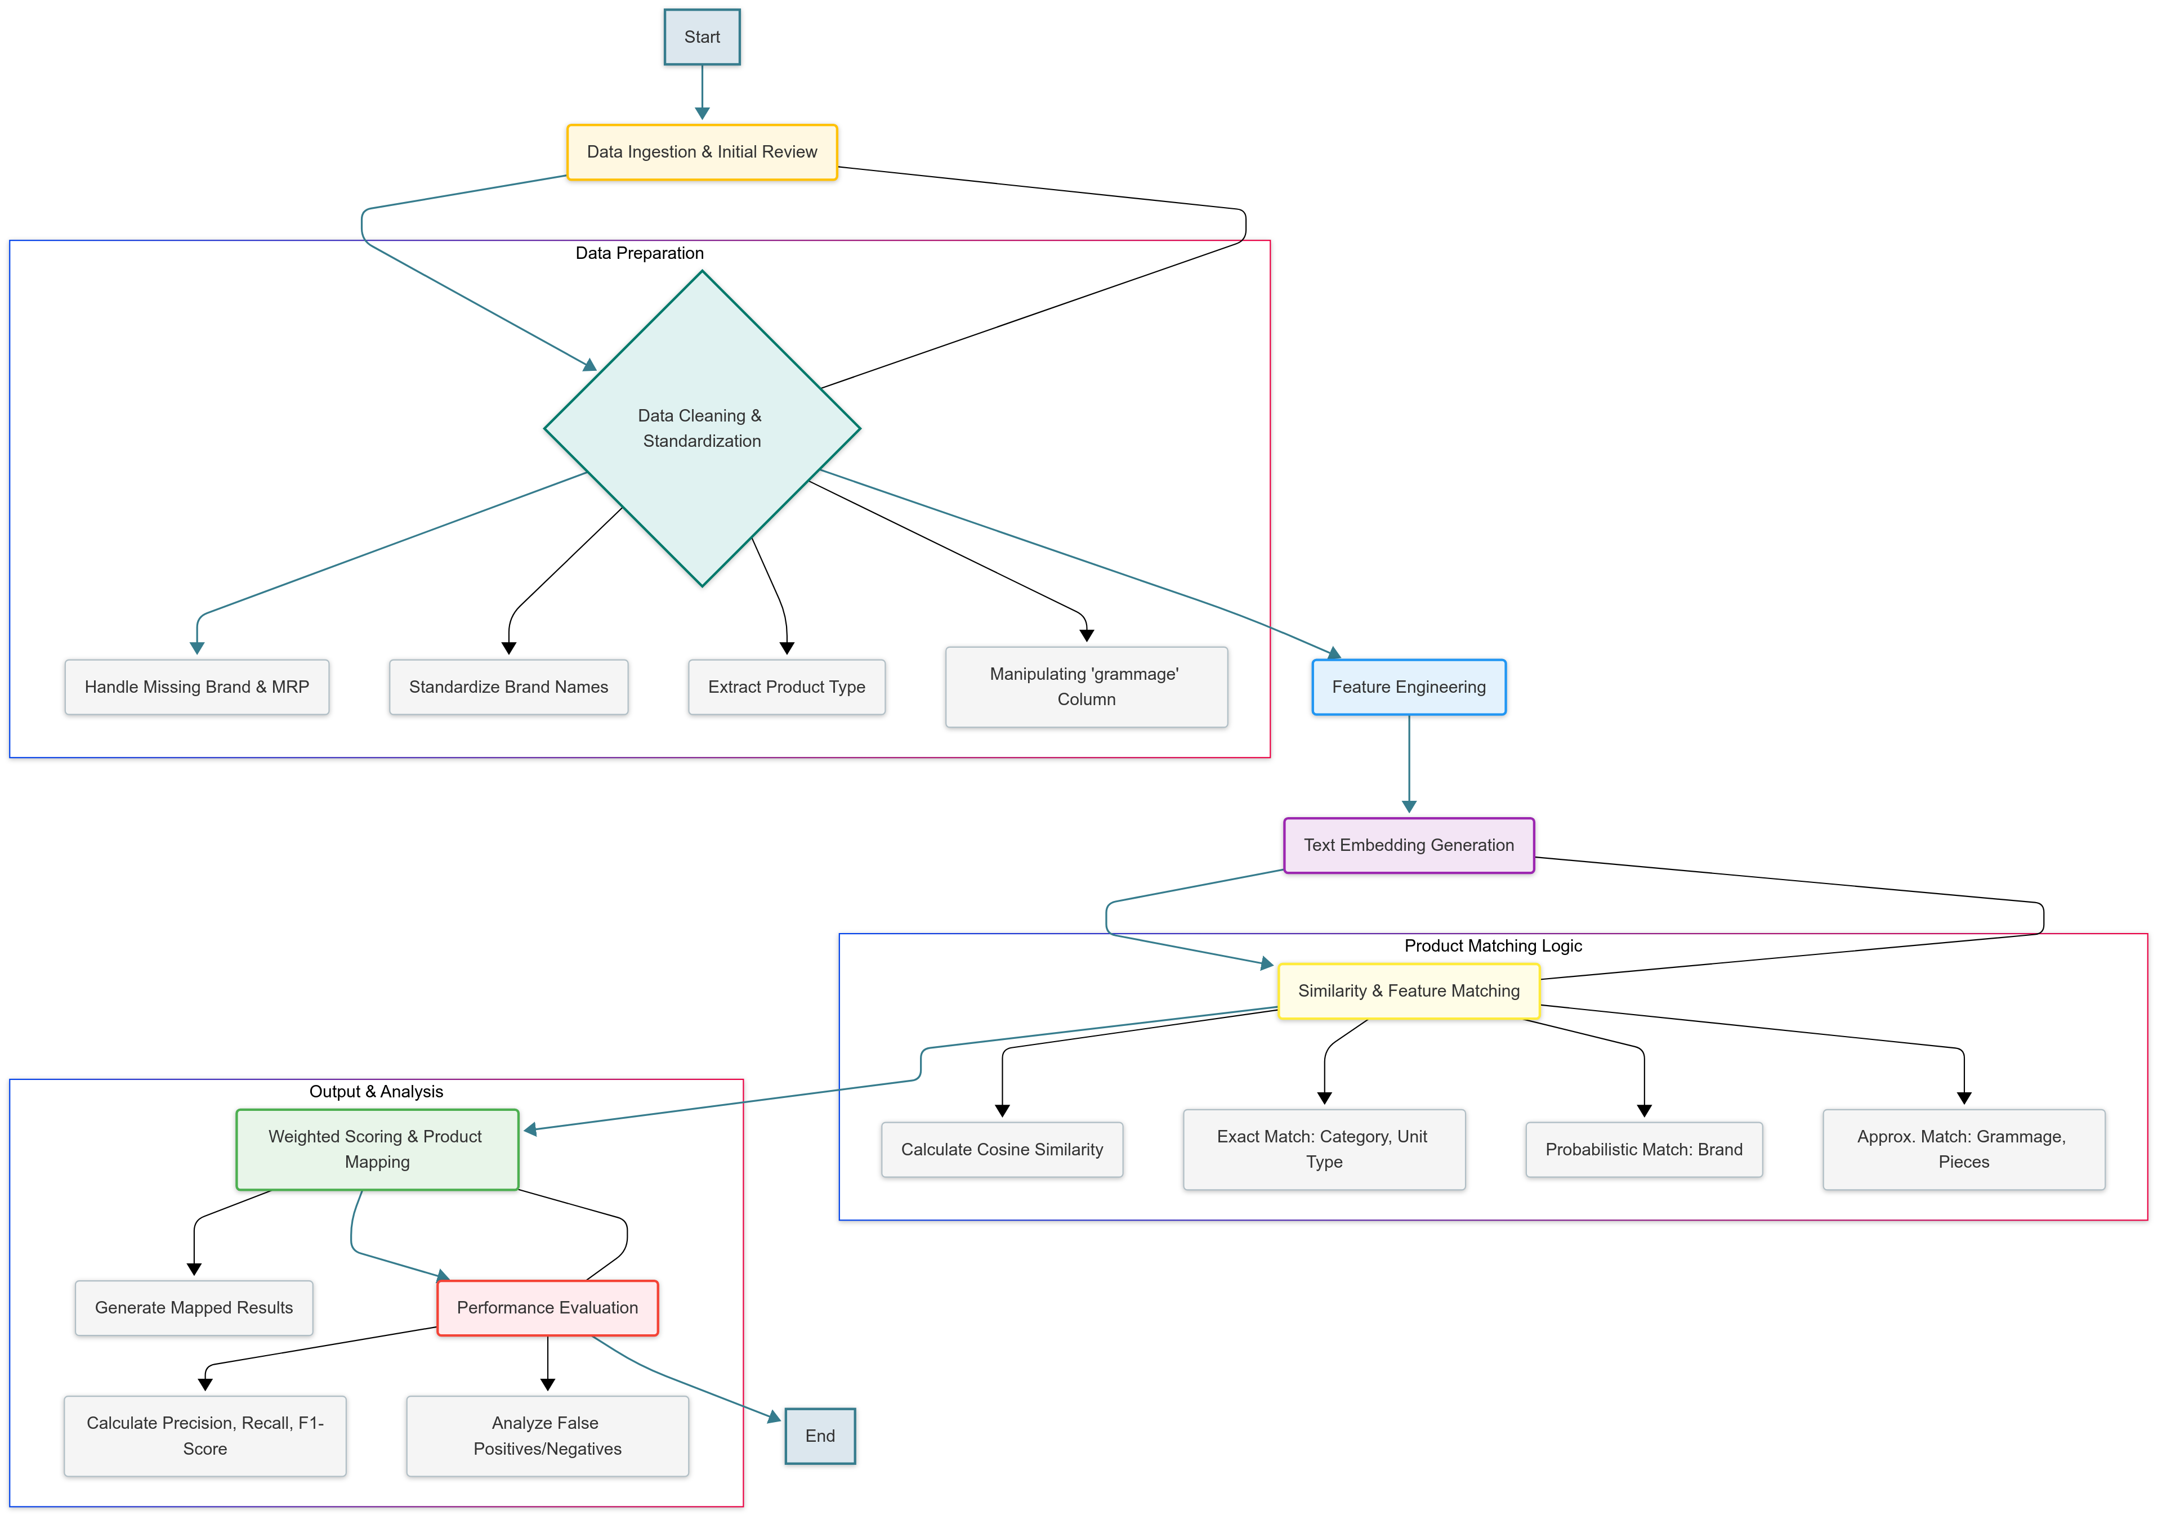
Flowchart

Slide 4
Data Profiling: few issues
Overall | Columns to work with: gc_platform, Product_id, Category, Brand, Title, MRP, Grammage
Specific to Blinkit | Blank in Betel Nuts brand column: looked at blinkit website and found two brands- whole farm and Svasti; took Whole Farm brand- similar price checked on blinkit MRPs values in blinkit not present for 102 brands - web scrape later Parle Monaco Piri Piri bisuit had brand Parle, but other Parle Monaco items had Parle Monaco brand. So changed that Amritam Jaggery powder is duplicated entry with diff product_id - 540345 / 540348. dropping 540345
Specific to Zepto | Desi Choice Sugar S30 in title, brand is Desi Sugar, 1kg but no MRP: not available on website also MRPs of 41 items not present ,Aesnackible brand should be Snackible Bikfarm should be Bisk farm JK Popy seeds of 100g has brand name JK, while same of 50g has brand name JK Paper; JK paper also present for Kala Jeera item Pran Potato biscuit come under Pran brand and not Tata as mentioned in the data; in Blinkit it is mentioned correctly
Specific to Instamart | Brand name missing for these titles: Ma products brands checked on Insta. PE Guntur Chilli is actually Popular Essentials MRP absent for 9 products in instamart data and so on….

Slide 5
Workable Solutions
Solution #1
Rule-based matching
Solution #2
TF-IDF Matching
Solution #3
Semantic Embedding with Weighted Similarity Score
Discarded- why?
Exact match on title, brand and grammage
Lack of scalability and high maintenance required
Used for text matching
Discarded- why?
Limited semantic understanding of the product descriptions
Used SentenceTransformer’s all-MiniLM-L6-v2 model to generate rich, contextual embeddings for product descriptions
Used Weighted similarity scoring mechanism
Selected
Very low similarity score: (<0.6 for Zepto and not a good result even for instamart)

Slide 6
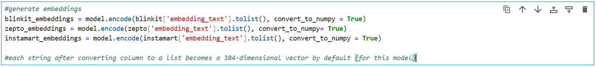
Chosen solution: Approach to Product Mapping Algorithm
Foundation: Utilizing SentenceTransformer’s all-MiniLM-L6-v2 model to generate rich, contextual numerical embeddings from product descriptions
Why this model?
Very fast and lightweight: Its’s a robust general purpose semantic similarity model, making it highly effective: generated the embedding text into 384 dimensions
Why not other models?
OpenAI’s Embeddings (text-embedding-ada-002/ text-embedding-3-large) not chosen due to cost
Larger SentenceTransformer Models (multi-qa-mpnet-base-dot-v1): not chosen due to resource constraint

Slide 7
Chosen solution: Approach to Product Mapping Algorithm
Intelligent Combination: Merges multiple product attributes (Category, Brand, Title, processing(Grammage column- abs value, unit, num_pieces) into a single embedding text for better semantic understanding
Precision through Weighting: Implementing a weighted similarity score that prioritizes key matching criteria, ensuring relevant mapping
Cosine_similarity: 0.6 weight to capture deep contextual meaning
Category & Brand match: (0.1 weight each; probabilistic matching of brand) to ensure foundational alignment
Grammage details: (0.2/3 weight each for unit_type, Value (+/-10%), pieces (+/-10%) refines matches based on quantity

Slide 8
Success metrics
For both platforms: Zepto & Instamart, metrics like False Positive Rate, False Negative Rate, Precision, Recall, F1 Score all were calculated for thresholds varying from 0.6 to 0.95
For threshold level of 0.7: this means if the total score is > 0.7, it is mapped else it is not mapped.
FPR was emphasized because higher FPR could impact the company financials- wrongful assortment, or promo/discount management, poor inventory management.

Slide 9
Assumptions
Related to Data | Provided product data (titles, categories, brands, grammage) across Q-com is representative of the products offered on each platform and contains sufficient information on meaningful comparisons. Inconsistencies around the brand column are dealt with.
Related to Model | The chosen model is robust and captures the semantic nuances well without requiring extensive domain-specific fine tuning
Related to Features & weightage allocation | Chosen weightage will hold true for very large datasets as well. Parsing Grammage column is assumed to be handling the majority of variations in formats
Related to threshold selection | Assumed to be effective cut-off points between true matches and non-matches, balancing precision and recall

Slide 10
Next steps to make the algorithm scalable & automated
Requirements:
Cloud based architecture to run the pipeline and deploy the solution (e.g. Google Cloud, AWS)
Event driven processing to implement automatic update of product data; also require batch & real time processing to provide real time updates
Monitoring through dashboard to track performance
Retraining the loop to develop a system to periodically retrain the embedding model
Employee as a resource to check manually and correct inconsistent mappings which can then be fed back into model training
Cost Implications:
Computation Cost: Cost of hosting on cloud ($500-$5000 per month) and memory cost. Cost of API- free if open source else OpenAI’s are costly
Storage cost: $50-$500 per month for databases and data lakes
Employees salary: Requires 1-2 ML engineers/Data Scientists and Devops guys. One resource (BA) for manually checking the results so obtained and doing away with inconsistencies: ($3000 per month)

Slide 11
Recommendations
Continuous performance monitoring & retraining: requires a robust data pipeline for monitoring mapping accuracy (precision, recall, F1 score)
Enhance Human-in-the-loop feedback: to develop a UI for analysts & PMs & Sales guys to easily review, correct and validate suggestions
Include Advanced Feature Integration: e.g. product images, customer review, price elasticity data, Flavour, Multipack/Singlepack, Refining Categories, etc.
Gradual roll-out & integration: integrate the solution with relevant business systems
Cost-Benefit Analysis: higher ROI = (Value derived/investments)

