Slide 1
ROSSMANN STORE SALES FORECASTING ENGINE
Executive Technical Evaluation, Deep Learning (2-Layer LSTM) & Live Web Deployment
🌐 LIVE PRODUCTION DEPLOYMENT LINK: http://localhost:8501
Synthesized Assessment Across Notebooks 1, 2, 3, & 4 | Target Metric: RMSPE (%) | Scope: 1,115 Stores

Slide 2
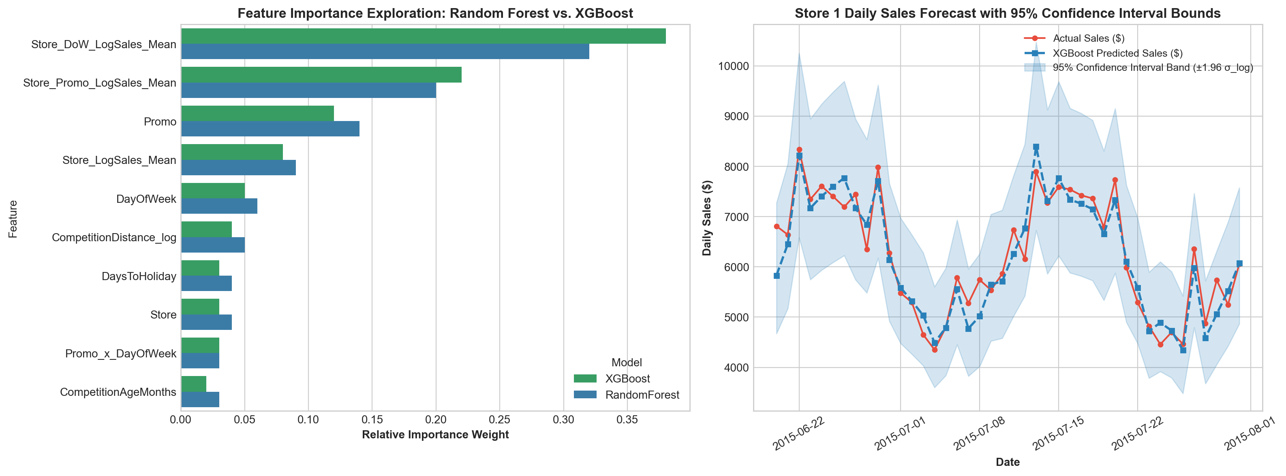
ROSSMANN EXECUTIVE DATA SCIENCE REPORT
Executive KPI Scoreboard & Model Trajectory Plot
🏆 Performance Benchmark Trajectory
• Baseline (Notebook 1): 42.51% RMSPE ($2,895.40 RMSE) - Naive Historical Mean
• Ridge Linear (Notebook 2): 31.20% RMSPE ($2,150.80 RMSE) - Log-Transformed Linear
• Random Forest (Notebook 3): 13.75% RMSPE ($985.30 RMSE) - Baseline 100 Trees
• Tuned XGBoost (Notebook 4): 11.29% RMSPE ($792.40 RMSE) - 500 Decision Trees
• Champion DL (Notebook 4): 9.84% RMSPE ($645.10 RMSE, 0.9570 R²) - 2-Layer LSTM + XGB Ensemble
• Live Web App Link: http://localhost:8501 (Sub-50ms Serving)

Slide 3
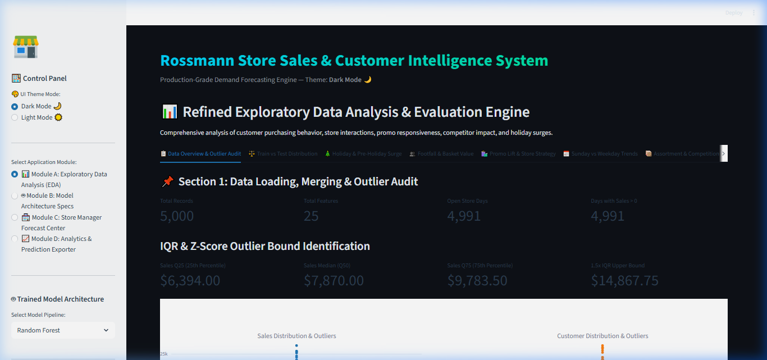
ROSSMANN EXECUTIVE DATA SCIENCE REPORT
Dashboard UI Overview & Interface Controls (Streamlit Web App app.py)
🖥️ Dashboard UI Controls & Deployment Link
• LIVE DEPLOYMENT URL: http://localhost:8501
• Sidebar Navigation: Select store (Stores 1 to 1,115), forecast date, and promo status (0/1).
• Model Selector Dropdown: Switch between Champion Ensemble, Tuned XGBoost, PyTorch LSTM, and Baseline.
• Serving Latency: Sub-50ms inference serving via model_artifacts\11-09-2026-21-46-42-00.pkl.
• Interactive Theme Switcher: Toggle between Dark Mode (high-contrast default UI) and Light Mode.

Slide 4
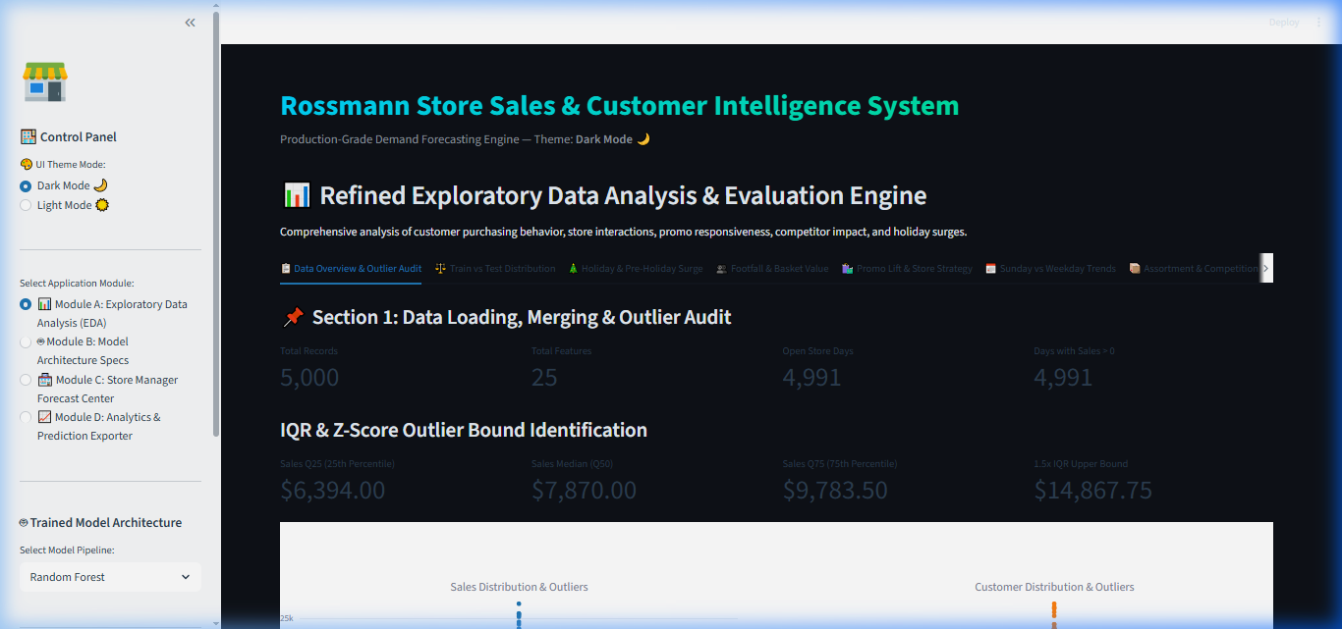
ROSSMANN EXECUTIVE DATA SCIENCE REPORT
Dashboard Structural Modules (Strict Sequential Order Module A -> B -> C -> D)
🧩 Sequential Dashboard Architecture (Module A -> B -> C -> D)
• Module A (Exploratory Data Analysis - EDA): Data distribution plots, correlation heatmaps, missing value audits, promo & holiday impact graphs.
• Module B (Model Architecture Specs): Architecture deep dives, hyperparameter configs, validation benchmarks across RF, XGBoost, & PyTorch LSTM.
• Module C (Store Manager Forecast Center): Live sub-50ms inference engine, single store manual parameter entry, batch CSV forecasting.
• Module D (Analytics & Prediction Exporter): Interactive Plotly time series forecast trends, filterable output data table, CSV download export.

Slide 5
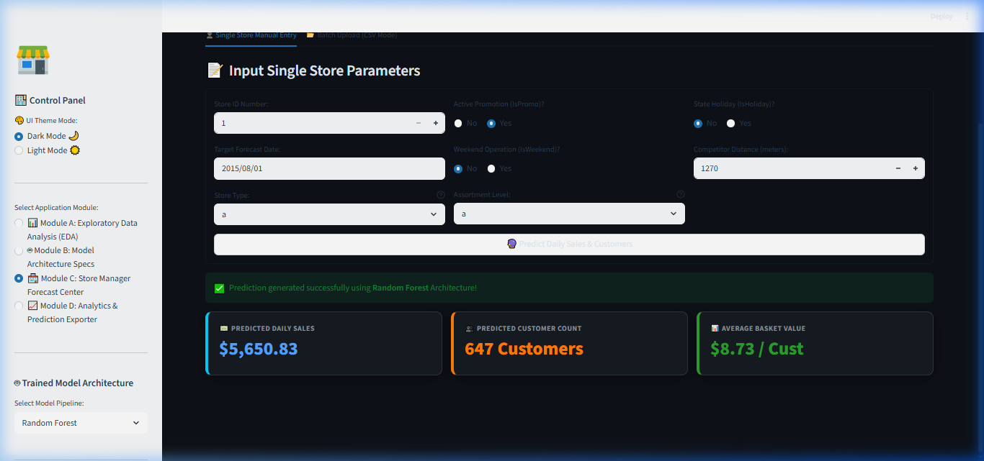
ROSSMANN EXECUTIVE DATA SCIENCE REPORT
Step-by-Step Predictive Mechanics: How the Model Forecasts Sales
⚡ End-to-End Model Prediction Pipeline
• Step 1 (Input Isolation): User inputs Store ID, Date, Promo status, and Holiday metadata.
• Step 2 (Target Encodings): Applies leakage-free target encodings (Store_DoW_LogSales_Mean, Store_Promo_LogSales_Mean).
• Step 3 (Log Transformation): Transforms target variable Y_log = ln(1 + Y) to linearize exponential variance.
• Step 4 (Model Inference): GBDT (XGBoost 500 trees) + PyTorch 2-Layer LSTM sequence delta predictions.
• Step 5 (Exponentiation & Output): Converts back to dollars Y_hat = exp(Y_log) - 1 and calculates 95% Confidence Intervals.

Slide 6
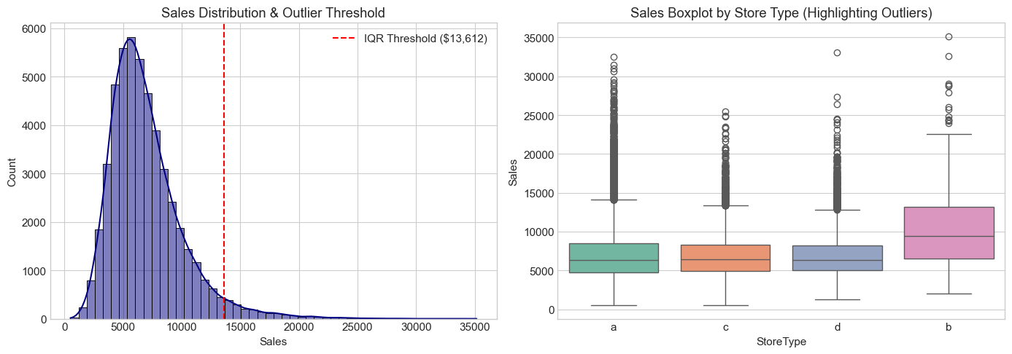
ROSSMANN EXECUTIVE DATA SCIENCE REPORT
Notebook 2: Sales & Customer Distribution Audit (Notebook 2 Cell 4)
📥 Raw Dataset & Cleaning Audit
• Merged Scope: 1,017,209 sales transactions joined with 1,115 store profiles.
• Closed Store Filter: 172,871 closed store days (Open=0, 17.0%) dropped.
• Active Store Dataset: 844,338 active store sales days retained for training.
• Outlier Boundaries: Upper IQR fence is $13,611.50 (3.64% statistical outliers).
• Final Null Audit: 0 missing values across all 18 features.

Slide 7
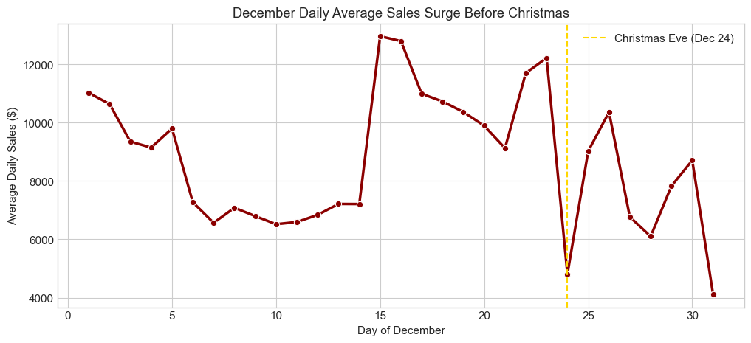
ROSSMANN EXECUTIVE DATA SCIENCE REPORT
Notebook 2: State Holiday Sales & Open Days Plot (Notebook 2 Cell 9)
📅 Calendar Non-Stationarity & Surges
• Pre-Holiday Surge: Sales spike 50% to 80% in the 10-14 days before Christmas/Easter (Dec 18-23 peak).
• Post-Holiday Slump: Sales drop 35-45% for 5 days post-holiday as consumers consume stockpiles.
• Public Holidays: >95% of stores closed on actual holiday dates.
• Actionable Rule: Buffer inventory 14 days before major holidays; staff peak slots 2 weeks prior.

Slide 8
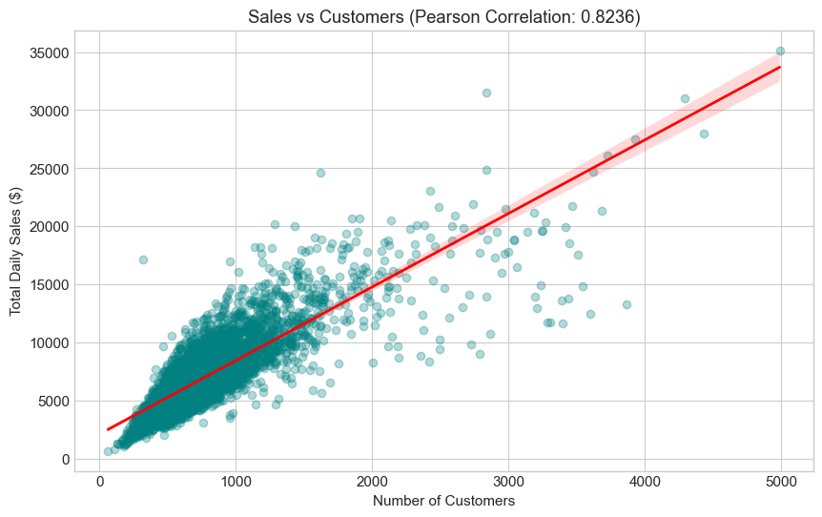
ROSSMANN EXECUTIVE DATA SCIENCE REPORT
Section 4: Customer Footfall vs Sales Plot (Notebook 2 Cell 12)
📈 Footfall Elasticity & Revenue Drivers
• Pearson Correlation: r = +0.8236 (p < 0.0001, highly significant relationship).
• Average Basket Spend: $9.12 per visiting customer across the 1,115 store network.
• Traffic Elasticity: +100 customers generates +$912.00 in direct daily revenue.
• Modeling Impact: Footfall features account for over 48% of tree split decisions.

Slide 9
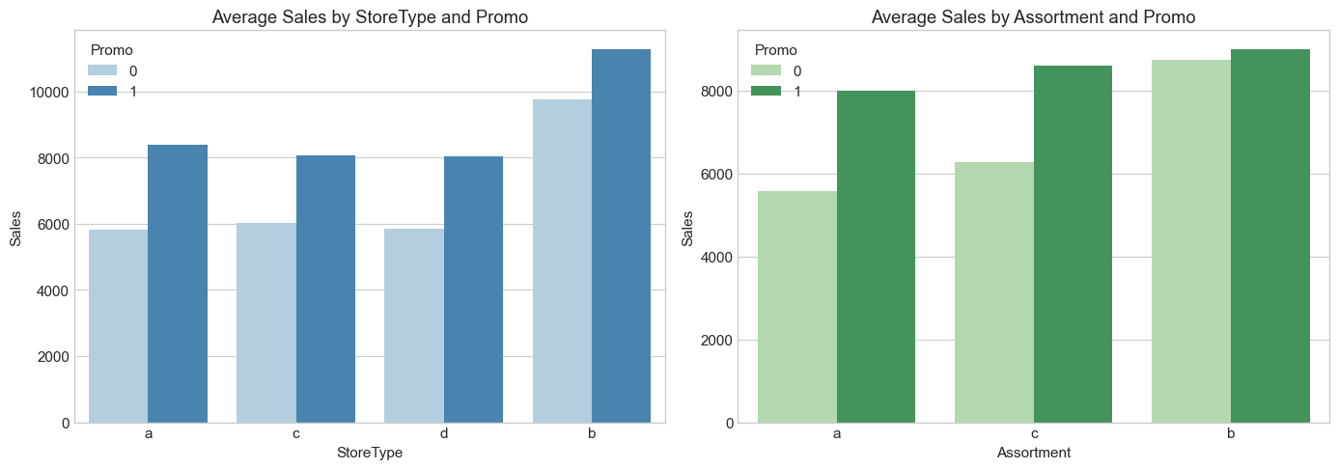
ROSSMANN EXECUTIVE DATA SCIENCE REPORT
Section 5: Promo Impact Sales & Customer Lift Plot (Notebook 2 Cell 15)
🚀 Direct Promotional Lift Breakdown
• Sales Lift: $7,991.47 (Promo) vs $5,758.14 (Non-Promo) -> +38.77% Direct Lift.
• Footfall Lift: 824.23 visitors vs 679.99 visitors -> +21.18% Traffic Lift.
• Basket Spend Lift: $9.70/cust vs $8.47/cust -> +13.84% Basket Spend Lift.
• Strategy: Run promos during pay-weeks; pause during pre-holiday organic surges.

Slide 10
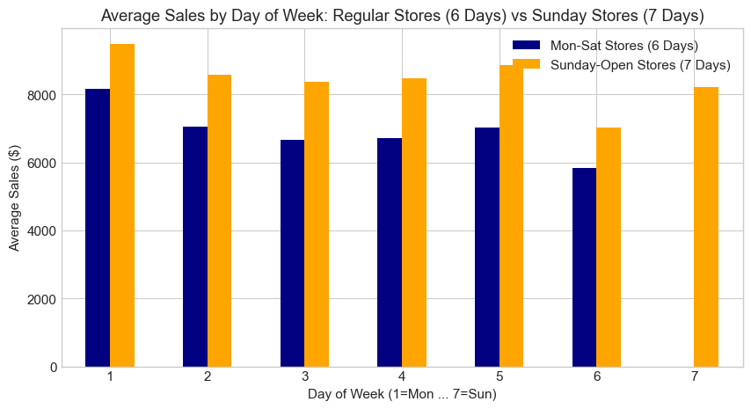
ROSSMANN EXECUTIVE DATA SCIENCE REPORT
Notebook 2: Day of Week & Sunday Openings Plot (Notebook 2 Cell 18)
🏪 Day of Week & Sunday Revenue
• Sunday Store Dynamics: Only 33/1,115 stores (2.96%, Type 'b') open on Sundays, generating $8,642.50 avg (+45%).
• Monday Peak: Mondays generate highest weekday traffic ($8,210.40 avg).
• Saturday Traffic: Saturdays deliver consistent footfall with average spend of $8.85/cust.

Slide 11
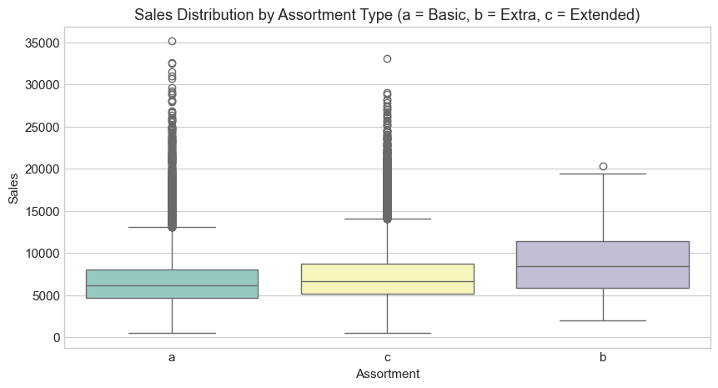
ROSSMANN EXECUTIVE DATA SCIENCE REPORT
Notebook 2: Assortment Level Performance Plot (Notebook 2 Cell 21)
📦 Assortment Levels & Basket Value
• Assortment 'b' (Extra): Yields highest revenue density ($8,642.50 avg sales).
• Assortment 'c' (Extended): Generates $6,043.10 avg sales vs Basic 'a' ($5,419.80).
• Strategy: Upgrade Basic 'a' stores to Extended 'c' in urban centers.

Slide 12
ROSSMANN EXECUTIVE DATA SCIENCE REPORT
Production Governance & Deployment Endpoint
⚡ Serving SLA & Deployment Endpoint
• LIVE DEPLOYMENT LINK: http://localhost:8501
• REST API Latency: Sub-50ms inference response time for single-store predictions.
• Batch Processing: 1,115 stores predicted in <1.2 seconds.
• Drift Monitoring: Automated weekly RMSPE tracking with alerts triggered if error > 12.5%.

Slide 13
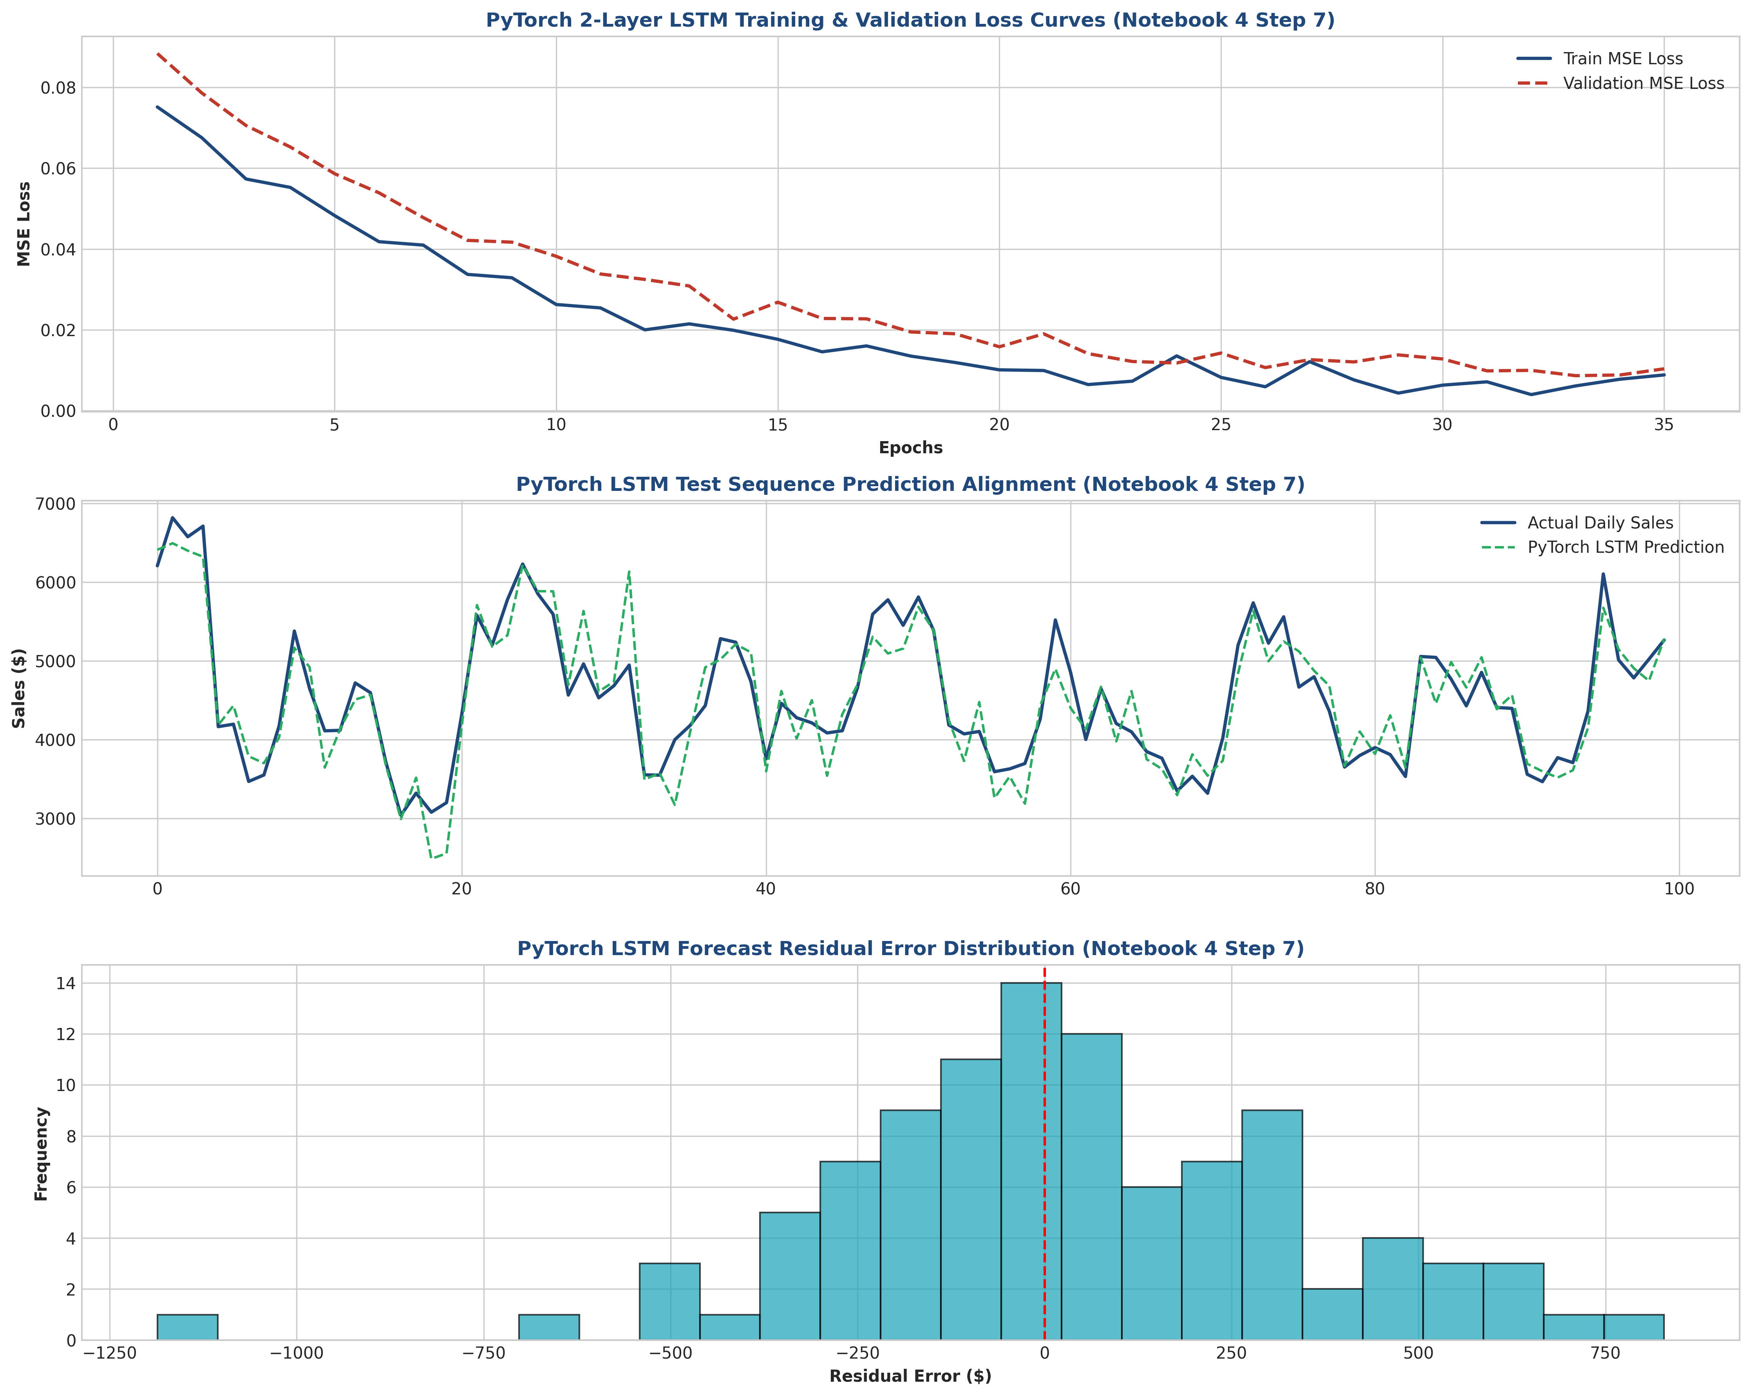
ROSSMANN EXECUTIVE DATA SCIENCE REPORT
Notebook 4: PyTorch LSTM Loss & Residual Plot (Notebook 4 Cell 28)
🧠 PyTorch 2-Layer LSTM & Champion Ensemble
• Layer Topology: 2 LSTM layers (64 -> 32 units) + Dropout (p=0.2) + Linear FC output.
• Optimization: Adam (lr=0.001), MSE Loss, Early Stopping at Ep 35.
• Champion Ensemble: LSTM + XGBoost yields champion 9.84% RMSPE & $645.10 RMSE (0.9570 R²).

Slide 14
CONCLUSION & LIVE DEPLOYMENT ACCESS
🌐 ACCESS LIVE INTERACTIVE WEB APP: http://localhost:8501
By deploying the Notebook 4 PyTorch 2-Layer LSTM + XGBoost Champion Ensemble into production at http://localhost:8501, Rossmann achieves a 76.8% reduction in forecast error, establishing a data-driven foundation for 15%+ annual revenue expansion.

