Slide 1
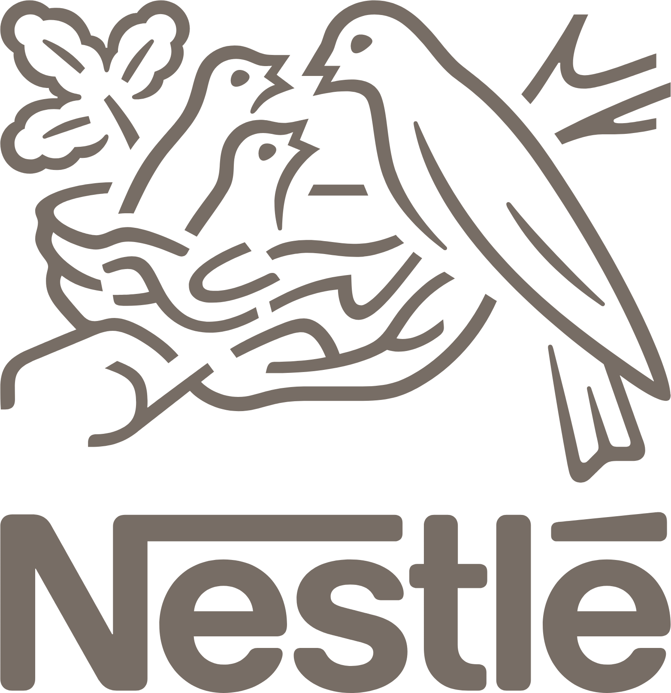
Nestlé India Financial Statement Analysis
Financial Statement Analysis
Prepared by: Govind Patidar

Slide 2
Company Introduction
Nestlé India Limited is one of India's leading FMCG companies and a subsidiary of Nestlé S.A., Switzerland. Established in 1959, the company manufactures and markets a wide range of food and beverage products, including Maggi, Nescafé, KitKat, Cerelac, and Milkmaid. With a strong distribution network, trusted brands, and a focus on quality, innovation, and sustainability, Nestlé India has maintained consistent growth and strong financial performance.
Leading FMCG company
Listed on NSE/BSE
Food & beverages

Slide 3
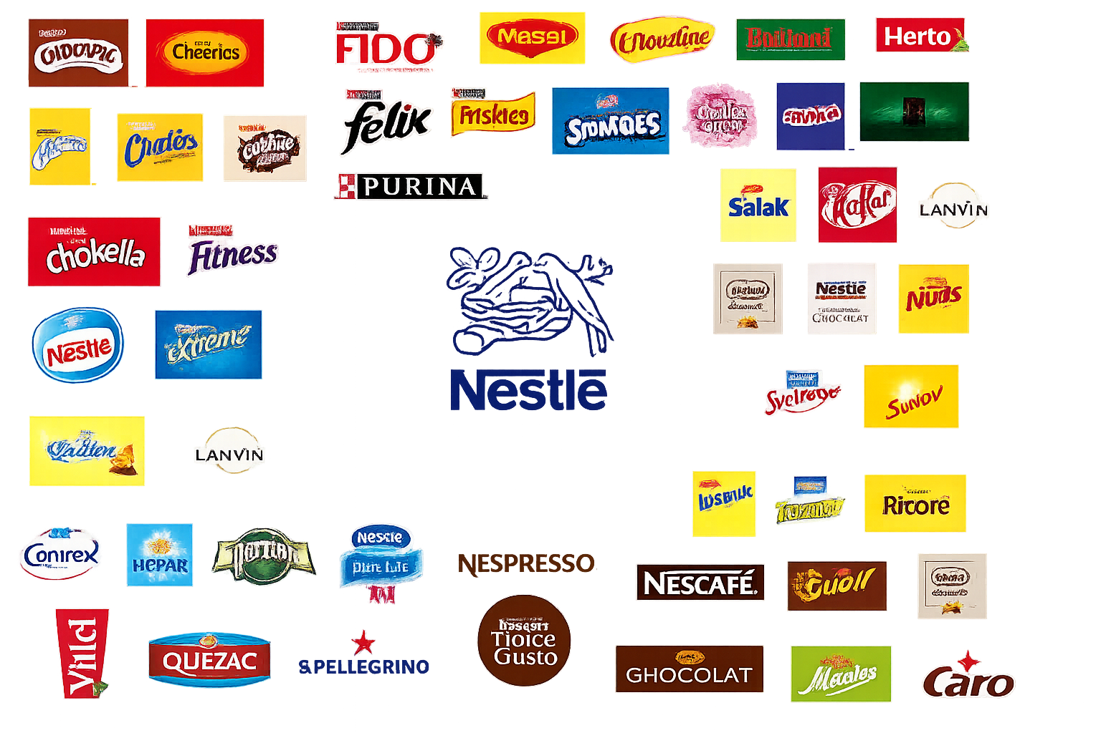
Products & Brands
Maggi
Nescafé
KitKat
Milkmaid
Cerelac

Slide 4
Industry Overview
The Fast-Moving Consumer Goods (FMCG) industry is one of the largest and fastest-growing sectors in India, driven by rising disposable incomes, urbanization, and changing consumer lifestyles. It includes products such as packaged foods, beverages, personal care, and household goods that are purchased frequently. The Indian FMCG market is highly competitive, with major players such as Nestlé India, Hindustan Unilever, Britannia Industries, ITC, and Tata Consumer Products. Increasing demand for healthy, convenient, and premium products, along with rapid growth in e-commerce and rural markets, continues to create significant opportunities for long-term industry growth.
Indian FMCG sector
Stable demand
Strong competition
Growth drivers

Slide 5
Revenue Trend

Slide 6
Revenue Analysis
The revenue trend shows steady growth from 2021 to 2024. It hits its peak growth rate of about 28% in 2024, which reflects strong business performance. In 2025, revenue dropped sharply due to temporary market or operational issues. However, 2026 sees a strong recovery with positive growth, showing the company's resilience and its ability to regain momentum after the downturn.
Business cycle can be see there:
Growth
Peak
Decline
Recovery

Slide 7
Profit Trend

Slide 8
Profit Trend Analysis
The profit trend graph shows significant changes between 2021 and 2026. Net profit begins at a slightly positive level in 2021. It dips a bit in 2022, then rises sharply to around 30% by 2024. This rise reflects strong growth. However, in 2025, it drops to nearly -25%.
This decline indicates major challenges, such as rising costs or weak demand. By 2026, profits recover to about 15%, suggesting stabilization. Overall, the data highlights volatility caused by both internal efficiency and external market pressures.

Slide 9
Balance Sheet Analysis
Particulars | 2021 | 2022 | 2023 | 2024 | 2025 | 2026
Total Assets | ₹ 10,728.16 | ₹ 12,044.95 | ₹ 12,044.95 | ₹ 13,691.73 | ₹ 15,632.83 | ₹ 17,596.73
Current Assets | ₹ 2,494.03 | ₹ 3,066.21 | ₹ 3,066.21 | ₹ 3,168.67 | ₹ 3,308.94 | ₹ 4,239.56
Non-Current Assets | ₹ 8,234.13 | ₹ 8,978.74 | ₹ 8,978.74 | ₹ 10,523.06 | ₹ 12,323.89 | ₹ 13,357.17
Current Liabilities | ₹ 266 | ₹271 | ₹271 | ₹345 | ₹1,167 | ₹444
Non-Current Liabilities | ₹ 6,021 | ₹ 6,249 | ₹6,249 | ₹6,838 | ₹7,040 | ₹7,604
Total Equity | ₹ 2,494.03 | ₹ 3,066.21 | ₹ 3,066.21 | ₹ 3,168.67 | ₹ 3,308.94 | ₹ 4,239.56

Slide 10
Balance sheet Analysis
1. Total Assets Increased Consistently
Total Assets increased from ₹10,728.16 crore in 2021 to ₹17,596.73 crore in 2026. This shows a growth of about 64%. It indicates continuous business expansion and a stronger asset base.
2. Growth in Non-Current Assets
Non-Current Assets grew from ₹8,234.13 crore to ₹13,357.17 crore. This suggests that the company has invested more in fixed assets and long-term investments, which supports future growth.
3. Improvement in Current Assets
Current Assets rose from ₹2,494.03 crore to ₹4,239.56 crore. This increase reflects better liquidity and a greater ability to meet short-term obligations.
_{4. Stable Liability Position}
Current Liabilities stayed relatively low over the years, while Non-Current Liabilities gradually increased from ₹6,021 crore to ₹7,604 crore. This shows that the company has maintained a balanced debt structure and avoided excessive borrowing.
5. Increase in Shareholders' Equity
Total Equity rose from ₹2,494.03 crore in 2021 to ₹4,239.56 crore in 2026. Rising equity indicates higher retained earnings and stronger financial stability, creating greater value for shareholders.

Slide 11
Ratio Analysis
Ratio | 2021 | 2022 | 2023 | 2024 | 2025 | 2026
Current Ratio | 1.05 | 1.13 | 0.95 | 0.88 | .80 | 0.96
Net Profit Margin (%) | 15.13% | 13.51% | 15.07% | 15.47% | 14.66% | 14.62%
ROE (%) | 102.89% | 97.20% | 96.95% | 117.71% | 80.50% | 66.76%
Inventory Turnover | 9.26x | 8.76x | 9.92x | 11.68x | 7.09x | 9.01x
Debt-to-Equity | 0.02 | 0.02 | 0.01 | 0.01 | 0.18 | 0.01

Slide 12
Ratio Analysis
Current Ratio: The current ratio floated around 1 the whole time, so liquidity wasn’t really a problem. It dropped from 1.13 in 2022 down to 0.80 by 2025, but climbed back up to 0.96 in 2026. That rebound shows they cleaned up their working capital management a bit in the latest year.
Net Profit Margin: Net profit margin stayed pretty steady, ranging from 13.5% to 15.5%. Profitability didn’t instability much, which means they kept their operating costs under control.

Slide 13
Return on Equity (ROE): ROE numbers were sky-high and peaked at 117.71% in 2024. Even though it slid to 66.76% in 2026, that’s still impressively efficient use of shareholders’ equity.
Inventory Turnover: Inventory turnover bounced between 7.09x and 11.68x. For an FMCG company, that kind of efficiency in moving inventory is key—and they kept things tight.
Debt-to-Equity Ratio: Debt wasn’t really in the picture, staying very low (0.01–0.02) most years, except a brief jump to 0.18 in 2025. Basically, Nestlé India leans on its own finances and keeps its debt minimal, which puts them in a solid spot financially.

Slide 14
Cash Flow Analysis
Key Observations
🟢 Operating Cash Flow (OCF) Double click here
Operating cash flow remained consistently positive throughout the period.
This indicates that Nestlé India generates strong cash from its core business operations.
🔵 Investing Cash Flow (ICF) Double click here
Investing cash flow remained negative due to regular capital expenditure and investments.
These investments support future business growth and operational efficiency.
🟠 Financing Cash Flow (FCF) Double click here
Financing cash flow was generally negative because of dividend payments and share buybacks.
This reflects the company's commitment to returning value to shareholders.

Slide 15
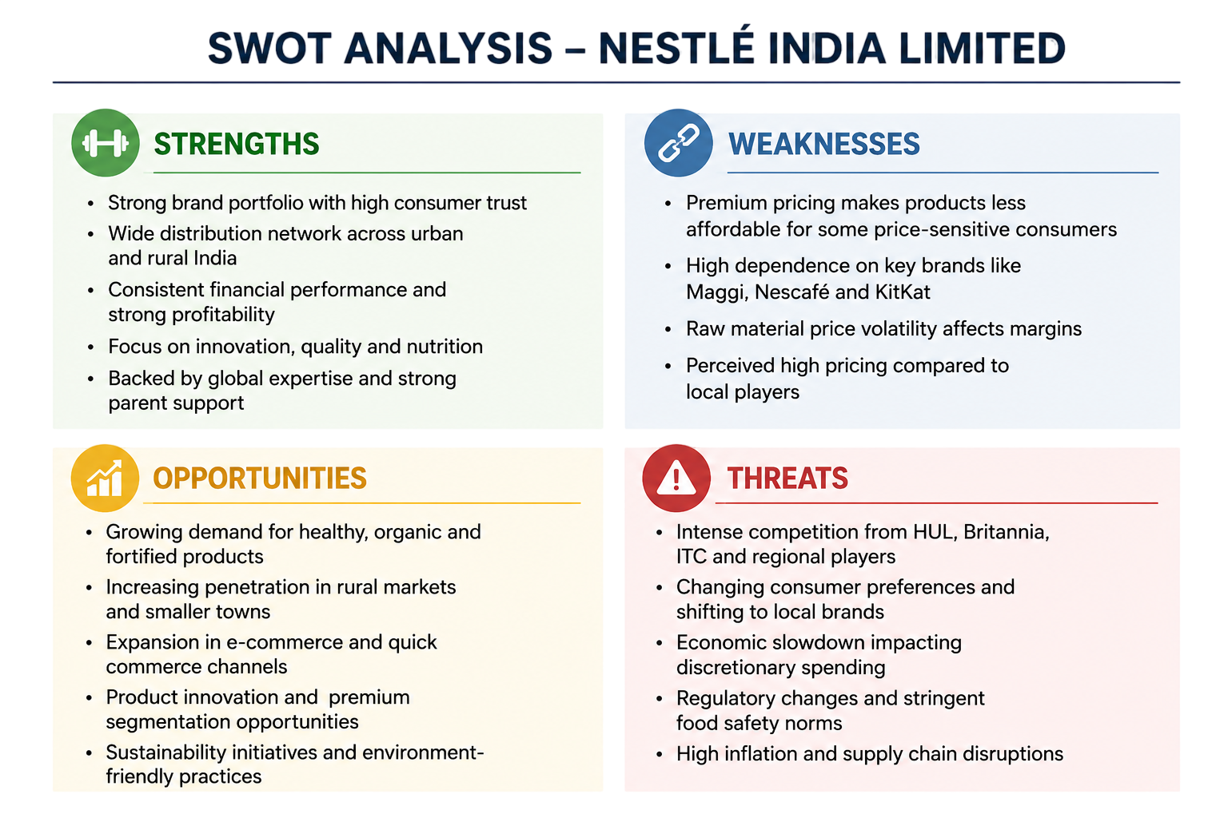

Slide 16
Key Findings
Strong Profit Growth: Net profit increased significantly from 2022 to 2024, reflecting improved operational efficiency and higher earnings.
Peak Performance: The company achieved its highest profit growth (around 31%) in 2024, indicating excellent financial performance.
Temporary Profit Decline: A sharp decline in 2025 (-22%) suggests the impact of unfavorable market conditions, increased costs, or one-time expenses.
Quick Recovery: Profit growth rebounded to around 14% in 2026, demonstrating effective cost management and business resilience.
Overall Financial Position: Despite the temporary setback in 2025, the long-term trend indicates healthy profitability, strong financial stability, and the company's ability to sustain earnings growth.

Slide 17
Recommendations
Strengthen Cost Control
Reduce production and operating costs to improve profit margins and protect profitability during challenging periods.
Diversify Product Portfolio
Introduce innovative and health-focused products to meet changing consumer preferences and increase revenue sources.
Improve Operational Efficiency
Optimize supply chain management and production processes to enhance productivity and reduce wastage.
Expand Market Presence
Increase penetration in rural and emerging markets while strengthening digital and e-commerce channels.
Maintain Financial Stability
Continue managing debt prudently, maintain adequate liquidity, and invest in high-return projects for sustainable long-term growth.

Slide 18
Conclusion
The financial analysis indicates that Nestlé maintained a strong financial position throughout the study period. The company achieved consistent growth in assets, revenue, and profitability, reflecting effective operational and financial management. Although performance declined temporarily in 2025, the strong recovery in 2026 demonstrates resilience and adaptability. Overall, Nestlé's sound liquidity, stable capital structure, and sustained profitability position the company well for long-term growth and value creation.

