Slide 1
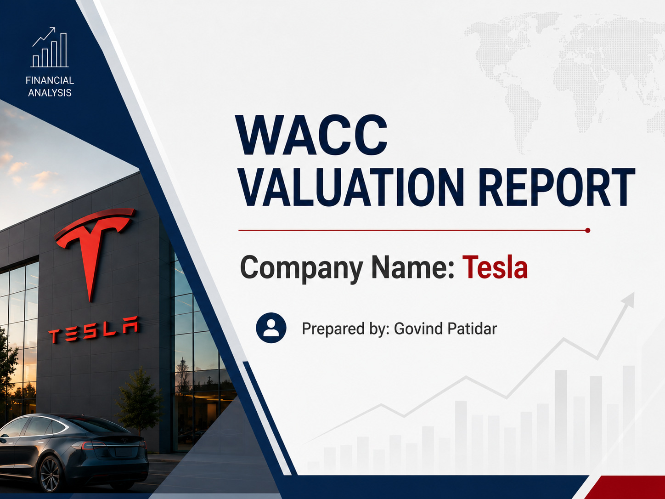

Slide 2
Company Overview
1. Industry
Tesla Inc. operates in the Automotive and Clean Energy industry. The company designs, manufactures, and sells electric vehicles (EVs), battery energy storage systems, and solar energy products. Tesla is recognized as one of the global leaders in sustainable transportation and renewable energy solutions.
2. Business Summary
Founded in 2003 and headquartered in Austin, Texas, Tesla develops innovative electric vehicles such as the Model 3, Model Y, Model S, and Model X. In addition to automobiles, the company offers energy storage products, solar panels, and charging infrastructure. Tesla focuses on technological innovation, automation, and sustainability to accelerate the world's transition to clean energy.

Slide 3
3. Why Selected
Tesla was selected because it is one of the world's most valuable and influential companies, with strong financial performance and significant market presence. Its publicly available financial statements, high-growth business model, and active capital market data make it an excellent company for analyzing capital structure, cost of capital, and WACC valuation.

Slide 4
Capital Structure Analysis
• Market Cap (E) = 32155000
• Market Value of Debt (D)= 14719000
• Total Value =46874000
• E/V = 68.59%
• D/V= 31.4%
Meaning
The company is financed 68.59% by shareholders and 31.4% by lenders.

Slide 5
Cost of Equity (CAPM)
Formula: Re = Rf + β(Rm − Rf)
Risk-free Rate: 4.30%
Beta: 1.83
Market Risk Premium: 5.50%
Cost of Equity (Re): 14.37%
Beta > 1 indicates Tesla is more volatile than the market.

Slide 6
After-Tax Cost of Debt
Pre-tax Cost of Debt: 2.08%
Tax Rate: 27%
After-tax Cost of Debt: 2.27% (per workbook)
Interest expense is tax deductible, reducing the effective borrowing cost.

Slide 7
WACC Calculation
WACC = (E/V × Re) + (D/V × Rd)
Equity Weight: 68.59%
Debt Weight: 31.40%
Cost of Equity: 14.37%
After-tax Cost of Debt: 2.27%
Final WACC: 10.37%

Slide 8

ROIC vs WACC
If ROIC > WACC → Company creates shareholder value.
If ROIC < WACC → Company destroys shareholder value.
With a WACC of 10.37%, Tesla should invest only in projects earning above this hurdle rate.

Slide 9
Sensitivity Analysis
• Interest rate ±10%
• Beta ±10%
Sensitivity analysis was performed to examine how changes in the Weighted Average Cost of Capital (WACC) affect Tesla's valuation. A lower WACC increases the present value of future cash flows, resulting in a higher enterprise value and share price. Conversely, a higher WACC decreases the present value of future cash flows, reducing enterprise value and equity value. Additionally, changes in beta affect the cost of equity through the CAPM model, which subsequently changes the WACC and overall company valuation. This analysis demonstrates that Tesla's valuation is highly sensitive to the discount rate assumptions used in the DCF model.

Slide 10
Limitations
Historical beta may not predict future risk.
Market conditions and interest rates change over time.
Capital structure may change.
CAPM assumptions may not fully reflect real markets

Slide 11
Final Conclusion
Tesla's WACC is approximately 10.37%.
A ROIC above WACC indicates value creation.
Sensitivity analysis shows valuation is highly dependent on interest rates and beta.
Management should pursue projects with expected returns above WACC.

