Slide 1
Code share between React and React native

Slide 2
Share code
We can reuse code except UI.
Utils
Action
Reducer
Store

Slide 3
Steps:
react-native init commonCode
yarn add webpack --dev
yarn add react-dom
Add redux, redux-thunk, react-redux

Slide 4
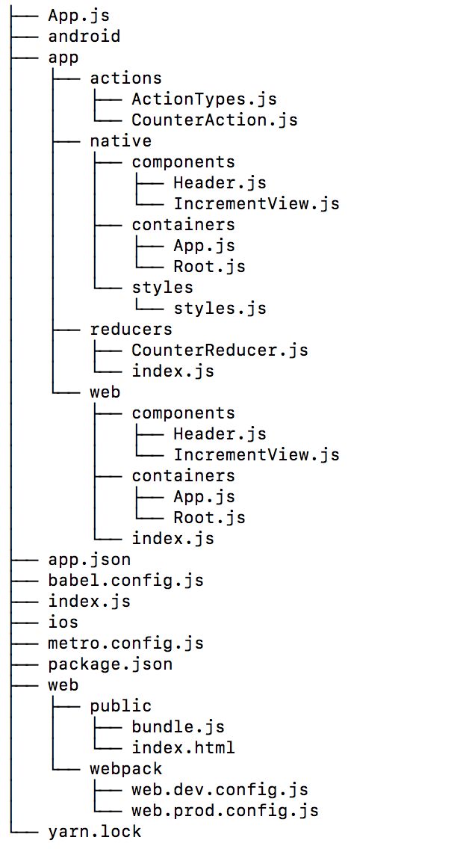
Folder structure

Slide 5
Let create a project

