Slide 1
A
Project
on
“Distributed Data management and Recovery System”
Guided By
Asst. Prof. A.S.Gehlot
MBM Engg. College
By
Govind Salvi
Nitin Tater
Don Pandya
Bharat Choudhary
Information Technology

Slide 2
Overview
Distributed databases
Client Server Architecture
Data Distribution and recovery
Web Server Component of the project
FTP Server Component of the project
Enhancement
References

Slide 3
Distributed System
Distributed database (DDB) is a collection of multiple, logically interrelated databases distributed over a computer network.
Site A
Site B
network
Site C
Distribution can be done by following ways
Replication
Fragmentation

Slide 4
Client Server Architecture
It is a application design approach that results in the decomposition of system into small number of server executing on one or more platform and providing services to a large number of server functions executing on one or more different platform.
Client Side
Application
Client Services
Communications
Application
Client Services
Communications
Application
Client Services
Communications
LAN
Communications
DBMS Services
Server Side
Database

Slide 5
TCP Sockets
process sends/receives messages to/from its socket
socket analogous to door
sending process shoves message out door
sending process relies on transport infrastructure on other side of door which brings message to socket at receiving process
host or
server
host or
server
controlled by
app developer
process
process
socket
socket
Internet
TCP with
buffers,
variables
TCP with
buffers,
variables
controlled
by OS

Slide 6
Tools and Technologies
Application | Client-side | Server-Side
Application architecture | JAVA | JAVA
Web-technology | HTML | PHP
Server | --------- | FTP ,Web, Apache
Database | ---------- | MYSQL,MSACCESS

Slide 7
Blue print of the project
server
client
Create Socket
Port =x for incoming request
Wait for Incoming connection Request
Create Socket Connected to Host ID , ,Port= x
Read request from connection socket
Send Request Using Client Socket
Write reply to Connection Socket
Read reply from Client Socket
Close Connection Socket
Close Client Socket
Communication between client and server via socket

Slide 8
User Case diagram
Central Branch
Server
Administrative control
A
Administrator
Data Entry
Branch A
Server
Branch B
Server
Data Entry
Data Entry
A
Using services
provided by root
Server
Employee at branch A
Employee at branch B

Slide 9
Organization of client and server Subsystem
Client Systems of Branch A
Client Systems of Branch B
Client Systems of Branch N
Server Subsystem
The client Subsystem system
Central Server
System
Branch A Server
Branch B Server
Branch A Clients
Branch B Clients
The server Subsystem

Slide 10
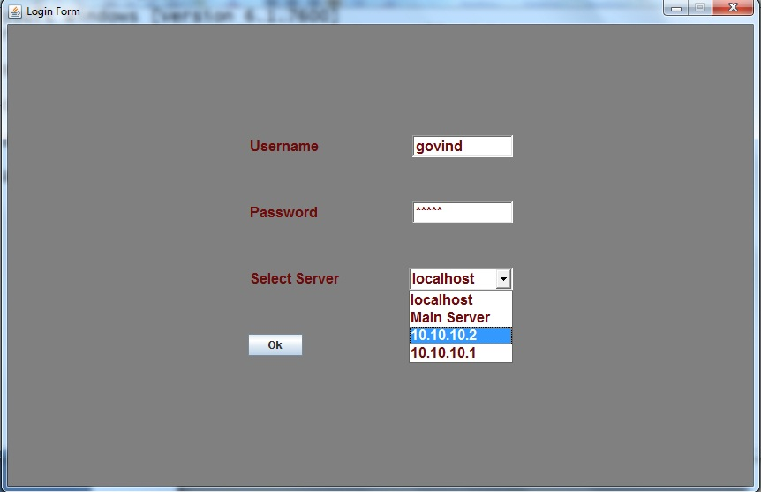
Client Side Snap Shoot of the login Screen

Slide 11
Web Server’s Working
The web Server attached to the whole application works as like, We have a 24*7 on Server System at the Central Server like (Apache) when Client ask for a particular page the Web Server first finds is it a static web page or a dynamic if static the it directly return it to the asking Client machine or otherwise if dynamic page request it first invoke the apache server then with the help of it our web server make an equivalent static web page then this static web page is sent to the Client.
Web Server
No
No
Yes
Http request
If Static
Web page
Process
Client
System
Http response
Web Container

Slide 12
HTTP request message: general format
Request = Request-Line
*( general-header
| request-header
| entity-header )
CRLF
[ message-body ]
Method sp URL sp version cr lf
Header field name : value cr lf
Header field name : value cr lf
Cr lf
Entity Body

Slide 13
HTTP request message
request line
(GET, POST,
HEAD commands)
GET /M.B.M/page.html HTTP/1.1
Host: www.mbmengg.edu
User-agent: Mozilla/4.0
Connection: close
Accept-language :fr
(extra carriage return , line feed
header
lines
Carriage return,
line feed
indicates end
of message

Slide 14
HTTP response message format :-After receiving and interpreting a request message, a server responds with an HTTP response message.
status line (protocol
status code
status phrase)
HTTP/1.1 200 OK
Connection close
Date: Thu, 06 Aug 1998 12:00:15 GMT
Server: Apache/1.3.0 (Unix)
Last-Modified: Mon, 22 Jun 1998 …...
Content-Length: 6821
Content-Type: text/html
data data data data data ...
header lines
data, e.g.,
requested
HTML file

Slide 15
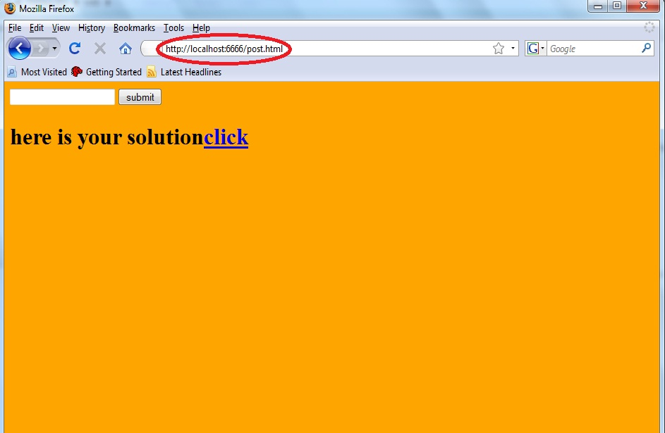
Getting a static page from web server
On some of the server machine our web server program is running 24*7 .when a client wants to use services provided by it .he/she first open up the browser and give the uniform resource locator (url) like wise.
Port no. Where server process running
protocol File name which client wants http://10.10.10.2:6666/post.html
IP Address of server machine

Slide 16
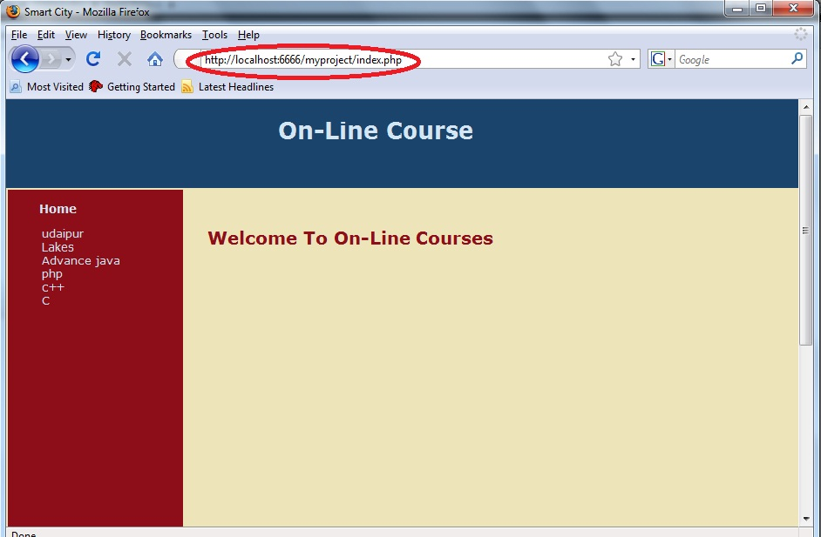
Getting a Dynamic Page from Server:- Here when we ask for a dynamic page to the server throws an exception as it dos not contain any dynamic page this exception is handled by apache server which convert the Dynamic page into equivalent static page the our server program returns this static page back to the client.

Slide 17
FTP Server
FTP is a protocol for moving files from one computer or server to another. These files may be stored in their new location for storage or for viewing/downloading by others on the World Wide Web.
To transfer the file, two connections are used: -
The control connection and
The data connection.
FTP user
interface
FTP client
File Transfer
FTP Client
FTP server
Local file system
Remote file system
FTP moves between local and remote file system

Slide 18
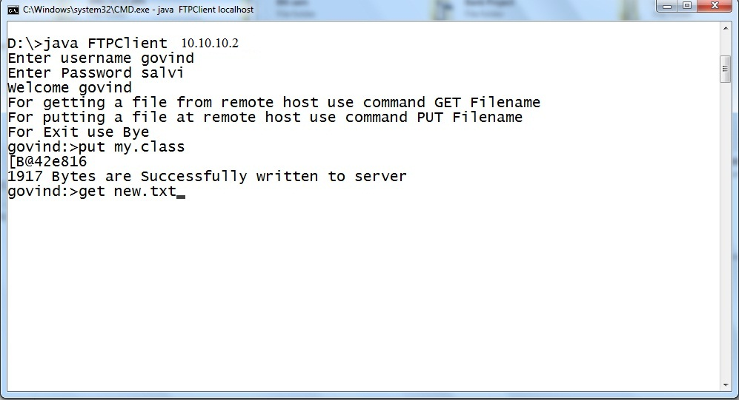
For connecting to the remote host with FTP client we have to first load the program FTPClient with the IP address of the server the following snap shoot shows how the environment is present in front of the FTP client.
Command are
PUT Filename
GET Filename

Slide 19
Enhancement
-Authorization level could be more strict.
- Currently system is working on the basses of double entry. Means first entry is made to the respective branch server then to the central server. By applying the replication technique the limitation can be overcome.
-The Server Subsystem is now working as a private network in future it could be deploy on the public network.
-when we ask for the dynamic page the system redirect the request to apache web server In future we can create such server that could resolve the Dynamic web page by it’s own.

Slide 20
References
Books
Computer Networking by kurose and ross third Edition.
Database system concepts by Korth and sudarshan. Fifth edition
Java – The complete reference by Herbert schildt.

Slide 21
Thank
You!

