Slide 1
A
Seminar
on
“Search Engine”
Guided By
Asst. Prof. N.L.Sharma
MBM Engg. College
By
Govind Salvi
Information Technology
Roll no 2471

Slide 2
Overview
What is Search?
What does it means by Search Engine?
Search Engine Basics
Search Engine Architecture
How Search Engine Works?
Conclusions
References

Slide 3
What is Search and Search Engine?
Search basically means find some thing.
Example: when we are trying to find some word in a dictionary we are actually searching for that particular word in the dictionary.
The one who performs this searching function is known as Search Engine. On this particular case Search Engine is Human.
When we talk about System terminology the machine (Program) which Perform this searching operation is called Search Engine.
The two basic type of Search Engines are..
Database Search Engine
Web Search Engine

Slide 4
Database Search Engine
Database search engine perform the search process by Pattern Matching when the user gives a particular query.
Example:-
Query SELECT name,class,roll_no FROM student WHERE roll_no > 100;
When we give above query to Database search Engine it perform the pattern matching with the algorithm that selects name ,class, roll_no form table student that satisfy condition roll_no >100

Slide 5
Web Search Engine
A software program that helps users find information stored on a personal computer, or a network of computers, such as the Internet. A user enters search terms and the search engine retrieves a list of World Wide Web sites, personal computer files, or documents.
Types of Web Search Engine
Crawler Based Search Engine
Human Powered Search Engine
Hybrid Search Engine

Slide 6
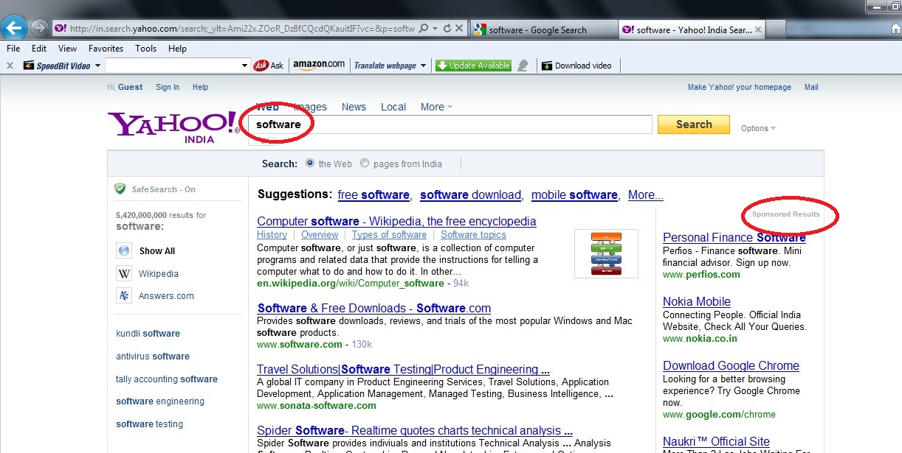
Visualization

Slide 7
Search Engine Basics
Meta Tag:-A special HTML tag that provides information about a Web page. they provide information such as who created the page, how often it is updated, what the page is about, and which keywords represent the page's content.
Spider (crawlers):- A program that automatically fetches Web pages. Spiders are used to feed pages to search engines. It's called a spider because it crawls over the Web. Another term for these programs is WebCrawler.

Slide 8
Search Engine Architecture
Page Repository
Document Store
Web
Link Analysis
Crawlers
Indexer
Structure
Ranking
Extraction
Text
Query Engine
Crawl Control

Slide 9
How Search Engine Works ?
The following steps are a part of the Google Search Framework:
Crawling
b. Indexing
c. Query Processing
d. Ranking

Slide 10
Crawling: Data of the new & updated content from all the web pages on the web. Crawlers / Spiders / Robots /Bots are Search Engine specific software that collects data from the Web.
Spiders
Crawling
Websites
Web Crawlers
Go through entire
www web database.

Slide 11
Indexing: This step is required for converting the unstructured page data to a structured format so that it can be used efficiently for Query processing.
Spiders
Search Engine Database
indexing Software
Search Engine Index

Slide 12
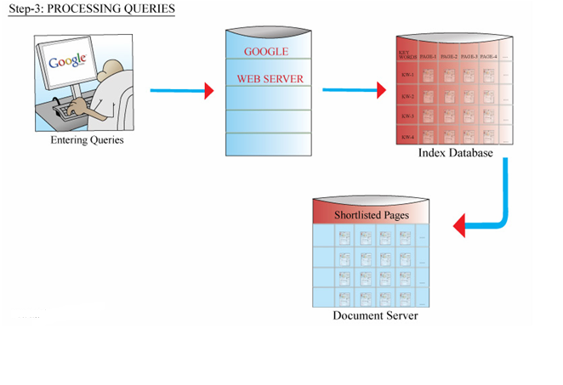
Query Processing: This step takes the User query (Keyword) as its input, which the user enters into the SEARCH BOX. The outcome of this step is the short listed pages from trillions of pages and which are relevant for this query.

Slide 13
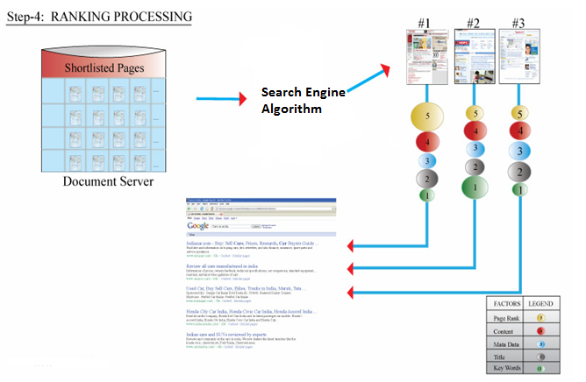
Ranking: This is the final step of the search process. Google algorithm comes into picture here

Slide 14
TF-IDF Algorithm
TF Term Frequency
How many times a word appears in a document
IDF Inverse Document Frequency
Logarithm of (Number of documents /
number of documents containing the term)
TF-IDF of a keyword in a page = TF * IDF

Slide 15
Example
100 web pages. Keyword: Mbm Engg. College
#1 has 8 mentions. TF = 8.
#2, 17, 19, 76 have 4 mentions. TF = 4.
20 pages have 1 mention. TF = 1.
IDF = log₂ (100 / 25) = 2
TF-IDF of Mbm Engg. College in #1= 8 * 2=16High!
TF-IDF of Mbm Engg. College in #2, 17, 19, 76 = 4 * 2 = 8 Not so high
TF-IDF of Mbm Engg. College in 20 others = 1 * 2 = 2 Small
TF-IDF of Mbm Engg. College in all the rest = 0 * 2 = 0 Irrelevant

Slide 16
Conclusions
Search engine plays important role in accessing the content over the internet, it fetches the pages requested by the user
It made the internet and accessing the
information just a click away.
The need for better search engines only increases

Slide 17
References
Web Links
Wikipedia. Till seminar
www.telezent.com 1-may-2011
http://searchenginewatch.com/ 24-april-2011
http://homeforprofits.com/search-engines/working-of-a-search-engine/
15-april-2011
http://computer.howstuffworks.com/internet/basics/ 15-april-2011
Books
Computer Networking Top down Approach by Kurose and Ross. 3 edition

Slide 18
Thank
You!

