Slide 1
♞De-Knight

Slide 2
Architecture

Slide 3
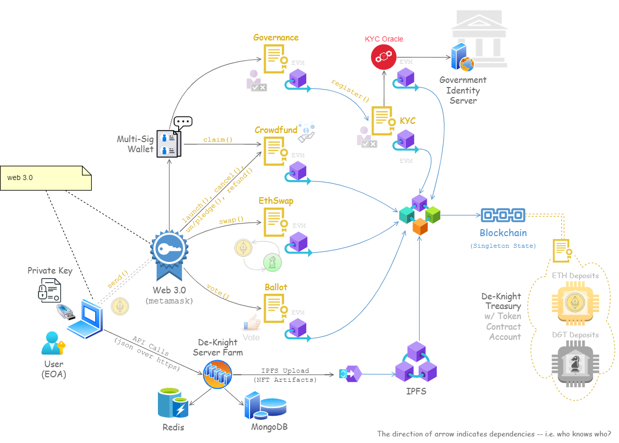

Slide 4
IPFS

Slide 5
Governance

Slide 6
Crowdfunding

