Slide 1
Intelligent tutoring systems
A Better Approach

Slide 2
ABOUT US
We are the members of group 6.
- Piyush Chanduka - Govind Tuli - Vatsal Agarwal

Slide 3
Paper review
The paper we inferred is “A Web-Based Intelligent Tutoring System for Computer Programming”.
It uses a model called BITS (Bayesian Intelligent Tutoring System). It is a web-based intelligent tutoring system for computer programming that utilizes Bayesian networks for uncertainty management.
A user learns a topic with minimum amount of knowledge he needs to know. BITS obtains evidence for updating the Bayesian network through two methods: (a) direct feedback from the student if they know a particular concept or not, and (b) sample quiz results to determine if a student has understood a particular concept.
BITS has been implemented for use in the initial computer programming course at the University of Regina and demonstrates the practical usefulness of Bayesian networks for web intelligence in tutoring systems.

Slide 4
Our changes
Chatgpt
Infusion of ChatGPT saves time and improve error detection ability. It takes both correct as well as erroneous code to specify the errors user made.
domain knowledge integration
We have assigned relative weights to each node to mark their importance. This helps to create a tree which will lead to shorter path.
optimization of probability propagation
This makes our model a unique one as it ensures a slight change in the parent node whenever child node’s probability updates.
Problem solving
We have introduced problem solving coding quizzes after each lesson. This would make the whole difference as it would increase the thinking ability of the user and practice for use in future.

Slide 5
Concepts we used
Bayesian Networks
Graph-based Results
model that visually represents the joint probability distribution of a set of random variables using a directed acyclic tree and conditional probability distributions for each node in the tree.
Generating 3D graphs and heatmap to visualize effect of varying node weights and probabilities
Accuracy Calculation
Incorporation of weights
Categorized ChatGPT’s response into 4 types – TP, TN, FP, FN in order to calculate ChatGPTs efficiency
This helps in better incorporation of domain knowledge as well as better modelling of users knowledge

Slide 6
Code OVERVIEW
Network Setup & CPDs
Baesian network is made. Nodes and edges defined. Weights assigned.
Access Conditions & ChatGPT Integration
Passing criteria of 0.7 value of probability is imposed and GPT integration with respect to problem solving is simulated
Simulation
User interaction simulated, CPDs updated accordingly, 3D plots made tovisualize the impact of varying weights and initial probabilities on parent-child node relationships.
Exhaustive Simulation and Heatmap
exhaustive simulation to calculate the average change in probability across all nodes in the network for various combinations of initial probabilities and weights

Slide 7
Chatgpt overview
Easy
Medium
hard
It works excellently well. The accuracy is neary perfect.
Accuracy is more than 95%
Accuracy is more than 95%

Slide 8
Results explained

Slide 9
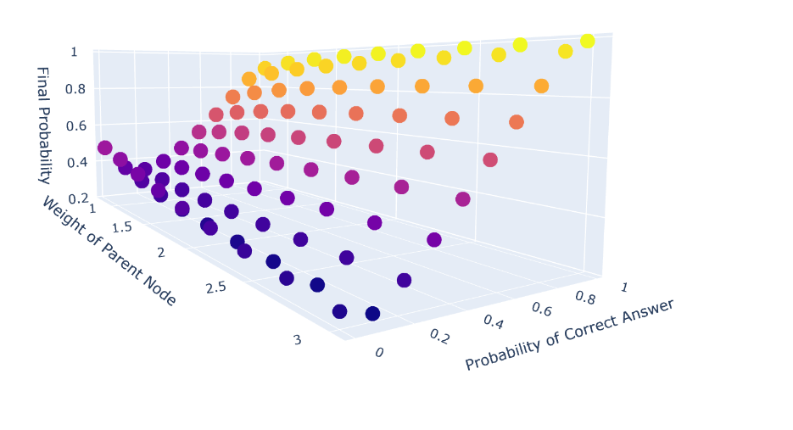
relationship between the weight of a parent node, the probability of a correct answer for the child node, and the final probability of knowing the parent node
weight of the parent node increases, its influence on the child node becomes stronger, meaning that the learner's understanding of the parent node has a more significant effect on their understanding of the child node. This causes the surface to rise in the direction of increasing parent node weight.
as the probability of a correct answer for the child node increases, the likelihood of the learner having a good understanding of the child node also increases. This causes the surface to rise in the direction of increasing the probability of a correct answer for the child node.
we can predict that the surface will have a sloping shape, with the lowest values in the corner representing low parent node weights and low probabilities of correct answers, and the highest values in the corner representing high parent node weights and high probabilities of correct answers

Slide 10
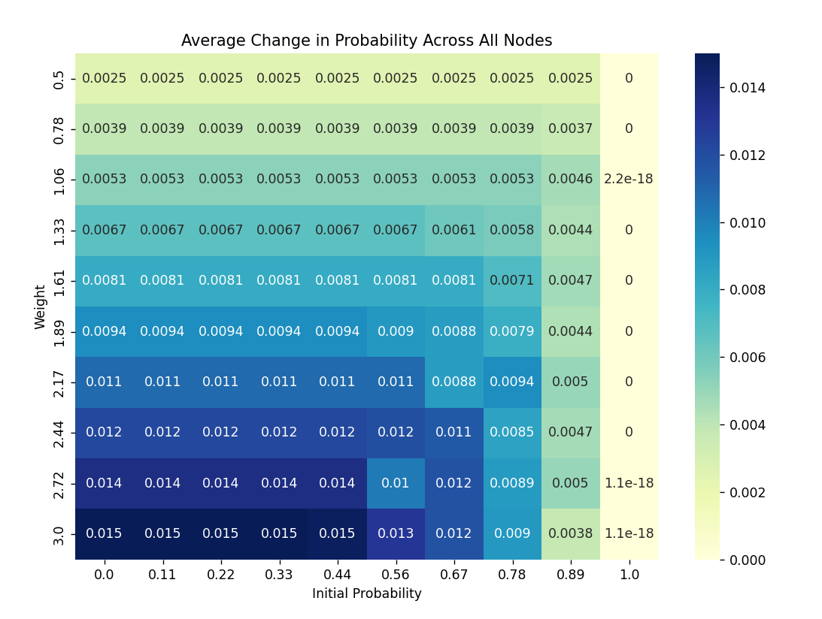
The heatmap displays the average change in probability across all nodes with respect to the initial probability and weight settings. The x-axis corresponds to the initial probability, and the y-axis corresponds to the weight.
High initial probability
Low initial probability
Low weight
High weight:

Slide 11
THANK YOU

