Slide 1
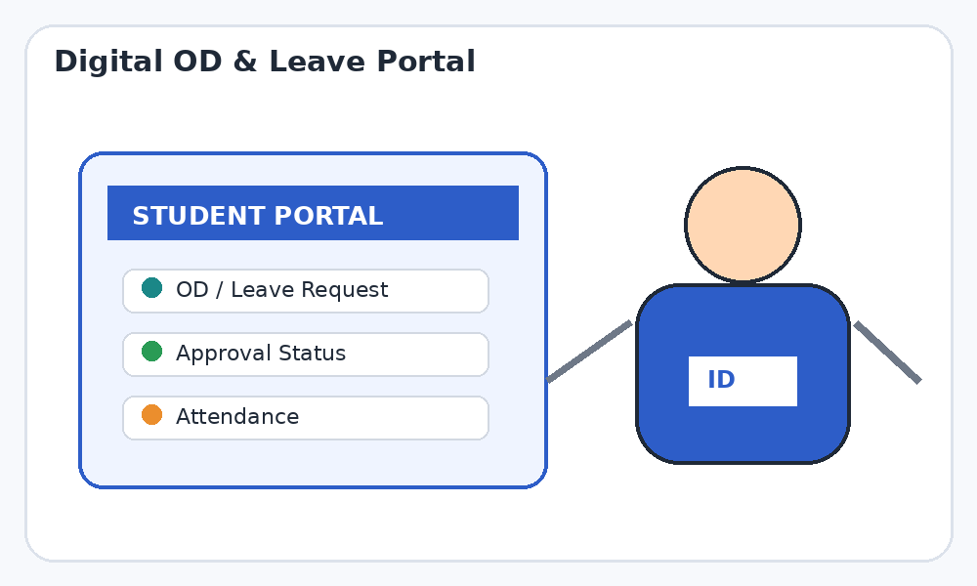
Automated Student OD and Leave Approval
with Attendance & Hostel Integration
REVIEW 1 – PROJECT REVIEW
Trainer Name: MS. NAGAMANI SEGALLA
Student Name: Govinth S
Department: Computer Science and Engineering
Topic: Automated Student OD and Leave Approval with Attendance Integration
1

Slide 2
Review 1 – Agenda
01
02
03
04
Functional & Non-Functional Requirements
System Architecture
Use Case Diagram
ER Diagram
05
06
07
Preceded by a short project overview
Module Description
Technology Stack
UI Design
2
Notes:
Seven Review-1 topics, in the order they will be presented. A short project overview comes first for context.

Slide 3
Project Overview
Problem Statement
Proposed Solution
OD / leave requests sent by forms, WhatsApp or in person
Faculty must manually check dates, reasons and details
Parents get no formal notice of reason and duration
Hostel students need a separate out-pass; attendance is updated late
One web platform for student, parent, faculty, warden and admin
Reason, event and duration captured and sent to the parent
Digital approval with remarks and full history
Approved OD feeds the warden list and updates attendance automatically
Student submits
Parent informed
Faculty approves
Warden synced
Attendance updated
Status stays visible to every role after each decision.
3
Notes:
Context only: the problem with manual OD/leave handling and what the proposed web platform changes.

Slide 4
Functional Requirements
Student
Parent
Faculty
FR1 Login and view profile
FR2 Submit OD/leave with reason, event, dates, proof
FR3 Track status and history
FR4 View attendance
FR5 Receive reason, event and duration
FR6 Acknowledge / confirm the request
FR7 View request history
FR8 Review pending requests
FR9 Approve or reject with remarks
FR10 Monitor requests and attendance
Warden
Admin
System
FR11 Auto-receive approved hostel-student list
FR12 View OD-linked exit status
FR13 Avoid a duplicate out-pass request
FR14 Manage users and roles
FR15 Reports and audit logs
FR16 Auto-update attendance on approval
FR17 Notify on every status change
FR18 Keep complete digital history
4
Notes:
Grouped by role. FR numbers are used again in the use case and module slides.

Slide 5
Non-Functional Requirements
Performance
Security
Usability
Reliability
Pages respond in about 3 s
Request submit is quick
JWT authentication
Hashed passwords
Role-based access
Simple, responsive UI
Few steps to apply
No lost requests
Consistent records
Scalability
Availability
Maintainability
Compatibility
Handles more students and departments
Web access any time
Works on any device
Modular code
Clean REST APIs
Modern browsers
Desktop and mobile
5
Notes:
Quality attributes the system is designed to meet. Response-time figures are design targets.

Slide 6
System Architecture
Student
Parent
Faculty
Warden
Admin
Presentation Layer
HTML • CSS / Bootstrap • JavaScript – role-based responsive dashboards
Application Layer – Node.js / Express REST API (JWT auth • role-based access • request validation)
Request
Service
Approval
Service
Attendance
Service
Hostel
Service
Notification
Service
MongoDB Database
Users • Students • Requests • Approvals • Attendance • Hostel exits • Notifications • Audit
Email / SMS gateway
6
Notes:
Three-tier web architecture: browser clients, a Node/Express REST layer with five services, and MongoDB. Notification service calls an email/SMS gateway.

Slide 7
Use Case Diagram
OD & Leave Approval System
Login / Logout (all actors)
Submit OD / Leave
Review Request
Upload Supporting Proof
Approve / Reject
Faculty
Student
Track Request Status
Auto-update Attendance
View Attendance
View Hostel OD List
Verify OD-linked Exit
Warden
Receive Notification
Manage Users & Roles
Parent
Acknowledge Request
Reports & Audit Logs
Admin
7
Notes:
Five actors. Everyone logs in first. Student and Parent on the left; Faculty, Warden and Admin on the right.

Slide 8
ER Diagram
PARENT
STUDENT
USER
NOTIFICATION
parent_id PK
user_id FK
name
phone
email
student_id PK
user_id FK
parent_id FK
roll_no
department
year
is_hosteller
user_id PK
name
email
password_hash
role
phone
notif_id PK
user_id FK
request_id FK
message
channel
sent_at
1 : N
1 : 1
1 : N
1 : N
1 : N
ATTENDANCE
OD_REQUEST
APPROVAL
HOSTEL_EXIT
attendance_id PK
student_id FK
request_id FK
subject
date
status
request_id PK
student_id FK
type (OD/Leave)
event_name
reason
from_time
to_time
status
approval_id PK
request_id FK
faculty_id FK
decision
remarks
decided_at
exit_id PK
approval_id FK
request_id FK
warden_id FK
out_time / in_time
status
N : 1
1 : N
1 : 0..1
8
Notes:
Eight entities. PK = primary key, FK = foreign key. In MongoDB each entity is a collection with ObjectId references.

Slide 9
Module Description
1. Authentication & Users
2. Student Module
3. Parent Module
Login / logout with JWT
Role-based access control
Admin manages users and roles
Submit OD / leave with proof
Track status and history
View attendance
Receive reason, event, duration
Acknowledge the request
View request history
4. Faculty Module
5. Warden / Hostel Module
6. Attendance & Notification
Review pending requests
Approve / reject with remarks
Monitor attendance
Auto list of approved ODs
OD-linked exit status
No duplicate out-pass
Auto attendance update
Status notifications
History, audit and reports
9
Notes:
Six modules. Each maps to the functional requirement numbers on the earlier slide.

Slide 10
Technology Stack
Frontend
Backend
Database
HTML5
CSS3 / Bootstrap
JavaScript
Node.js
Express.js
REST APIs
MongoDB
Mongoose ODM
Indexed collections
Security
Notifications
Tools
JWT authentication
bcrypt password hashing
Role-based middleware
Email via Nodemailer
In-app status alerts
SMS / push (future)
VS Code
Git / GitHub
Postman for API tests
Browser
Express REST API
MongoDB
10
Notes:
MERN-style stack without React: plain HTML/CSS/JS front end, Node and Express back end, MongoDB.

Slide 11
UI Design – Login, Dashboard, Request Form
Login
Student Dashboard
New OD / Leave Request
OD
Pending
Approved
Rejected
Type ▾
Event name
Reason
Event / Date / Status
Email / Roll number
From
To
Hackathon
Approved
Password
Medical leave
Pending
Location
Symposium
Approved
Role ▾
⬆ Upload proof (PDF / image)
Family event
Rejected
Login
+ New OD / Leave Request
Submit Request
Login
Student dashboard
OD / leave request form
11
Notes:
Wireframes for the student-facing screens. Same layout language is reused for the other roles.

Slide 12
UI Design – Parent, Faculty, Warden Views
Parent – Request Notice
Faculty – Pending Requests
Warden – Hostel OD List
Your ward has applied for OD
Event: Hackathon
Reason: Inter-college event
Duration: 24 hours
Status: Awaiting faculty
Student A
Hackathon
Student / Out – In / Exit
Student A
10 AM – 10 AM
Linked
Approve
Reject
Student C
2 PM – 9 PM
Linked
Student B
Medical leave
Student D
9 AM – 5 PM
Pending
Approve
Reject
Student E
6 AM – 8 PM
Linked
Remarks
Acknowledge
Contact
Approved hostel ODs act as the exit permission – no second out-pass form.
Submit decision
Parent view
Faculty approval
Warden list
12
Notes:
Wireframes for the parent, faculty and warden screens.

Slide 13
Conclusion & Next Steps
Review 1 Summary
Next Steps
Requirements: 18 functional and 8 non-functional
Architecture: three-tier, Node/Express REST + MongoDB
Use cases for five actors; ER model with eight entities
Six modules defined; technology stack finalised
UI wireframes ready for six screens
Frontend and backend development
REST API and database integration
Module-wise implementation and testing
Hostel exit linking and attendance rules
Screenshots, progress report, challenges
13
Notes:
Review-1 design is complete; the remaining items feed the Review-2 topics.

Slide 14
THANK YOU

