Slide 1

EDA on IMDB Movies
by Ramesh Govindarajan
Apr 2019 Cohort

Slide 2
Story
This dataset contains a large number of public data on films such as the title of the film, the year of release of the film, the genre of the film, the audience, the rating of critics, the duration of the film and much more. Source is from IMDB website and data extracted with movies year of release between the year 2000 and the year 2017
Dataset attributes includes the Movie name, Genre, duration of the film, Release Year, Votes, Audience Rating, Critic Rating and Movie Gross in millions.
With the help of this dataset, I tried to gain the following insights:
Movies with Top revenue
Top categories of movies made in the given time period
Correlation between various parameter in the movie dataframe

Slide 3
Data in depth
Total No. of records in dataset: 4583
Total No. of columns (attributes): 9
‘grossMillions’ attribute has null values which needs to be cleaned
‘unnamed’ attribute has no value for the analysis and it needs to be removed
‘Movie’ and ‘Genre’ attributes should be changed to category data type
‘Year’ attribute should be converted to ‘int64’ data type

Slide 4
Problem Statement
This project has been executed to perform EDA using Pandas on the Movies data and provide actionable insights to the stakeholders. The stakeholders can be:
Movie watching audience – to understand the importance of ratings and votes which are influencing the revenue of the movie.
Movie producers – to give more information about what genres of movies have been most successful in the recent past and what are all the influencing factors for successful movies based history data

Slide 5
Data Profiling
Understood the data using the ‘info’, ‘dtypes’ and ‘describe’ methods of the dataframe into which data was loaded from the csv file.
Performed pre profiling using pandas profiling feature to understand the dataset info of each attribute and identify the values to be cleaned (refer the file imdb_before_preprocessing.html)
Performed data cleaning:
Dropped rows with missing values in ‘grossMillions’ column.
Dropped column ‘unnamed’ since it is not required for analysis and it is not having any meaningful information.
Changed the data types of columns ‘Year’, ‘Movie’ and ‘Genre’.
Performed post profiling using pandas profiling feature to ensure that the new dataset has clean values for the above mentioned columns (refer the file imdb_post_profiling.html):

Slide 6
Data Analysis
Analyzed the data to gain following details:
What is the movie with highest revenue?
What is the amount of movies that were released each year?
Is there any correlation between audience ratings and critics ratings?
Is there any correlation between audience ratings and movie length?
Is there any correlation between critic ratings and movie length?
Is there any correlation between revenue and audience rating?
Is there any correlation between revenue and critic rating?
Is there any correlation between votes and audience rating?
Is there any correlation between revenue and movie length?
Distribution by various columns in the movies data.
Which are the Top 5 Genres based on number of movies?
Charts based on different genres.
Which is the correlation between each column?

Slide 7
What is the movie with highest revenue?
The movie Star Wars: Episode VII is the highest gross making movie from the available data. It was released in 2015 with $936.66 millions as gross revenue.

Slide 8
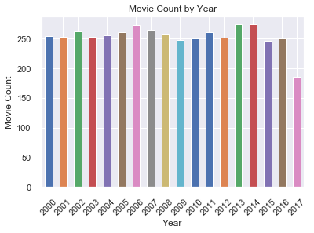
What is the amount of movies that were released each year?
On an average, around 250 movies were released between years 2000 and 2017

Slide 9
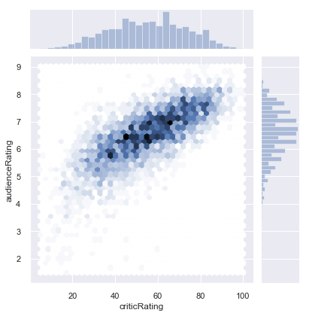
Is there any correlation between audience ratings and critics ratings?
The audience ratings of the movies are in agreement with those of the critics ratings.

Slide 10
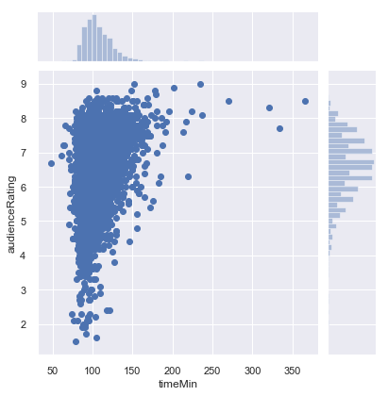
Is there any correlation between audience ratings and movie length?
On this graph, we see that most of the movies last between 60 minutes and 120 minutes and collect the most scores and these scores are between 4/10 and 8/10 with a majority of scores above 6/10

Slide 11
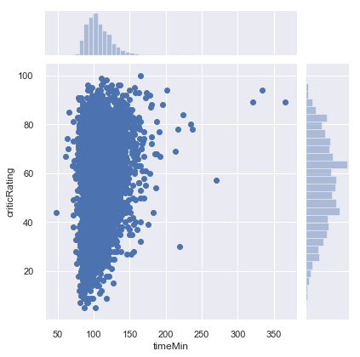
Is there any correlation between critic ratings and movie length?
On this graph, we note that for films between 60 minutes and 120 minutes, the ratings of the critics are more concentrated and vary between 10/100 and 98/100

Slide 12
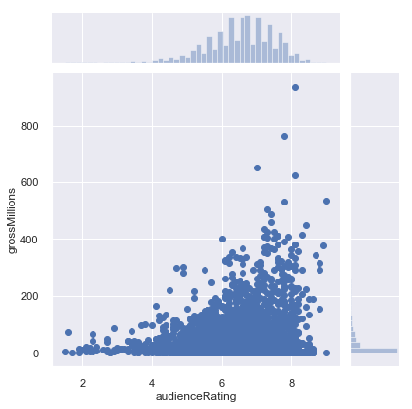
Is there any correlation between revenue and audience rating?
On this chart, it is clear that the movies that have been well rated by the public are movies that have generated the most millions of dollars, which is logical because if people have enjoyed a movie, they will talk about them, which will encourage other people to go to the cinema to see it, and thus increase the gross of the movie. Audience (public) ratings are more concentrated between 5/10 and 8/10.

Slide 13
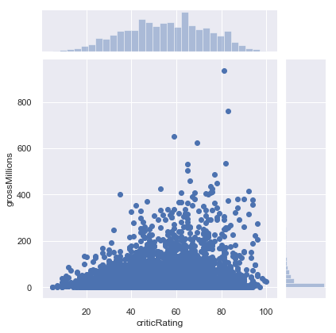
Is there any correlation between revenue and critic rating?
In this graph, we note that the ratings of the critics are more concentrated between 30/100 and 80/100, which means that the critics are more demanding towards the films than the public. We also note that the films that have high ratings from critics are those who have brought back a lot of money.

Slide 14
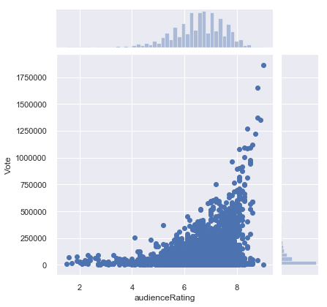
Is there any correlation between votes and audience rating?
In this chart, the audience rating mostly falls between 5-8 and it has some kind of correlation with votes.

Slide 15
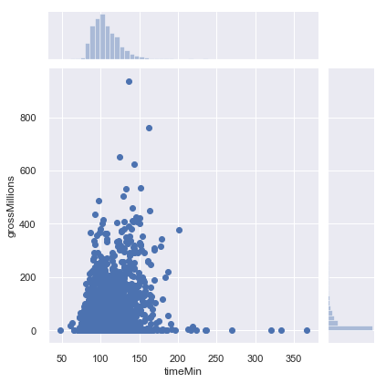
Is there any correlation between revenue and movie length?
On this graph, we notice that the movies between 60 minutes and 150 minutes (2h30) are the ones that bring the most. On the other hand, movies with a very long duration, exceeding 3 hours, yield much less, that is to say, under one million dollars.

Slide 16
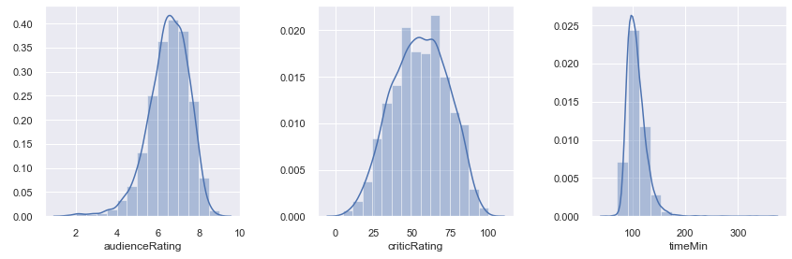
Distribution by various columns in the movies data
* Audience Ratings: Most of the audience ratings are between 6/10 and 7/10.
* Critics Ratings: Most critics ratings are between 40/100 and 70/100.
* Duration of the movie: A large number of films have a duration of 100 minutes (1h40).

Slide 17
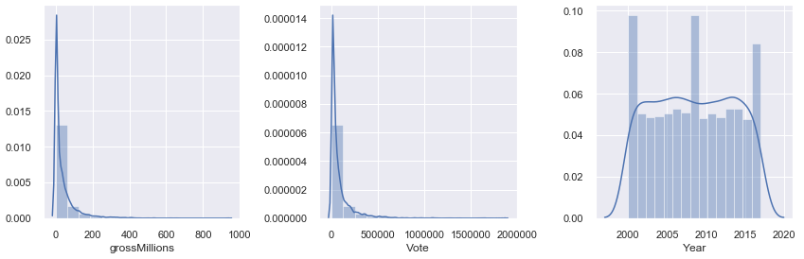
Distribution by various columns in the movies data
* Movie Gross: Most movies are worth between 0 and 100 million dollars.
* Number of votes: Most votes are between 0 and 250000 votes.
* Year: Many movies were released in 2000, 2009 and 2017.

Slide 18
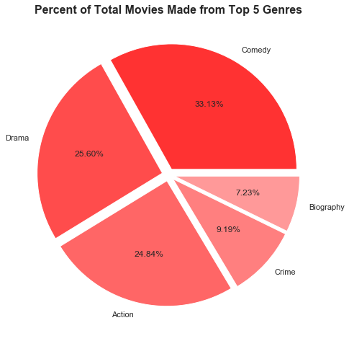
Which are the Top 5 Genres based on number of movies?
Based on the above Pie chart, the following are the top 5 genres based on number of movies released. 1) Comedy 2)Drama 3) Action 4) Crime and 5) Biography

Slide 19
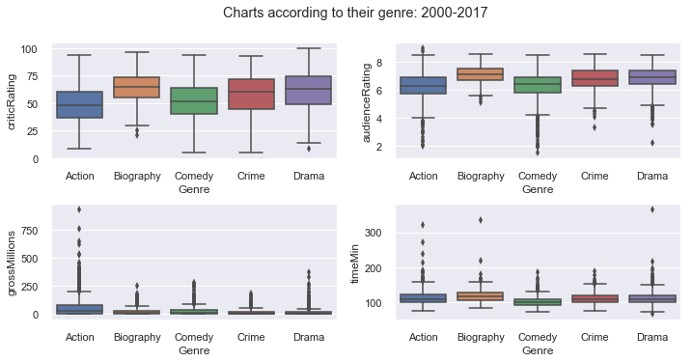
Charts based on different genres

Slide 20
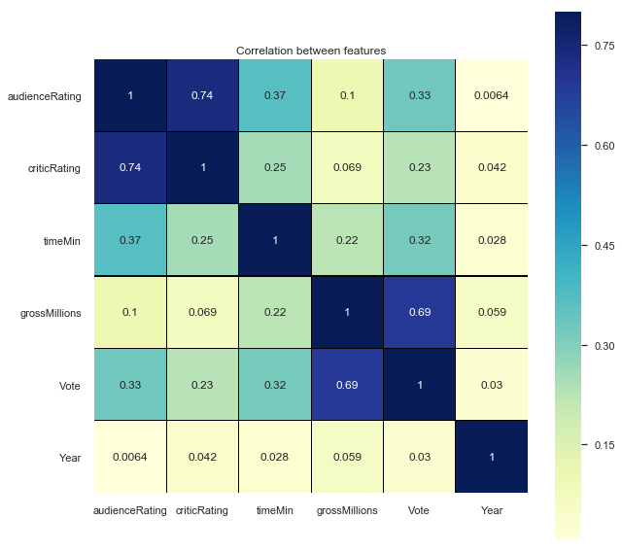
Which is the correlation between each column?

Slide 21
Conclusion
Audience ratings of the movies are quite close to those of the critics ratings
Critics rate more severely than the public
Most movies last between 60 minutes and 120 minutes
Movies that are well rated by public and critics make the most money
The more the public appreciates a film, the more they vote and give a good rating
Movies between 60 minutes and 150 minutes (2h30) make the most money
Movies that exceed 3 hours bring in the least money
Action Genre movies made the highest revenue in comparison to other genre movies

