Slide 1
보충
Taylor and Maclaurin Series
Copyright © Cengage Learning. All rights reserved.

Slide 2
Definitions of Taylor Series and Maclaurin Series

Slide 3
Definitions of Taylor Series and Maclaurin Series (1 of 6)
We start by supposing that f is any function that can be represented by a power series
Let’s try to determine what the coefficients c_{n} must be in terms of f.
To begin, notice that if we put x = a in Equation 1, then all terms after the first one are 0 and we get

Slide 4
Definitions of Taylor Series and Maclaurin Series (2 of 6)
We can differentiate the series in Equation 1 term by term:
and substitution of x = a in Equation 2 gives
Now we differentiate both sides of Equation 2 and obtain
Again we put x = a in Equation 3. The result is

Slide 5
Definitions of Taylor Series and Maclaurin Series (3 of 6)
Let’s apply the procedure one more time. Differentiation of the series in Equation 3 gives
and substitution of x = a in Equation 4 gives
By now you can see the pattern. If we continue to differentiate and substitute x = a, we obtain

Slide 6
Definitions of Taylor Series and Maclaurin Series (4 of 6)
Solving this equation for the nth coefficient c_{n}, we get
This formula remains valid even for n = 0 if we adopt the conventions that 0! = 1
Thus we have proved the following theorem.
Theorem If f has a power series representation (expansion) at a, that is, if
then its coefficients are given by the formula

Slide 7
Definitions of Taylor Series and Maclaurin Series (5 of 6)
Substituting this formula for c_{n} back into the series, we see that if f has a power series expansion at a, then it must be of the following form.
The series in Equation 6 is called the Taylor series of the function f at a (or about a or centered at a).

Slide 8
Definitions of Taylor Series and Maclaurin Series (6 of 6)
For the special case a = 0 the Taylor series becomes
This case arises frequently enough that it is given the special name Maclaurin series.

Slide 9
Example 2
Find the Maclaurin series of the function
and its radius of convergence.
Solution:
If
for all n. Therefore the Taylor
series for f at 0 (that is, the Maclaurin series) is

Slide 10
Example 2 – Solution
To find the radius of convergence we let
Then
so, by the Ratio Test, the series converges for all x and the radius of convergence is R = ∞.

Slide 11
When Is a Function Represented by Its Taylor Series?

Slide 12
When Is a Function Represented by Its Taylor Series? (1 of 12)
From Theorem 5 and Example 2 we can conclude that if we know that
has a power series representation at 0, then this power series must be its Maclaurin series
So how can we determine whether
does have a power series representation?

Slide 13
When Is a Function Represented by Its Taylor Series? (2 of 12)
Let’s investigate the more general question: under what circumstances is a function equal to the sum of its Taylor series?
In other words, if f has derivatives of all orders, when is it true that
As with any convergent series, this means that f (x) is the limit of the sequence of partial sums.

Slide 14
When Is a Function Represented by Its Taylor Series? (3 of 12)
In the case of the Taylor series, the partial sums are
Notice that T_{n} is a polynomial of degree n called the n th-degree Taylor polynomial of f at a.

Slide 15
When Is a Function Represented by Its Taylor Series? (4 of 12)
For instance, for the exponential function
the result of Example 2
shows that the Taylor polynomials at 0 (or Maclaurin polynomials) with n = 1, 2, and 3 are

Slide 16
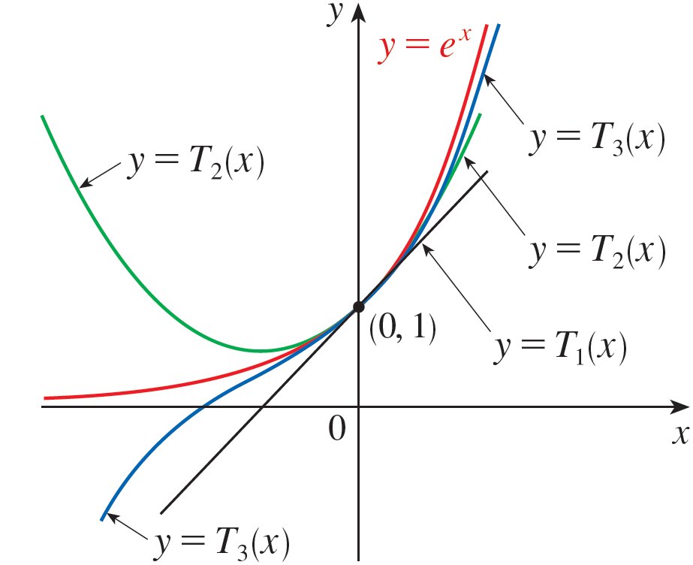
When Is a Function Represented by Its Taylor Series? (5 of 12)
The graphs of the exponential function and these three Taylor polynomials are drawn in Figure 1.
As n increases, T_{n} (x) appears to approach
in Figure 1. This suggests that
is equal to the sum of its Taylor series.
Figure 1

Slide 17
When Is a Function Represented by Its Taylor Series? (6 of 12)
In general, f (x) is the sum of its Taylor series if
If we let
then R_{n}(x) is called the remainder of the Taylor series. If we can somehow show that
then it follows that

Slide 18
When Is a Function Represented by Its Taylor Series? (7 of 12)
We have therefore proved the following.
Theorem If f(x) = T_{n}(x) + R_{n}(x), where T_{n} is the nth-degree Taylor polynomial of f at a, and if
for
then f is equal to the sum of its Taylor series on the interval
In trying to show that
for a specific function f, we usually use the
following Theorem.
Taylor's Inequality If
then the remainder R_{n}(x) of
the Taylor series satisfies the inequality

Slide 19
Taylor Series of Important Functions

Slide 20
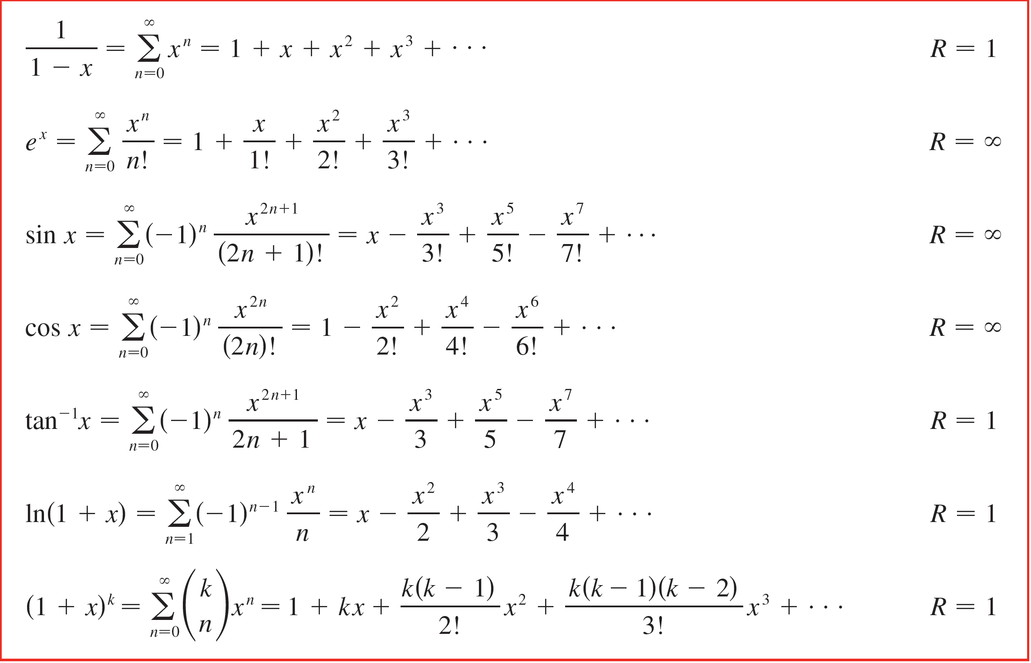
Taylor Series of Important Functions
We collect in the following table, for future reference, some important Maclaurin series that we have derived in this section and the preceding one.
Important Maclaurin Series and their Radii of Convergence
Table 1

Slide 21
New Taylor Series from Old

Slide 22
New Taylor Series from Old (1 of 1)
if a function has a power series representation at a, then the series is uniquely determined. That is, no matter how a power series representation for a function f is obtained, it must be the Taylor series of f.
So, we can obtain new Taylor series representations by manipulating series from Table 1, rather than using the coefficient formula given in Theorem 5.

Slide 23
Example 10
Find the Maclaurin series for (a) f (x) = x cos x and
Solution:
(a) We multiply the Maclaurin series for cos x (see Table 1) by x :
(b) Replacing x by
in the Maclaurin series for ln(1 + x) gives
We know from Table 1 that this series converges for

Slide 24
Multiplication and Division of Power Series

Slide 25
Example 15
Find the first three nonzero terms in the Maclaurin series for (a)
and (b) tan x.
Solution:
(a) Using the Maclaurin series for
in Table 1, we have

Slide 26
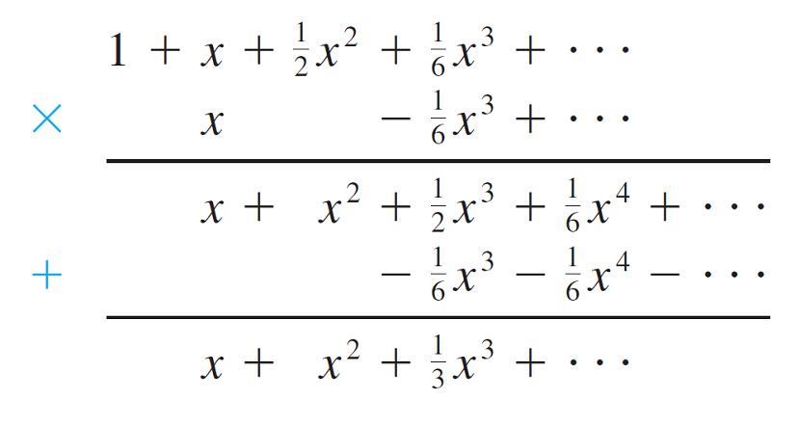
Example 15 – Solution (1 of 3)
We multiply these expressions, collecting like terms just as for polynomials:

Slide 27
Example 15 – Solution (2 of 3)
Thus
(b) Using the Maclaurin series in Table 1, we have

Slide 28
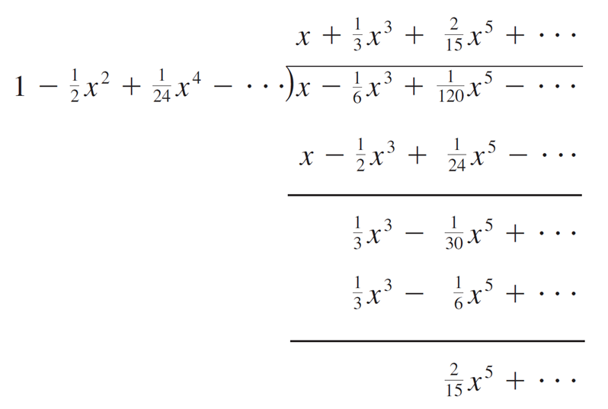
Example 15 – Solution (3 of 3)
We use a procedure like long division:
Thus

