Slide 1
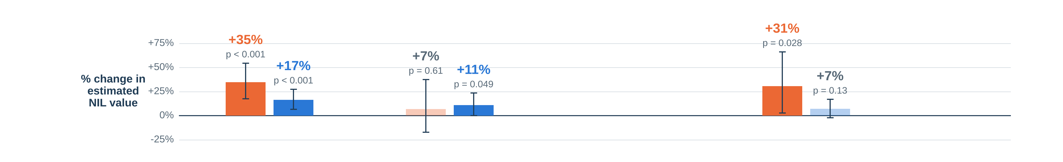
One model, run separately in each sport
Bars: % change in estimated NIL value from each piece, holding the others fixed. Lines = 95% range; faded = not statistically significant.
Basketball (100 players)
Football (100 players)
NIL value
estimated deal value
=
Followers
twice as many Instagram followers
+
Performance
last season, ranked within sport (+25 points)
+
No stats last season
adjustment so freshmen stay in (not shown)
+
Years in college
each extra year
+
Noise
everything we didn’t measure
What each fit shows
Basketball: twice the followers → +35% NIL value
95% range +18% to +54%, p < 0.001
Followers: 64% of what the model explains (model explains 23% overall)
Football: twice the followers → +17% NIL value
95% range +7% to +27%, p < 0.001
Followers: 69% of what the model explains (model explains 30% overall)
The sports’ follower effects are not statistically different (p = 0.08). An association, not cause and effect.
AIPI 510 | Govil and Teshome | November 2026

