Slide 1
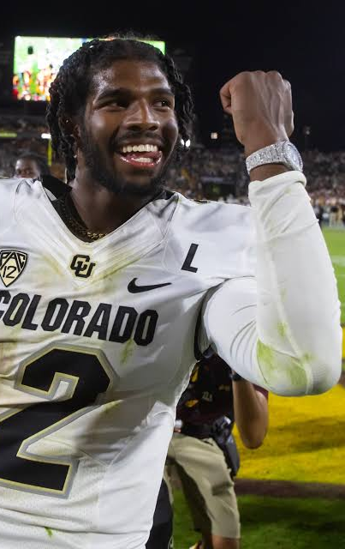
AIPI 510 | MODULE PROJECT 2
Social media & NCAA NIL Evaluations
How has a new payment structure in college athletics changed standards?
Rahul Govil • Sam Teshome
November 3, 2026
OBSERVATIONAL STUDY

Slide 2
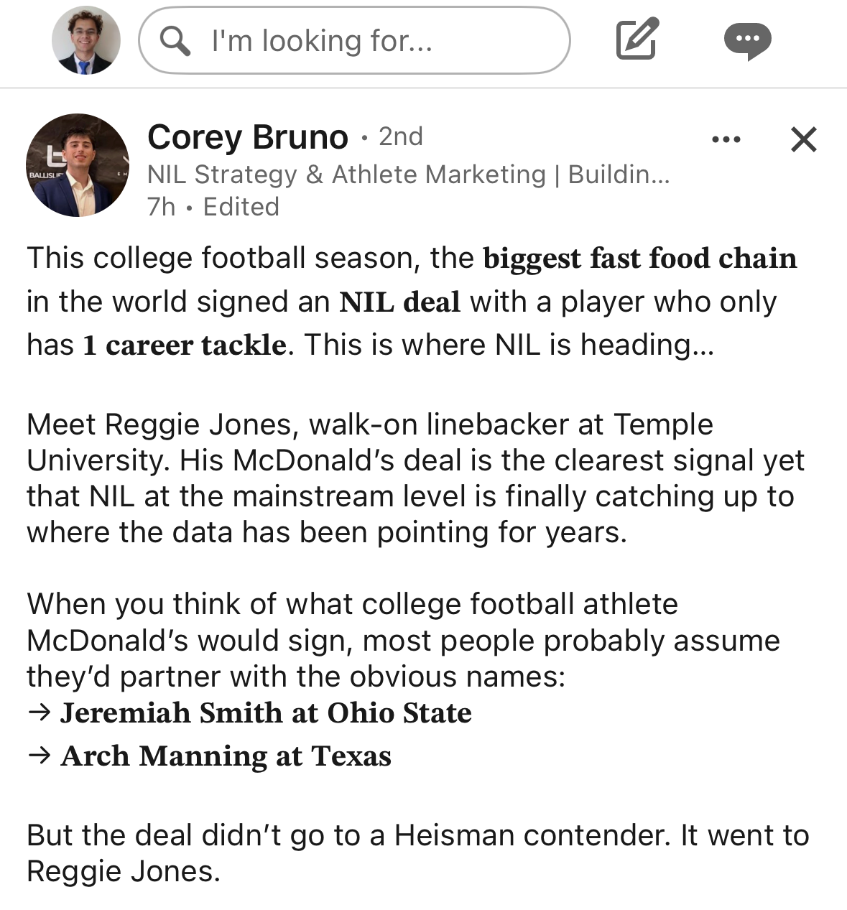
Background: NIL changed the landscape
02
AIPI 510 • Govil & Teshome • November 1, 2026
PROJECT 2

Slide 3
Background: NIL changed the landscape
03
A policy inflection point
A plausible connection
A measurement challenge
The NCAA interim name, image and likeness (NIL) policy took effect July 1, 2021.
A larger social audience may create commercial opportunities. Athletic visibility can also generate followers.
Reported NIL valuation is an estimate—not a verified payment, scholarship offer, or recruiting decision.
Three concepts we keep separate
Social reach
Commercial valuation
College selection
Instagram followers
Audience size / visibility
Reported NIL estimate
Not confirmed compensation
Offers and roster decisions are a different outcome entirely
Our completed analysis tests the first relationship only: followers ↔ reported valuation in a selected football sample.
AIPI 510 • Govil & Teshome • November 1, 2026
PROJECT 2

Slide 4
Research questions & hypotheses
04
One question is testable with the current data; two planned comparisons remain open
01 Current valuation
02 Cross-sport
Is the football follower coefficient different from zero?
H₀: βfootball = 0
Does the social-media slope differ between football and basketball?
H₀: βsocial × sport = 0
Important: a coefficient changing sign or significance across separate models does not prove that the coefficients differ. The interaction term directly tests the difference.
Three-test Bonferroni threshold: α = 0.05 / 3 = 0.0167. Only the football slope has paired data.
AIPI 510 • Govil & Teshome • November 1, 2026
PROJECT 2

Slide 5
Observational design & sampling
05
Random sampling improves coverage of a frame—it does not randomize followers or NIL exposure
Completed: football
Planned: basketball
SOURCE FRAME
Top 1,000 reported NIL valuations
ANALYSIS SAMPLE
100 selected athletes
39 schools • 99 Power 4 players
SELECTION
25 / 50 / 25 across low, middle and high valuation tiers
TARGET SAMPLE
1,000 athletes total
250 from each full-frame NIL quartile
REQUIREMENT
Build quartiles from the full NIL frame before enrichment—not from a truncated top-1,000 list
STATUS
Frame is not yet available
NESTED FILES ≠ NEW PEOPLE
The 1,000-player frame, 100-player sample and 100 enriched records are nested layers—not 1,200 independent observations.
The football fits reproduce the inherited unweighted analysis; design-weighted population estimates were not calculated.
AIPI 510 • Govil & Teshome • November 1, 2026
PROJECT 2

Slide 6
Power: focus on the social term
06
Overall model fit does not establish power for one coefficient or an interaction
80%
0.0167
1
8
target power
family α
tested term
predictor df
Required sample size by assumed partial f²
How to read this
0.02
527
For a small added effect (partial f² = 0.02), the planning estimate is N = 527. For a larger effect (0.15), N = 74.
At N = 100, estimated power ranges from 0.158 to 0.922 across these scenarios.
0.05
213
0.15
74
Planning assumptions: independent, homoskedastic errors. Clustering, missingness and measurement error can increase required N; these are not exact HC3/clustered-test power estimates.
AIPI 510 • Govil & Teshome • November 1, 2026
PROJECT 2

Slide 7
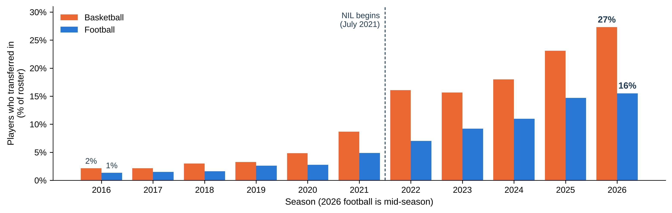
Transfers rose in both sports, fastest in basketball
% of Transferred Players
A basketball team carries about 14 players, a football team about 115
So each basketball move is far more visible. NIL arrived with the one-time transfer rule, so the rise isn’t NIL alone.
AIPI 510 | Govil and Teshome | November 1 2026
05
Notes:
45 seconds. This slide shows how rosters have changed over time in both sports. Each pair of bars is one season: orange is Division I men's basketball, blue is FBS football. Before 2021, only a few percent of any roster had transferred in. Since NIL began in July 2021, that share has climbed every year: to 27 percent in basketball and 16 percent in football. Basketball moved faster. Basketball rosters are small, about 14 players a team against about 115 in football, so each basketball player is far more visible. One caution: NIL arrived together with the one-time transfer rule, so we can't credit the rise to NIL alone. Source: figures/fig7_transfer_rate_by_sport and figure_data/roster_trends.csv.

Slide 8
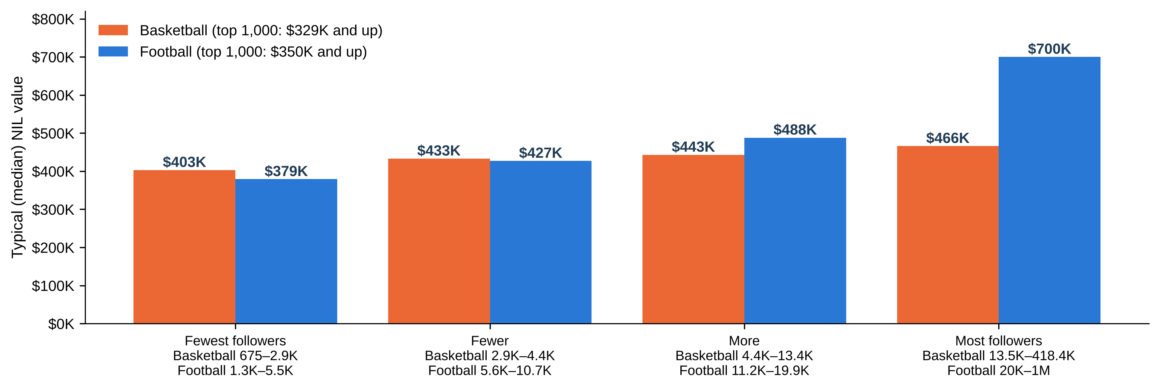
More followers, higher NIL value, mostly in football
Median NIL Value
Q1
Q2
Q3
Q4
• Basketball: $403K for the fewest followers up to $466K for the most, about 16% higher.
• Football: $379K up to $700K, almost twice as high.
AIPI 510 | Govil and Teshome | November 1 2026
06
Notes:
50 seconds. Now NIL value. Both sports are now sampled the same way: 100 players drawn from the top 1,000 NIL valuations, 25 from each value tier, so every player here is worth at least about 330 thousand dollars in basketball and 350 thousand in football. In each sport we split the 100 players into four equal groups by Instagram followers and show the typical NIL value in each group. Football climbs steeply, from 379 thousand for the fewest followers to 700 thousand for the most, almost twice as high. Basketball rises only a little, from 403 to 466 thousand. Because the samples now cover the same price range, the two colors can be compared directly. Typical following also differs: about 4,400 for basketball players and 11,000 for football players. These values are one November 2026 snapshot. Sources: Data/curated/basketball_top1000_instagram_100.csv, Data/football_modeling_data.csv, figures/fig8_nil_by_follower_group_by_sport.

Slide 9
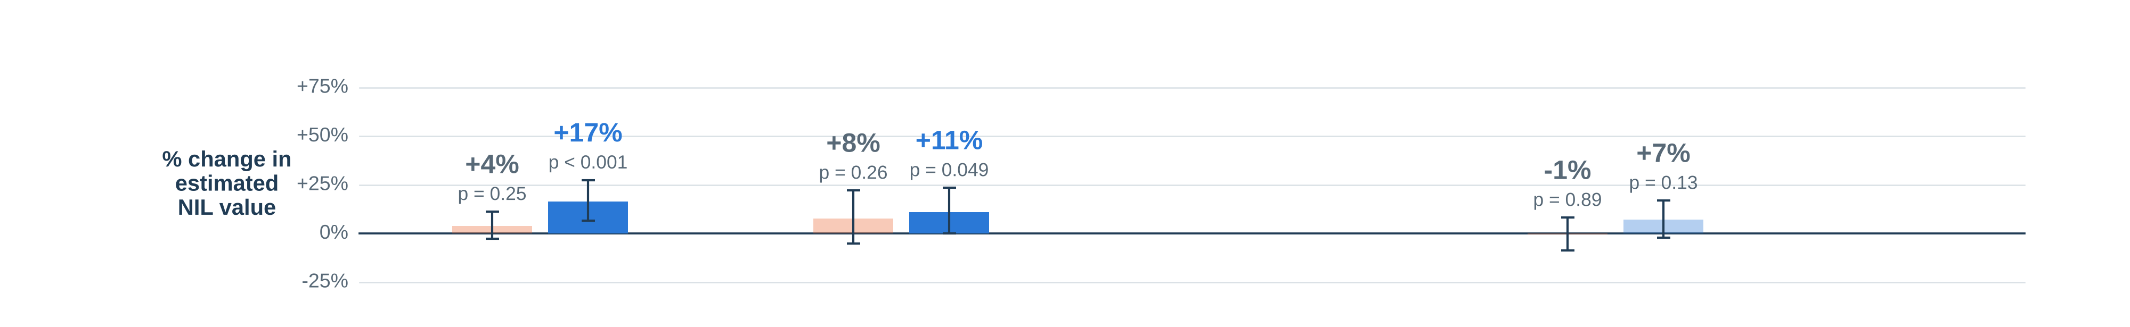
Predicting NIL value
Using a Linear Regression Model
Basketball (100 players)
Football (100 players)
% change in NIL value
NIL value
estimated deal value
=
Followers
twice as many Instagram followers
+
Performance
last season, ranked within sport (+25 points)
+
Years in college
each extra year
Basketball: β = 0.057 95% CI [-0.040 to 0.153]
p = 0.25 (not significant)
Football: β = 0.221 95% CI [0.093-0.350]
p < 0.001
twice the followers → +4% NIL value
twice the followers → +17% NIL value
Bars: % change in estimated NIL value from each piece, holding the others fixed. Lines = 95% range; faded = not statistically significant.
AIPI 510 | Govil and Teshome | November 2026
Notes:
60 seconds. This is our main model, fitted the same way in each sport: NIL value explained by Instagram followers, last-season performance ranked within the sport, and years in college, with a flag for players who had no college stats last season. Each bar is the percent change in estimated NIL value from that piece, holding the others fixed; faded bars are not statistically significant. In football, twice the followers goes with about 17 percent higher NIL value, and that is statistically clear, p below 0.001. In basketball it is only about 4 percent, and we can't rule out zero, p 0.25. The difference between the two sports is itself statistically significant, p 0.04. Performance helps a little in football, plus 11 percent for a 25-point higher ranking; nothing is clear in basketball. Sources: scripts/make_unified_figures.py, figures/figure_data/unified_model_results.json.

Slide 10
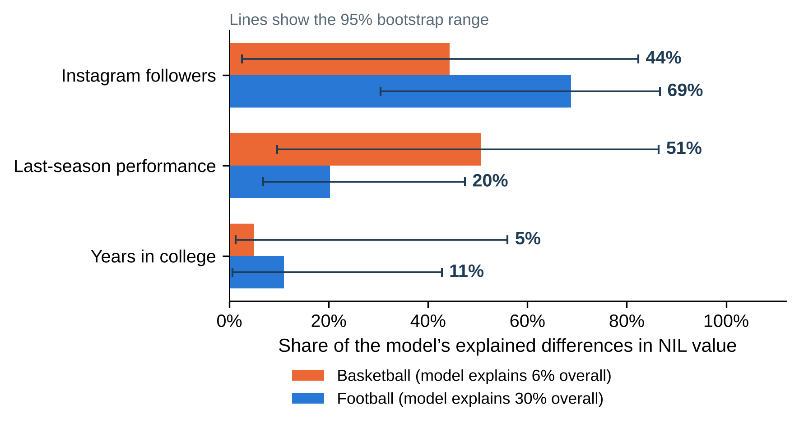
Followers lead in football; little explains basketball value
Same model in both sports: followers + last-season performance + years in college
AIPI 510 | Govil and Teshome | November 1 2026
07
Notes:
60 seconds. How much of what the model explains comes from each factor. In football, followers account for about two-thirds, 69 percent, ahead of performance at 20 and years in college at 11, and the model explains 30 percent of the differences in NIL value. In basketball the picture is different. The model explains only 6 percent of the differences, so the shares are splitting a very small pie: performance 51 percent, followers 44, years 5, and the wide lines show none of these is pinned down. Among top-valued basketball players, our three factors simply don't separate NIL values much. In a separate basketball-only check, playing in a big conference (ACC, Big Ten, Big 12, SEC, Big East) mattered more, about 24 percent higher value. Sources: figures/figure_data/unified_model_results.json, basketball_only_model.json.

Slide 11
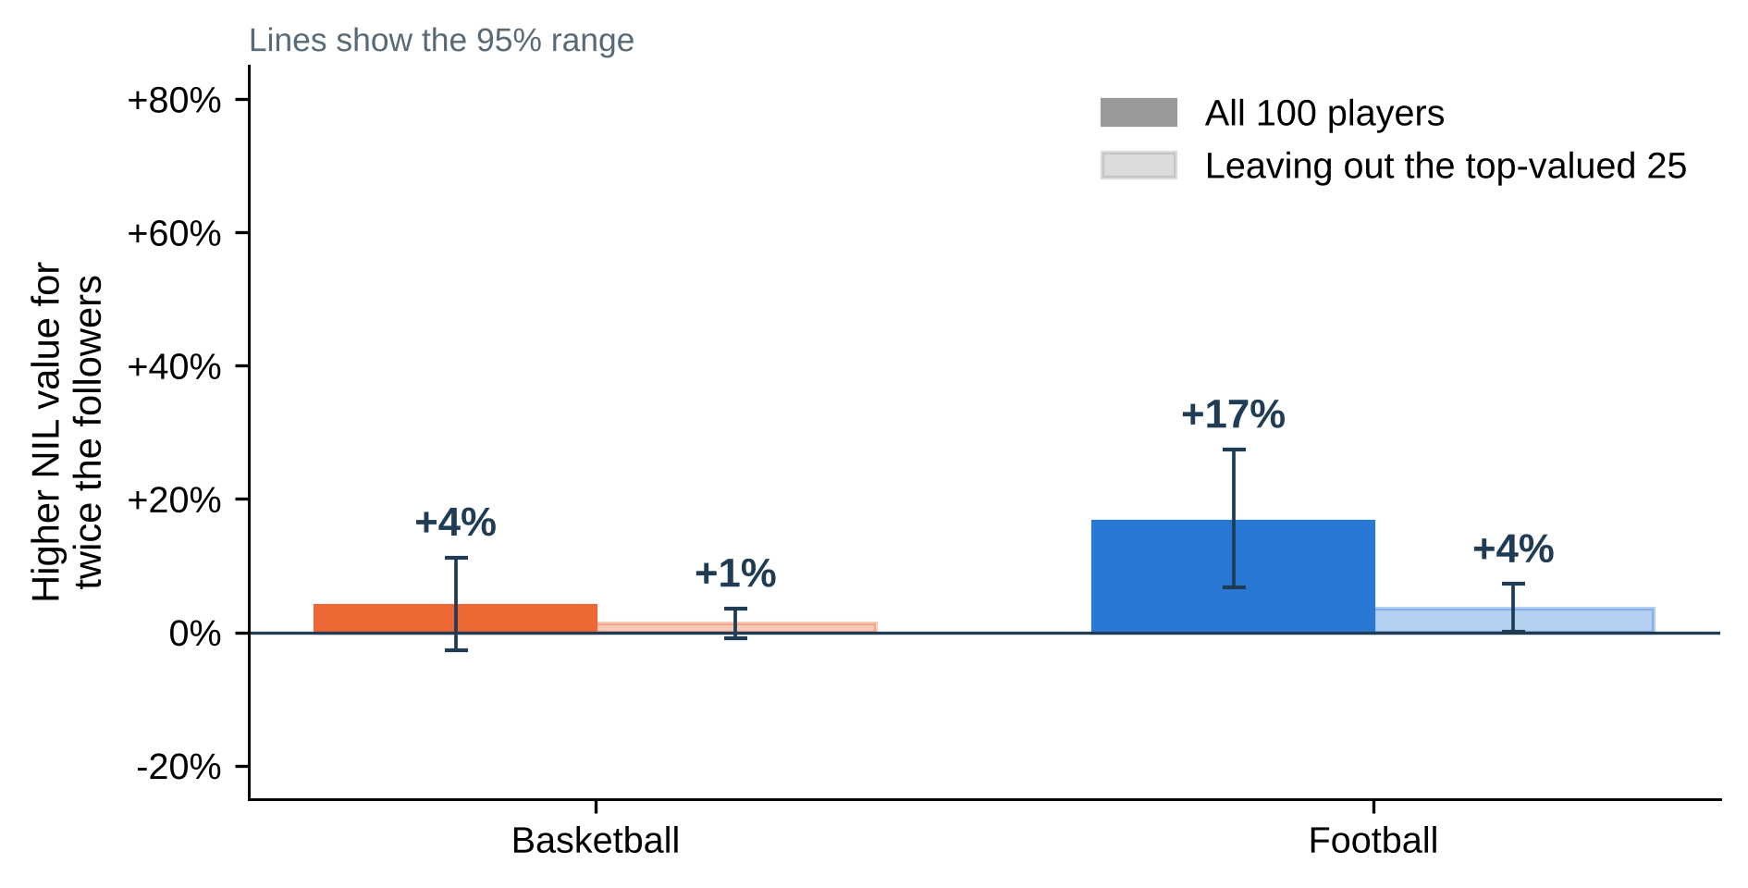
In football, the follower effect lives at the top
Same model, run again without the 25 highest-valued players in each sport
• Without the top 25 football players, the follower effect drops from +17% to +4%.
• Basketball shows little follower effect either way: +4% with all players, +1% without the top 25.
• We can’t tell yet whether followers raise value or famous players gain both. The data are one snapshot in time.
AIPI 510 | Govil and Teshome | November 1 2026
08
Notes:
40 seconds. A stress test. If we leave out the 25 highest-valued players in each sport and refit the same model, the football follower effect shrinks from plus 17 to about plus 4 percent. So in football the result comes mainly from the top of the market, where big audiences and big valuations go together. Basketball has little follower effect to begin with, plus 4 percent, and about plus 1 percent without the top 25. We also can't say which comes first. Followers might raise NIL value, famous players might attract both, or the valuation source might use follower counts in its estimates. Source: figures/fig11_follower_effect_top_market.

Slide 12
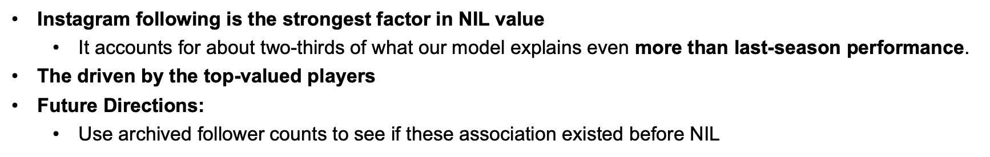
Conclusions
• Followers are linked to NIL value in football, not clearly in basketball
– Football: twice the followers → +17% NIL value; about two-thirds of what the model explains.
– Basketball: +4%, not statistically significant, and the model explains only 6%.
– The two sports differ: p = 0.04, with both samples drawn from the same top-1,000 price range.
• In football, the effect is driven by the top-valued players
• Future directions:
– Use archived follower counts to see if this association existed before NIL.
– Add team and conference factors for basketball, where a big conference meant about +24%.
AIPI 510 | Govil and Teshome | November 1 2026
09
Notes:
40 seconds. Our answer: with both sports drawn the same way from the top 1,000 NIL valuations, social media following is clearly linked to NIL value in football but not in basketball. In football, twice the followers goes with about 17 percent higher value, and followers make up about two-thirds of what the model explains. In basketball the link is small and not statistically clear, and our model explains very little. The difference between the sports is statistically significant. Three cautions. The football effect is concentrated among the top-valued players. Most of the variation in NIL value is still unexplained. And this is a single snapshot, so it shows association, not cause. Next we would use archived follower counts from before each valuation, and add team and conference factors for basketball. Sources: project report and figures/figure_data/unified_model_results.json.

Slide 13
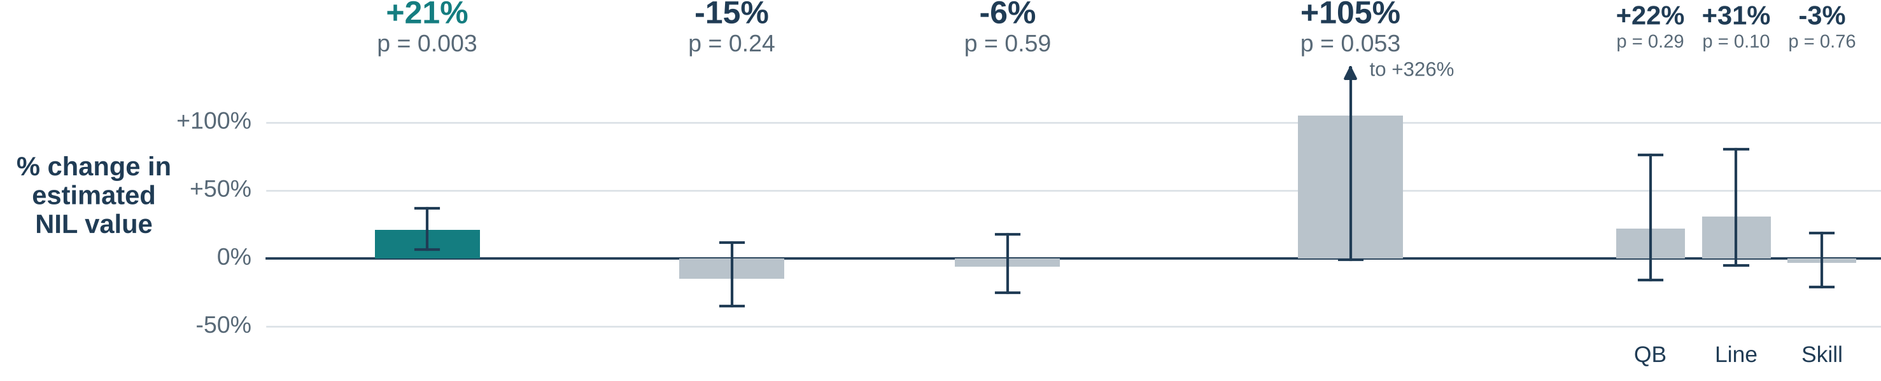
What moves NIL value in Football
Model: Linear Regression
NIL value
estimated deal value
=
Followers
Instagram followers
+
Stars
high-school recruiting rating
+
Freshman
first-year player?
+
Stars × Freshman
extra boost from stars for first-years?
+
Position group
QB, skill, line or defense
Each followers increases NIL value: β = 0.274 95% CI [0.094- 0.454]
p-value of model = 0.003
12
Notes:
Backup slide, not presented. 60 seconds. The boxes are our main model: estimated NIL value built from followers, recruiting stars, freshman status, a stars by freshman term and position group, plus everything we did not measure. The bar above each box is how much that piece moves estimated value with the others held fixed. Twice the Instagram followers goes with about 21 percent higher value, 95 percent range 7 to 37 percent, p 0.003. No other piece is clearly different from zero: stars, freshman status and position point in different directions with wide ranges. The model explains about 35 percent of the variation. The arrows show our checks. Replication is our partner's original model, which uses a game-performance score, a big-conference flag and a premium-position flag in place of stars and position group. Dropping the one million follower account, and allowing teammates at the same school to be alike, both keep the follower effect positive, between 0.21 and 0.27. These checks address uncertainty and influence, not selection or confounding. Breusch Pagan p is 0.000373 in the main model and nine Cook distance flags warrant review. Source: figures/fig6_feature_effects, figure_data/feature_effects_position_groups_hc3.csv and model_statistics.json.

Slide 14
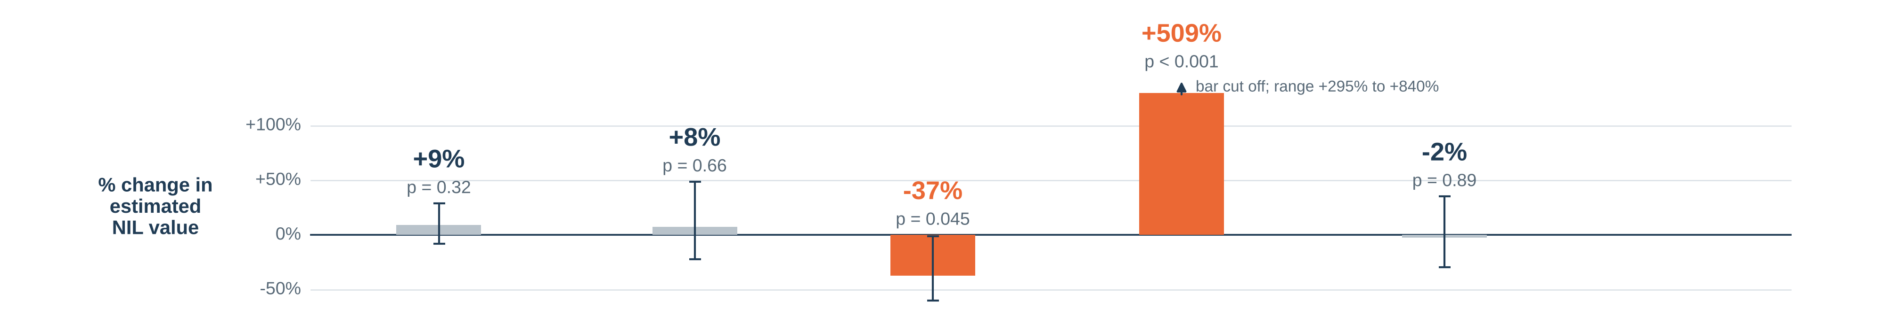
Basketball only: what moves NIL value
Model: Linear Regression 100 Division I men’s basketball players. Bars: % change from each piece, others held fixed; grey = not significant.
NIL value
estimated deal value
=
Followers
Instagram followers (twice as many)
+
Points per game
last season (+5 points)
+
Freshman
first-year player?
+
Big conference
ACC, Big Ten, Big 12, SEC or Big East
+
Position
forward or center (vs guard)
+
No stats last season
adjustment so freshmen stay in (not shown)
How much followers matter here: β = 0.124 (twice the followers → +9% NIL value)
95% confidence range = -0.119 to 0.367 p-value for followers = 0.32
The model explains 54% of the differences in basketball NIL value
Playing in a big conference is the dominant factor. Once it is in the model, followers are no longer statistically significant.
AIPI 510 | Govil and Teshome | November 2026

