Slide 1
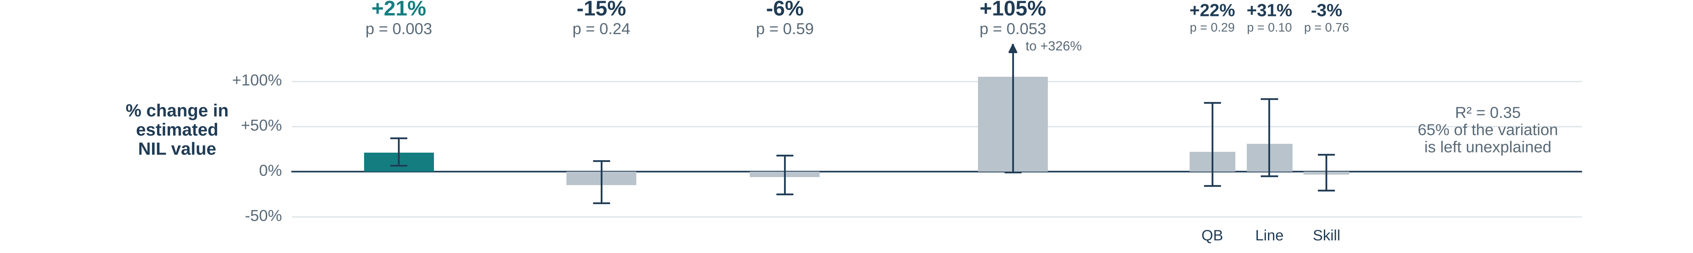
What moves NIL value, and how we checked it
Bars: % change in estimated value from each piece, holding the others fixed (whiskers = 95% range). Arrows: what each check changes.
NIL value
estimated deal value
=
Followers
Instagram followers
+
Stars
high-school recruiting rating
+
Freshman
first-year player?
+
Stars × Freshman
extra boost from stars for first-years?
+
Position group
QB, skill, line or defense
+
Noise
everything we didn’t measure
Largest audience omitted
Drops the one 1M-follower player so a single superstar can’t drive the result
Replication (our partner’s original model)
Swaps Stars and Position group for a game-performance score, a big-conference flag and a “premium position” flag; stars count only for freshmen
School clustered
Treats teammates as alike, for honest error bars
How much followers matter in each version: β, 95% confidence range, p-value
0.207 Replication
CI 0.079–0.335 p = 0.002
0.274 Position groups (shown)
CI 0.094–0.454 p = 0.003
0.212 Largest audience omitted
CI 0.068–0.355 p = 0.004
0.274 School clustered
CI 0.121–0.427 p < 0.001
β ≈ 0.2 means twice the followers goes with about 15% higher estimated NIL value (an association, not cause and effect)
AIPI 510 | Govil and Teshome | November 2026
Notes:
All four models: ordinary least squares on ln(NIL valuation), 100 football players. Followers enter as ln(1 + Instagram followers). The equation shown is the position-groups model (stars centered at the sample mean; defense is the reference position group). Replication = partner model: ln(value) ~ ln(1+followers) + PPA per play + Freshman + Freshman x Stars + Power 4 + Premium position (QB/RB/WR/DE/EDGE). It is one model with one followers coefficient (0.207); the slide shows HC3 robust errors (the partner draft reported HC1, same coefficient). Stars enter only through Freshman x Stars. Largest audience omitted = position-groups model without the 1M-follower account (n=99). School clustered = position-groups model with standard errors clustered by school (39 schools). Doubling followers corresponds to roughly 15-21% higher modeled valuation; associations, not causal effects. Bars above the equation are the position-groups model (HC3): followers per doubling +21% (95% CI +7% to +37%, p=0.003); +1 star for non-freshmen -15% (p=0.24); freshman at average stars -6% (p=0.59); extra per star for freshmen +105% (CI -1% to +326%, p=0.053); quarterback +22%, offensive line +31%, skill offense -3% vs defense (all p>0.1). R-squared 0.35.

