Slide 1
Social media and college athlete
NIL valuation
A positive association in a selected football sample
Rahul Govil and Sam Teshome
Current valuation results and the data needed for a before and after comparison
AIPI 510 | Govil and Teshome | November 1 2026
01
Notes:
25 seconds. Our original motivation was whether social media matters differently in college athlete selection after NIL. We first analyzed the data we actually have: a current football valuation sample. This presentation reports that result and explains why it cannot yet answer the original policy question. The association is positive, but scholarship and policy effects remain unanswered. Sources: project report and reports/deliverables/model_statistics.json, November 1 2026.

Slide 2
Research questions and hypotheses
NCAA interim NIL policy took effect July 1 2021
Current valuation: is the follower coefficient different from zero?
Cross sport: does the social slope differ between football and basketball?
Before and after: does social by post differ from zero for one common outcome?
Valuation, scholarship offers, and later career outcomes measure different things
AIPI 510 | Govil and Teshome | November 1 2026
02
Notes:
50 seconds. The partner plan contains football and basketball slope tests, plus a social by sport interaction. Its within sport alternatives were positive; we report conservative two sided p values. The planned three test family uses alpha 0.05 divided by three, or 0.0167. For the original policy question, the null is zero social by post interaction on a common outcome. A sign change or a change in significance in separate models does not establish a difference. Historical NIL values are absent rather than zero. Source: NCAA history https://www.ncaa.org/about-us/history/ and project report hypotheses.

Slide 3
Observational design and sampling
Random sampling does not randomize followers or NIL exposure
Completed football
Requested basketball
Top 1000 frame
100 modeled athletes
39 schools and 99 Power 4 players
Full NIL frame first
250 from each quartile
1000 selected before enrichment
Legacy 25 / 50 / 25 allocation is nearly proportional; rounded ties change tier sizes
AIPI 510 | Govil and Teshome | November 1 2026
03
Notes:
50 seconds. The three inherited football files are nested: a frame, a sample, and enriched versions of the same players. They are not 1200 independent observations. The original code uses valuation cutoffs and seed 510. Ties give populations 266, 479 and 255 with draws 25, 50 and 25. This is close to proportional allocation, rather than deliberate oversampling of the highest quarter. For new basketball work, quartiles come from the full available NIL frame before drawing 250 each. That frame is still missing. Weighting can target the frame but cannot recover athletes excluded from it. Source: Data/sample_data.py; scripts/sample_quartiles.py; project report design.

Slide 4
Power for the social term
Overall model fit does not justify power for one coefficient or interaction
80% target power
alpha = 0.0167
1 tested term
8 predictor degrees of freedom
Planning assumes independent homoskedastic errors; clustering and missingness need allowance
AIPI 510 | Govil and Teshome | November 1 2026
04
Notes:
45 seconds. We corrected the distinction between overall model power and power for the social term. Partial f squared measures the extra R squared from that term relative to unexplained variation. With eight predictor degrees of freedom, one tested term, target power 80 percent and alpha 0.0167, the planning requirements are 527, 213 and 74 for the three scenarios shown. These assume independent homoskedastic errors. They are not exact power for HC3 or school clustered tests. We did not claim that 100 observations have adequate power merely because the full model fits reasonably well. Source: scripts/power_sensitivity.py and model_statistics.json.

Slide 5
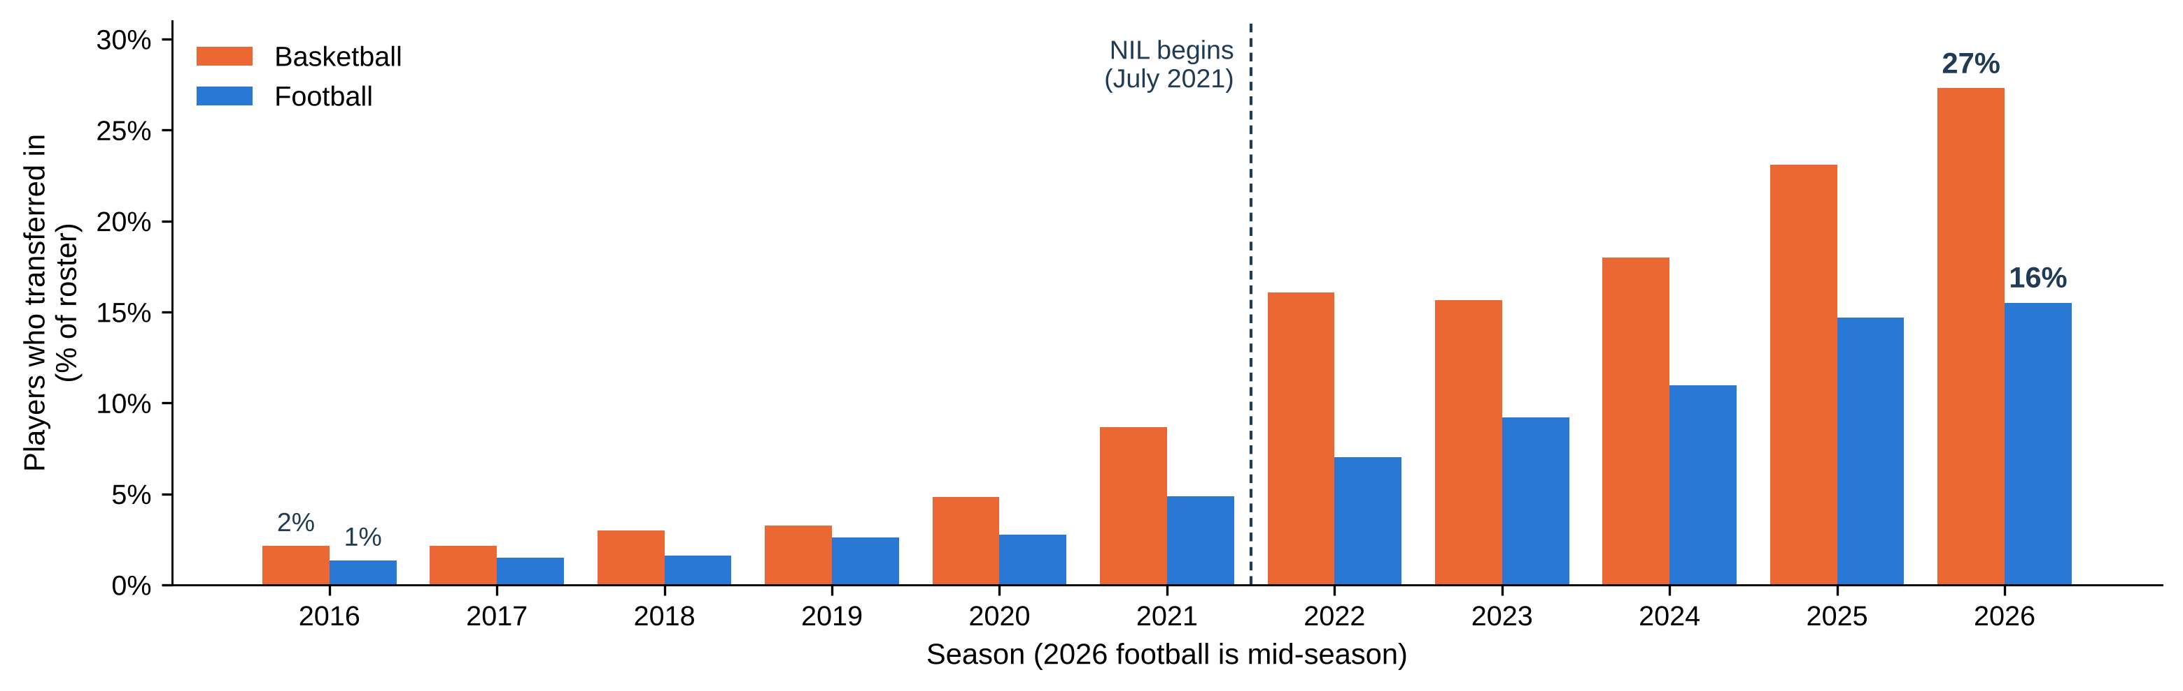
Transfers rose in both sports, fastest in basketball
Share of each roster that transferred in, all D-I basketball and FBS football teams
• Basketball: 2% of rosters in 2016, 27% in 2026.
• Football: 1% in 2016, 16% in 2026, rising more slowly.
• A basketball team carries about 14 players, a football team about 115, so each basketball move is far more visible. NIL arrived with the one-time transfer rule, so the rise isn’t NIL alone.
AIPI 510 | Govil and Teshome | November 1 2026
05
Notes:
45 seconds. This slide shows how rosters have changed over time in both sports. Each pair of bars is one season: orange is Division I men's basketball, blue is FBS football. Before 2021, only a few percent of any roster had transferred in. Since NIL began in July 2021, that share has climbed every year: to 27 percent in basketball and 16 percent in football. Basketball moved faster. Basketball rosters are small, about 14 players a team against about 115 in football, so each basketball player is far more visible. One caution: NIL arrived together with the one-time transfer rule, so we can't credit the rise to NIL alone. Source: figures/fig7_transfer_rate_by_sport and figure_data/roster_trends.csv.

Slide 6
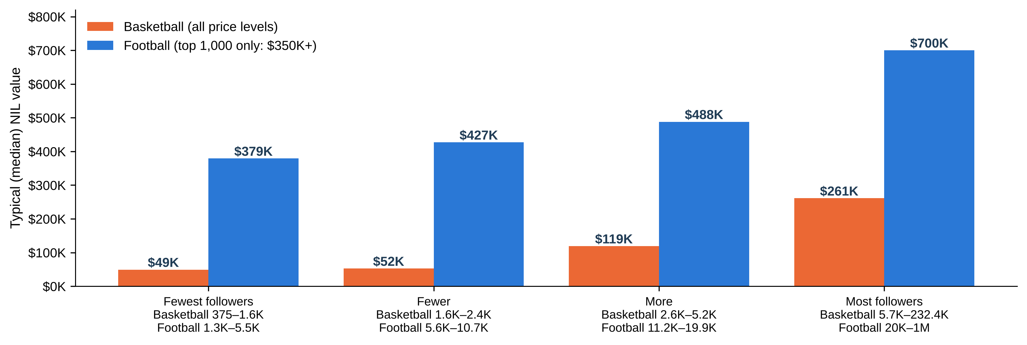
More followers, higher NIL value, in both sports
Typical NIL value for four equal follower groups, 100 players per sport
• Basketball: $49K for the fewest followers up to $261K for the most, more than 5 times higher.
• Football: $379K up to $700K, almost twice as high.
• Football values look higher partly by design: that sample covers only the top 1,000 football players ($350K and up), while basketball covers the whole market.
AIPI 510 | Govil and Teshome | November 1 2026
06
Notes:
50 seconds. Now NIL value. In each sport we split the 100 players into four equal groups by Instagram followers, and show the typical NIL value in each group. Both sports climb from left to right. In basketball, typical value goes from about 49 thousand dollars for players with the fewest followers to 261 thousand for those with the most, more than five times higher. In football it goes from 379 thousand to 700 thousand. Don't compare the heights of orange against blue directly. The football sample was drawn only from the top 1,000 football NIL values, all at least 350 thousand dollars, while basketball covers the whole market. The pattern within each sport is the point. Typical following also differs: about 2,500 for basketball players and 11,000 for football players. These values are one November 2026 snapshot, so this shows today's pattern, not change over time. Sources: Data/curated/basketball_instagram_100.csv, Data/football_modeling_data.csv, figures/fig8_nil_by_follower_group_by_sport.

Slide 7
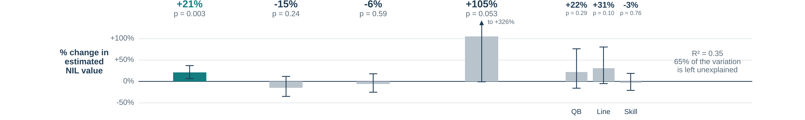
What moves NIL value, and how we checked it
Model: Linear Regression
NIL value
estimated deal value
=
Followers
Instagram followers
+
Stars
high-school recruiting rating
+
Freshman
first-year player?
+
Stars × Freshman
extra boost from stars for first-years?
+
Position group
QB, skill, line or defense
How much followers an additional follower increases NIL value: β = 0.274
95% confidence range = 0.094- 0.454
p-value of model = 0.003
12
Notes:
Backup slide, not presented. 60 seconds. The boxes are our main model: estimated NIL value built from followers, recruiting stars, freshman status, a stars by freshman term and position group, plus everything we did not measure. The bar above each box is how much that piece moves estimated value with the others held fixed. Twice the Instagram followers goes with about 21 percent higher value, 95 percent range 7 to 37 percent, p 0.003. No other piece is clearly different from zero: stars, freshman status and position point in different directions with wide ranges. The model explains about 35 percent of the variation. The arrows show our checks. Replication is our partner's original model, which uses a game-performance score, a big-conference flag and a premium-position flag in place of stars and position group. Dropping the one million follower account, and allowing teammates at the same school to be alike, both keep the follower effect positive, between 0.21 and 0.27. These checks address uncertainty and influence, not selection or confounding. Breusch Pagan p is 0.000373 in the main model and nine Cook distance flags warrant review. Source: figures/fig6_feature_effects, figure_data/feature_effects_position_groups_hc3.csv and model_statistics.json.

Slide 8
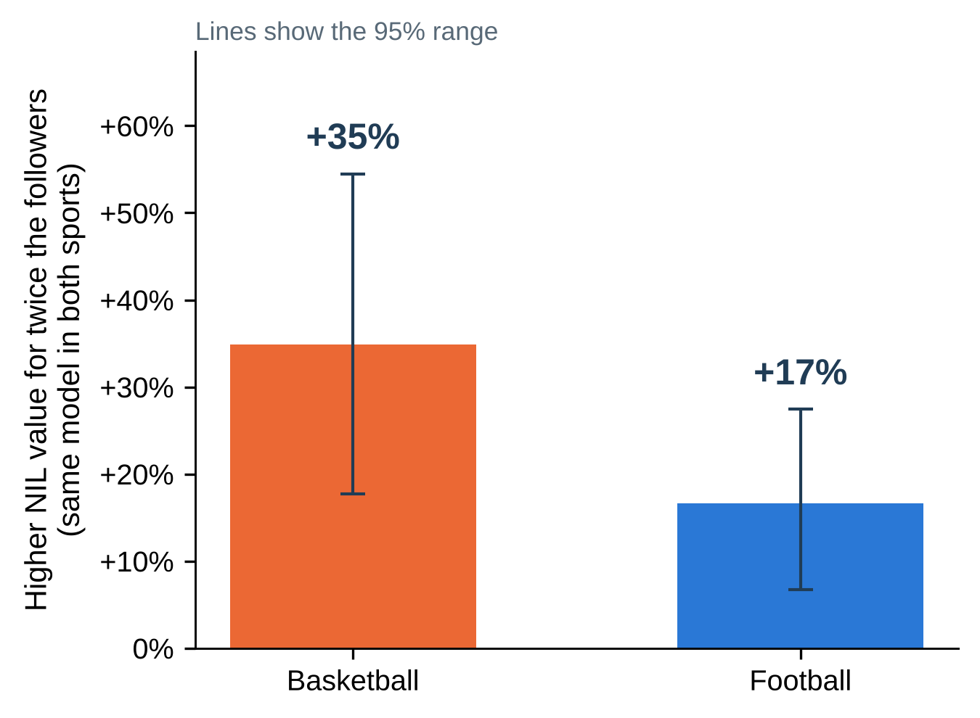
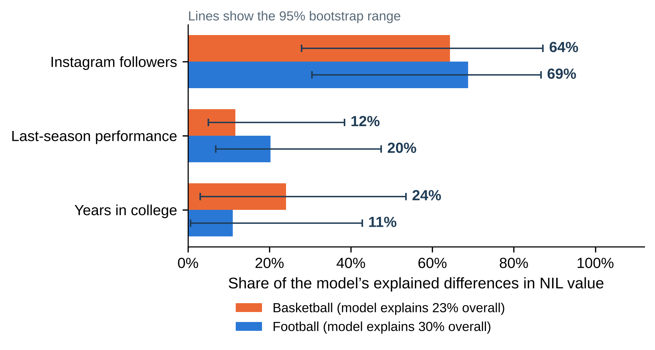
Followers are the strongest factor in both sports
Same model in both sports: followers + last-season performance + years in college
• Twice the followers goes with 35% higher NIL value in basketball and 17% in football.
• Followers account for about two-thirds of what the model explains: 64% in basketball, 69% in football.
• Last-season performance accounts for 12–20%. Most of the difference between players (70–77%) is still unexplained.
AIPI 510 | Govil and Teshome | November 1 2026
07
Notes:
75 seconds. To compare the sports fairly we fit the exact same model in each: NIL value explained by Instagram followers, last-season performance, and years in college. Performance is ranked within each sport, points per game for basketball and the partner's performance score for football, and players with no college stats last season, mostly freshmen, are flagged. Left: twice the followers goes with about 35 percent higher NIL value in basketball and 17 percent in football, holding the other factors fixed. Both are statistically clear. The basketball number looks larger, but the gap between the sports is not quite statistically clear, p 0.08. Right: how much of what the model explains comes from each factor. Followers account for roughly two-thirds in both sports, 64 and 69 percent. Performance accounts for 12 to 20 percent, and years in college the rest. Two honest limits. The model explains only 23 percent of the differences in basketball and 30 percent in football, so most of what drives NIL value is not in our data. And our performance measures are rough: football's performance score has unverified values, and basketball points per game only exists for the 58 players who played last season. Sport type itself can't be tested, because the two samples were drawn from different price ranges. Sources: scripts/make_unified_figures.py, figures/figure_data/unified_model_results.json.

Slide 9
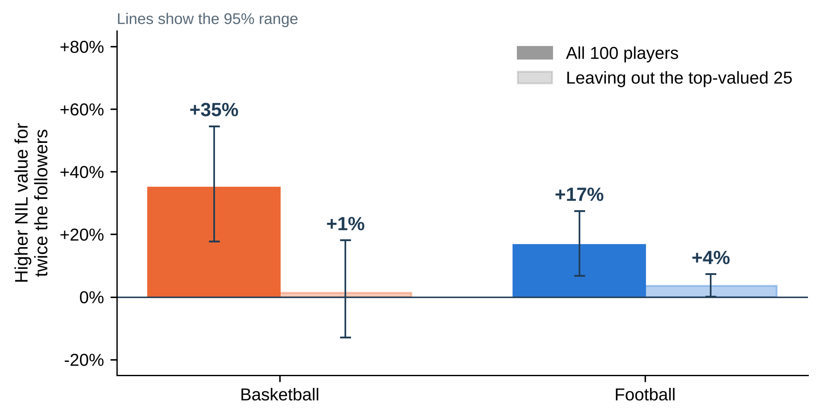
The follower effect lives at the top of the market
Same model, run again without the 25 highest-valued players in each sport
• Without the top 25, the follower effect drops to about +1% in basketball and +4% in football.
• So followers mainly separate the stars of the NIL market from everyone else, rather than lifting all players evenly.
• We can’t tell yet whether followers raise value or famous players gain both. The data are one snapshot in time.
AIPI 510 | Govil and Teshome | November 1 2026
08
Notes:
45 seconds. A stress test. If we leave out the 25 highest-valued players in each sport and refit the same model, the follower effect almost disappears: about plus 1 percent in basketball and plus 4 percent in football. So the strong overall result comes mainly from the top of the market, where big audiences and big valuations go together. Among ordinary players, followers barely separate NIL values. We also can't say which comes first. Followers might raise NIL value, famous players might attract both, or the valuation source might use follower counts in its estimates. With one snapshot in time we can't separate these. Source: figures/fig11_follower_effect_top_market.

Slide 10
Conclusions
What the data support today, and what would make the case stronger
• In both sports, Instagram following is the strongest factor we measured. It accounts for about two-thirds of what our model explains, well ahead of last-season performance.
• The effect is real but concentrated: it is driven by the top-valued players, and most differences in NIL value remain unexplained.
• This is an association in a single snapshot, not proof that followers cause NIL value. Sport type can’t be compared because the two samples cover different price ranges.
• Next: dated follower counts, verified performance stats, and the same sampling frame for both sports.
AIPI 510 | Govil and Teshome | November 1 2026
09
Notes:
40 seconds. Our answer: among the things we could measure, social media following is the strongest factor linked to NIL value in both basketball and football, accounting for about two-thirds of what the model explains, well ahead of last-season performance and years in college. Three cautions. The effect is concentrated among the top-valued players. Most of the variation in NIL value is still unexplained. And this is a single snapshot, so it shows association, not cause. To strengthen the case we would collect follower counts dated before each valuation, verified performance statistics, and draw both sports from the same NIL price range so sport itself can be compared. Sources: project report and figures/figure_data/unified_model_results.json.

Slide 11
Backup slides
Earlier football-only analysis and data coverage, for questions
AIPI 510 | Govil and Teshome | November 1 2026
10
Notes:
0 seconds. Not presented; for questions.

Slide 12
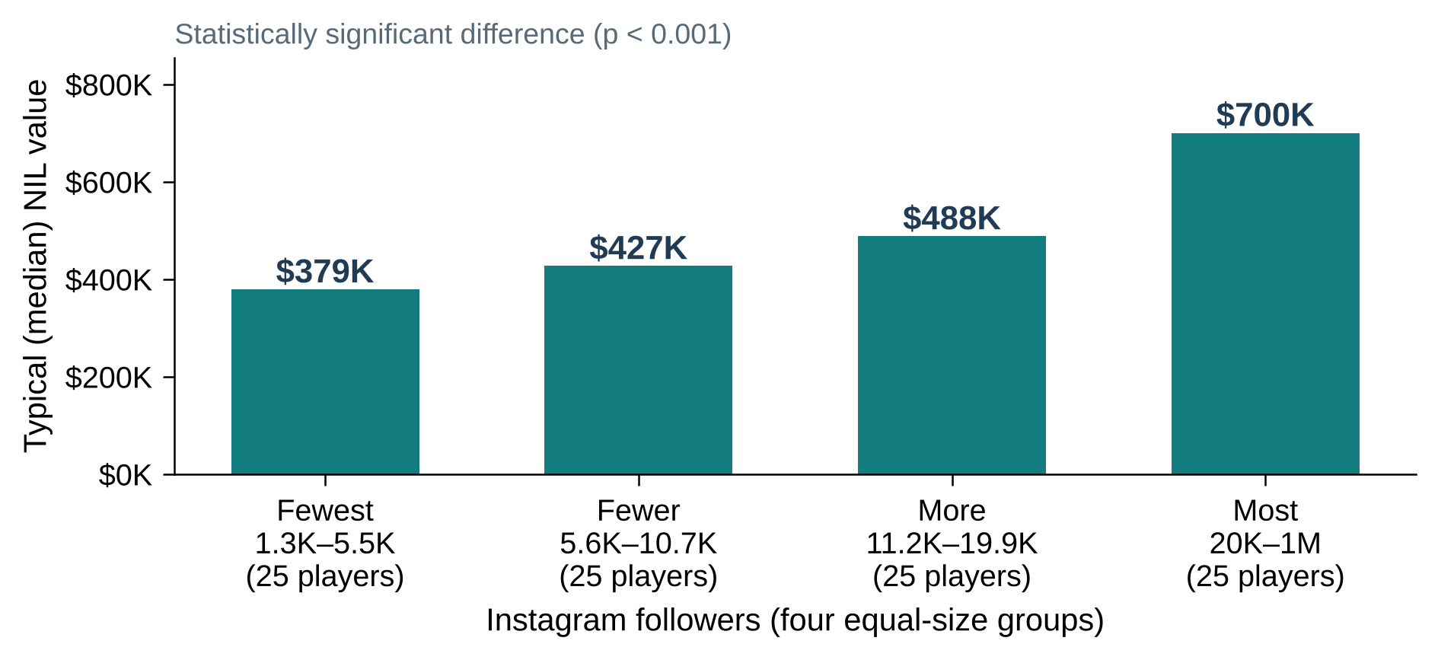
Followers and NIL are positively associated
100 selected football players with both measurements
Replicated model HC3
beta = 0.207
95% CI 0.079 to 0.335
two sided p = 0.00155
About 15.4% higher modeled valuation for twice the followers
Conditional selected sample association; follower timing and performance remain unverified
AIPI 510 | Govil and Teshome | November 1 2026
11
Notes:
Backup slide, not presented. 65 seconds. The chart splits the 100 players into four equal groups by Instagram followers: typical (median) NIL value rises from about 379 thousand dollars in the group with the fewest followers to 700 thousand in the group with the most, a statistically significant difference (Kruskal Wallis p below 0.001). The chart is descriptive and unadjusted. The coefficient beside it comes from the replicated multiple regression with the inherited controls. HC3 gives beta 0.207, a 95 percent interval from 0.079 to 0.335, and a two sided p value 0.00155. At alpha 0.0167 it is below the planned threshold; the family adjusted 98.33 percent interval is 0.050 to 0.363. At sufficiently large follower counts, doubling corresponds to about 15.4 percent higher modeled valuation, with a 95 percent interval about 5.6 to 26.1 percent. This is not an effect of acquiring followers. The inherited performance variable is unverified, and valuation may itself use social audience information. Source: inherited public football CSV and aggregate model_statistics.json.

Slide 13
What moves NIL value, and how we checked it
Bars: % change in estimated value from each piece, holding the others fixed (whiskers = 95% range). Arrows: what each check changes.
NIL value
estimated deal value
=
Followers
Instagram followers
+
Stars
high-school recruiting rating
+
Freshman
first-year player?
+
Stars × Freshman
extra boost from stars for first-years?
+
Position group
QB, skill, line or defense
+
Noise
everything we didn’t measure
Largest audience omitted
Drops the one 1M-follower player so a single superstar can’t drive the result
Replication (our partner’s original model)
Swaps Stars and Position group for a game-performance score, a big-conference flag and a “premium position” flag; stars count only for freshmen
School clustered
Treats teammates as alike, for honest error bars
How much followers matter in each version: β, 95% confidence range, p-value
0.207 Replication
CI 0.079–0.335 p = 0.002
0.274 Position groups (shown)
CI 0.094–0.454 p = 0.003
0.212 Largest audience omitted
CI 0.068–0.355 p = 0.004
0.274 School clustered
CI 0.121–0.427 p < 0.001
AIPI 510 | Govil and Teshome | November 1 2026
12
Notes:
Backup slide, not presented. 60 seconds. The boxes are our main model: estimated NIL value built from followers, recruiting stars, freshman status, a stars by freshman term and position group, plus everything we did not measure. The bar above each box is how much that piece moves estimated value with the others held fixed. Twice the Instagram followers goes with about 21 percent higher value, 95 percent range 7 to 37 percent, p 0.003. No other piece is clearly different from zero: stars, freshman status and position point in different directions with wide ranges. The model explains about 35 percent of the variation. The arrows show our checks. Replication is our partner's original model, which uses a game-performance score, a big-conference flag and a premium-position flag in place of stars and position group. Dropping the one million follower account, and allowing teammates at the same school to be alike, both keep the follower effect positive, between 0.21 and 0.27. These checks address uncertainty and influence, not selection or confounding. Breusch Pagan p is 0.000373 in the main model and nine Cook distance flags warrant review. Source: figures/fig6_feature_effects, figure_data/feature_effects_position_groups_hc3.csv and model_statistics.json.

Slide 14
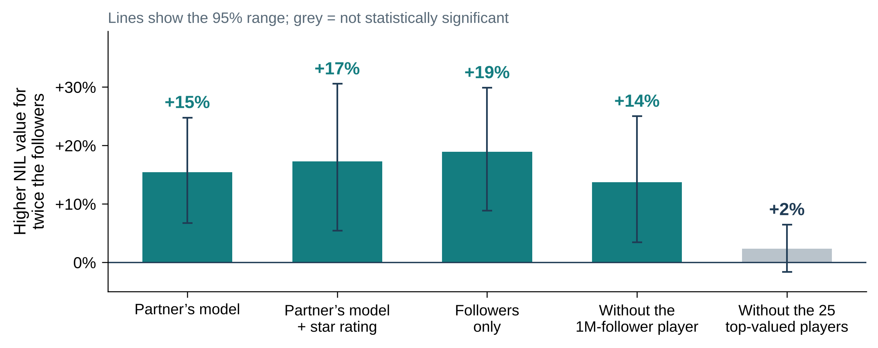
The follower link comes from the top-valued players
Extra NIL value for twice the followers, in each version of the model
Leave out the 25 top-valued players and the follower effect almost disappears (+2%)
Every full-sample version shows +14% to +19%; read the result as driven by high-value players
AIPI 510 | Govil and Teshome | November 1 2026
13
Notes:
Backup slide, not presented. 35 seconds. Each bar re-estimates the follower effect a different way, as the extra NIL value for twice the followers. It stays between 14 and 19 percent with the partner model, with star rating added, with followers alone, and without the one million follower player. But if we leave out the 25 top-valued players, it drops to 2 percent and is no longer statistically significant. So the link is concentrated among the highest-valued players, and because the sample was drawn by valuation tier, this matters. Source: figures/fig3_followers_vs_valuation and figure_data/follower_elasticity.csv.

Slide 15
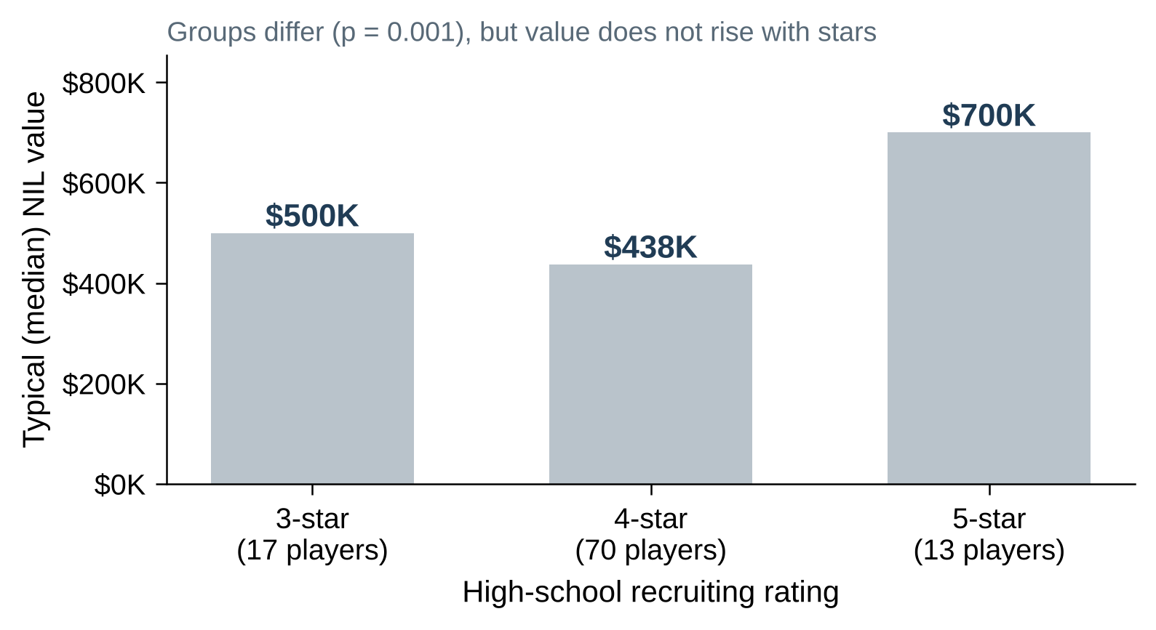
Recruiting stars don’t line up with NIL value
Typical (median) NIL value by high-school star rating
4-star players have the lowest typical value; 3-star players are not far behind 5-star players
The groups differ (p = 0.001), but value does not rise with stars
AIPI 510 | Govil and Teshome | November 1 2026
14
Notes:
Backup slide, not presented. 30 seconds. Typical NIL value is 500 thousand dollars for three-star players, 438 thousand for four-star and 700 thousand for five-star. The groups do differ, Kruskal Wallis p 0.001, but not in star order: four-star players sit lowest. Across all players stars barely track value, Spearman 0.08, p 0.42, and adding stars to the model gives minus 0.16, p 0.28. Followers line up with value far more clearly. Source: figures/fig4_recruiting_stars and figure_data/spearman_with_valuation.csv.

Slide 16
Coverage limits the remaining tests
Large roster frames do not supply missing social or decision measurements
Basketball season | Source rows | BPM observed | BPM qualified
2018 to 2019 | 5590 | 4762 | 2940
2019 to 2020 | 5587 | 4768 | 2915
2025 to 2026 | 5680 | 5015 | 3114
No paired NIL and social inputs in these basketball or historical frames
2018 football candidate stars: 52% FBS vs 10% FCS; high school classification unverified
AIPI 510 | Govil and Teshome | November 1 2026
15
Notes:
Backup slide, not presented. 55 seconds. We collected historical and current basketball and football source frames and career crosswalks. Basketball BPM has broad coverage, but about half the roster rows satisfy the provider qualification flag. Low minute rows have more extreme values; the metric is model derived and needs calibration review. In historical football, recruiting candidate availability is very different between FBS and FCS, so complete case selection changes the population. We do not yet have verified high school classification in those frames. Roughly 63 percent of 2018 athletes also occur in 2019 in each sport, which requires dependence aware analysis. Draft no match is unknown, and current careers have less follow up. Source: reports/eda/README.md and supporting coverage tables.

Slide 17
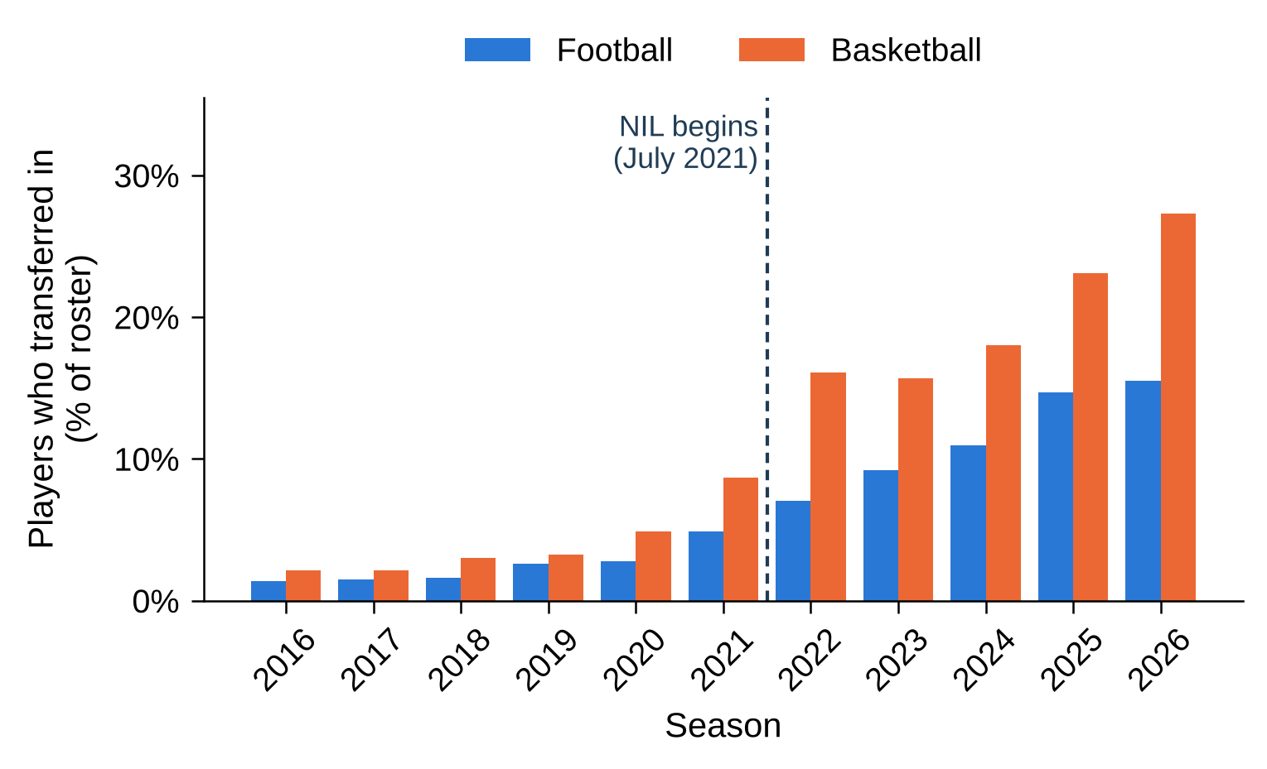
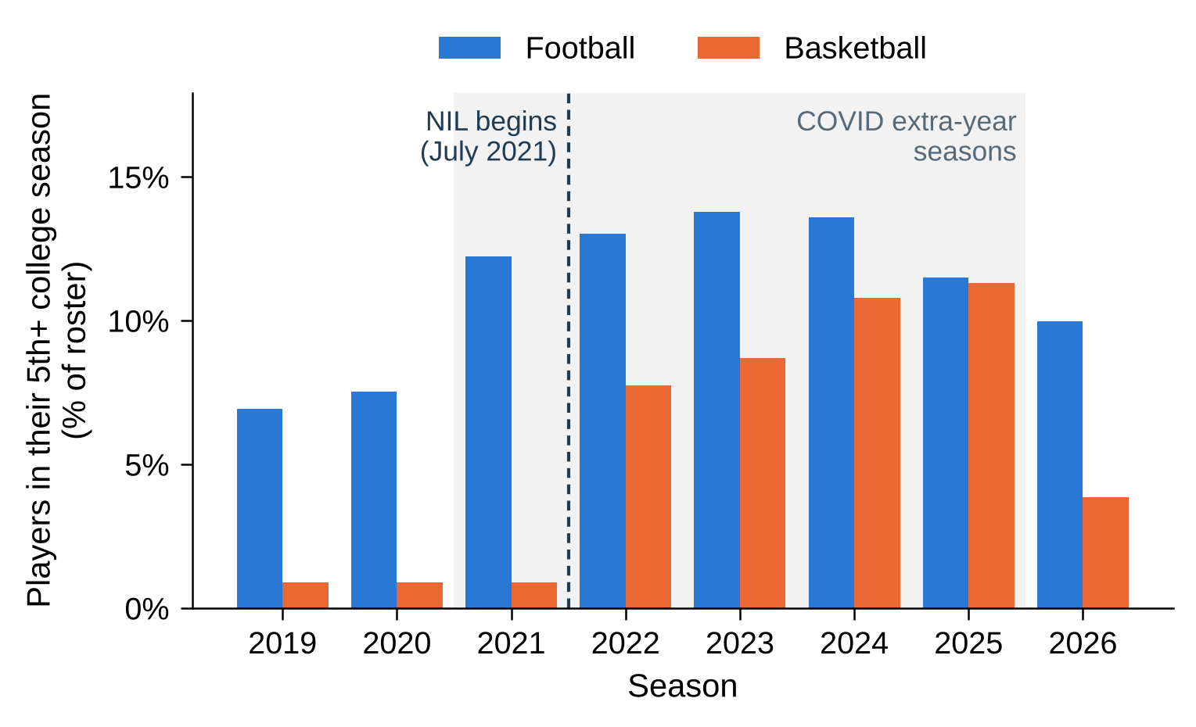
Rosters changed after July 2021
All FBS football and Division I basketball rosters, not our NIL sample
Transfers kept rising after NIL; the 5th-year bump is mostly the COVID extra year
Descriptive context only: NIL, the one-time transfer rule and COVID eligibility arrived together
AIPI 510 | Govil and Teshome | November 1 2026
16
Notes:
Backup slide, not presented. 40 seconds. Left: the share of each roster made up of transfers climbs after July 2021 in both sports, to about 27 percent in basketball and 15 percent in football. Right: the share of players in a fifth or later season rose with the COVID extra eligibility year and is now falling back, sharply in basketball. The one-time transfer exception also arrived in 2021, so these trends cannot be credited to NIL alone. Source: figures/fig1_transfer_share, fig2_fifth_year_share and scripts/make_manuscript_figures.py.

Slide 18
A valid before and after comparison
Test the change in social slope on a common outcome
Y = baseline terms + beta social + gamma post
+ delta social by post + error
Measure followers before the same kind of decision in both eras
Use comparable populations and address athlete and school dependence
Delta tests the slope change. Different outcome scales cannot support that comparison.
AIPI 510 | Govil and Teshome | November 1 2026
17
Notes:
Backup slide, not presented. 45 seconds. To study the original question, we need the same outcome and eligible population on both sides of July 2021. If the outcome is an offer, we need documented offers and credible non offers, not absence of a public report. Followers must precede the decision. Current followers cannot reconstruct historical reach, and historical NIL values cannot be coded as zero. Sampling current players by NIL and historical players by stars also changes the target population. The interaction delta directly tests the change in association. Calendar changes, COVID and other policies still prevent an automatic causal NIL interpretation. Source: docs/research_design.md; scripts/analyze_prepost.py; project report recommendations.

