Slide 1
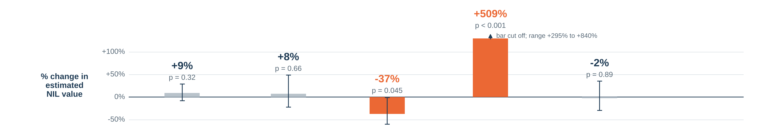
Basketball only: what moves NIL value
Model: Linear Regression 100 Division I men’s basketball players. Bars: % change from each piece, others held fixed; grey = not significant.
NIL value
estimated deal value
=
Followers
Instagram followers (twice as many)
+
Points per game
last season (+5 points)
+
Freshman
first-year player?
+
Big conference
ACC, Big Ten, Big 12, SEC or Big East
+
Position
forward or center (vs guard)
+
No stats last season
adjustment so freshmen stay in (not shown)
How much followers matter here: β = 0.124 (twice the followers → +9% NIL value)
95% confidence range = -0.119 to 0.367 p-value for followers = 0.32
The model explains 54% of the differences in basketball NIL value
Playing in a big conference is the dominant factor. Once it is in the model, followers are no longer statistically significant.
AIPI 510 | Govil and Teshome | November 2026

