Slide 1
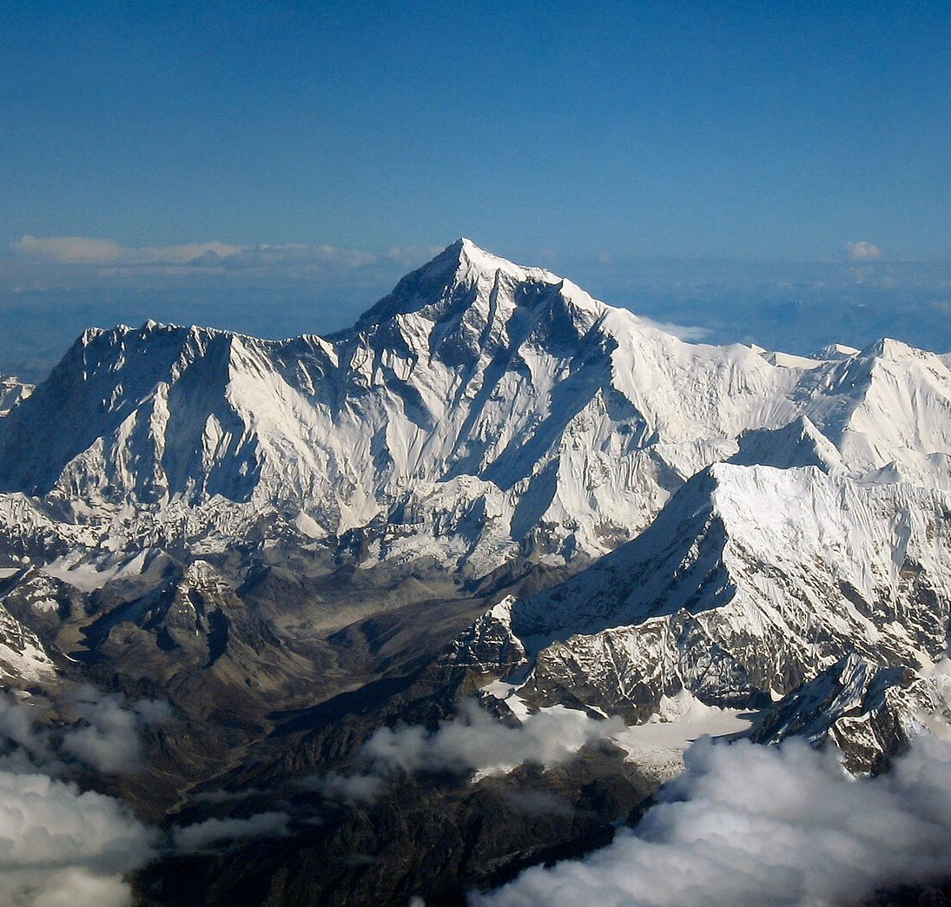
Nepal OS
One free, Nepali-first operating system for all of government
नेपाल ओएस: सरकारका लागि स्वतन्त्र, नेपाली-प्रथम अपरेटिङ सिस्टम
Proposal · Prototype · 2026
Built on free software. Run in Nepal, in Nepali, for every ministry.
Notes:
Nepal OS is a proposal and prototype: one free, Nepali-first operating system for every ministry. It is not an official Government of Nepal project.
Photo: Mount Everest as seen from a Drukair flight. Author: shrimpo1967; derivative work by Papa Lima Whiskey 2. Licence: CC BY-SA 2.0. Cropped. Source: https://commons.wikimedia.org/wiki/File:Mount_Everest_as_seen_from_Drukair2_PLW_edit.jpg

Slide 2
The problem today
Three issues that every ministry shares
Licence costs
Vendor dependence
Legacy fonts
Paying every year for proprietary desktops and office suites.
Foreign companies control updates, data and roadmaps.
Many files are still in non-Unicode Preeti: hard to search, share and archive.
Each problem has the same answer: a free, open system that Nepal manages itself.
Notes:
Three problems: yearly licence payments for proprietary desktops and office suites; dependence on foreign vendors for updates, data and roadmaps; and legacy documents in the non-Unicode Preeti font, which are hard to search, share and archive.
No figures are given on purpose: we have no sourced cost data. Content is from the Nepal OS proposal.

Slide 3
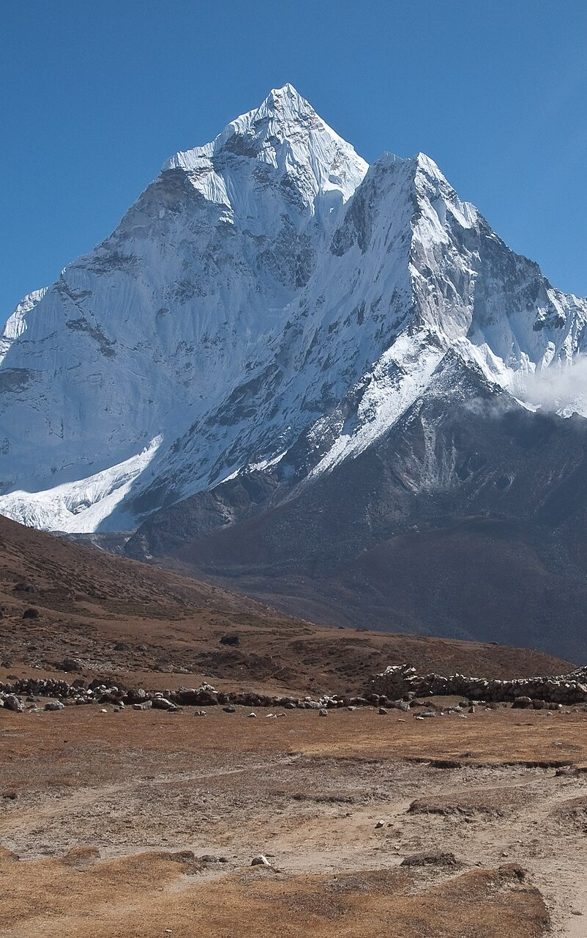
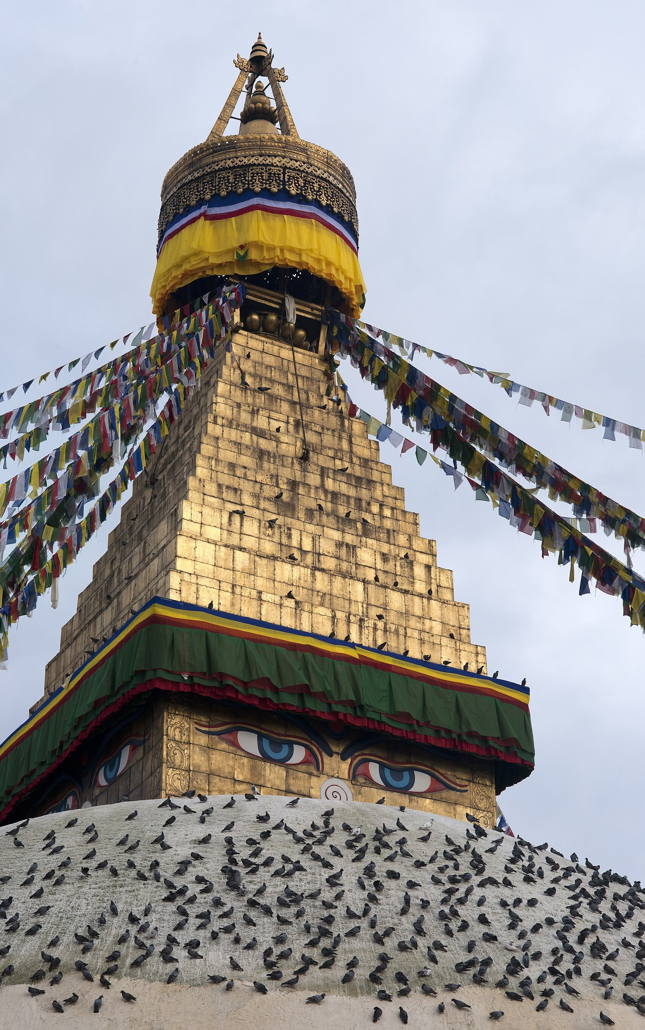
What we copy
The model: EU OS
The method, not the code: test a free desktop, package it and manage it centrally.
Europe's public sector already has a working example. Nepal OS follows the same approach, on a base built for long, stable use.
01. EU OS
02. Nepal OS
Community-led proof of concept for the EU public sector.
Fedora Linux, KDE Plasma, bootable containers.
Not an official EU project.
The same approach, on Debian stable.
Tested, packaged and centrally managed.
No new kernel, no fork.
Notes:
EU OS is a community-led proof of concept for the EU public sector, based on Fedora Linux with KDE Plasma and bootable containers. It is not an official EU project; it is a tested and packaged setup. Source: https://eu-os.eu
Nepal OS takes the same approach on Debian stable: tested, packaged and centrally managed. No new kernel and no fork.
Photo (centre): Ama Dablam, Nepal. Author: Vyacheslav Argenberg. Licence: CC BY 4.0. Cropped. Source: https://commons.wikimedia.org/wiki/File:Ama_Dablam,_Nepal.jpg
Photo (right): Buddha eyes, Boudhanath Stupa, Kathmandu. Author: Ggia (Wikimedia Commons user). Licence: CC BY-SA 3.0. Cropped. Source: https://commons.wikimedia.org/wiki/File:20110725_Budha_eyes_closeup_Bodhnath_Stupa_Kathmandu_Nepal.jpg

Slide 4
What's inside: ready for Nepali work on day one
Office suite
Fonts
LibreOffice, with a Nepali interface and Nepali spellcheck.
Kalimati (default), Preeti for legacy files plus a converter, and Noto Sans Devanagari.
Keyboards
Nepali by default
Romanized and Traditional Nepali layouts, with a one-click switch.
Bikram Sambat calendar, Kathmandu time, and Himalaya and temple wallpapers.
Notes:
What ships in Nepal OS: LibreOffice with a Nepali interface and spellcheck; fonts (Kalimati as default Nepali, Preeti for legacy files plus a converter, Noto Sans Devanagari); Romanized and Traditional Nepali keyboards with a one-click switch; Nepali defaults: Bikram Sambat calendar, Kathmandu time, Himalaya and temple wallpapers.
Content is from the Nepal OS proposal. Font licensing for Kalimati and Preeti is covered on the risks slide.

Slide 5
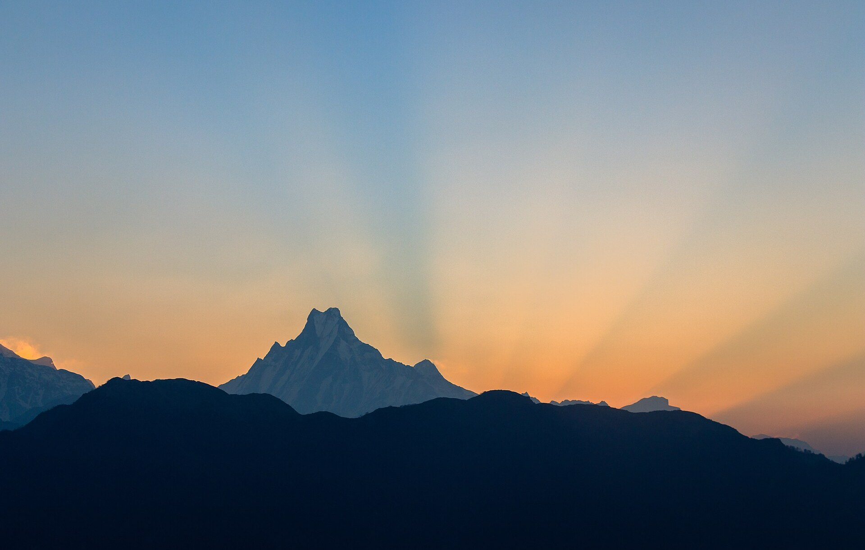
One image, every ministry
Every computer gets the same signed image. At install, a ministry code such as mof, moha or moest sets the ministry's name in Nepali and English, its logo, login screen, wallpaper, About page, bookmarks and update server.
One image
Any ministry
Same for all
Set at install
One signed image for all of government.
A short code gives each ministry its own identity.
Notes:
One signed image for every ministry. The ministry is chosen at install with a code such as mof, moha or moest. The code sets the ministry's name in Nepali and English, its logo, login screen, wallpaper, About page, bookmarks and update server.
Laptop screen photo: Machapuchare (Fishtail) at sunrise. Author: Bijay Chaurasia. Licence: CC BY-SA 4.0. Cropped. Source: https://commons.wikimedia.org/wiki/File:Machapuchare_Himal-3797.jpg

Slide 6
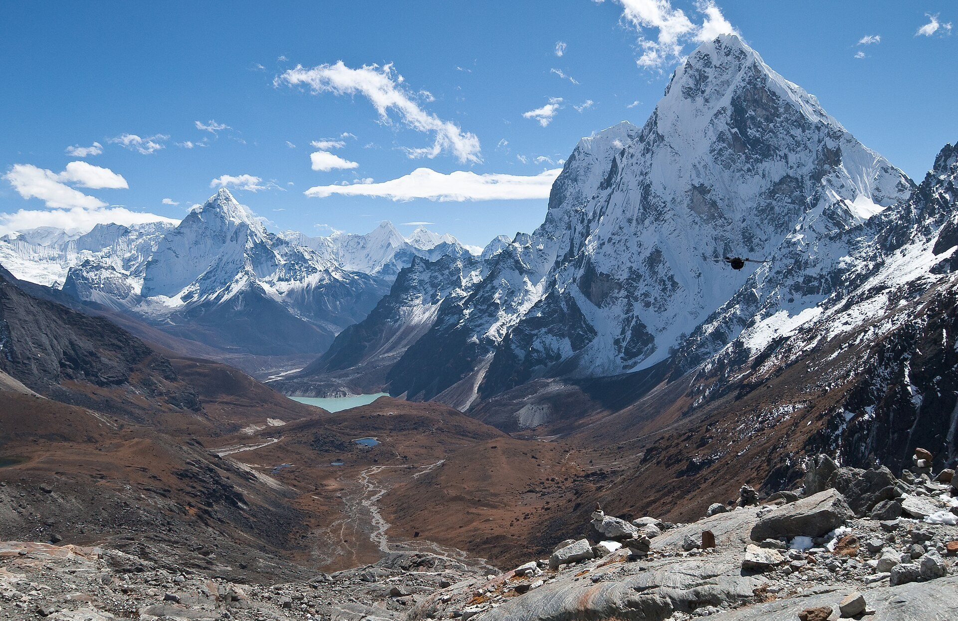
Mass deployment
Three steps take one tested image to every government computer, with updates under central control.
1
Automatic install
2
National mirror
3
Staged updates
From USB or network boot. The ministry code is the only input.
A national package mirror in a government data centre.
Central IT, then a pilot ministry, then all of government. Nightly security fixes; rollback to a snapshot.
Notes:
1. Automatic install from USB or network boot; the ministry code is the only input. 2. A national package mirror in a government data centre. 3. Staged updates: central IT first, then a pilot ministry, then all of government; nightly security fixes; rollback to a snapshot.
Content is from the Nepal OS proposal.
Photo: Cholatse and the Chola valley, Nepal. Author: Vyacheslav Argenberg. Licence: CC BY 4.0. Cropped. Source: https://commons.wikimedia.org/wiki/File:Himalayas,_Cholatse,_Nepal.jpg

Slide 7



No telemetry
Security and sovereignty
No usage reports and no phone-home to any vendor.
Government keeps control of its own computers and its own data.
Open source
All code is open and can be audited.
These three rules apply to every ministry, from the first pilot onward.
Stays in Nepal
Updates and data stay on infrastructure in Nepal.
Notes:
Three commitments: no telemetry or phone-home; open source and auditable; updates and data stay on infrastructure in Nepal.
Content is from the Nepal OS proposal.
Icons: Lucide (eye-off, code, map-pin), ISC licence, https://lucide.dev/license

Slide 8






Risks and responses
RISK
Font licensing
Translation gaps
Old printers and apps
Kalimati and Preeti need clear permission for use and sharing.
Some programs are not yet fully translated into Nepali.
Some printers and Windows-only programs may not work.
RESPONSE
Written permission
Translation drive
Test list and options
Ask for written permission for Kalimati and Preeti; Noto is a free fallback.
A translation drive with Nepali universities.
A hardware test list, plus web or virtual-machine options.
Notes:
Top row: the risks. Bottom row: the response to each risk, in the same column.
Font licensing: ask for written permission for Kalimati and Preeti, with Noto Sans Devanagari as a free fallback. Nepali translation gaps: a translation drive with universities. Old printers and Windows-only apps: a hardware test list, and web or virtual-machine options.
Content is from the Nepal OS proposal.
Icons: Lucide (type, languages, printer, file-check, graduation-cap, wrench), ISC licence, https://lucide.dev/license

Slide 9





Twelve months to version 1.0
Five steps, from the first packages to a phased rollout.
Months 1–2
Months 3–4
Months 5–7
Months 8–10
Months 11–12
Licensing, repository and first packages.
Keyboard and translation testing; pilot on about 20 machines.
Automatic install, ministry profiles, 2–3 pilot ministries.
Fixes, guides and IT training.
Version 1.0 and phased rollout.
Notes:
Months 1–2: licensing, repository, first packages. Months 3–4: keyboard and translation testing, pilot on about 20 machines. Months 5–7: automatic install, ministry profiles, 2–3 pilot ministries. Months 8–10: fixes, guides, IT training. Months 11–12: v1.0 and phased rollout.
Plan from the Nepal OS proposal.
Icons: Lucide (package, keyboard, monitor-down, book-open, flag), ISC licence, https://lucide.dev/license

Slide 10
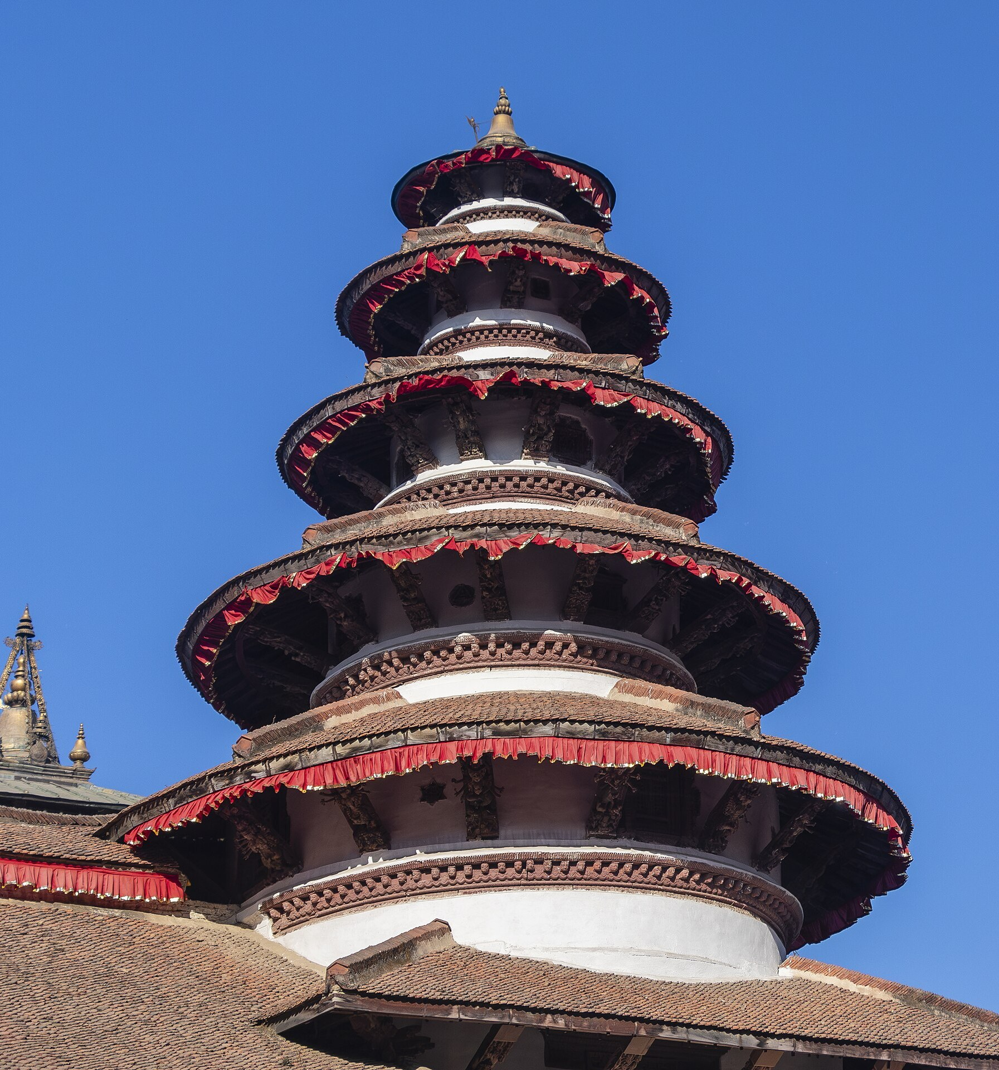
The ask
Two decisions let the pilot begin.
1. Approve a pilot
In one or more ministries.
2. Name a central owner
For the base image and the ministry profiles.
Nepal OS · Proposal · 2026
Notes:
The ask: (1) approve a pilot in one or more ministries; (2) name a central owner for the base image and the ministry profiles.
Photo: historic pagoda-style temples, Kathmandu Durbar Square. Author: Bijay Chaurasia. Licence: CC BY-SA 4.0. Cropped. Source: https://commons.wikimedia.org/wiki/File:Historic_Pagoda_Style_Architecture_in_Kathmandu_Durbar_Square-IMG_4069.jpg
Credits for the whole deck: Photos from Wikimedia Commons - Mount Everest from Drukair (shrimpo1967; derivative by Papa Lima Whiskey 2; CC BY-SA 2.0); Ama Dablam and Cholatse (Vyacheslav Argenberg; CC BY 4.0); Boudhanath Stupa (Ggia; CC BY-SA 3.0); Machapuchare and Kathmandu Durbar Square (Bijay Chaurasia; CC BY-SA 4.0). Source URLs are in the notes of each slide. All photos cropped. Icons: Lucide, ISC licence, https://lucide.dev/license. EU OS facts: https://eu-os.eu. Other content: the Nepal OS proposal.

