Slide 1
The basics: left-aligned Helvetica Neue, 40pt text size for headers, 32pt for text
Make a document instead of a slide deck if you are trying to say too much
Email us on gds-brand-support@ if you have any questions or feedback
Read useful tips on good presentations

Slide 2
If sensitive - add a classification to the top of your slides
First name Second name
Job title
Government Digital Service

Slide 3
This is a text slide

Slide 4
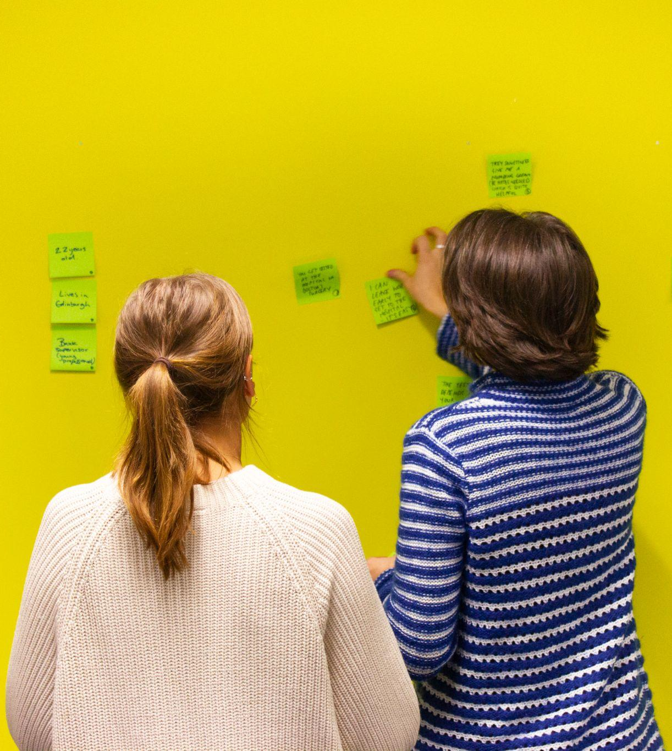
This is how to have image or a screenshot with text

Slide 5
This is a section slide

Slide 6


This is a section slide with a background

Slide 7
Use this for new sections if your image is too bright

Slide 8

Notes:
This is a gallery: use it to lay out a series of images in a grid

Slide 9
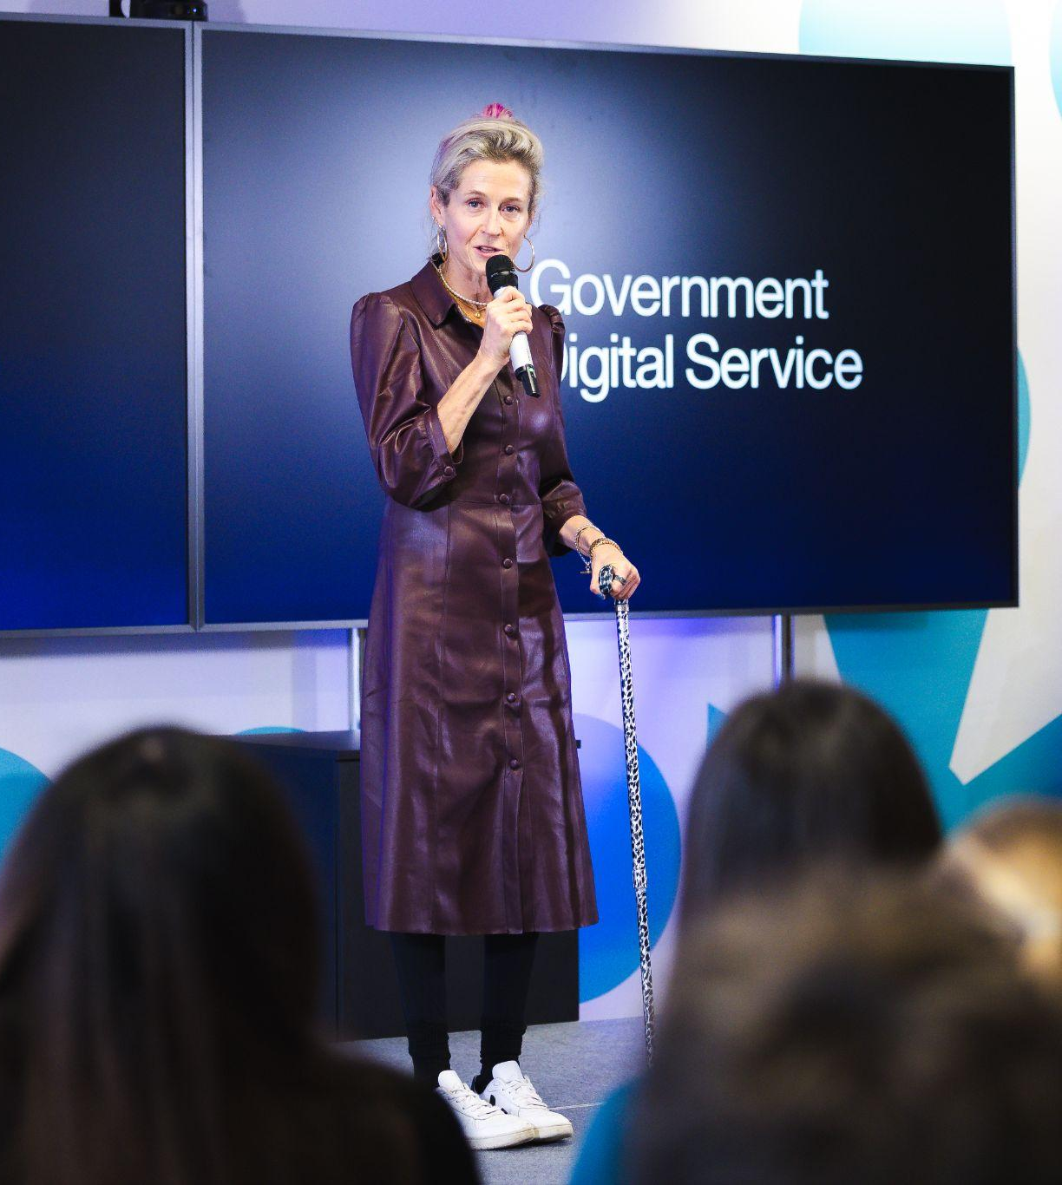
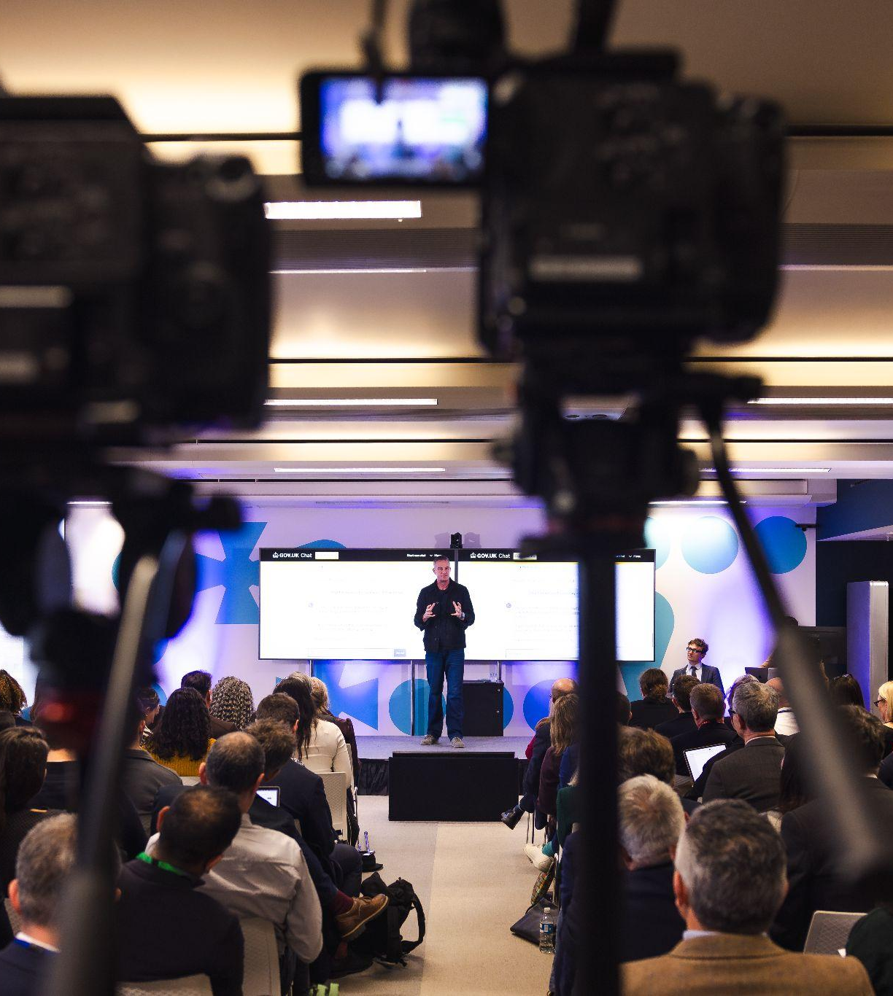

Notes:
This is a gallery: use it to lay out a series of images in a grid

Slide 10
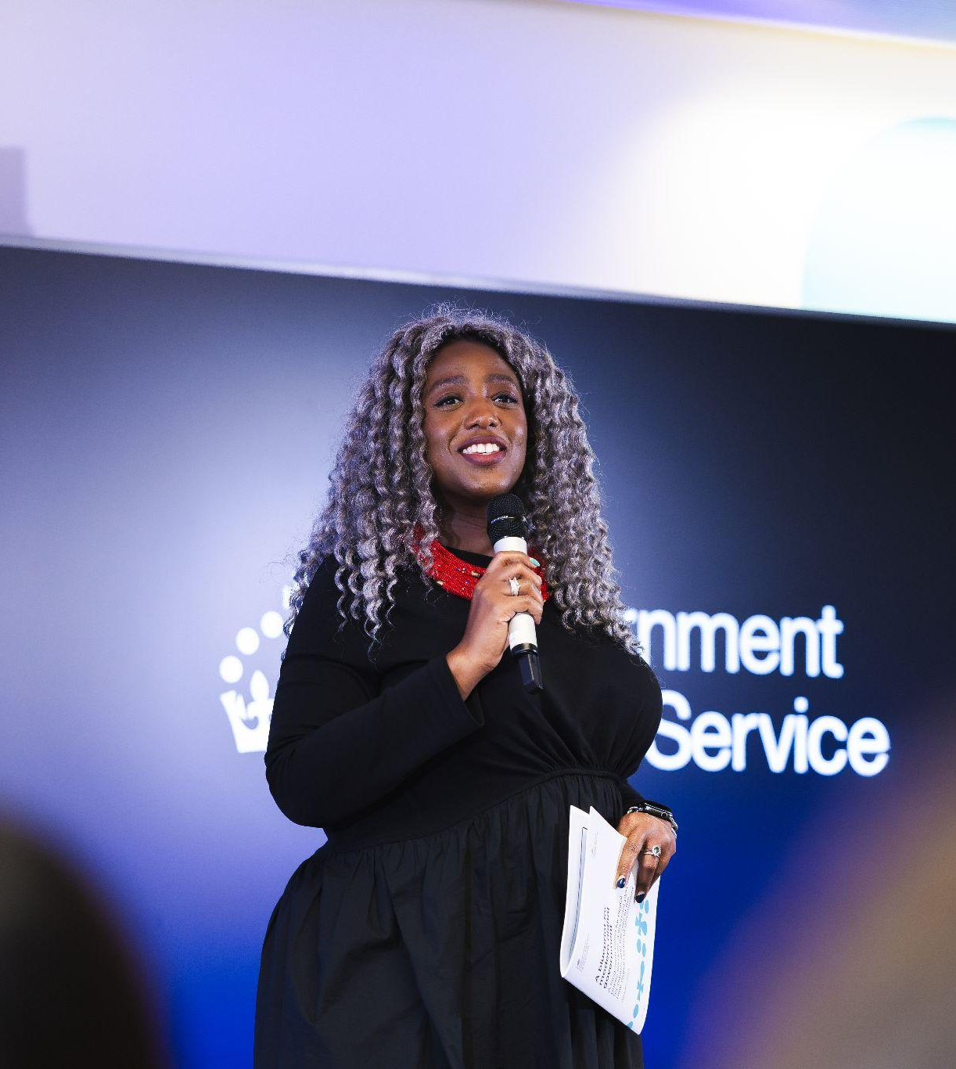
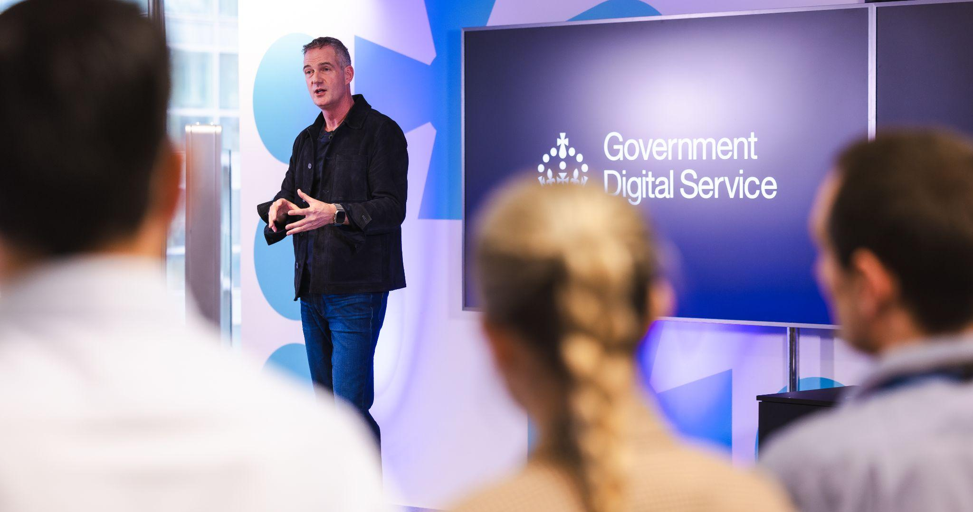

Notes:
This is a gallery: use it to lay out a series of images in a grid

Slide 11
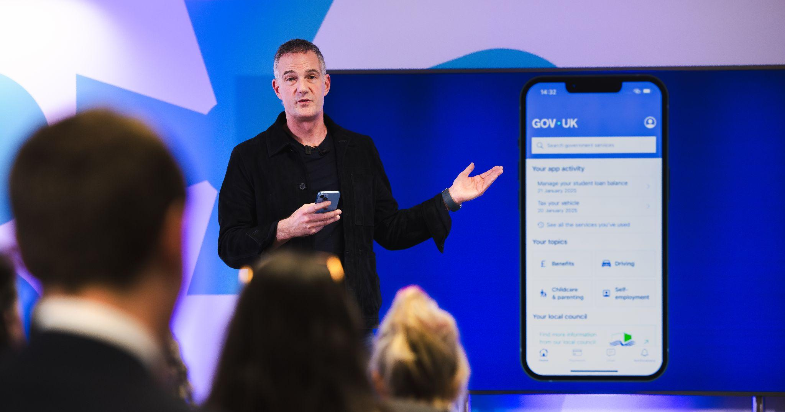

Notes:
This is a gallery: use it to lay out a series of images in a grid

Slide 12
Thanks!
Firstname Secondname
Job title
Government Digital Service

