Slide 1
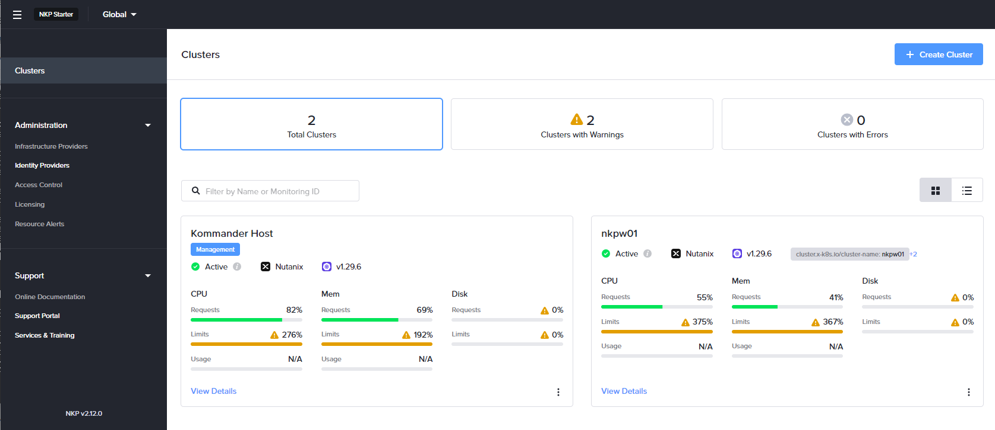
Nutanix Kubernetes Platform（NKP）ラボ | 概要
Identity Provider
Active Directory
lab-nxad-01
(nxad.go-lab.jp)
Managed Cluster
(Workload Cluster)
Management Cluster
認証 / RBAC 設定
Management Cluster の作成
Workload Cluster
の作成
Prism Central: lab-nxpc-01
nkp CLI
CE Cluster #1
lab-nxce-01
CE Cluster #2
lab-nxce-02
NKP
Control Plane
NKP
Control Plane
Podman
Bootstrap
Linux
CVM
Prism Element
Prism Central
CVM
Prism Element
NKP
Worker
NKP
Worker
AHV
AHV

Slide 2
Nutanix Kubernetes Platform（NKP）ラボ | 概要
Identity Provider
Active Directory
lab-nxad-01
(nxad.go-lab.jp)
Managed Cluster
(Workload Cluster)
Management Cluster
認証 / RBAC 設定
Management Cluster の作成
Workload Cluster
の作成
Prism Central: lab-nxpc-01
nkp CLI
CE Cluster #1
lab-nxce-01
CE Cluster #2
lab-nxce-02
NKP
Control Plane
NKP
Control Plane
Podman
Bootstrap
Linux
CVM
Prism Element
Prism Central
CVM
Prism Element
NKP
Worker
NKP
Worker
AHV
AHV

Slide 3
Nutanix Kubernetes Platform（NKP）ラボ | 概要
Identity Provider
Active Directory
lab-nxad-01
(nxad.go-lab.jp)
Managed Cluster
(Workload Cluster)
Management Cluster
認証 / RBAC 設定
Management Cluster の作成
Workload Cluster
の作成
Prism Central: lab-nxpc-01
nkp CLI
CE Cluster #1
lab-nxce-01
CE Cluster #2
lab-nxce-02
NKP
Control Plane
NKP
Control Plane
Podman
Bootstrap
Linux
CVM
Prism Element
Prism Central
CVM
Prism Element
NKP
Worker
NKP
Worker
AHV
AHV

Slide 4
Nutanix Kubernetes Platform（NKP）ラボ | 概要
Identity Provider
Active Directory
lab-nxad-01
(nxad.go-lab.jp)
Managed Cluster
(Workload Cluster)
Management Cluster
認証 / RBAC 設定
Management Cluster の作成
Workload Cluster
の作成
Prism Central: lab-nxpc-01
nkp CLI
CE Cluster #1
lab-nxce-01
CE Cluster #2
lab-nxce-02
NKP
Control Plane
NKP
Control Plane
Podman
Bootstrap
Linux
CVM
Prism Element
Prism Central
CVM
Prism Element
NKP
Worker
NKP
Worker
AHV
AHV

