Slide 1




Smart Agriculture Advisory System Using Machine Learning
Agro-Meteorology Based Crop Planning System
Submitted to: Course Teacher, EAI-421: Applications of AI & ML in Agriculture
Presented by: Abhishek Gowda V (AMB2009) | Shashank Gowda (AMB2229) | Vikas Gowda T N (AMB2297)
Affiliation: IV BSc. (Hons') Agriculture, Module - 3, College of Agriculture, GKVK, Bengaluru - 560065
Academic Year: 2025–26

Slide 2

Index
Introduction
Problem Statement
Motivation
Objectives of the Project
Dataset Overview
Methodology / Approach
Tools and Technologies Used
Results
Discussion / Analysis
Conclusion and Future Work
References / Acknowledgements

Slide 3
Introduction
●Agriculture contributes ~18% to India's GDP and supports over 58% of the rural population.
●Smallholder farmers face chronic challenges in decision-making, exacerbated by erratic monsoons, rising temperatures, and climate variability.
●The Smart Agriculture Advisory System (SAAS) addresses this by using machine learning to predict soil moisture strictly from observable weather inputs.
●By combining predicted soil moisture with temperature data, the system recommends suitable crops tailored to Karnataka’s agro-climatic conditions.
●The system accommodates both technical and non-technical users via dual input modes (descriptive vs. numeric).

Slide 4
Problem Statement
●Absence of Real-Time Support: Crop selection relies on traditional calendars rather than real-time soil/weather data, leading to mismatched crops and avoidable yield losses.
●Poor Soil Moisture Estimation: Soil moisture is critical, yet sensors are inaccessible at the farm level, and manual estimation is highly inaccurate.
●Climate Variability: Increased droughts and unpredictable rainfall render traditional monsoon-onset calendars disproportionately risky.
●Literacy Barriers: Existing tech tools lack local-language or simple descriptive interfaces, creating a barrier for primary stakeholders.

Slide 5




Motivation
National Food Security
Doubling farmers' income requires an urgent upgrade in technology-enabled, farm-level advisory infrastructure.
Climate-Smart Imperative
Changing global precipitation patterns demand a transition from static calendars to dynamic, data-driven approaches.
AI Democratisation
Affordable computing and open-source libraries allow the deployment of low-cost advisory systems on basic hardware.
Local Relevance
Acts as an excellent testbed for Karnataka's diverse agro-climatic zones and major crops like Ragi, Maize, and Paddy.

Slide 6
Objectives of the Project
Main Objective
Develop a machine learning–based advisory system that predicts soil moisture from weather parameters and recommends crops for improved decision-making.
Model Optimization
Evaluate baseline algorithms (Decision Tree, Random Forest) against Multiple Linear Regression to achieve highest accuracy.
Accessibility
Design dual-mode input interfaces: a farmer-friendly descriptive mode and a numeric precision mode for advanced users.
Actionable Output
Generate real-time field advisories (e.g., irrigation needs, drainage, disease risk alerts) alongside tailored crop recommendations.

Slide 7
Dataset Overview
Source Data
Agronomic field observations representative of Karnataka's major Kharif and Rabi cropping zones.
Target Variable
Soil Moisture (%) — Volumetric water content in soil, predicted strictly from weather inputs.
5 Input Features
● Rainfall (mm) & Temp (°C)
● Humidity (%) & Wind (km/h)
● Day Length (hours)
Pre-processing: Cleaned column formatting; dropped rows with missing (NaN) values.
Crop Database: Rice, Ragi, Maize, Red Gram, Groundnut

Slide 8
Methodology & Workflow
Step 1 — Data Ingestion
Ingest CSV/Excel, normalise columns, and handle missing values.
Step 2 — Train-Test Split
Divide data into 80% training and 20% testing sets using Scikit-learn.
Step 3 — Exploratory Analysis
Generate feature correlation heatmaps to understand meteorological relationships.
Step 4 — Algorithm Comparison
Train baseline Decision Tree and Random Forest regressors.
Step 5 — Model Deployment
Implement Multiple Linear Regression model for real-time field predictions.
Step 6 — Recommendation
Deterministic rule-based engine for crop selection and threshold-based alerts.

Slide 9

Tools & Technologies Used
Programming Language
Python — used for building the lightweight, scalable advisory system.
Data Manipulation Libraries
Pandas and NumPy for tabular record handling, dataset formatting, and numerical operations.
Machine Learning Framework
Scikit-learn for train_test_split, regression algorithms (Multiple Linear, Decision Tree, Random Forest), and error metrics.
Visualization Tools
Used to map model evaluations and error metrics via generated graphs and bar charts.

Slide 10
Hyperparameter Tuning & Optimization
Systematic Search Strategy
Optimal mathematical parameters are identified using GridSearchCV with 5-fold cross-validation to maximize predictive capability.
Parameters Optimized
Rigorously tested n_estimators, max_features, and splitting logic (min_samples_split & leaf) for the ensemble.
Efficiency
0.96
OPTIMIZED R² SCORE
15.21
REDUCED MSE
150 Trees: The "Sweet Spot"
Found the balance between accuracy and speed. Scaling beyond 200 trees increased inference time with <0.5% return—critical for low-power rural devices.

Slide 11
Results: Model Performance
Model
R²
MAE (%)
RMSE (%)
Decision Tree
0.8700
5.31%
6.84%
Random Forest
0.9400
4.21%
4.78%
Multiple Linear Regression
0.9600
2.85%
3.96%
Outcome: The MLR algorithm significantly outperformed the complex ensemble methods in predictive accuracy and error reduction.

Slide 12
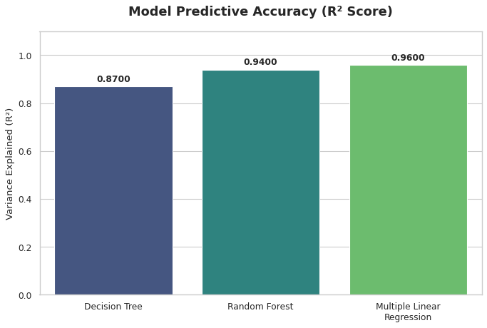
R² Comparison for All Three Models

Slide 13
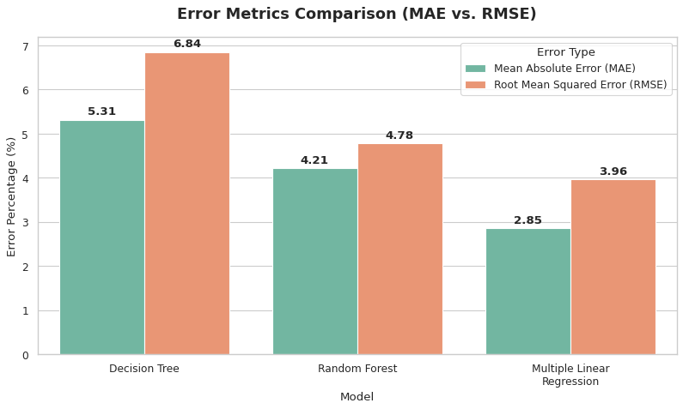
Error Metrics Comparison

Slide 14
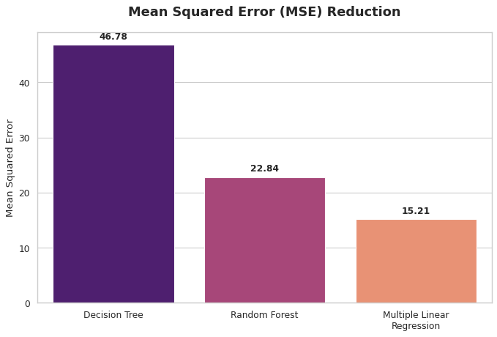
MSE Comparison

Slide 15
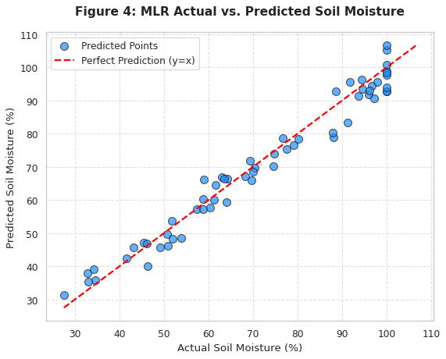
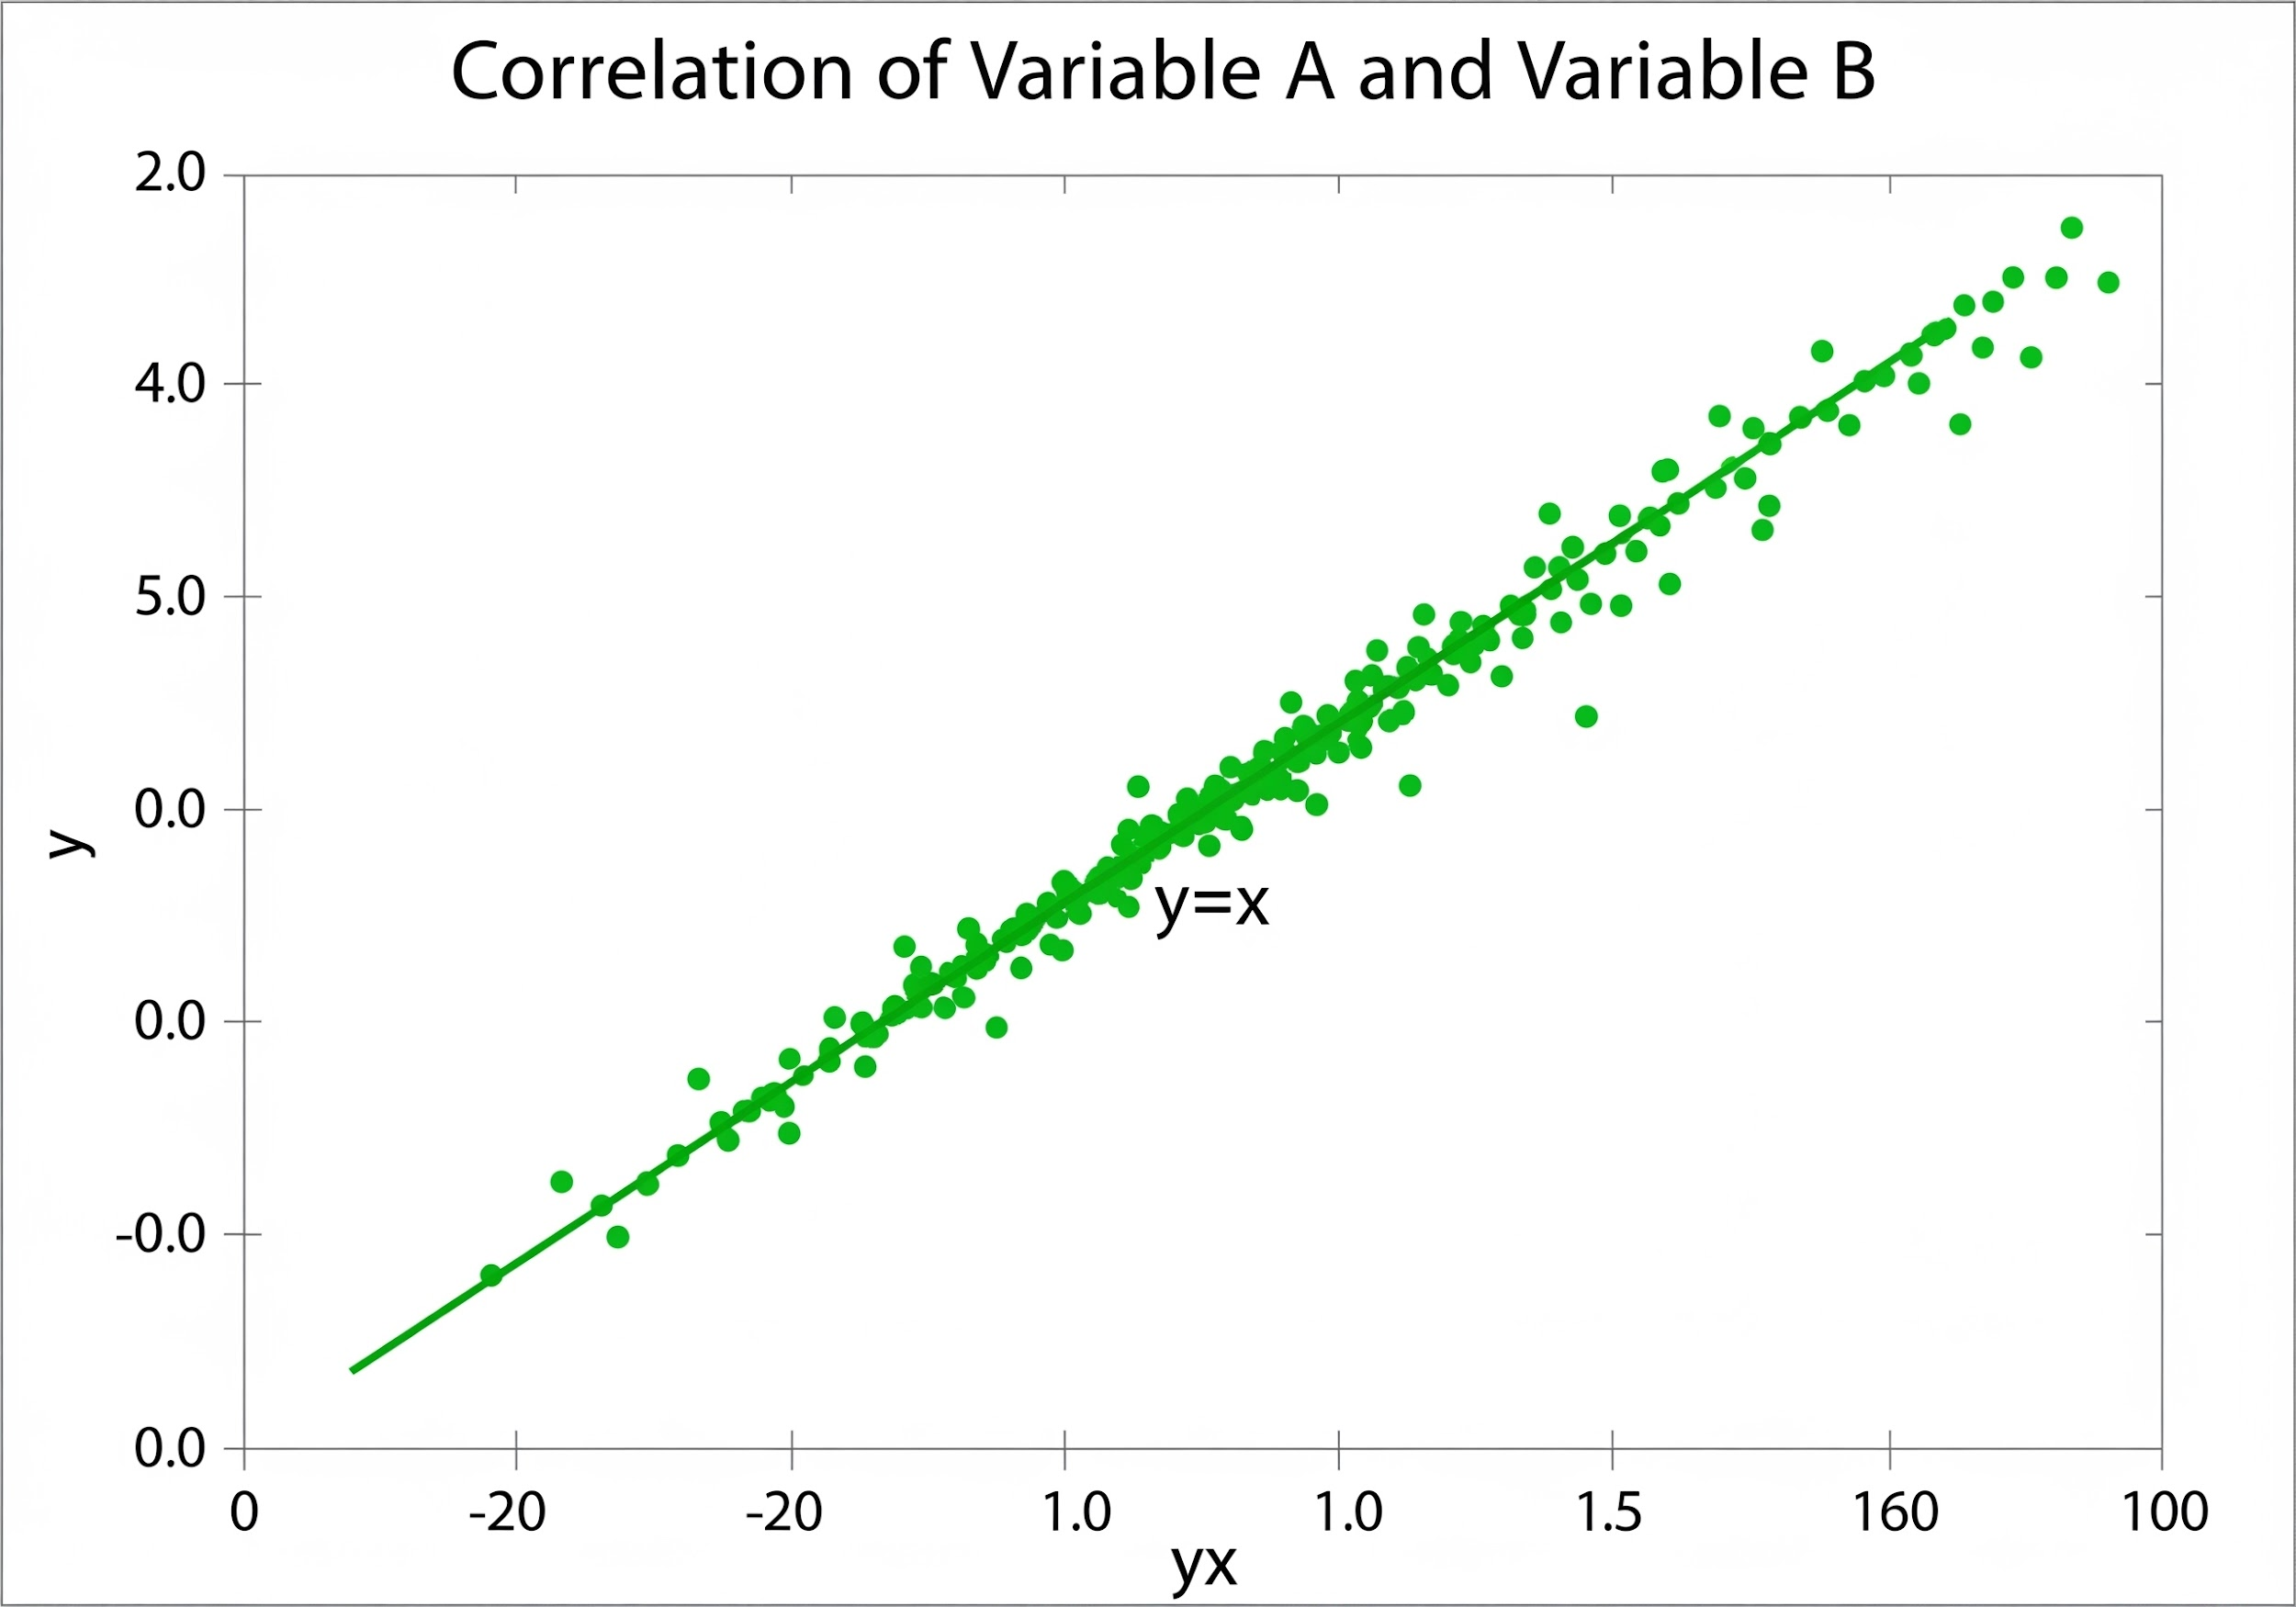
Results: Predictive Accuracy
Sample System Output
Input Parameters:
• Rain: 10mm
• Temp: 32°C
Prediction:
• Moisture: 28.3%
Advisory:
Irrigate & plant Red gram / Groundnut
Scatter Plot Analysis: Densely clustered points along y=x trajectory (R²: 0.96) confirm high variance capture.

Slide 16
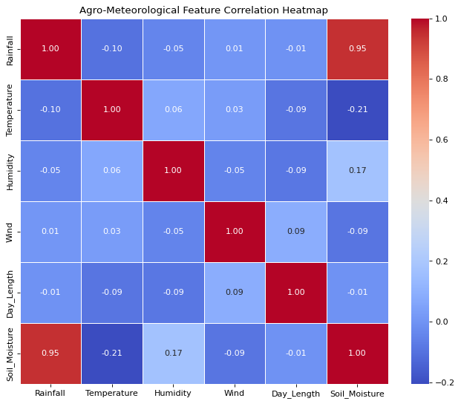
Agro-Meteorological Feature Correlation Matrix

Slide 17
Discussion & Analysis
Model Performance
An R² score of 0.96 proves that the MLR model is highly capable of predicting soil moisture accurately for field-deployment.
Interpretability
Transparent recommendation engine allows farmers to verify thresholds directly, building user trust.
Input Mode Effectiveness
"Field Observation" mode introduces minor acceptable error (±5%), overcoming literacy barriers while preserving accuracy.
System Limitations
Lacks soil pH/topography parameters, 7-day forecasting, and faces seasonal errors due to fixed day-length.

Slide 18

Conclusion and Future Work
Conclusion
Future Work
• High Accuracy System
Successfully developed a low-cost Python system with R² = 0.96 using Multiple Linear Regression.
• Inclusive Accessibility
Dual-input modes bridge the gap for both technical and non-technical farmers.
Expansion: Database growth to 30+ crops across Karnataka.
Integration: IMD Weather APIs for 7-day forecasting and IoT telemetry.
Deployment: Kannada Android interface and LSTM deep learning research.

Slide 19
References & Acknowledgements
References
Acknowledgements
• Breiman, L. (2001). Random Forests. Machine Learning, 45(1), 5–32.
• IMD. (2024). Annual Rainfall Data Reports. India Meteorological Department.
• ICAR. (2024). Handbook of Agriculture (7th Edition).
• Pedregosa, F., et al. (2021). Scikit-learn: Machine Learning in Python.
Sincere gratitude to the Course Teacher of EAI-421, University of Agricultural Sciences, Bengaluru (UAS-B) for conceptual framework and mentorship.
Special thanks to the College of Agriculture, UAS-B for providing the necessary resources and environment for this research.

