Slide 1

PCB Design with the KiCad EDA
Presented by Richard Gowen (@alt_bier)
Created for BSidesDFW 2020 HHV
This Slide Deck Is Available at https://altbier.us/pcb/

Slide 2
What are all these acronyms?
PCB = Printed Circuit Board
A PCB mechanically supports and electrically connects electronic components using conductive tracks and pads that are etched from copper laminated on sheets of a non-conductive substrate. The pattern is etched using a form of photolithography allowing mass duplication like photographs from a film negative thus ‘printing’ the circuit boards.
EDA = Electronic Design Automation
A category of software tools for designing electronic systems such as integrated circuits and printed circuit boards.
KiCad = “Ki” + Computer Aided Design
The term ‘Ki’ (pronounced Key even though I keep saying it wrong) is a reference to a company that the original software author Jean-Pierre Charras knew.
Computer Aided Design refers to the use of computers in the creation, modification, analysis, or optimization of a design.
KiCad is an open source software suite for electronic design automation.

Slide 3

KiCad Overview
KiCad is an open source software suite for EDA that has the following features:
A Schematic editor to create your design.
It comes with a stocked library of schematic symbols but also includes a schematic symbol editor to modify or create your own
A PCB Layout editor supporting up to 32 copper layers with auto-routing options.
It comes with a stocked library of PCB footprints but also includes a footprint editor to modify or create your own
A 3D Viewer which allows you to inspect your design in an interactive canvas.
It comes with a stocked library of 3D models and includes options to easily import additional 3D models as needed and tie them to footprints.
These three features being linked together with reference points between symbols and footprints and models allows for ease of design with quick visual confirmation
You can download the program and find libraries and documentation here: https://kicad-pcb.org/

Slide 4
Project File Layout
KiCad will create files in a project directory when you work with various features.
Here is a list of those files and a recommended directory structure to use for organization.
< project name >.pro – the main project file. Holds parameters that apply to the entire project (e.g. schematic, PCB layout, etc.).
< project name >.sch – a schematic file.
< project name >.kicad_pcb - a PCB New layout file.
< project name >.net – netlist in "Pcbnew" format
< project name >.bak – backup of schematic file.
< project name >.kicad_pcb-bak – backup of the new PCB layout file.
< project name >-cache.lib – a local cache copy of all the symbols used in the schematic
< project name >-kicad_wks – page layout worksheet template file
fp-lib-table – Footprint library list
sym-lib-table – Schematic library list
./3d_models/ – Optional directory contains local 3d model files
./gerber/ – Optional directory contains gerber formatted output files for manufacturing
./lib_fp/ – Optional directory contains local footprint module directories
./lib_sh/ – Optional directory contains local schematic library files
./snapshots/ – Optional directory contains prints of schematic / cad files and images

Slide 5

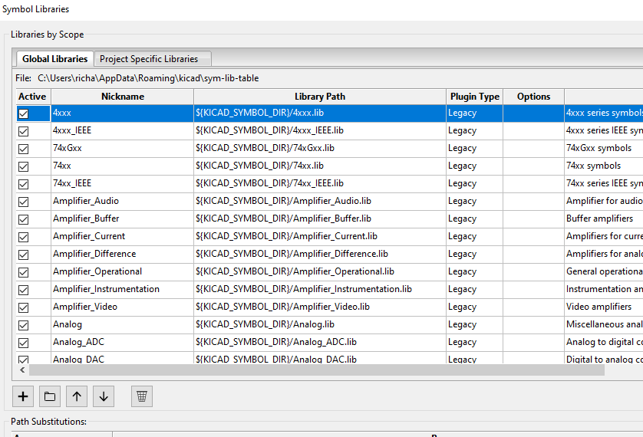
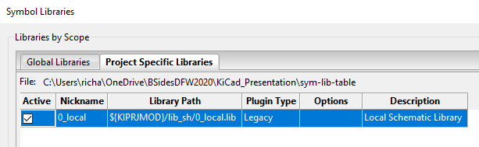
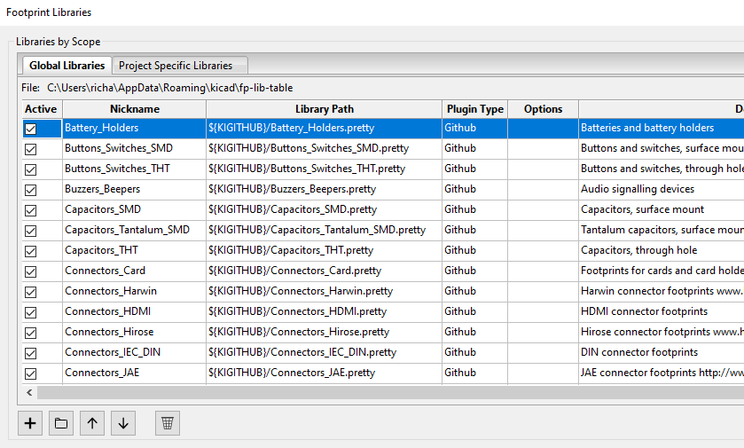
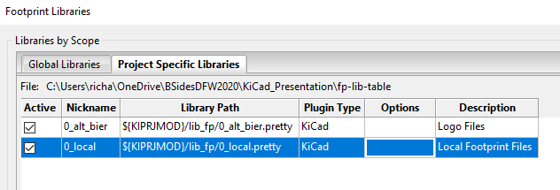
Setting Project Preferences
You will want to review some default project setting and adjust them as needed.
Configure Paths allows you to set which directories will be searched for files
Manage Symbol Libraries allows you to set which global libraries will be available to your project and the location of local project specific libraries (e.g. /lib_sh/local.lib)
Manage Footprint Libraries allows you to set which global libraries will be available to your project and the location of local project specific libraries (e.g. /lib_fp/local.pretty)

Slide 6
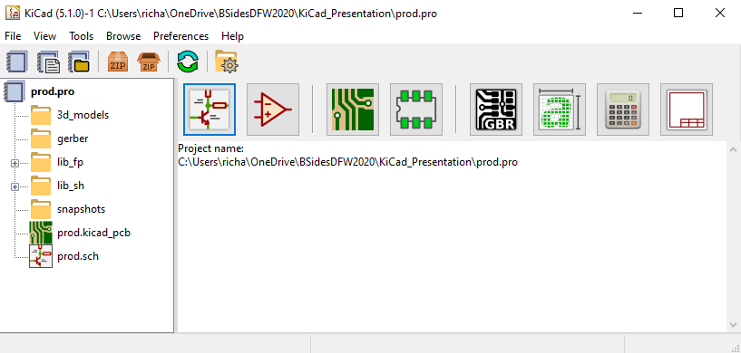
KiCad Program Layout
The program layout is intuitive and easy to navigate.
Project
File
Explorer
Schematic
Layout
Editor
Eeschema
PCB
Layout
Editor
Pcbnew
Gerber
File
Viewer
GerbView
PCB &
Component
Calculator
Symbol
Editor
Footprint
Editor
Bitmap
Converter
Page Layout
Editor

Slide 7
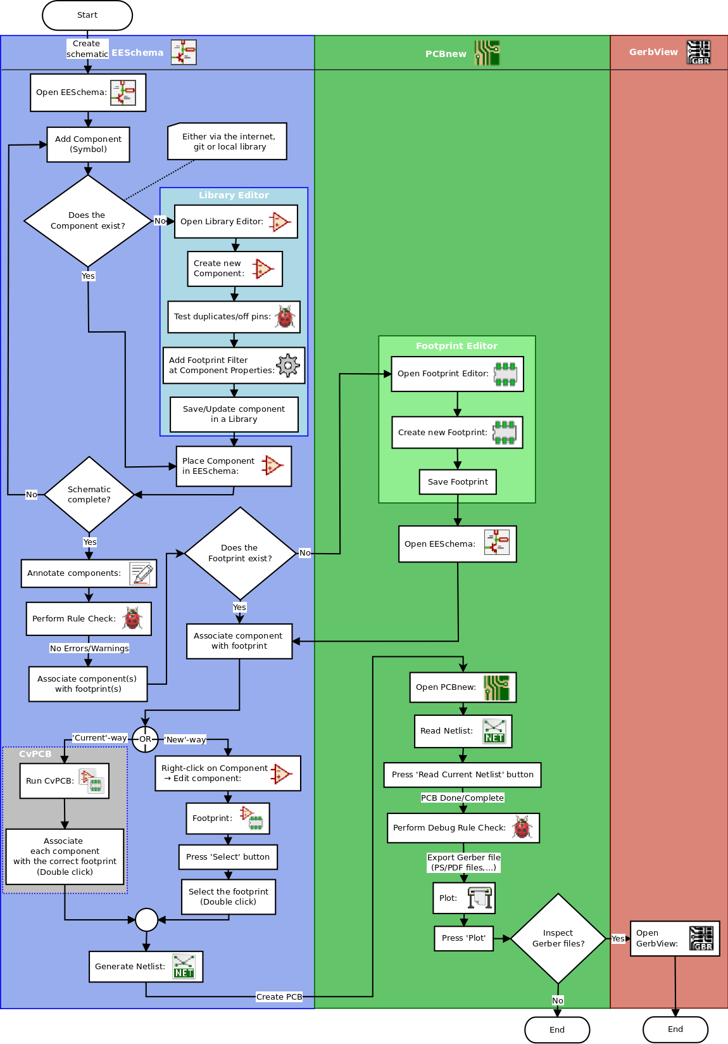
KiCad Design Workflow
Open Eeschema to create a schematic
Use the symbol editor as needed to create or modify symbols
Use the calculator as needed to verify component values.
Associate component symbols with footprints
Use the footprint editor if needed to create or modify footprints
Generate a Netlist file from Eeschema
Open Pcbnew to layout the PCB
Import the Netlist file
Size the board, move components around, run traces, add vias, etc.
Use the calculator as needed to verify track widths and spacing.
Associate component footprints with 3D models if needed
Use the 3D viewer to visually inspect your work.
Plot gerber files from Pcbnew for manufacturing
Open GerbView to confirm the integrity of the Gerber files
Send Gerber files to manufacturer

Slide 8
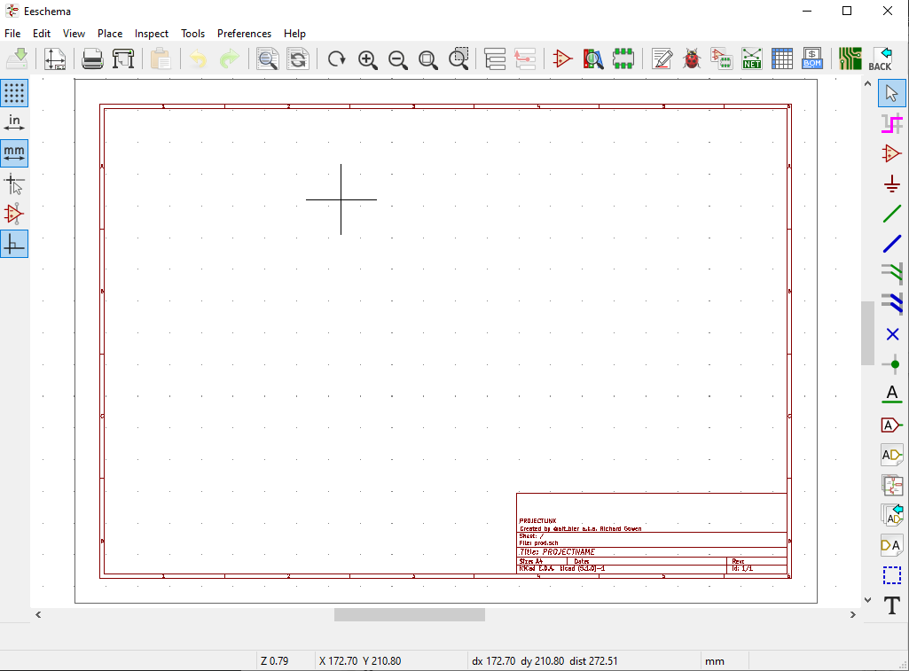
Eeschema Schematic Layout Editor
Eeschema Button Quick Reference
Electrical Rules Check
Assign Footprints to Symbols
Select
Highlight Net
Place Symbol
Power Port
Page
Settings
Place Wire
Open
Symbol
Editor
Open
Footprint
Editor
Generate
Netlist
Place Bus
Wire to Bus
Bus to Bus
Option
Toggles
No Connection Flag
Junction
Net Label
Global Label
Hierarchical Label
Create Hierarchical Sheet
Hierarchical Pin Import
Create Hierarchical Pin
Graphic Lines
Place Text

Slide 9
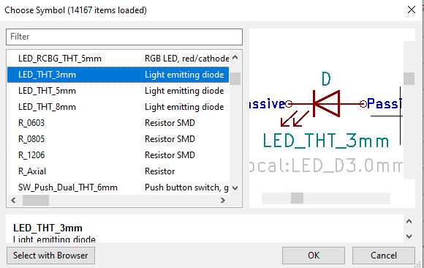
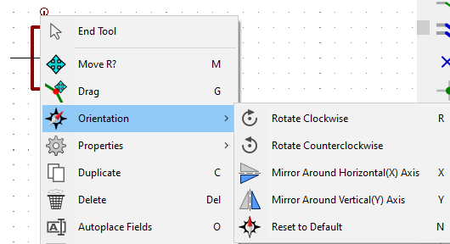
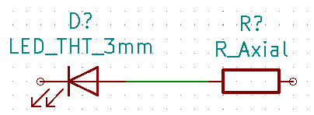
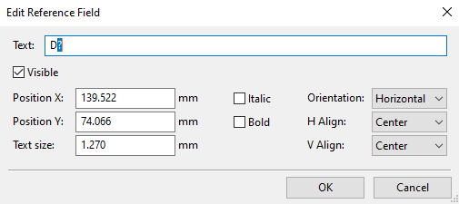
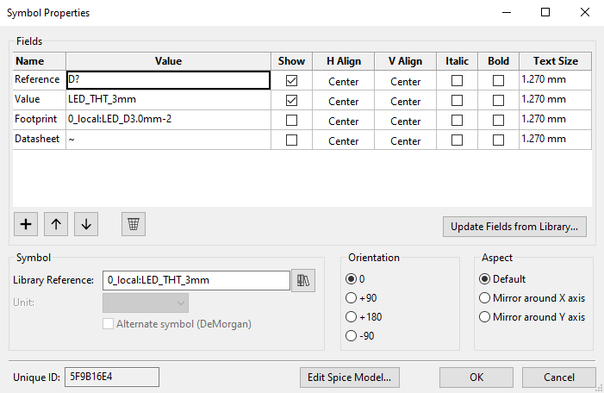
Eeschema Schematic Layout Editor
Eeschema Basics
To place a new symbol on your schematic click the Place Symbol tool and click on the schematic page. You will be prompted to choose a symbol from the available libraries.
To move or rotate a placed symbol right-click it and choose the move or orientation menus
To connect symbols choose the wire or bus tool and select the symbol pins to connect.
To edit a symbol reference number double-click on it
To edit all the properties of a symbol right click and choose the Edit Properties menu

Slide 10
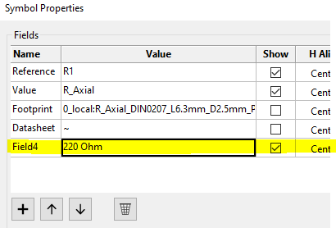
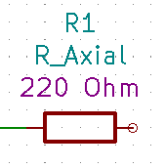
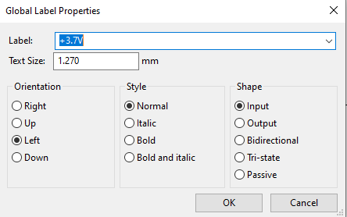
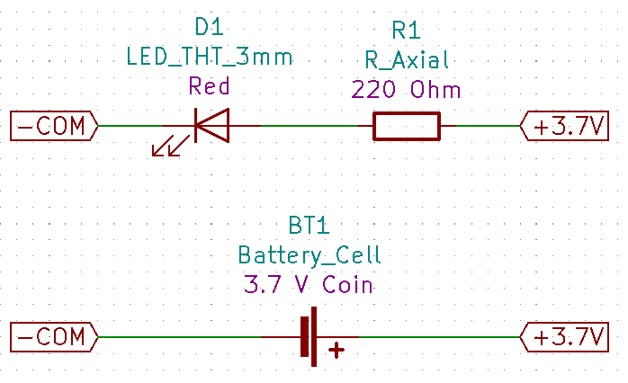
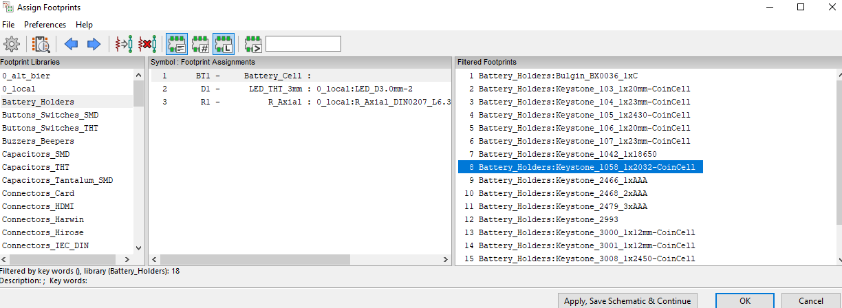
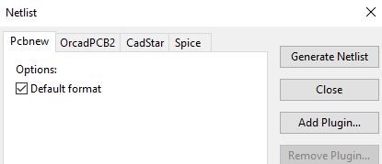
Eeschema Schematic Layout Editor
Eeschema Basics
To add additional information to a symbol under edit properties click the + add field and enter your text and choose if it should be shown.
To place a label click the global label tool and click on the schematic. You will be prompted enter the label and other setting like orientation.
Global labels can be used to connect wire nets without crossing wires on the schematic.
Make sure that all your symbols have associated footprints by clicking the Assign Footprints button and selecting footprints for the symbols that need them.
When complete click the Generate Netlist button to create the file that will be imported into Pcbnew

Slide 11
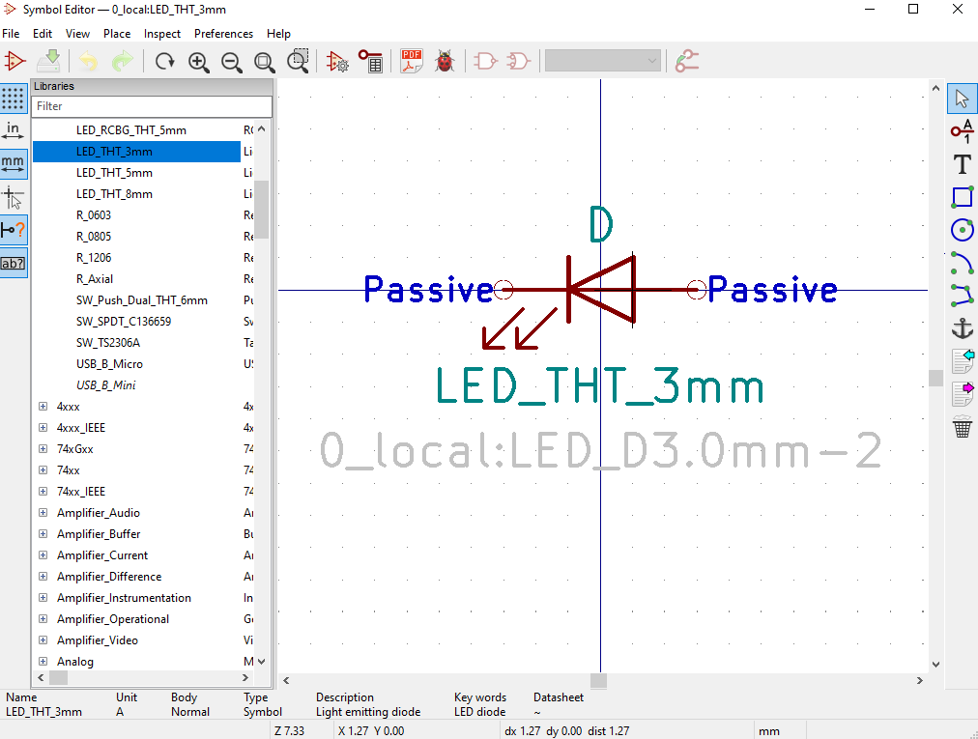
Symbol Editor
The Symbol Editor works much like the Eeschema Schematic Layout Editor. The major difference being that you are working with one symbol in a library at a time.
You can copy symbols to have variations of text or footprint assignments.
These symbols are stored in the libraries that are available for use by Eeschema.

Slide 12
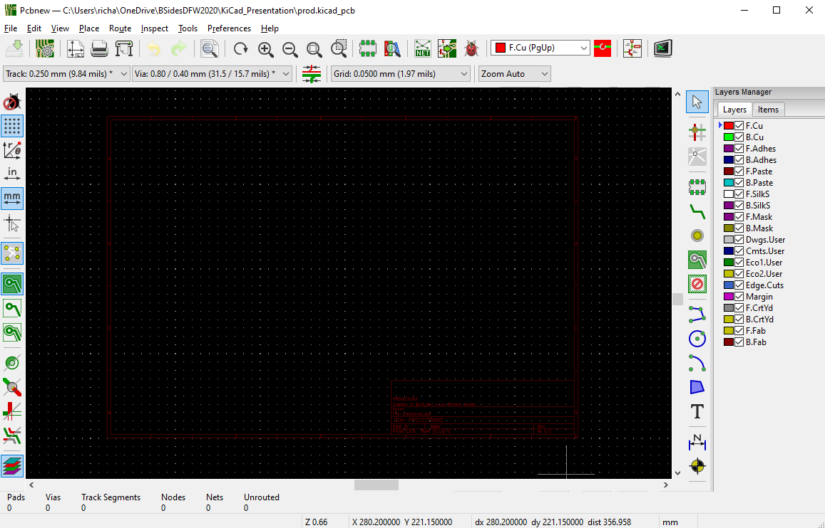
Pcbnew PCB Layout Editor
Pcbnew Button Quick Reference
Plot Gerber Files
Choose Working Layer
Board Setup
Choose
Visible
Layers
Change Track &
Via & Grid Settings
Select
Highlight Net
Ratsnest
Open
Footprint
Editor
Load
Netlist
Add Footprint
Route Tracks
Add Vias
Add Filled Zones
Keepout Areas
Option
Toggles
Graphic Lines
Graphic Circle
Graphic Arc
Graphic Polygon
Add Text
Layer Alignment
Add Dimension

Slide 13
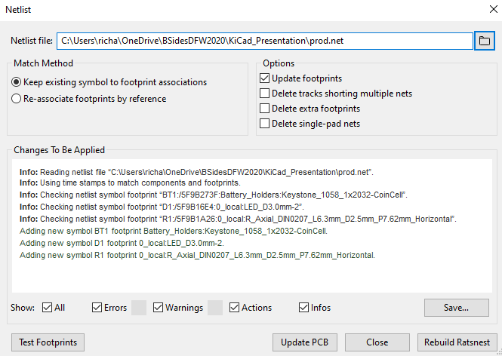
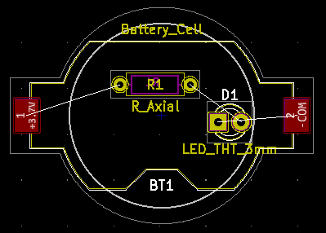
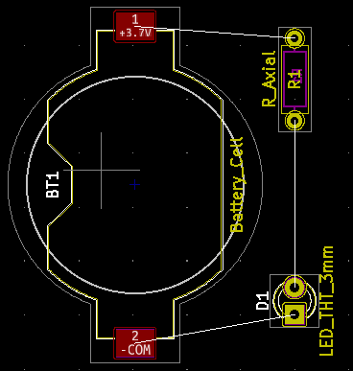
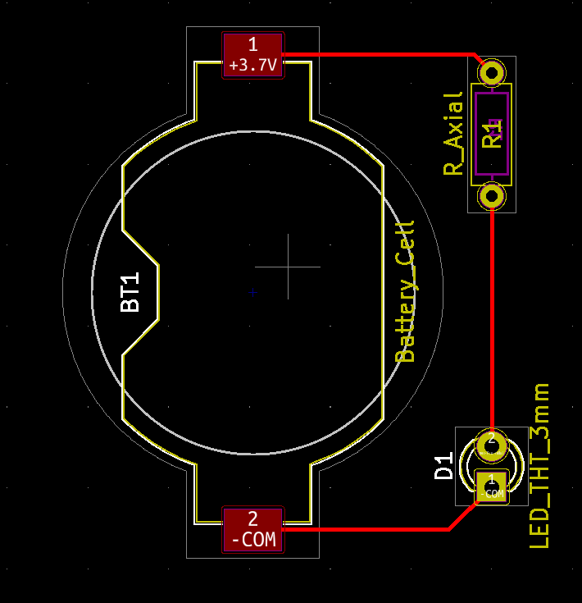
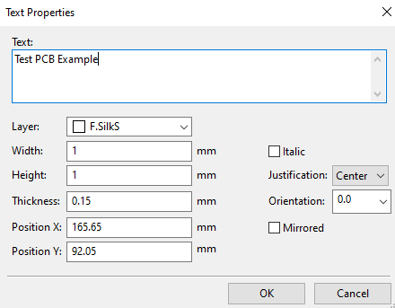
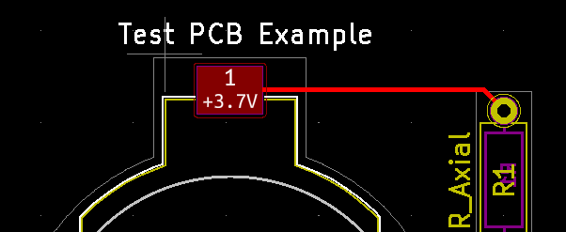
Pcbnew PCB Layout Editor
Pcbnew Basics
When starting a new layout or to update a layout from schematic changes you will click the Load Netlist button to load all the schematic components. This will prompt you for the file and how you want to handle existing footprints.
This will load or update the footprints in your layout showing lines connecting them where traces will need to be.
Using the select tool and the properties settings move and orient your footprints where you want them on the board
Select a copper layer as the active layer and click on route tracks to run traces between the footprint pads
To add silkscreen text to the board select front silk as the active layer and click the add text button and click the board. This will prompt you for the text and settings. You can move this around on the PCB as needed after creation.

Slide 14
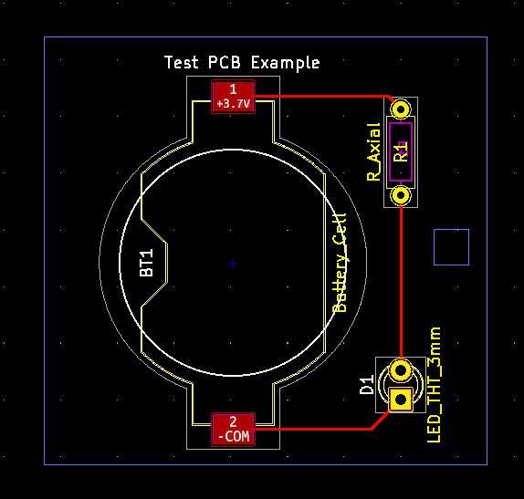
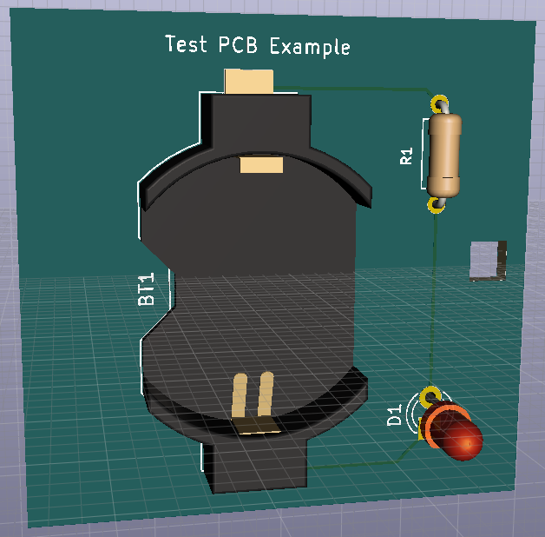
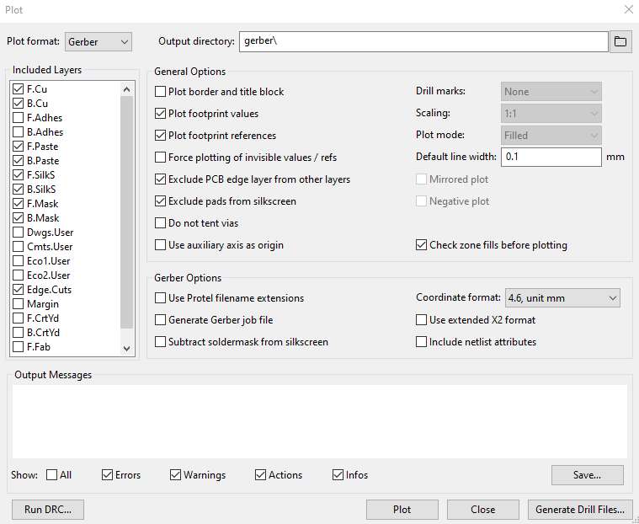
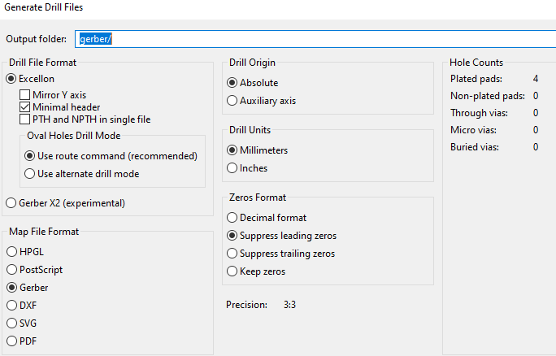
Pcbnew PCB Layout Editor
Pcbnew Basics
To size your PCB you need to give it an outline in the edge cuts layer. Select Edge Cuts as the active layer and click the Add Graphic Lines tool. Then draw your outline surrounding your component footprints.
The Edge Cuts layer can also define cut outs in the PCB.
To visually inspect your work you can use the 3D viewer by selecting it under the view menu.
This provides an interactive 3D render of your PCB.
When you are done click on Plot to generate Gerber files for manufacturing. The options you choose here will be dictated by the manufacturer you are planning to use.
In addition to the Gerber formatted design file it is usually necessary to also produce additional drill files. This is done within the plot menu by choosing the Generate Drill Files button.

Slide 15
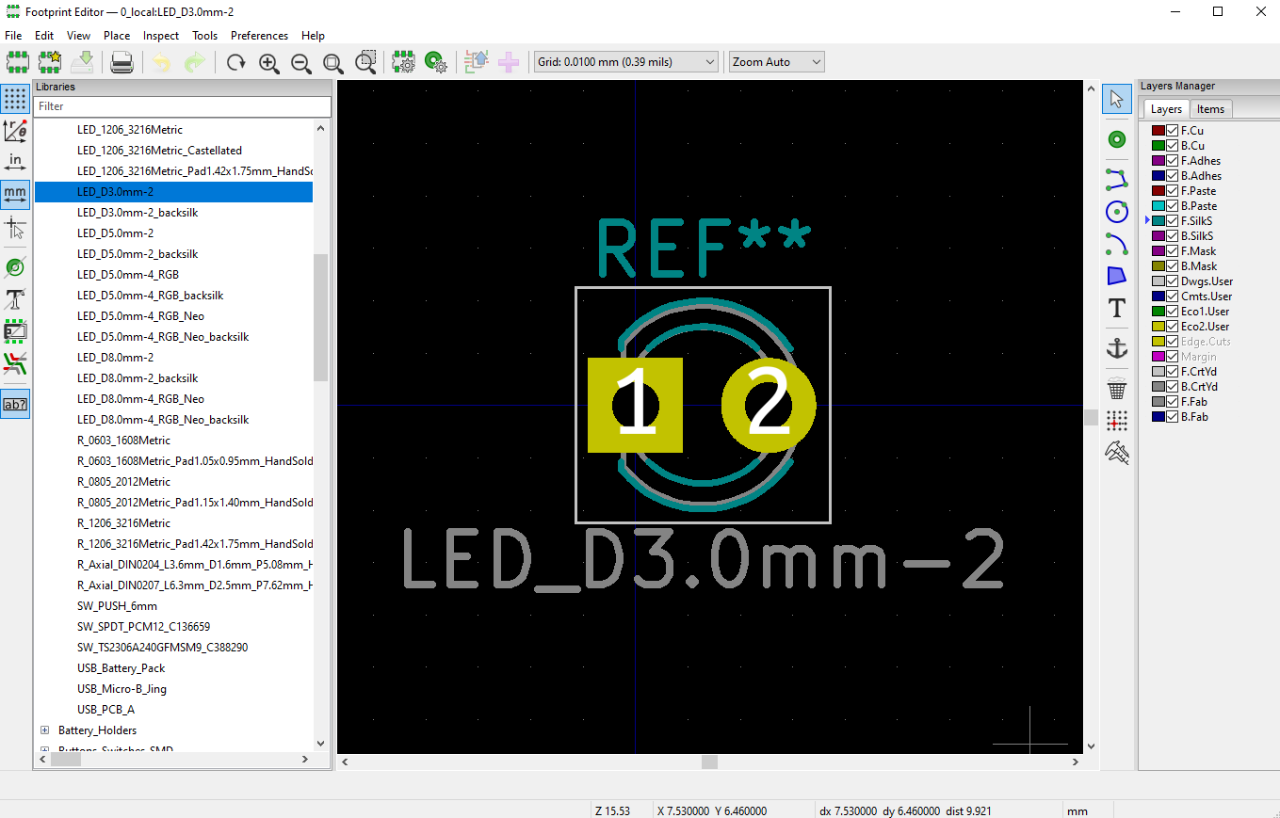
Footprint Editor
The Footprint Editor works much like the Pcbnew PCB Layout Editor. The major difference being that you are working with one footprint in a library at a time.
You can copy footprints to have variations of text or 3D model assignments.
These footprints are stored in the libraries that are available for use by Pcbnew.

Slide 16
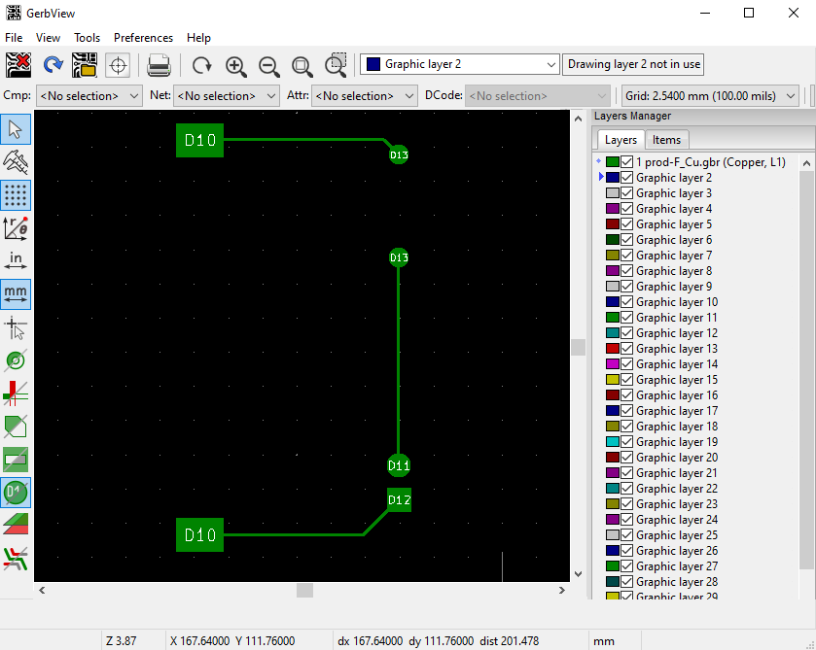
Gerber File Viewer
The Gerber File Viewer lets you load Gerber formatted design files for viewing.
These can be files you have created or from a project you downloaded.
There is a separate Gerber file for each layer of the design. You can open multiple files at once to overlay the entire PCB design.

Slide 17
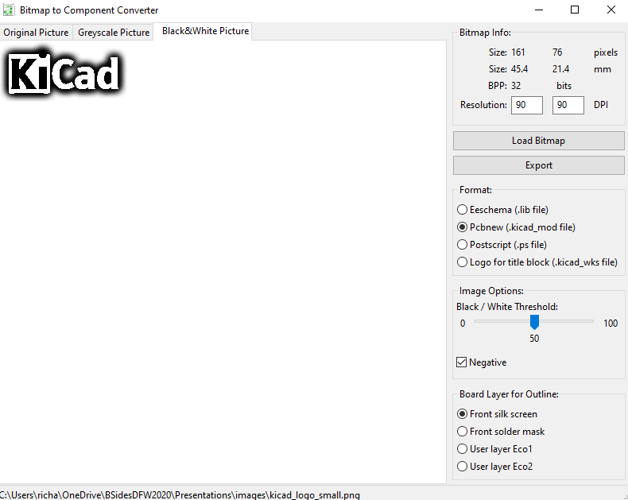
Bitmap to Component Converter
This tool takes a bitmap image to generate a footprint file.
This can be a handy way to import a logo to your silkscreen layer.
It’s also good for complex fill areas or edge cuts created in an art program.

Slide 18
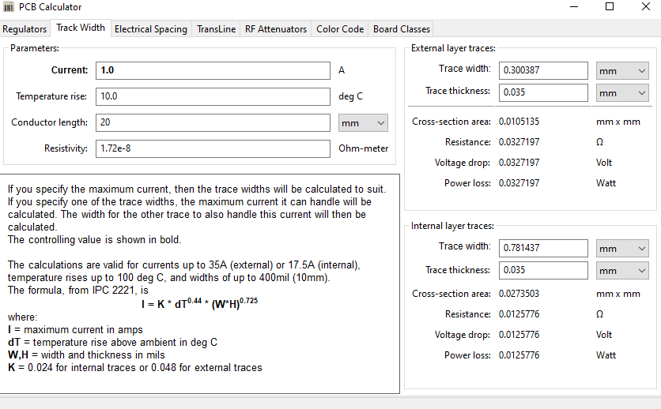
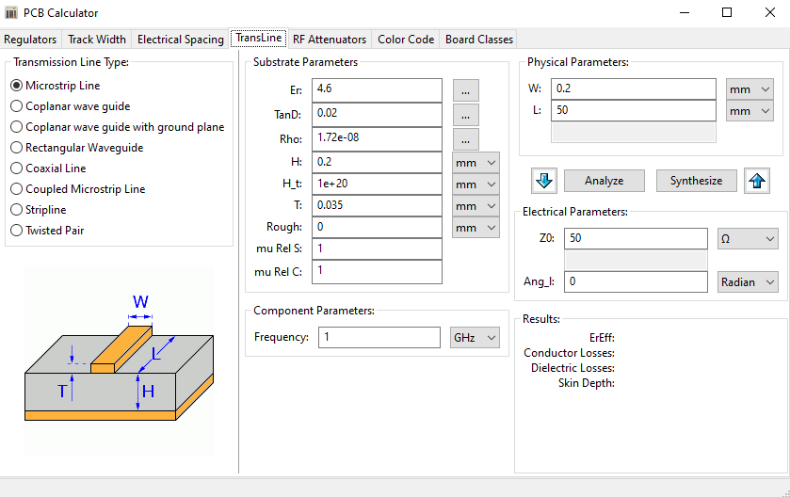
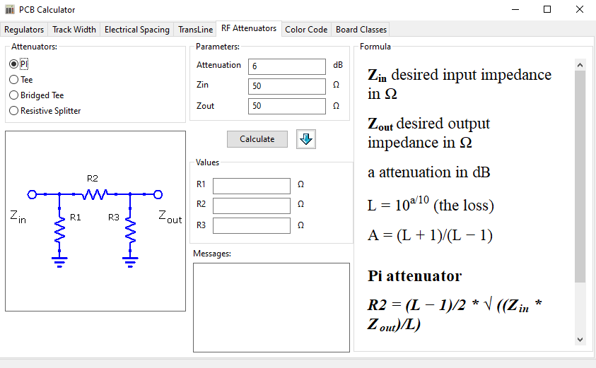
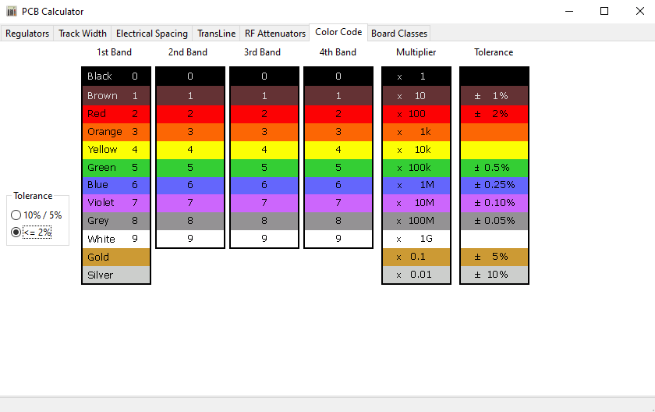
PCB Calculator
This tool bundles several useful calculation and reference items.

Slide 19
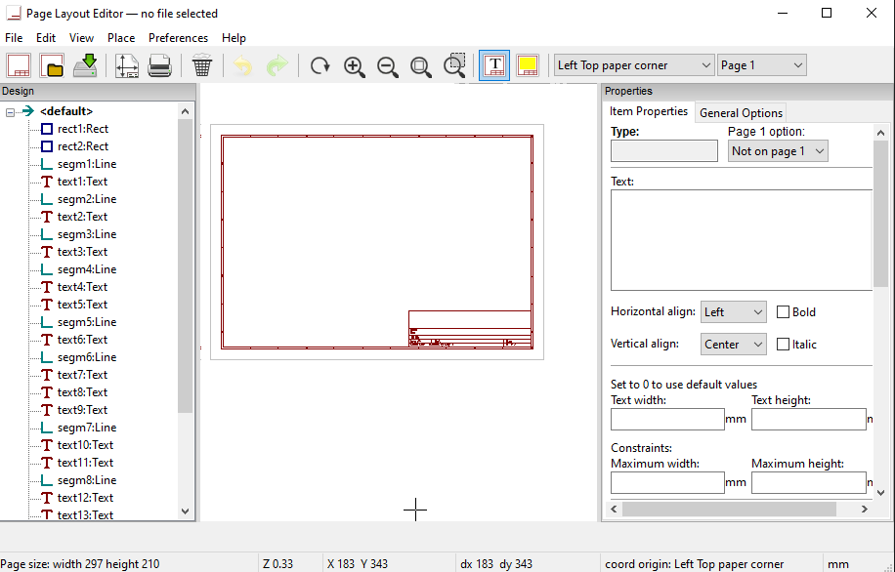
Page Layout Editor
This tool allows you to change the default look of the printed design pages.

Slide 20
PCB Manufacturing
Once you have completed your design you are ready to send it to be manufactured.
There are several factors to consider when choosing a PCB manufacturer. Cost is probably the top factor. But time and location and quality are all also important. The cheapest PCB manufacturer might take months to deliver or might have poor quality.
Look at customer reviews and do some small prototype runs to confirm they meet your needs. There are many PCB manufacturers to choose from.
Here are a few:
• https://pcbshopper.com/ Travelocity like site for PCB Mfrs.
• https://jlcpcb.com/ Very Inexpensive but with some limitations.
• https://pcbway.com/ Inexpensive and fast shipping.
• https://oshpark.com/ Beautiful, High Quality, made in USA

Slide 21
Thank You
I hope you enjoyed this presentation and learned something from it.
-- @alt_bier
This Slide Deck – https://altbier.us/pcb/
Code – https://github.com/gowenrw/BSidesDFW_2020_HHV/

