Slide 1

Working with NeoPixels
Presented by Richard Gowen (@alt_bier)
Created for BSidesDFW 2020 HHV
This Slide Deck Is Available at https://altbier.us/neopixels/

Slide 2
What is a NeoPixel?
NeoPixel is the term coined by Adafruit to refer to their brand of individually addressable RGB color pixels and strips based on the WS2812 (and other) integrated light source packages using a single wire control protocol.
The term NeoPixel has become the defacto standard name for addressable single wire controlled LEDs regardless of manufacturer.
Unlike a standard LED, even the RGB type, NeoPixels cannot be lit with a simple circuit. They require a microcontroller to send the control signals that tell it how to light up.

Slide 3
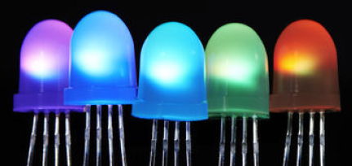
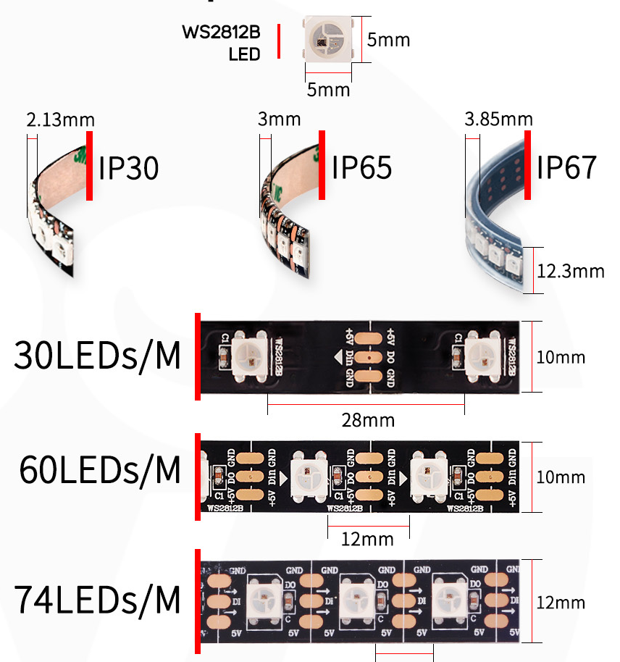
Form Factors
NeoPixels come in many different form factors from individual LEDs to strips to matrixes and more. Here are a few popular examples:
Through-Hole NeoPixels – These look like RGB LEDs as they have 4 pins, but they have a tiny NeoPixel embedded and can be chained together in a circuit using a single control wire.
Surface Mount NeoPixels – Available a 5050 and other popular packages these SMD components are used in other NeoPixel form factors like the strips.
NeoPixel Strips – These flexible LED strips are very popular as they can be cut to length to fit into any project. These come in several pixel densities such as 30 LEDs per meter, 60 LEDs per meter, and more.

Slide 4
Adafruit NeoPixel Resources
The Adafruit website https://www.adafruit.com/ has a wide range of NeoPixel products and microcontrollers that can control them. They also have devices that contain microcontrollers and NeoPixels and other cool things all in a single form factor.
You can find an awesome detailed guide to NeoPixels here: https://learn.adafruit.com/adafruit-neopixel-uberguide/

Slide 5
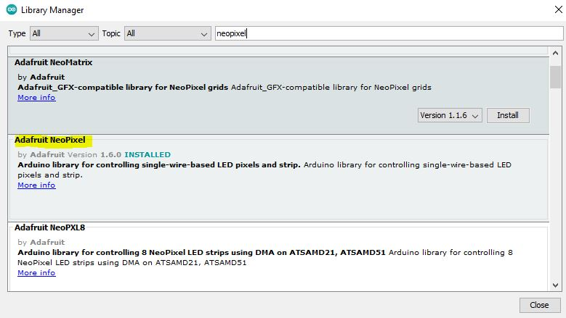
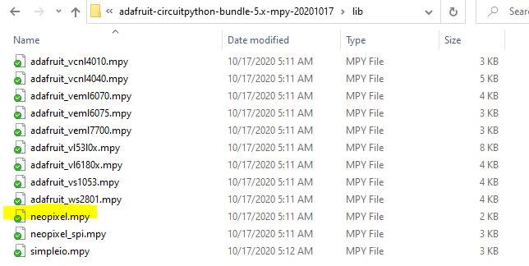
NeoPixel Libraries
While it is possible to write your own NeoPixel interface library, Adafruit has already created libraries for Arduino and CircuitPython.
The Adafruit Arduino library is called Adafruit_NeoPixel
It can be installed via the library manager in the Arduino IDE
To use it you will add #include <Adafruit_NeoPixel.h> in your code
The Adafruit CircuitPython library is named neopixel.mpy
This library file is part of the CircuitPython library bundle
To use it you just copy the file to the lib directory on your device and add import neopixel in your code

Slide 6
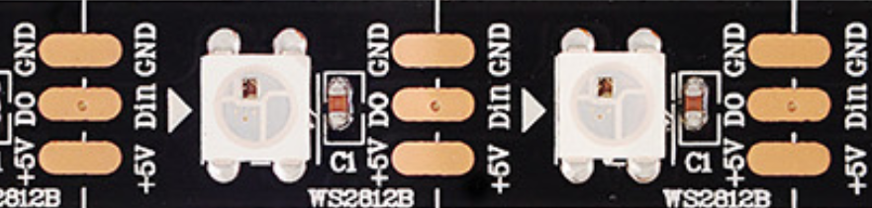
Connecting NeoPixels
To connect Neopixels for use you must provide power (usually +5V) and ground and a control wire that will connect a microcontroller to the Data-In on the pixel.
Individual pixels will have at least four connectors: VIN, GND, Data-In, Data-Out.
In a strip or other multi-pixel form the voltage and ground are run through the pixels like power rails and each pixels Data-Out is chained to the next Data-In.
While a small number of pixels can be powered by a microcontrollers power output, this is not recommended for larger strips of pixels as the power draw will quickly exceed the microcontrollers limits (each pixel can draw a max current of 60mA).
A large capacitor (1000uF) should be used on the power source for the pixels to prevent problems with initial on-rush current or voltage drops.
The control data line should contain a 470 Ohm resistor between the microcontroller and the NeoPixel Data-In to prevent spikes that could damage the pixels.

Slide 7
NeoPixel Addresses
NeoPixels are individually addressable.
What this means is that you can identify each pixel in a chain to control it even though they are all using the same control pin on the microcontroller.
When assigning an object to a NeoPixel control pin it will operate like an array with each element referring to a pixel in the chain.
Assigning objects and referencing individual pixel addresses varies slightly between Arduino and CircuitPython

Slide 8
Working with NeoPixels on Arduino
You need to do the following for NeoPixels on Arduino
Include the library using #include <Adafruit_NeoPixel.h>
Define an object to reference the NeoPixels using the following syntax:
Adafruit_NeoPixel object = Adafruit_NeoPixel(<num_pixels>, <pin>, <type_flag> + <type_flag>);
The object name can be assigned following typical Arduino variable naming rules
The first parameter is the number of pixels; the second parameter is the Arduino pin that is controlling it
The third parameter is made up of flags that identify the type of NeoPixel. This typically includes the color layout with values such as NEO_GRB or NEO_RGB and the bitstream rate with values such as NEO_KHZ800 or NEO_KHZ400
Adafruit_NeoPixel strip = Adafruit_NeoPixel(5, A1, NEO_GRB + NEO_KHZ800);
Prime your NeoPixels in setup() using object.begin(); and object.show(); like this:
void setup() { strip.begin(); strip.show(); }
Within your main loop assign the NeoPixels colors using the following syntax:
object.setPixelColor(<pixel>, <Red[0-255]>, <Green[0-255]>, <Blue[0-255]>);
To set the 3rd pixel in your strip to bright red you would use this: strip.setPixelColor(2, 255, 0, 0);
After assigning colors use object.show(); to send the assignments to the NeoPixels: strip.show();
Beyond that you would add delays and other code like you would working with any other LED.

Slide 9
Working with NeoPixels on CircuitPython
You need to do the following for NeoPixels with CircuitPython
Import the library using import neopixel
Define an object to reference the NeoPixels using the following syntax:
object = neopixel.NeoPixel(<pin>, <num_pixels>, <flag>=<flag_value>, <flag>=<flag_value>...)
The object name can be assigned following typical variable naming rules
The first parameter is the pin that is controlling it; the second parameter is the number of pixels
The third parameter is made up of flags that identify the type of NeoPixel and other settings. Here are some flags:
pixel_order typical values: neopixel.GRB or neopixel.RGB – pixel color Layout
auto_write values:. True or False – send to pixels upon assignment without a show()
brightness values: 0.0 to 1.0 – brightness percentage
strip = neopixel.NeoPixxel(board.D1, 5, pixel_order=neopixel.GRB, brightness=0.7);
Flags can be set outside object definition using object.<flag> = <flag_value> like this: strip.auto_write = False
Within your main loop assign the NeoPixels colors using the following syntax:
object[pixel] = (<Red[0-255]>, <Green[0-255]>, <Blue[0-255]>)
To set the 3rd pixel in your strip to bright red you would use this: strip[2] = (255, 0, 0)
After assigning colors use object.show() to send the assignments to the NeoPixels: strip.show()
Beyond that you would add delays and other code like you would working with any other LED.

Slide 10
NeoPixel Projects
This next section will outline some NeoPixel projects using the Arduino and Trinket.
These projects will be centered around two different physical circuit layouts with several Arduino or CircuitPython code blocks for each.
Arduino Nano NeoPixel Control – Lab HHV2020_06
Blink a single 8mm NeoPixel
Blink a strip of NeoPixels
Color cycle a strip of NeoPixels
Adafruit Trinket CircuitPython NeoPixel Control – Lab HHV2020_07
Blink a single 8mm NeoPixel
Blink a strip of NeoPixels
Color cycle a strip of NeoPixels
The Lab reference numbers refer to the BSidesDFW Hardware Hacking Village Videos which can be accessed here: https://altbier.us/bsidesdfwHHV2020/

Slide 11
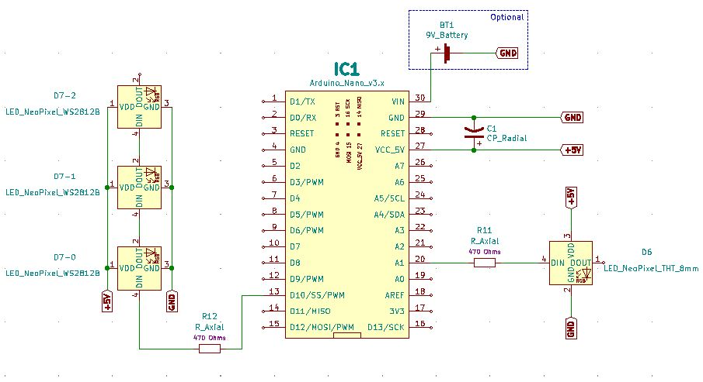
Arduino Nano NeoPixel Control
LAB HHV2020_06
Schematic

Slide 12
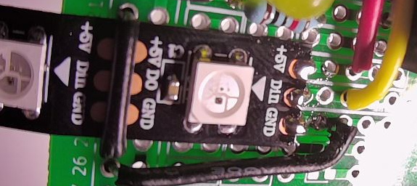
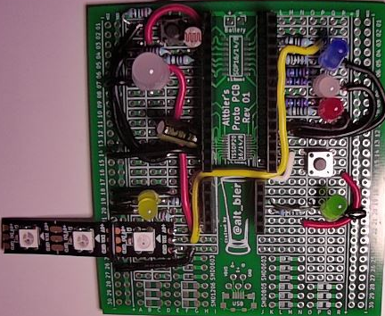
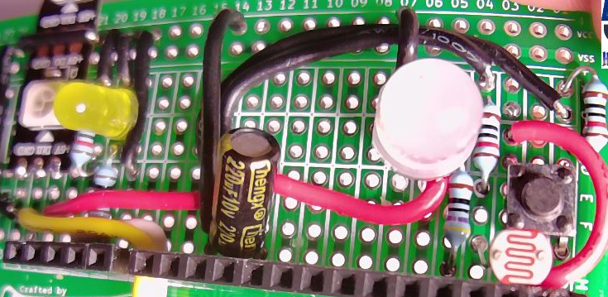
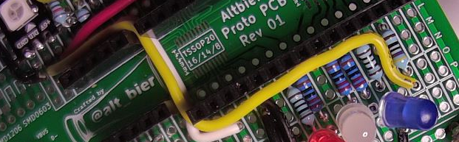
Arduino Nano NeoPixel Control
LAB HHV2020_06
Physical Layout
Wire up a circuit as shown in the schematic and physical layout.
Strip Board Connection Details
Nano – I1-15 and K1-15
Resistor 470 Ohm – L3 and O3
Resistor 470 Ohm – D5 and H5
Capacitor 220 uF (Polarized)
Anode – H12
Cathode – H14
NeoPixel 8mm THT APA106
Pin 1 (DIN) – C5
Pin 2 (VIN) – C6
Pin 3 (GND) – B7
Pin 4 (DOUT) – C8
NeoPixel Strip WS2812B
Pin 1 (VIN) – E22
Pin 2 (DIN) – E23
Pin 3 (GND) – E24
Wire – G14 and VCC14
Wire – A7 and VCC7
Wire – G24 and VCC27
Wire – D6 and E12
Wire – F12 and G22
Wire – G23 and P3
Wire – VCC21 and VCC25
Components:
2x Resistor 470 Ohm
1x Capacitor 220 uF
1x NeoPixel 8mm THT
1x NeoPixel Strip

Slide 13
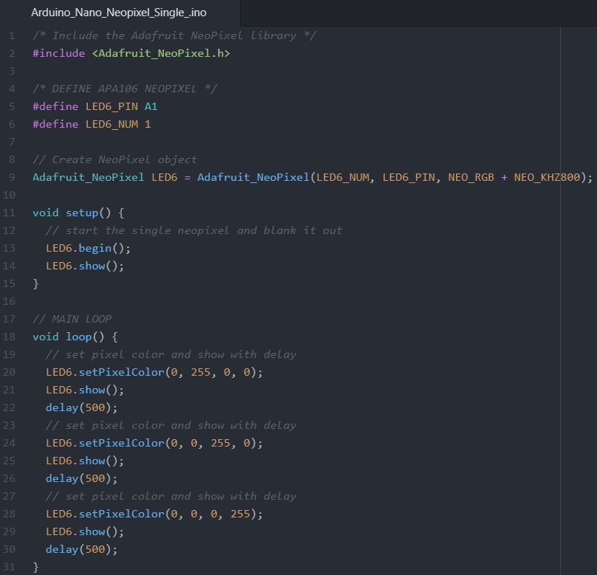
Arduino Nano NeoPixel Control
LAB HHV2020_06
Blink a single 8mm NeoPixel
This code will blink an external 8mm NeoPixel with the colors Red then Green then Blue.
Let's examine this code.
We include the Adafruit_NeoPixel library.
We then create a NeoPixel object named LED6 using pin A1 with 1 pixel that is an RGB 800Khz type.
We prime it in the setup() and then in the main loop() we set each color and show it for ½ sec.
This Code Is Available Here: https://github.com/gowenrw/BSidesDFW_2020_HHV/

Slide 14
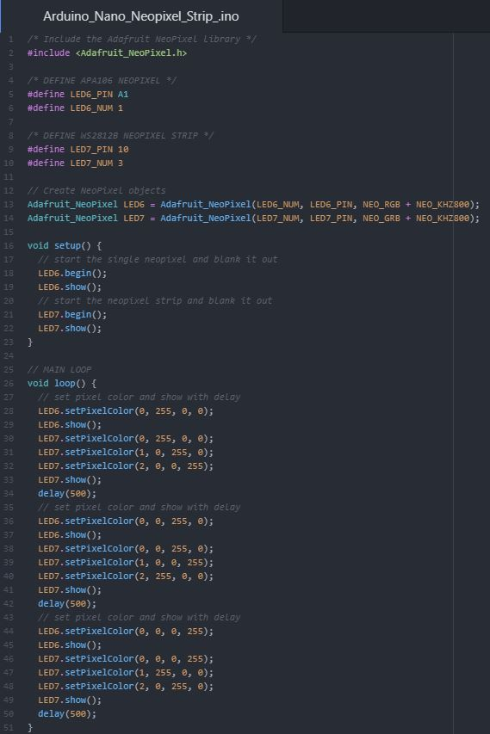
Arduino Nano NeoPixel Control
LAB HHV2020_06
Blink a strip of NeoPixels
This code will expand on the previous code to also blink an external strip of 3 NeoPixels with each showing the colors Red, Green or Blue.
Let's examine this code.
We include the Adafruit_NeoPixel library.
We then create a NeoPixel object named LED7 using pin D10 with 3 pixels that is an GRB 800Khz type.
We prime it in the setup() and then in the main loop() we set each color and show it for ½ sec.
This Code Is Available Here: https://github.com/gowenrw/BSidesDFW_2020_HHV/

Slide 15
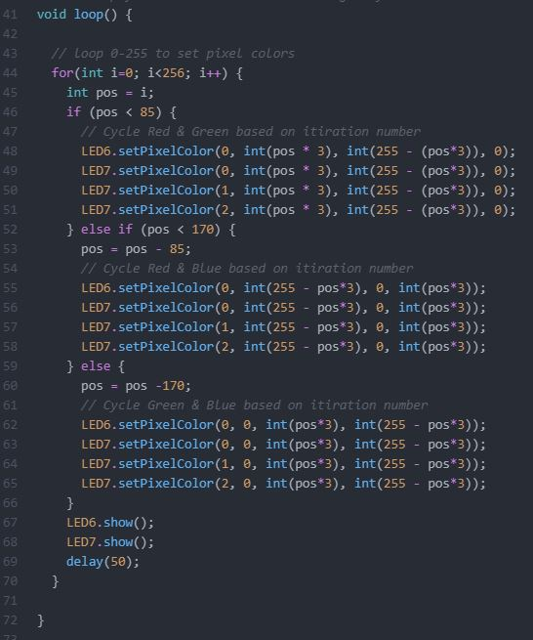
Arduino Nano NeoPixel Control
LAB HHV2020_06
Color cycle a strip of NeoPixels
This code expands on the previous code changing the main loop from blinking colors to cycling through colors.
Let's examine this new main loop.
We use a for loop running 256 times and use some simple math on the iteration to set different RGB color values for the NeoPixels.
Within each loop iteration we show the given color set for 50ms before we return to the top of the loop to set the next color.
This Code Is Available Here: https://github.com/gowenrw/BSidesDFW_2020_HHV/

Slide 16
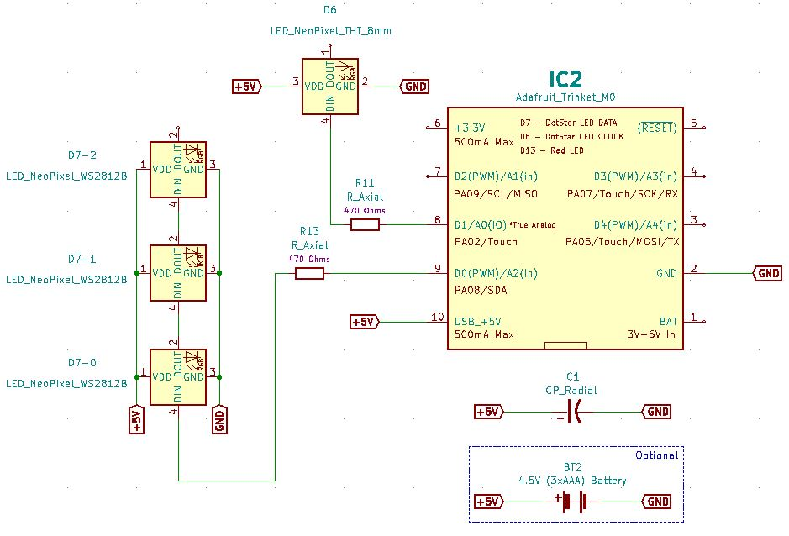
Adafruit Trinket CircuitPython NeoPixel Control
LAB HHV2020_07
Schematic

Slide 17
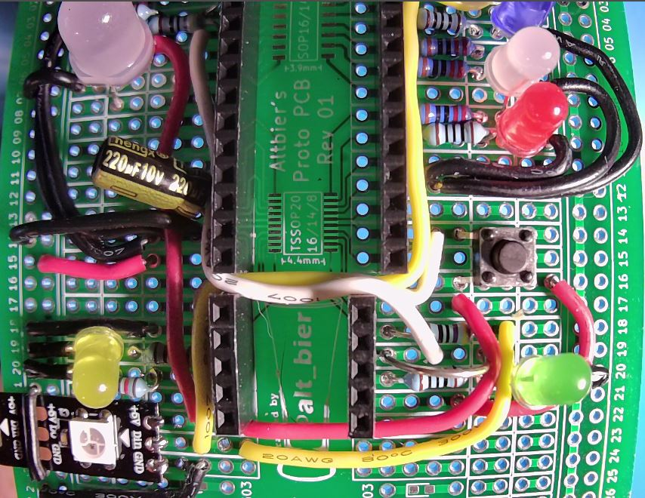
Adafruit Trinket CircuitPython NeoPixel Control
LAB HHV2020_07
Physical Layout
Wire up a circuit as shown in the schematic and physical layout.
Strip Board Connection Details
Trinket – I17-21 and J17-21
Resistor 470 Ohm – K18 and O18
Wire – P18 and I23
Wire – N17 and I22
Wire – M19 and G5
Note: Most of the components and connections needed for this schematic are being shared with the Arduino schematic and were added in the previous lab
Components (not added in previous lab):
1x Resistor 470 Ohm

Slide 18
CircuitPython Library File Needed
LAB HHV2020_07
Adafruit Trinket CircuitPython NeoPixel Control
The code used in the following examples will require a library file that is not built into CircuitPython.
You can find the library file bundle packages for recent versions of CircuitPython here: https://circuitpython.org/libraries
Download the bundle for the version you are working with (5.x) and extract it in a directory on your PC.
Locate this library file and copy it to the lib directory on the CIRCUITPY drive:
neopixel.mpy

Slide 19
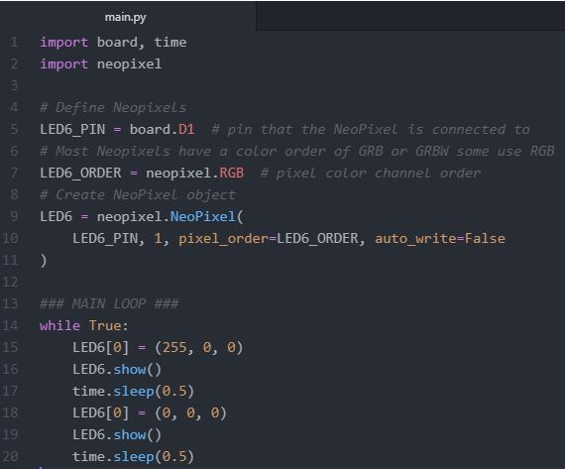
Adafruit Trinket CircuitPython NeoPixel Control
LAB HHV2020_07
Blink a single 8mm NeoPixel
This code will blink an external 8mm NeoPixel with the color red.
Let's examine this code.
We import the neopixel library.
We define the pin and color-order constants
We then create a neopixel object named LED6 using the pin and color-order and with a type flag of auto_write=False (telling it to wait for a show command to send to the pixels).
We set our color and show it then sleep for ½ sec before turning it off for ½ sec.
This Code Is Available Here: https://github.com/gowenrw/BSidesDFW_2020_HHV/

Slide 20
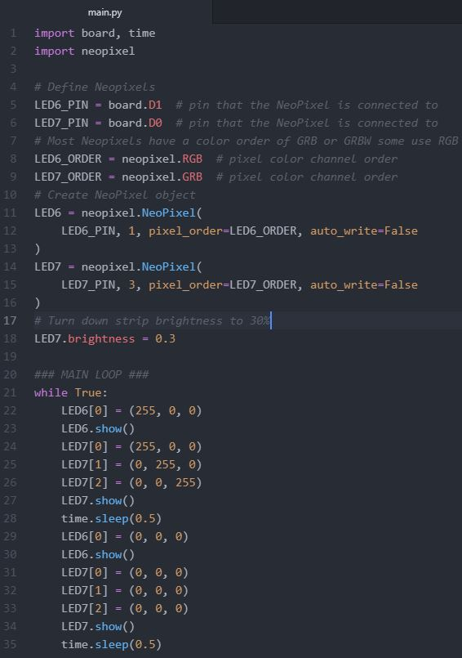
Adafruit Trinket CircuitPython NeoPixel Control
LAB HHV2020_07
Blink a strip of NeoPixels
This code expands on the previous code to also blink an external strip of 3 NeoPixels.
Let's examine this code.
We import the neopixel library.
We define the pin and color-order constants (note that the strip has a different order than the 8mm pixel)
We then create neopixel objects named LED6 and LED7 using the pin and color-order and with a type flag of auto_write=False (telling it to wait for a show command to send to the pixels).
We set an additional type flag on LED7 of brightness=0.3 since the strip is so bright we want to turn down its intensity.
We set our colors and show it then sleep for ½ sec before turning them off for ½ sec.
This Code Is Available Here: https://github.com/gowenrw/BSidesDFW_2020_HHV/

Slide 21
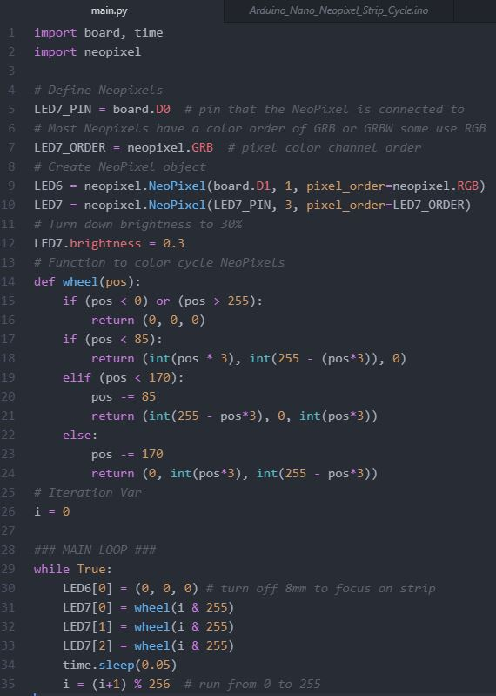
Adafruit Trinket CircuitPython NeoPixel Control
LAB HHV2020_07
Color cycle a strip of NeoPixels
This code color cycles the NeoPixel strip.
Let's examine this code.
We import the neopixel library and define pin and color-order constants for LED7 (we use direct values in LED6 object)
We then create neopixel objects named LED6 and LED7. Note that the auto_write flag is not set meaning it will default to True.
We set the LED7 brightness=0.3
We create a function to return RGB color values based on an input from 0 – 255.
We set our set the colors for LED7 pixels based on our function and iterate a number from 0-255 to use in that function. Note we are not using show() since it is not needed with auto_write=True
This Code Is Available Here: https://github.com/gowenrw/BSidesDFW_2020_HHV/

Slide 22
Thank You
I hope you enjoyed this presentation and learned something from it.
-- @alt_bier
This Slide Deck – https://altbier.us/neopixels/
Code – https://github.com/gowenrw/BSidesDFW_2020_HHV/

