Slide 1

Working with Surface-Mount Technology
Presented by Richard Gowen (@alt_bier)
Created for BSidesDFW 2020 HHV
This Slide Deck Is Available at https://altbier.us/SMT/

Slide 2
What is Surface-Mount Technology?
Surface-mount technology (SMT) is a method in which the electrical components are mounted directly onto the surface of a printed circuit board (PCB). An electrical component mounted in this manner is referred to as a surface-mount device (SMD).
An SMT component is usually smaller than its through-hole counterpart because it has either smaller leads or no leads at all
In commercial applications, this approach has largely replaced the through-hole technology in large part because SMT allows for increased manufacturing automation reducing cost and improving quality.

Slide 3
Common Abbreviations
Different terms describe the components, technique, and machines used in manufacturing.
Abbreviation | Description
SMT | Surface-mount technology (assembling and mounting technology)
SMD | Surface-mount devices (active, passive and electromechanical components)
SMC | Surface-mount components (components for SMT)
SMP | Surface-mount packages (SMD case forms)
SMA | Surface-mount assembly (module assembled with SMT)
SME | Surface-mount equipment (SMT assembling machines)

Slide 4
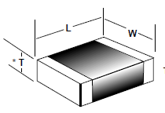

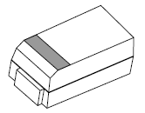

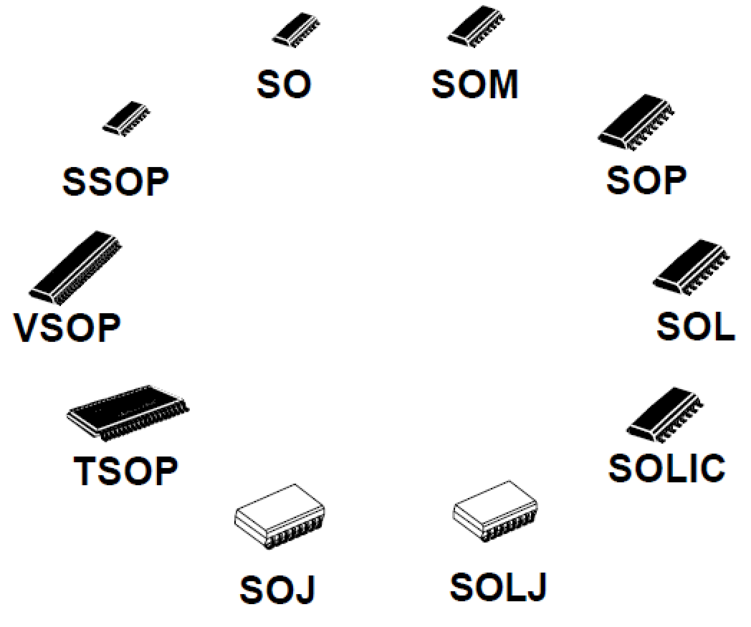
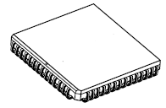
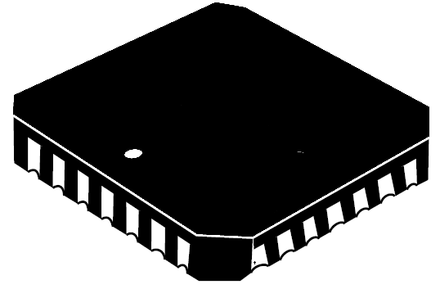
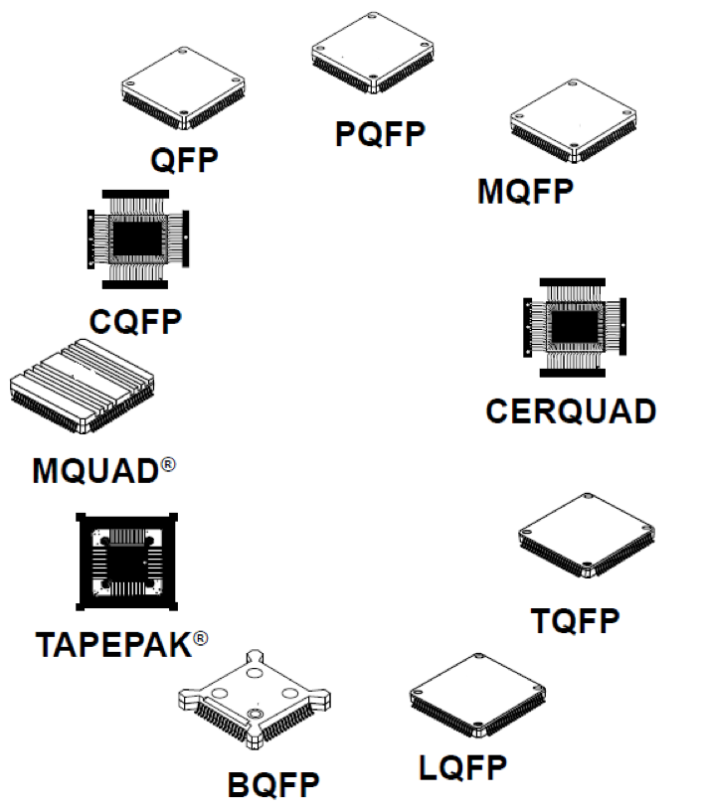
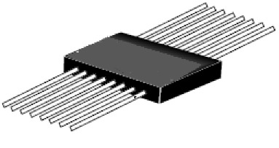
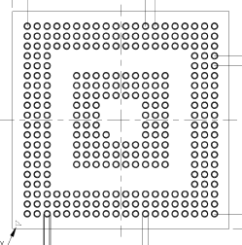
Surface-Mount Packages
SMC come in many different sizes and shapes. Here are the categories of SMP.
Note the term package(s) refers to the case forms and not delivery packaging.
Flat Chip
SMP Type | Description
Flat Chip | Simple flat chip components
MELF | Metal Electrode Face Bonded components
Tantalum | Tantalum molded capacitors
SOT | Small Outline Transistor
SOIC | Small Outline Integrated Circuit
PLCC | Plastic Leaded Chip Carrier
LCC | Leadless Chip Carrier
Flat Pack | Plastic Carriers with Flat leads
QFP | Quad Flat Pack
BGA | Ball Grid Array
MELF
Tantalum
SOT
PLCC
SOIC
LCC
Flat Pack
QFP
BGA

Slide 5
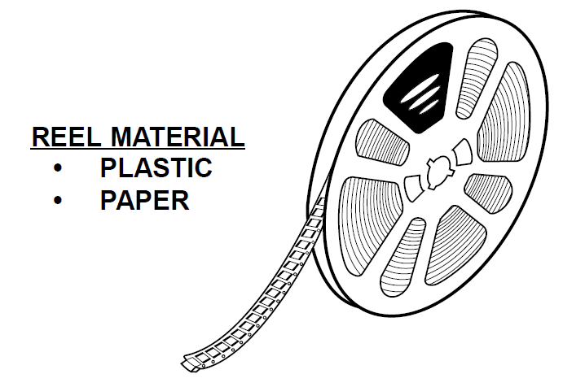
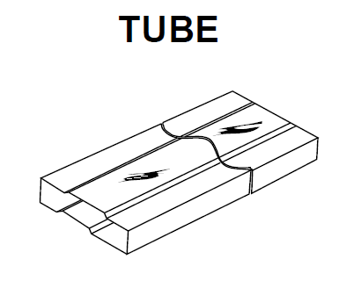
Surface-Mount Packaging
SMC come delivered in several different types of packaging. All of which are designed to allow for automation tools such as pick and place machines to make use of them with minimal human intervention.
Two of the most common packaging types:
Tape and Reel – SMC inside separation tape on a reel
Tube – SMC inside a plastic slide tube
TAPE AND REEL

Slide 6


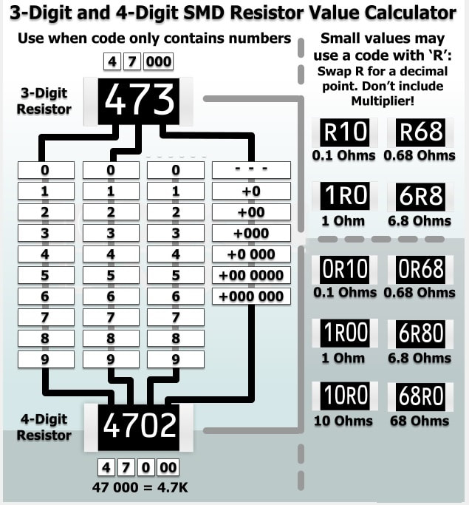
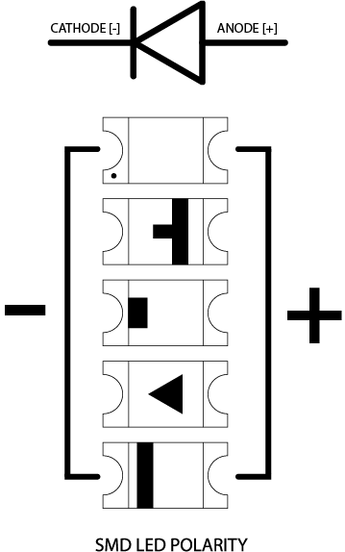
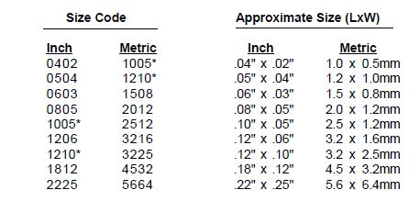
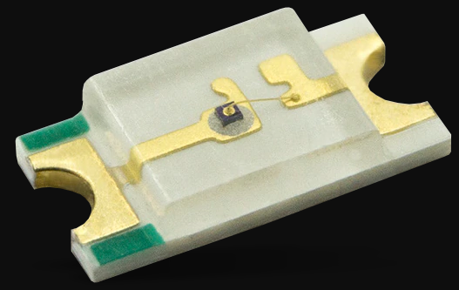
Flat Chip SMP
Flat Chip components include ceramic capacitors, resistors, and diodes.
Flat capacitors tend not to have markings. Be careful not to mix them up!
Flat resistors are marked with a number code that will tell you what resistance value it has. The letter R is used as a decimal place.
Diodes including LEDs tend to have makings indicating Anode and Cathode. These markings differ by product and manufacturer.
Flat Chip SMP nomenclature denotes the size of the SMD in inch or mm. (e.g. an 0805 SMD is 0.08 x 0.05 inches)

Slide 7
SOIC – Small Outline IC
Small Outline IC’s are a family of packages with a variety of lead styles and lead counts. Small outline packages are called by many different names. There are small differences between each type, and often they are called by the wrong name. The typical nomenclature is <SOIC_Package_Type><Number_of_Pins> (e.g. SOP16).
SOIC Package Type | Description
SO / SOP | Small Outline Package. It consists of a molded plastic case measuring approximately 156 mils (3.97mm) wide and has gull-wing leads with 50 mils (1.27mm) lead pitch.
SOM | SO Medium has a wider body measuring 220 mils (5.6mm) wide.
SOL | SO Large has the widest body measuring 300 mils (7.62mm) wide or larger.
SOJ / SOLJ | SO components with J leads
VSOP | Very Small Outline Package. Has high density 25 mil (.65mm) gull-wing leads and a 300 mil (7.62mm) wide body. Sometimes the term VSOP and SSOP (see below) are interchanged.
SSOP | Shrink Small Outline Package. Like VSOP has high density 25 mil (.65mm) gull-wing leads but has a smaller 208 mil (5.3mm) case.
QSOP | Quarter Small Outline Package. Same body as SOP and leads with 25 mils (0.635mm) lead pitch.
TSOP | Thin Small Outline Package. A low-profile body (1mm high) with a body width of 300 mils (7.62mm) or larger and fine pitch19.7 mils (0.5mm) leads
TSSOP | Thin Shrink Small Outline Package. A low-profile body (1mm high) with a body width of less than 300 mils (7.62mm) and fine pitch19.7 mils (0.5mm) leads

Slide 8
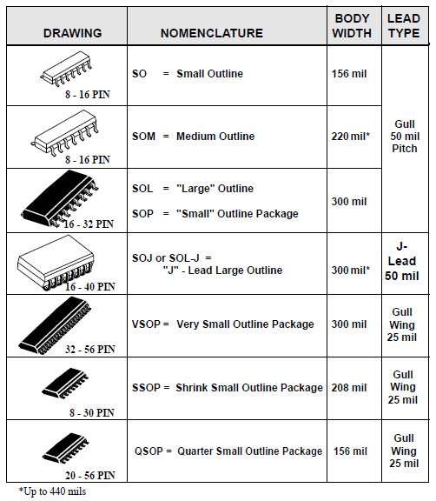
SOIC – Small Outline IC
As demonstrated by the table on the previous slide, we know that Small Outline IC’s can come in a variety package sizes and lead pitches and densities.
When working with these components it is always important to RTFM the specifications sheets to ensure compatibility with your project.

Slide 9
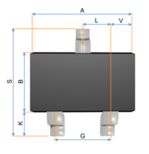
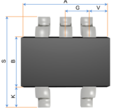
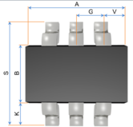
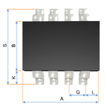
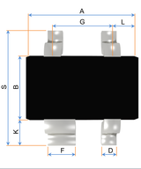
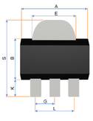
SOT – Small Outline Transistor
A small outline transistor (SOT) is a family of small footprint, discrete surface mount transistor.
The most common are the SOT23 variations.
The nomenclature for SOT components is SOT<serial>[-<variant>] where serial is the JEDEC SOT specification number and variant is an accepted variation (e.g. SOT23-3).
Note: Several different SOT specification may use the same basic body shape but with slightly different dimensions.
Here are a few examples of SOT packages.
SOT23-3
SOT323
SOT416
SOT23-5
SOT353
SOT23-6
SOT363
SOT23-8
SOT143
SOT343
SOT89-3

Slide 10
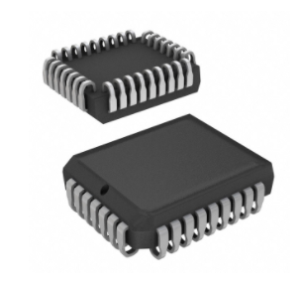
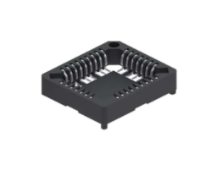
PLCC – Plastic Leaded Chip Carrier
The plastic body PLCC is the most popular leaded chip carrier.
Its J leads are always 50 mils (1.27mm) pitch.
They are commonly available from 18 to 100 leads.
As an alternative to the plastic case, leaded chip carriers are available in other materials
Ceramic (known as CLCC)
Metal (known as MLCC)
These components are designed to fit into IC sockets.

Slide 11
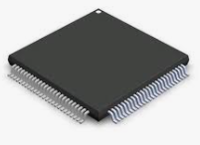
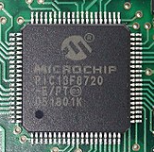
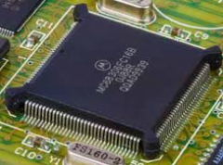
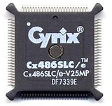
QFP – Quad Flat Pack
The QFP is a very popular IC package.
It has gull wing leads that vary in pitch from 12 mils (0.3mm) to 50 mils (1.27mm).
They are commonly available from 32 to 304 leads.
They come in several sizes and body materials. Here are a few examples.
QFP Package Type | Description
QFP | Quad Flat Pack
PQFP | Plastic Quad Flat Pack
CQFP / CERQUAD | Ceramic Quad Flat Pack
MQUAD | Metal Quad Flat Pack
BQFP | Bumpered Quad Flat Pack (bumpered corners protect leads)

Slide 12
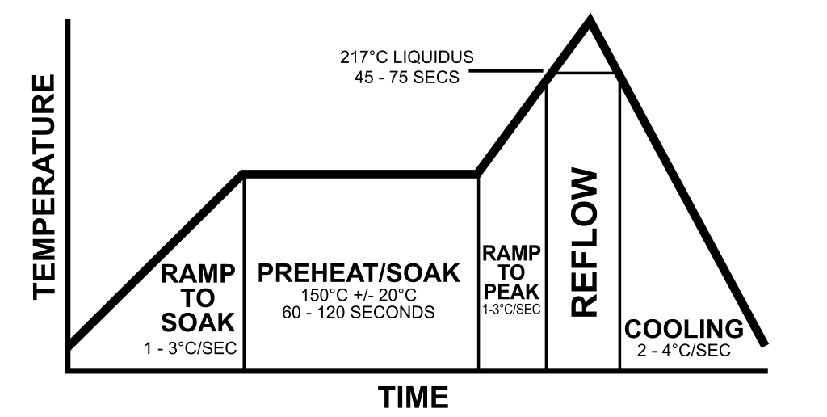
Reflow Soldering SMT
Reflow soldering is the most widely used method of attaching surface-mount components to a printed circuit board.
This process involves applying a solder paste (a sticky mixture of powdered solder and flux) to the PCB component contact pads, placing the SMD components onto the pads, and evenly heating to controlled temperatures that cause the solder paste to reflow into a molten state creating permanent solder joints.
While the heating process usually takes place in a specialized oven, it can be accomplished with any heat source that can have temperature predictably controlled in short time frames.
It is also possible to use a hot air solder rework tool to apply heat to a specific area of a PCB or to a specific SMD component to reflow it for individual component assembly or replacement.

Slide 13
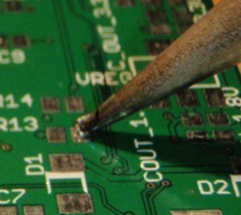
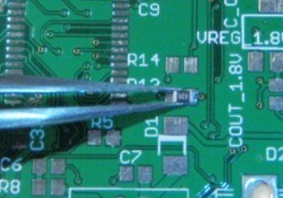
Traditional Soldering SMT
Based on the size of the SMD and its lead pitch it may be possible to use traditional soldering methods.
When the SMD size and/or lead pitch is too small then the traditional soldering method is likely to bridge connections causing shorts.
The choice of how small is too small comes down to an individual’s soldering skill.
When soldering SMD components with an iron and rosin core solder, I find it easier to accomplish by first applying solder to the PCB contact pads.
Then you can hold the SMD with tweezers onto those contact pads with one hand while you use the iron in your other to reheat those pads allowing the molten solder to affix to the SMD.

Slide 14
Surface-Mount Project
This next section will outline a simple surface-mount project using the Arduino.
This project will use a single circuit with two SMD components: a resistor and an LED.
Each of the two SMD components will be attached to the PCB using a different method, the first using traditional soldering, and the second using reflow soldering via a hot air rework tool.
Since the focus of this lab is the SMD soldering, we will just use a simple LED blink code to demonstrate its functionality.
Arduino Nano SMD LED – Lab HHV2020_08
Blink an SMD LED
The Lab reference number refers to the BSidesDFW Hardware Hacking Village Videos which can be accessed here: https://altbier.us/bsidesdfwHHV2020/

Slide 15
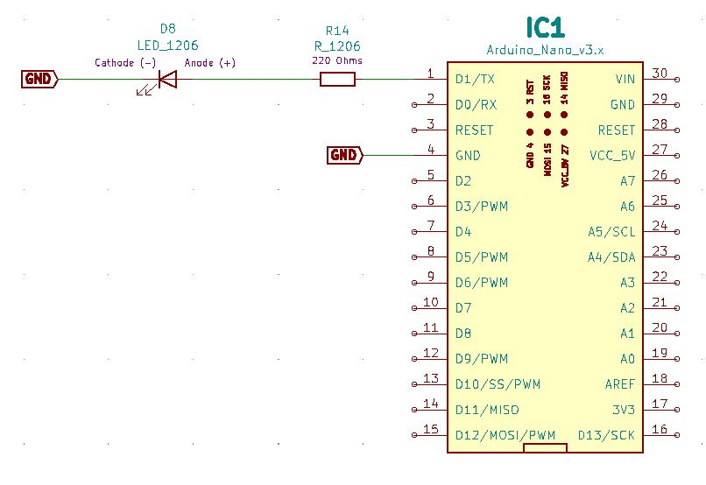
Arduino Nano SMD LED
LAB HHV2020_08
Schematic

Slide 16
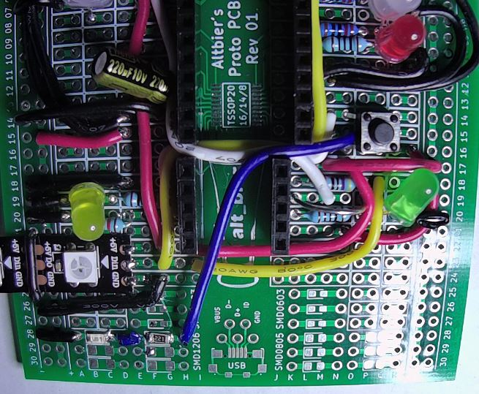
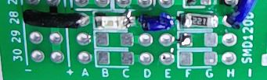
Arduino Nano SMD LED
LAB HHV2020_08
Physical Layout
Wire up a circuit as shown in the schematic and physical layout.
Strip Board Connection Details
Nano – I1-15 and K1-15
Resistor 220 Ohm 1206 – G28 and F28
LED 1206 – C28 (Anode) and B28 (Cathode)
Wire – N15 and H28
Wire – E28 and D28
Wire – A28 and VCC28
Note: The Resistor and LED are SMD 1206 components.
Components:
1x Resistor 220 Ohm SMD 1206
1x LED SMD 1206

Slide 17
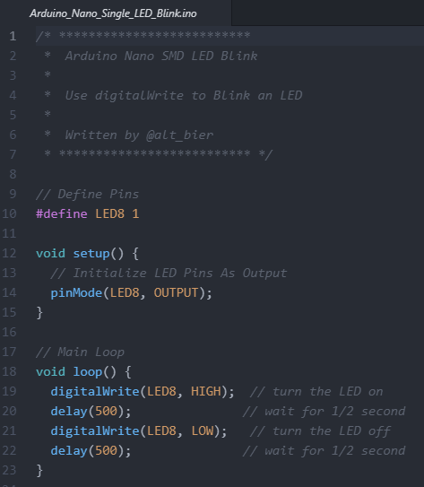
Arduino Nano SMD LED
LAB HHV2020_08
Blink a single SMD LED
This code will blink an external SMD 1206 LED.
This is just a slight modification of the standard Blink LED Arduino example code.
The purpose of this is to ensure that our SMD components are working.
If the SMD LED does not blink, then you will need to troubleshoot the SMD component solder joints.
Be careful when re-soldering SMD components as they are much more heat sensitive that THT components and can be burned into little bricks that do nothing.
This Code Is Available Here: https://github.com/gowenrw/BSidesDFW_2020_HHV/

Slide 18
Thank You
I hope you enjoyed this presentation and learned something from it.
-- @alt_bier
This Slide Deck – https://altbier.us/SMT/
Code – https://github.com/gowenrw/BSidesDFW_2020_HHV/

