Slide 1
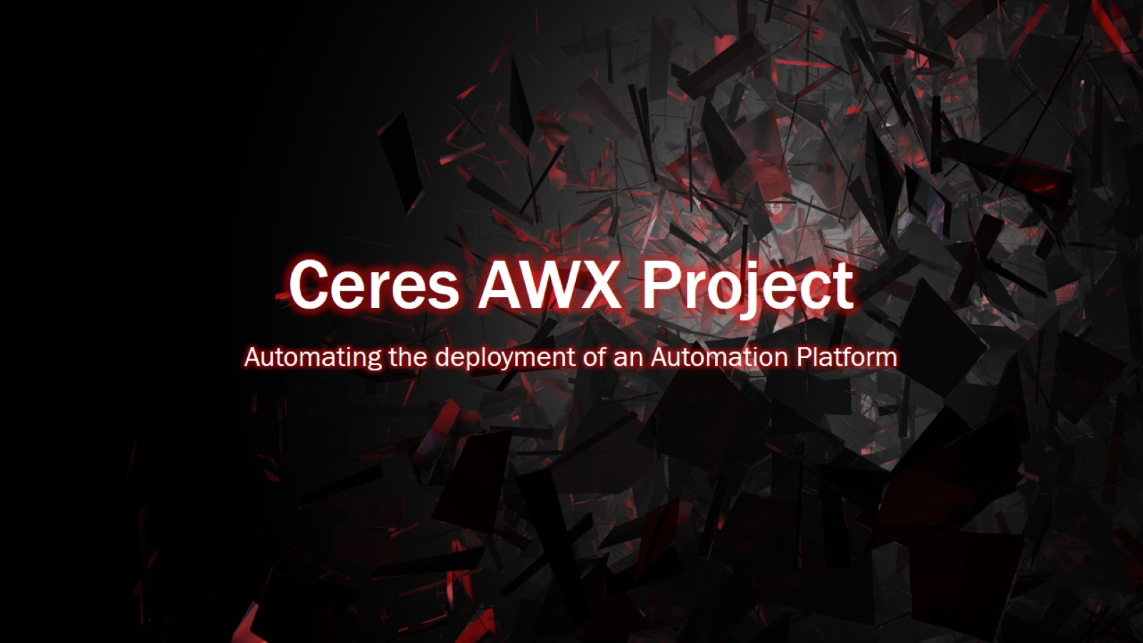
Ceres AWX Project

Slide 2
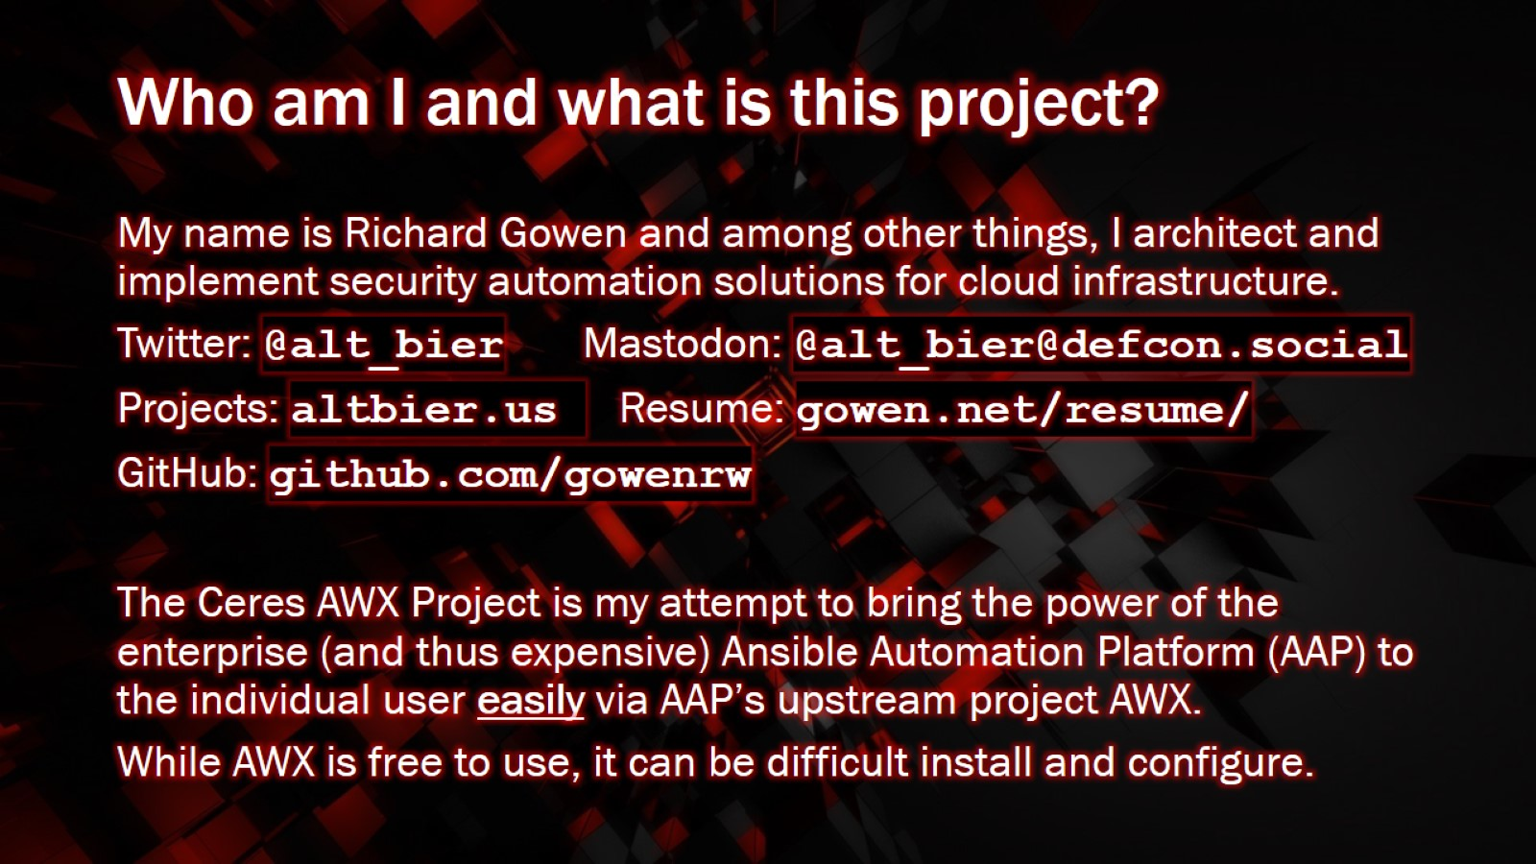
Who am I and what is this project?

Slide 3
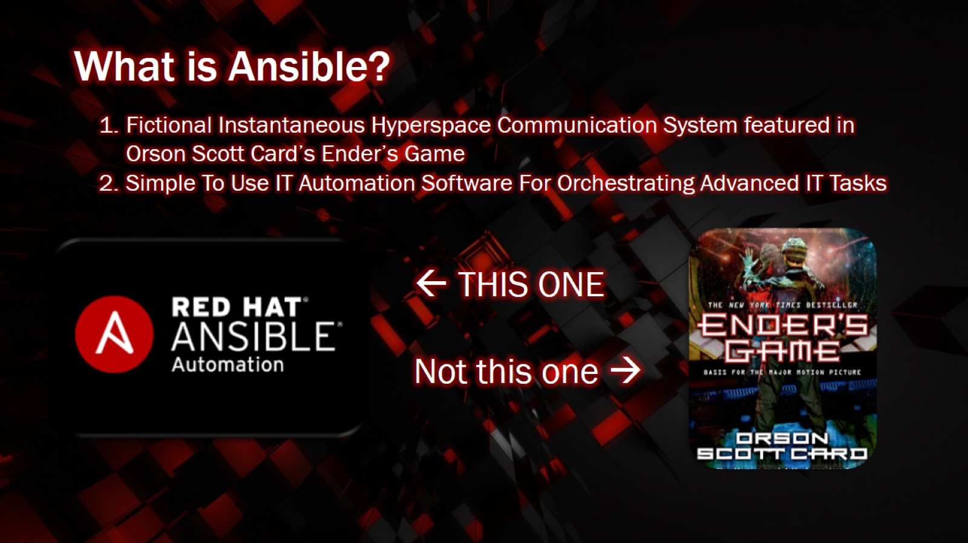
What is Ansible?

Slide 4
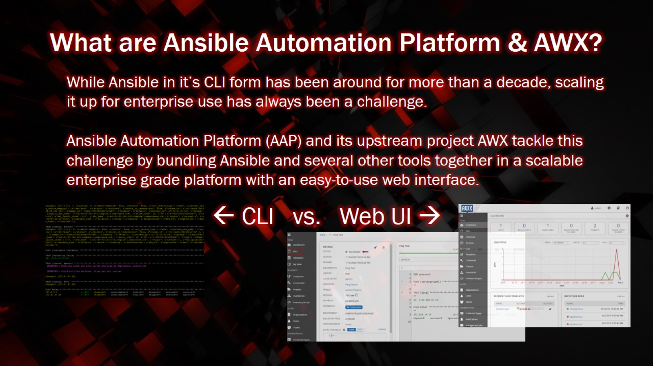
What are Ansible Automation Platform & AWX?

Slide 5
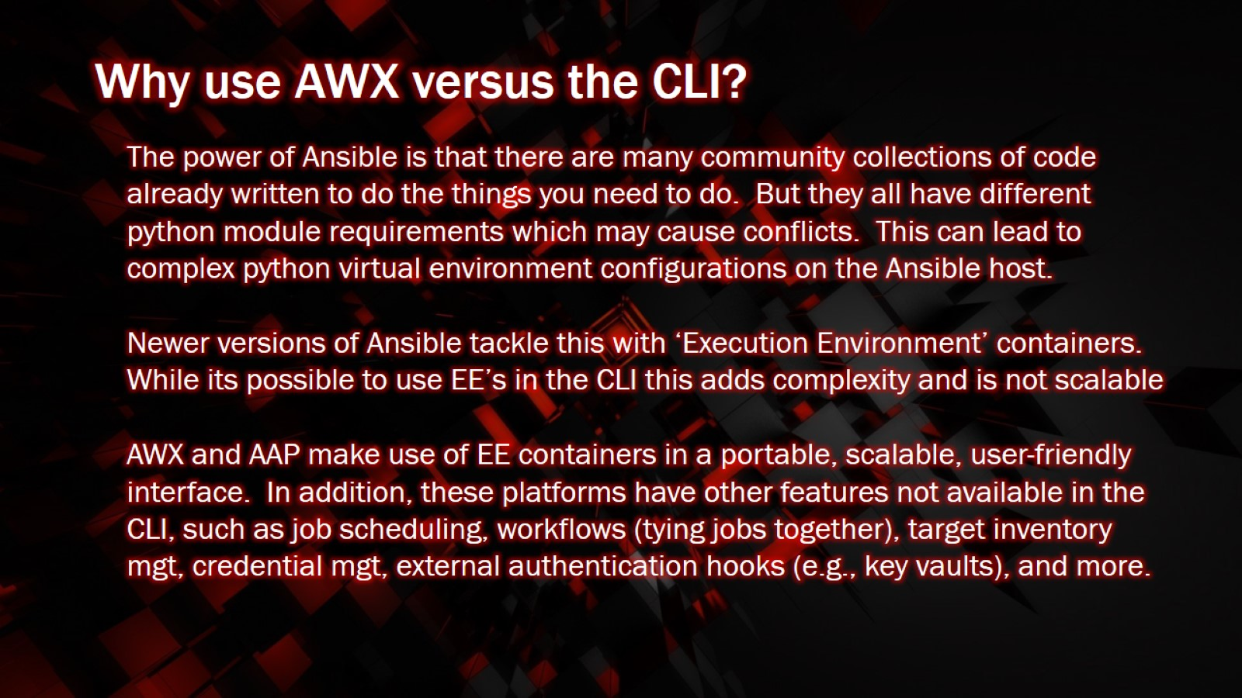
Why use AWX versus the CLI?

Slide 6
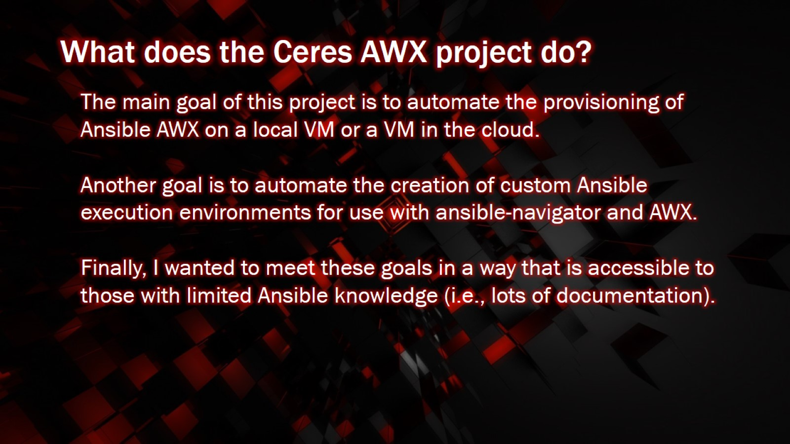
What does the Ceres AWX project do?

Slide 7

Where Can I Get The Ceres AWX Project?

Slide 8
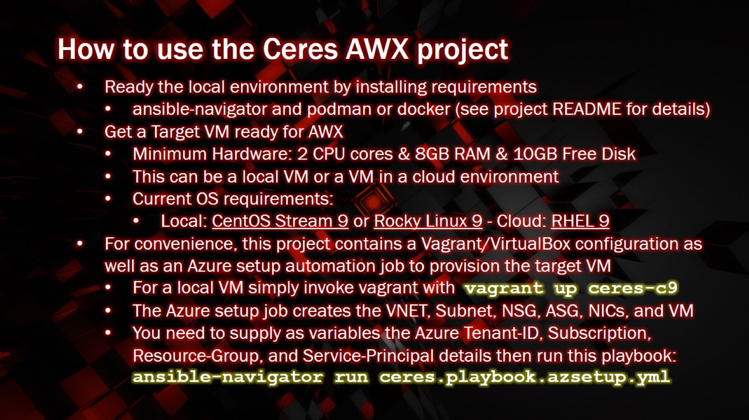
How to use the Ceres AWX project

Slide 9
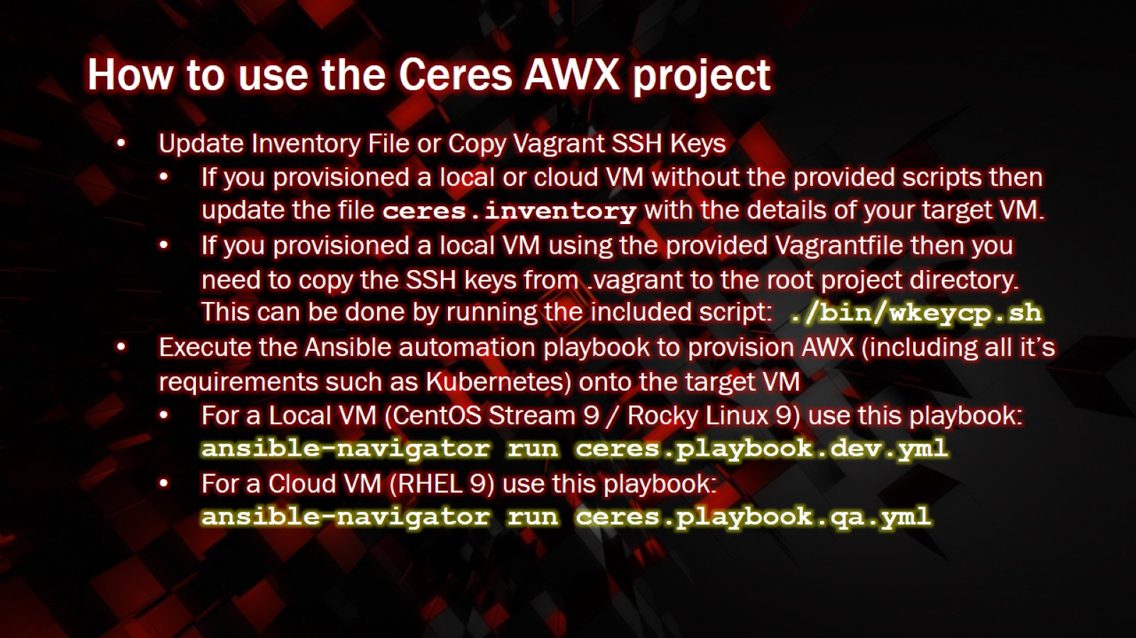
How to use the Ceres AWX project

Slide 10
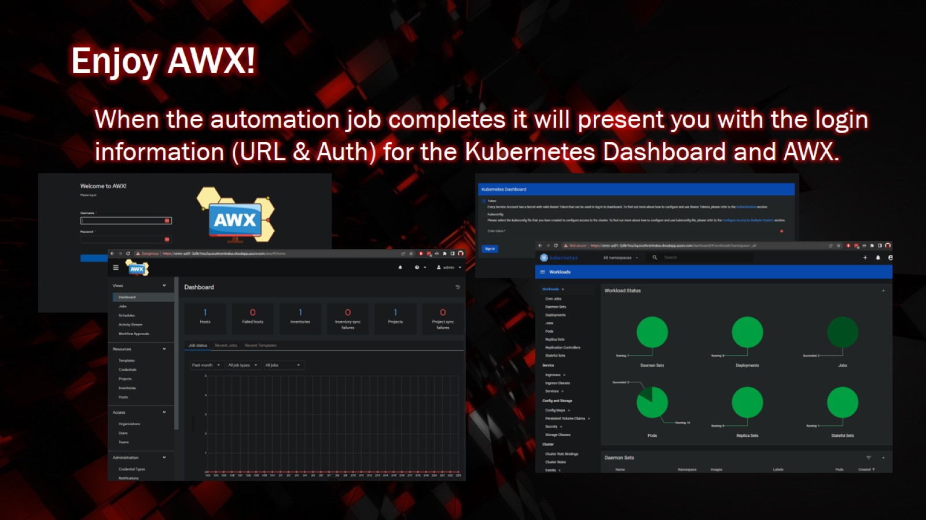
Enjoy AWX!

Slide 11
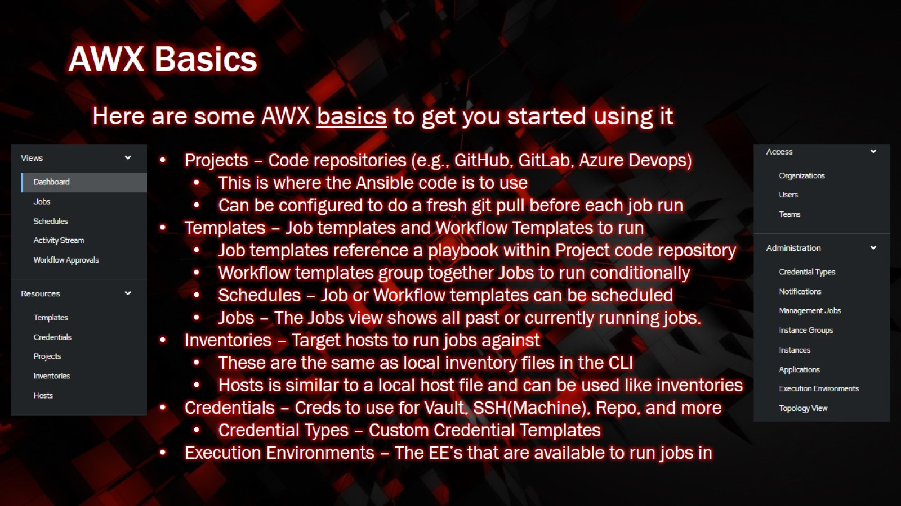
AWX Basics

Slide 12

Thank You!

