Slide 1


FundFair
Lee Xuin Hean B1201826
Go Wen Xi B1300649
Virtual Stock Game

Slide 2
AGENDA
01
02
INTRODUCTION
SEQUENCE DIAGRAM
02
04
DESIGN ARCHITECTURE
PLATFORM
03
06
PROTOTYPE
USE CASE DIAGRAM
04
08
GANTT CHART
SYSTEM SEQUENCE DIAGRAM

Slide 3
Introduction
Gamify the concept of Investment of stock and develop into a game application for novice to learn investment
Provide a stepping stone to let user experience, at the same time enrich their knowledge

Slide 4







PLATFORM
Hardware:
LG G3 smartphone support android 5.0.1 Lollipop
HP Pavilion laptop windows 10
Software:
Android Studio version 2.2.3
Gantt Project version 2.8.1Pilsen
DIA version 0.97.2
GoAnimate
Adobe Photoshop CS6
Adobe Illustrator CS6
Firebase

Slide 5
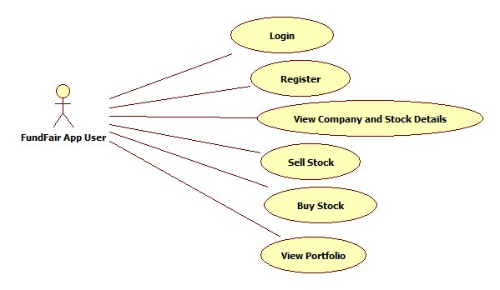
USE CASE DIAGRAM

Slide 6
Design Architecture

Slide 7
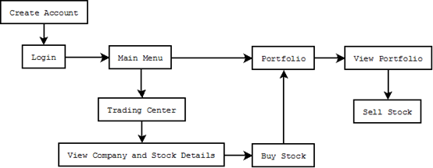
Site Map

Slide 8
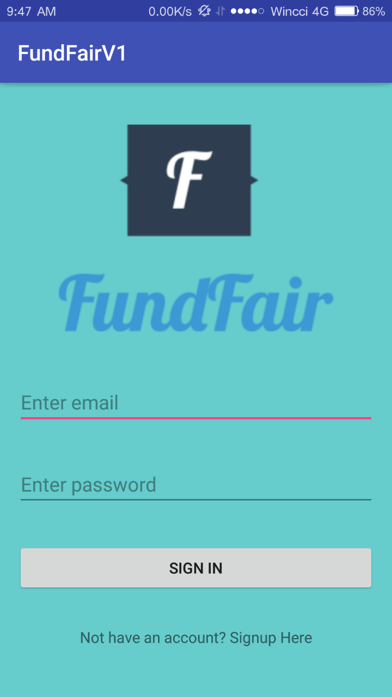
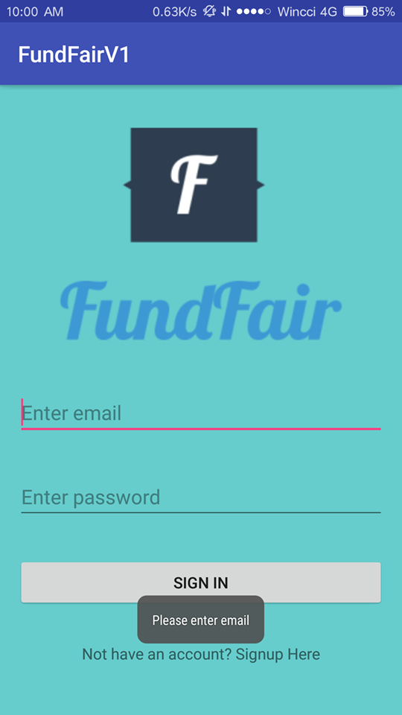
Prototype – Login

Slide 9
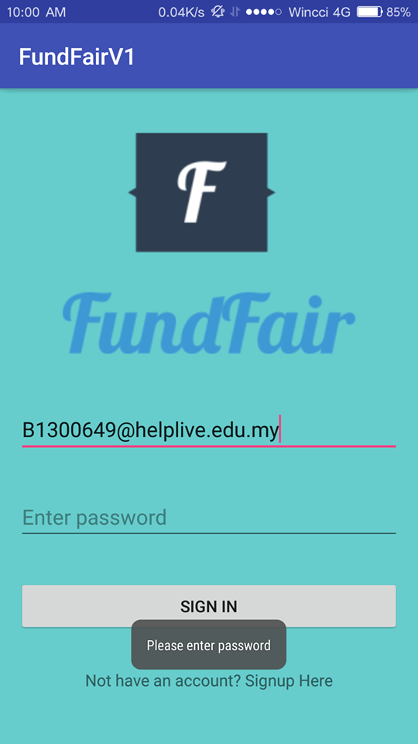
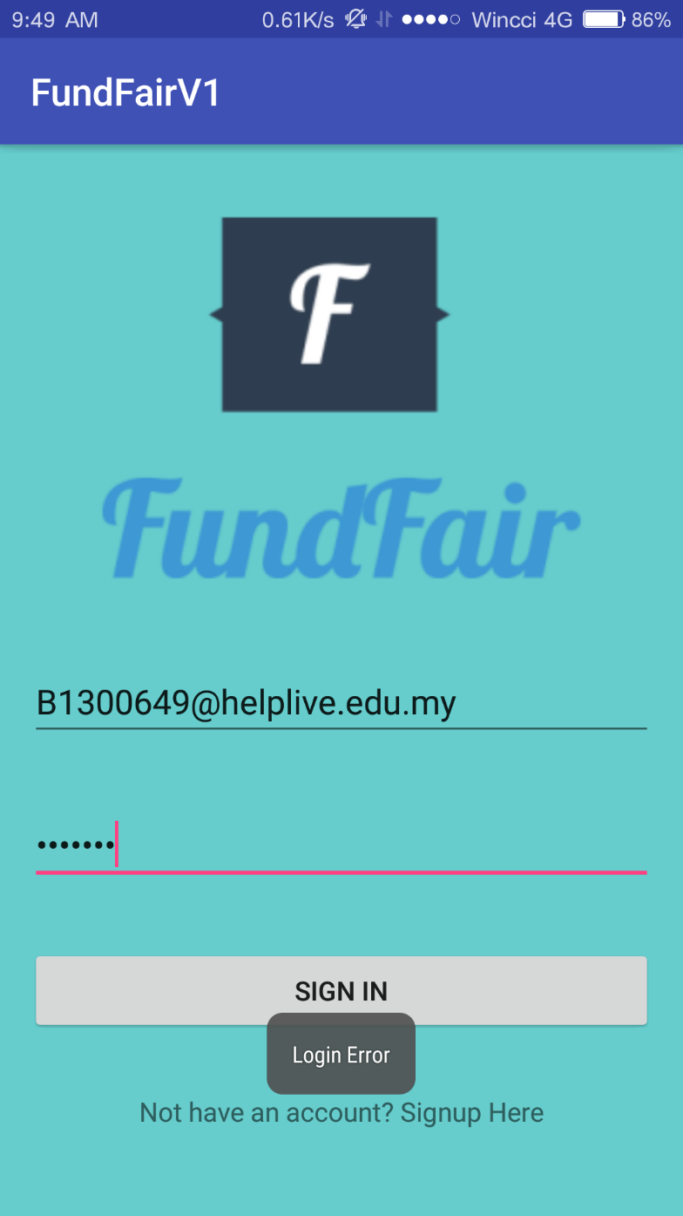
Prototype – Login

Slide 10
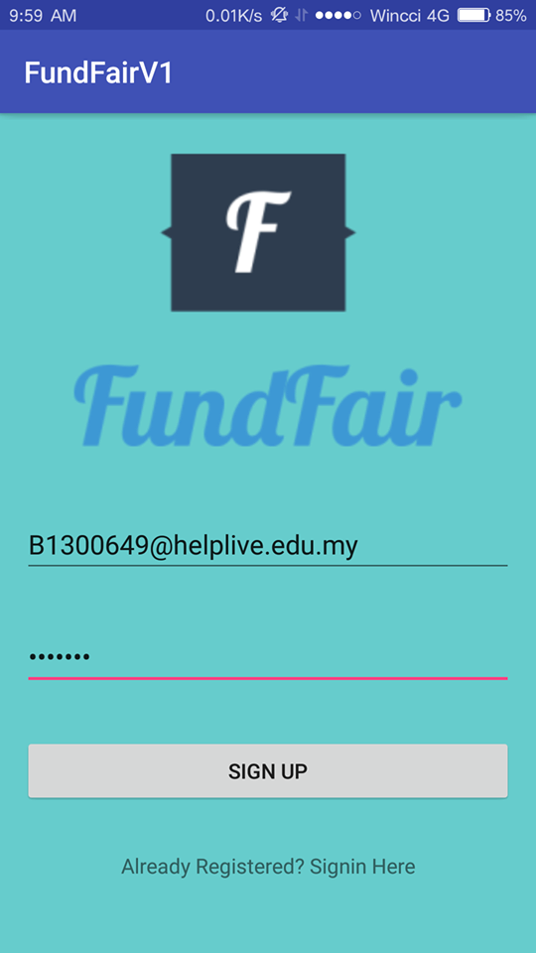
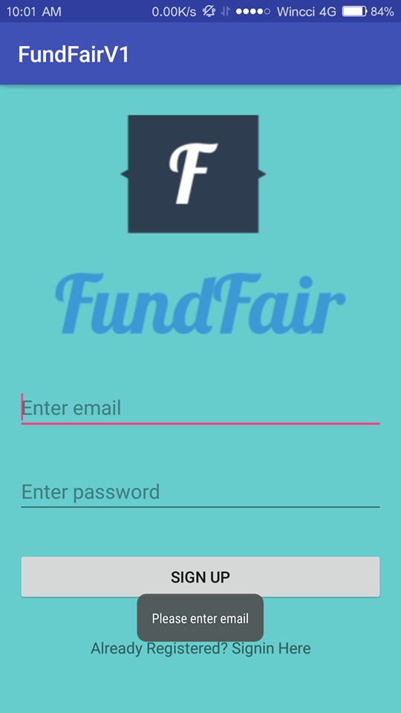
Prototype - Register

Slide 11

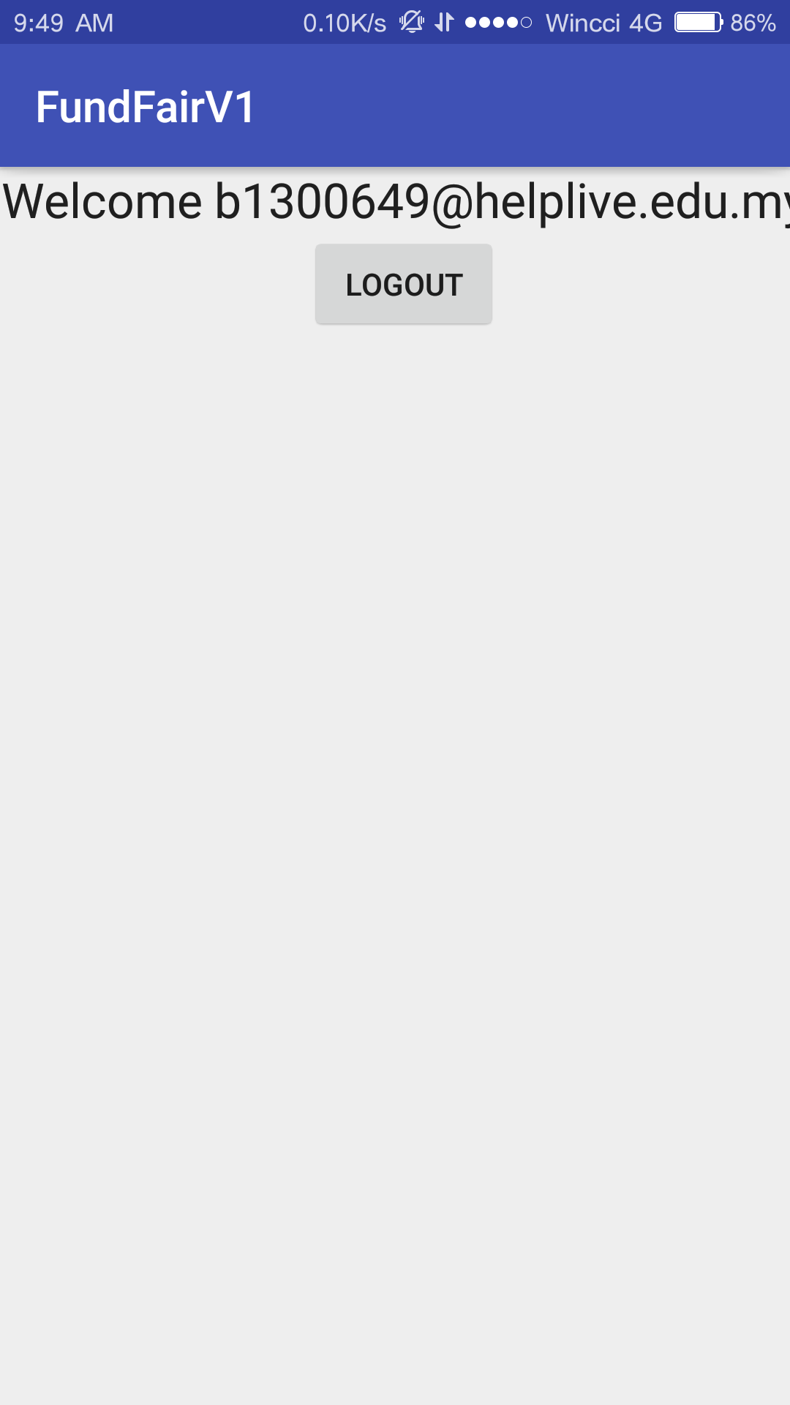
Prototype - Register

Slide 12
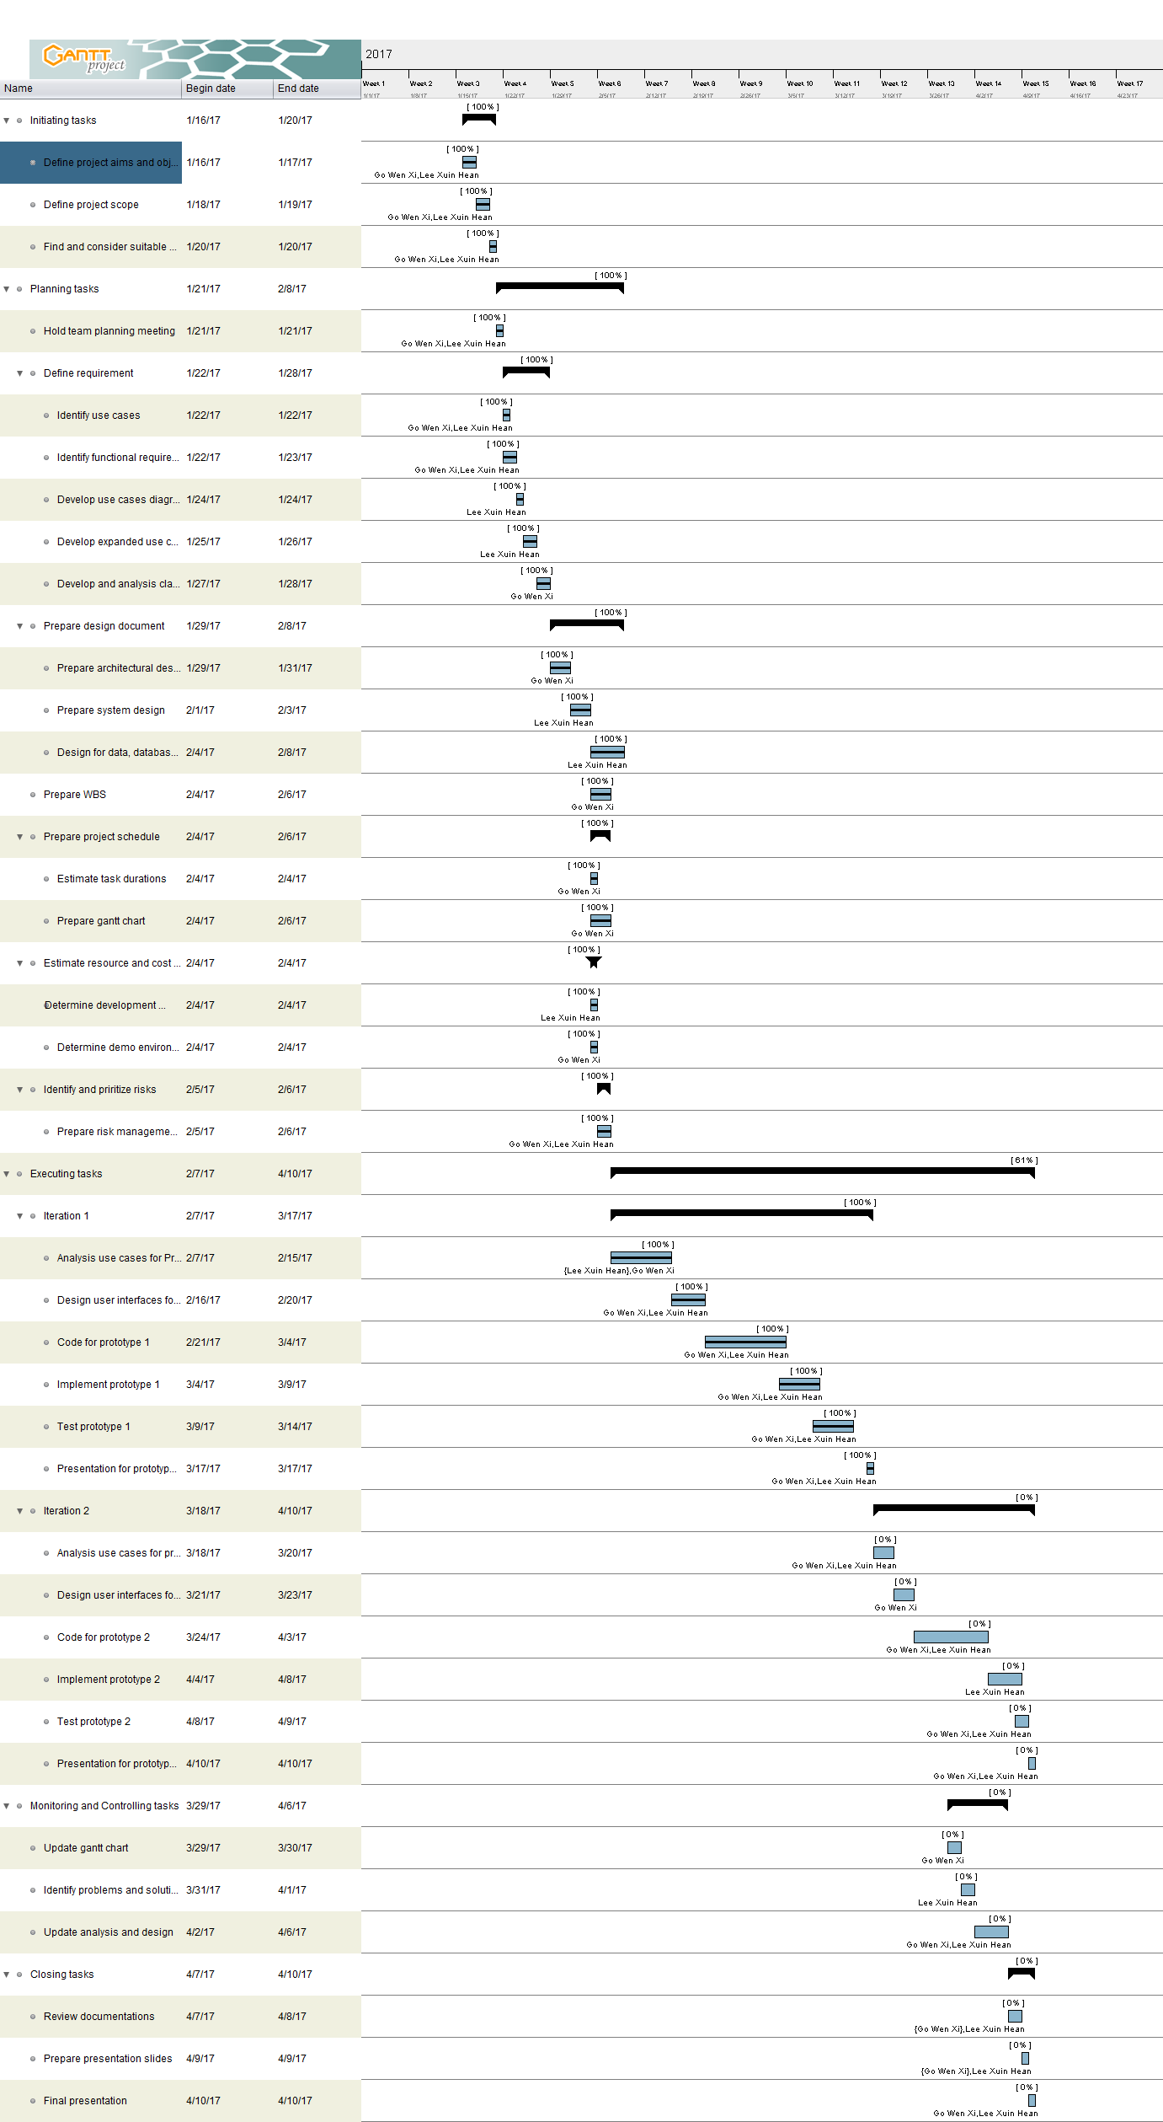

GANTT CHART
..\Desktop\SEGANTTCHART.png
Notes:
I will link the gantt chart to the image file to display a full image.

Slide 13
THANK YOU!
Notes:
SSD – DCD -

