Slide 1

Convexity, Smoothness and the Gradient Method
Master 2 Data Science, Univ. Paris Saclay
Robert M. Gower

Slide 2

Solving the Finite Sum Training Problem

Slide 3
Optimization Sum of Terms
A Datum Function
Finite Sum Training Problem

Slide 4
The Training Problem

Slide 5
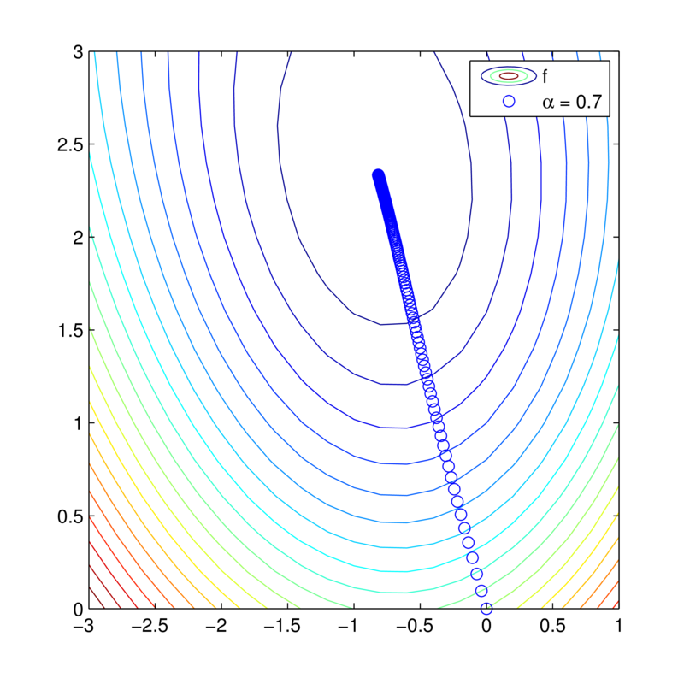
Gradient Descent Example
Optimal point
A Logistic Regression problem using the fourclass labelled data from LIBSVM
(n, d)= (862,2)
Can we prove that this always works!?
Convex training problems

Slide 6
Convexity
Global minimizer = Stationary point = Local minimizer

Slide 7
Convexity: First derivative

Slide 8
Convexity: Second derivative

Slide 9
Convexity: Examples
Norms and squared norms:
Proof is an exercise!
Negative log and logisitc:
Hinge loss
Negatives log determinant, exponentiation … etc

Slide 10
Smoothness

Slide 11
Smoothness: Convex
counter-example
Does not fit. Not smooth

Slide 12
Smoothness Equivalence
Proof on board

Slide 13
Insight into Gradient Descent
Minimizing the upper bound in x we get:
A gradient descent step !

Slide 14
Smoothness: Examples
Convex quadratics:
Logisitc:
Trigonometric:
Proof is an exercise!

Slide 15
Smoothness Properties
Proof on board

Slide 16
Convex and Smooth Properties
Co-coercivity
Proof on board

Slide 17
Convergence GD I
Theorem
Let f be convex and L-smooth.
Where
Proof on board

Slide 18
Strong convexity

Slide 19
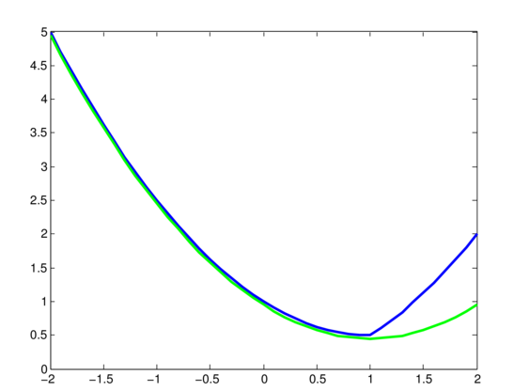
Example of Strong Convexity
Hinge loss + L2
Quadratic lower bound

Slide 20
Strong Convexity Properties
This is known as the Polyak- Lojasiewicz inequality.
Proof on board

Slide 21
Convergence GD II
Theorem
Let f be μ-convex and L-smooth.
Where
Proof on board

