Slide 1

Proximal operator and methods
Master 2 Data Science, Univ. Paris Saclay
Robert M. Gower

Slide 2
Optimization Sum of Terms
A Datum Function
Finite Sum Training Problem

Slide 3
The Training Problem

Slide 4
Convergence GD I
Not true for many problems
Theorem
Let f be convex and L-smooth.
Where
Proof on board
Is f always differentiable?

Slide 5
Change notation: Keep loss and regularizor separate
Loss function
The Training problem
Why not keep them separate?
If L or R is not differentiable
L+R is not differentiable
If L or R is not smooth
L+R is not smooth

Slide 6
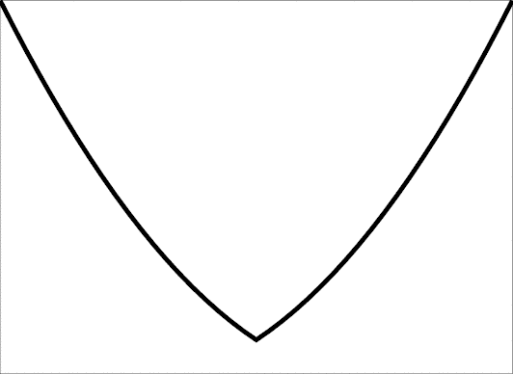
Non-smooth Example
Does not fit. Not smooth
Need more tools

Slide 7
Convexity: Subgradient
g =0

Slide 8
Examples: L1 norm
Why not keep them separate?

Slide 9
Examples
Lasso
Not smooth
Low Rank Matrix Recovery
Why not keep them separate?
SVM with soft margin
Not smooth

Slide 10
Assumptions for this class
The Training problem
Why not keep them separate?
What does this mean?

Slide 11
Optimality conditions
The Training problem
Why not keep them separate?

Slide 12
Working example: Lasso
Lasso
Why not keep them separate?
Difficult inclusion, do iteratively.

Slide 13
Proximal method I
The w that minimizes the upper bound gives gradient descent
But what about R(w)? Adding on +R(w) to upper bound:
Can we minimize the right-hand side?

Slide 14
Proximal method II
Minimizing the right-hand side of
What is this prox operator?

Slide 15
Proximal Operator I
Rearranging

Slide 16
Proximal Operator II
Exe:

Slide 17
Proximal Operator III:
Soft thresholding
Exe:

Slide 19
Proximal Operator IV:
Singular value thresholding
Similarily, the prox of the nuclear norm for matrices:

Slide 20
Proximal method V
Minimizing the right-hand side of
Make iterative method based on this upper bound minimization

Slide 21
The Proximal Gradient Method

Slide 22
Proximal Operator and Optimality conditions
The Training problem
Why not keep them separate?
Optimal is a fixed point.

Slide 23

Working example: Lasso
Lasso
Why not keep them separate?
Amir Beck and Marc Teboulle (2009), SIAM J. IMAGING SCIENCES,
A Fast Iterative Shrinkage-Thresholding Algorithm
for Linear Inverse Problems.

Slide 24
Convergence of Prox-GD
Theorem (Beck Teboulle 2009)
Can we do better?
Then
where
Is f always differentiable?
Amir Beck and Marc Teboulle (2009), SIAM J. IMAGING SCIENCES,
A Fast Iterative Shrinkage-Thresholding Algorithm
for Linear Inverse Problems.

Slide 25
The FISTA Method
Weird, but it works

Slide 26
Convergence of FISTA
Theorem (Beck Teboulle 2009)
Is this as good as it gets?
Then
Where w^{t} are given by the FISTA algorithm
Amir Beck and Marc Teboulle (2009), SIAM J. IMAGING SCIENCES,
A Fast Iterative Shrinkage-Thresholding Algorithm
for Linear Inverse Problems.

Slide 27
Convergence lower bounds
Theorem (Nesterov)
For any optimization algorithm where
Then
Where w^{t} are given by the FISTA algorithm and
Is f always differentiable?
Yuri Nesterov (1998), Springer Publishing, Introductory Lectures on Convex Optimization: A Basic Course

Slide 28
Lab Session 02/10
Bring your laptop!
Is f always differentiable?

Slide 29

Introduction to Stochastic Gradient Descent

Slide 30
Optimization Sum of Terms
A Datum Function
Finite Sum Training Problem

Slide 31
The Training Problem

Slide 32
The Training Problem

Slide 33

Stochastic Gradient Descent
Is it possible to design a method that uses only the gradient of a single data function at each iteration?
Unbiased Estimate
Let j be a random index sampled from {1, …, n} selected uniformly at random. Then

Slide 34
Stochastic Gradient Descent

