Slide 1
Introduction to Climate Related Disclosures: Starting the Climate Journey
Drivers of Climate-Related Disclosure
Dec 2022

Slide 2
What is Climate-Related Disclosure?
2015 UNFCCC Paris Agreement: target to minimize global warming to 2°C (relative to pre-industrial levels) with an aspirational target of 1.5 °C, thus preventing dangerous climate change
2018 UN Intergovernmental Panel on Climate Change (IPCC) special report: to limit global warming to 1.5°C, net anthropogenic CO2 emissions must decline by 45% (from 2010 levels) by 2030 and to net zero by 2050
2019, European Commission, New guidelines on reporting climate-related information
Impact of climate change on an organization (financial materiality): how climate-related issues might impact the organization's future financial performance
Financial impact, adaptation strategies, principal risks and opportunities, etc.
Contribution of an organization to the climate change agenda (environmental & social materiality)
Mitigation strategies, resource consumption, production of pollutants, etc.

Slide 3
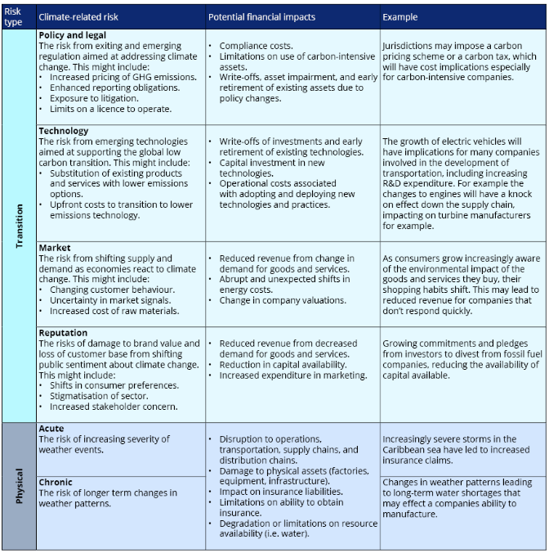
Impact of Climate Change
Climate change poses a major risk to the global economy
The impacts are difficult and uncertain, but the uncertainty and complexity should not be used as reasons for not reporting relevant information.
Financial impact of climate change on organizations
Impact of physical climate change (i.e., flooding, wildfires)
Adopting operations of account for climate change
Reducing greenhouse gas emissions
Increasing price of carbon
Climate Related Risks
Transition Risks
Physical Risks

Slide 4
Investor Perspective
Transition to a low-carbon economy will require US$90 trillion of investments by 2030
Investors will need to consider the risk-return profile of organizations exposed to climate-related risks
physical risks and transition risks
Impacts over short-, medium-, long-term
Investors need relevant, comparable, consistent and decision-useful information about companies and their management of climate-related risks and opportunities

Slide 5
Introduction to Climate Related Disclosures: Starting the Climate Journey
The Corporate Reporting Landscape
Dec 2022

Slide 6
What is Reporting Landscape?
Reporting Landscape
The collection of organizations, initiatives, requirements and supporting infrastructure
Complexity
Different audiences require different information
Many initiatives and elements
Various reporting standards and frameworks
Types of reporting requirements
Mandatory reporting: legislations and listing rules
Voluntary reporting
Organizations involved in corporate reporting
Governments and Regulators: develop mandatory/voluntary reporting requirements and laws
Standard Setters: set the structure, content, principles and standards for reporting; such as IIRC, SASB, GRI, CDSB, CDP, FASB, IASB…
Stock Exchanges
Investors
Indexes/Ratings Agencies
Supranational Organizations: influence across national boundaries; such as UN Global Compact, OECD, UNEP Finance Initiative
Supporting Organizations: advocate for reporting, provide guidance, lead initiatives; such as WBCSD, WEG, Natural Capital Coalition, Climate Group

Slide 7
Reporting Standards, Frameworks, Initiatives
Corporate Reporting Dialogue (CRD): promote greater coherence, consistency and comparability between framework and standards
Carbon Disclosure Project (CDP): reporting programs on climate change and environmental risk
Climate Disclosure Standards Board (CDSB): CDSB provides a framework for reporting environmental information via corporate report
Global Reporting Initiative (GRI): GRI has a framework for reporting economic, environmental and social impacts
Sustainability Accounting Standards Board (SASB): SASB offers sector-specific sustainability accounting standards, and it supports SEC 10-K and 20-F fillings.
International Integrated Reporting Council (IIRC): Integrated Reporting (IR) framework to incorporate sustainability information with financial information
International Organization for Standardization (ISO): ISO 26000 on how business can operate in a socially responsible way
International Financial Reporting Standards (IFRS): develop high-quality and globally accepted accounting standards, set by International Accounting Standards Board (IASB)
Financial Accounting Standards Board (FASB): establish accounting and reporting standards in the USA – Generally Accepted Accounting Principles (GAAP)

Slide 8
Climate Measure Standards and Initiatives
Greenhouse Gas (GHG) Protocol: measure GHG emissions from operations, value chains and mitigation actions
Transition Pathway Initiative (TPI): assess companies’ preparedness for the transition to a low-carbon economy; aimed at investors and free-to-use
Natural Capital Protocol (NCP): measure organizations direct and indirect impacts and dependencies on natural capital
RE100: bring together business committed to 100% renewable electricity to accelerate change towards zero carbon grids at global scale
Science Based Targets Initiative (SBTI): target settings for companies to transit to low carbon economy
World Benchmarking Alliance (WBA): increase private sector’s impact towards sustainable future, with free benchmark methodologies

Slide 9
Introduction to Climate Related Disclosures: Starting the Climate Journey
Key Concepts of Climate-Related Disclosure
Dec 2022

Slide 10
Reporting Channels and Audiences
Reporting Channels
Mainstream report: annual report, 10-K, registration documents
Sustainability report
Specialist platforms and questionnaires
Integrated report
Audiences
Shareholders, creditors
Supply and value chain, consumers
Board members, employees
Government
Other businesses
Non-governmental organizations (NGO)
General public

Slide 11
Elements of Disclosure
From interview transcript:
The story of how your business model creates and sustains value from climate and governance perspectives
Roles in the organization with responsibility to oversight climate change
Do you need a board committee
Internal and external strategies to mitigate and adapt to climate change related issues
Risks and opportunities brought by the transition – both positives and negatives
Metrics and targets, impacts and dependencies, such as natural resources usage and GHG emissions

Slide 12
Technical Concepts
Materiality is an important concept to climate-related reporting, while it has many different interpretations
In general, information is material if omitting, misstating or obscuring it could influence decision making
Organizations are expected to disclose climate-related information when it is important for decision-making purposes
Corporate Reporting Dialogue (CRD)’s common principles: https://corporatereportingdialogue.com/publication/statement-of-common-principles-of-materiality/
Forward-looking: companies’ future risks and opportunities which may have financial implications in the short-, medium- and long-term
Challenge in providing forward-looking disclosures from a financial perspective

Slide 13
Understanding the Recommendations of TCFD
What is TCFD?
Dec 2022

Slide 14
What is TCFD
The Task Force on Climate-related Financial Disclosures (TCFD)
Established in 2015
Target to develop voluntary, consistent climate-related financial disclosures, which are useful in understanding material risks related to climate change
TCFD recommendations are designed to help organizations to provide disclosures useful for investors, lenders and insurers to make capital allocation and risk underwriting decisions.
What is different about the TCFD
Link non-financial and financial information: how climate-related risks and opportunities may impact future financial position as reflected in the financial statements
Risk and Opportunities: transition risks and physical risks
Time horizons: encourage organizations to disclosure short-, medium- and long-term impacts
Scenario Analysis and Forward-Looking Disclosure: consider potential future outcomes under different scenarios vs. business-as-usual (BAU)
Financial Filings: disclose material information in mainstream financial filings

Slide 15
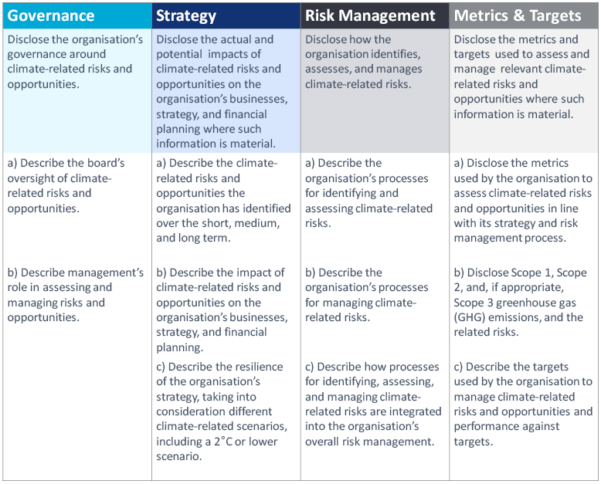
Recommendations of the TCFD

Slide 16
How are the TCFD Recommendations Structured?
For each of the 4 core elements, TCFD provides
guidance for all sectors
supplemental guidance for certain sectors
7 principles of effective disclosure
Relevant information
Specific and complete
Clear, balanced, and understandable
Consistent over time
Comparable among companies within a sector / industry / portfolio
Reliable, verifiable, objective
Timely

Slide 17
Who Should be Disclosing, and Where?
Who shall disclose?
Financial sector – banks, insurers, assets owners, asset managers
Non-financial sector with large GHG emissions, energy usage and water usage
Energy – O&G; coal; utilities
Transportation – air freight; passenger air transportation; maritime; rail; trucking; automobiles
Materials and Buildings
Metals & Mining; chemicals; construction materials
Real Estate management & development; capital goods
Agriculture, Food and Forest Products
Beverages; packaged foods and meats
Agriculture; paper and forest products
Where to disclose information?
Mainstream annual financial filings
especially for companies with public debt / equity

Slide 18
What is Scenario Analysis
Organizations shall disclose the resilience of their strategy against a 2°C or lower scenario
A tool for developing strategic plans that are more robust to a range of plausible future states
Explore alternatives that may alter the basis for “business-as-usual” assumptions
Hypothetical (stress testing) – not forecasts / predictions / sensitivity analysis

Slide 19
Understanding the Recommendations of TCFD
Deep Dive into the Recommendations
Dec 2022

Slide 20
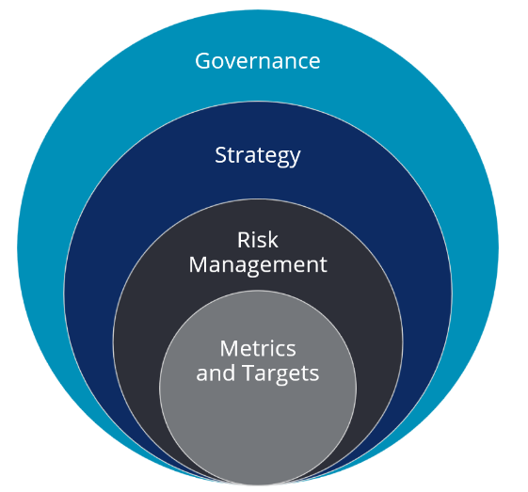
Overview & Governance
4 core elements, 11 recommended disclosures
Designed to interlink and inform one another
TCFD Implementation Guide by CDSB and SASB
Governance
https://www.tcfdhub.org/governance/
How an organization’s governing body is involved in assessing and managing and overseeing climate-related issues
Board Oversight
Processes and frequency by which board committees are informed about climate-related issues
Whether the board considers climate-related issues when reviewing and guiding strategy, major plans of action, risk management policies, annual budgets, and business plans, as well as setting the organization's performance objectives, monitoring implementation and performance, and overseeing major capital expenditures, acquisitions, and divestitures.
How the board monitors and oversees progress against goals and targets for addressing climate-related issues.
Role of Management
Whether climate-related responsibilities are assigned to management-level positions; whether such management positions report to the board; whether those responsibilities include assessing and managing climate-related issues.
Associated organizational structure(s)
Processes by which management is informed about climate-related issues
How management monitors climate-related issues.

Slide 21
Strategy
To understand the risks and opportunities an organization faces in relation to climate change, over different time-scales
https://www.tcfdhub.org/strategy/
What are the relevant short-, medium-, and long-term time horizons, taking into consideration the useful life of the assets or infrastructure. For example: short (<2 year), medium (2-5 year), long (5-10 year)
Specific climate-related issues for each time horizon (short, medium, and long term) that could have a material financial impact on the organization
Processes used to determine which risks and opportunities could have a material financial impact on the organization.
Describe risks and opportunities by sector and/or geography, as appropriate.
(continue to next page)

Slide 22
Strategy
(from previous page) What to disclose
Impact of climate change on
Products and services
Supply chain and/or value chain
Adaptation and mitigation activities
Investment in research and development
Operations (including types of operations and location of facilities)
How climate-related issues serve as an input to their financial planning process, the time period(s) used, and how these risks and opportunities are prioritized
Operating costs and revenues
Capital expenditures and capital allocation
Acquisitions or divestments
Access to capital
Climate-related scenarios were used to inform the organization's strategy and financial planning
How resilient their strategies are to climate-related risks and opportunities, taking into consideration a transition to a lower-carbon economy consistent with a 2°C or lower scenario
Where their strategies may be affected by climate-related risks and opportunities;
How their strategies might change to address such potential risks and opportunities;
The climate-related scenarios and associated time horizon(s) considered.

Slide 23
Risk Management
How organizations identify, assess and manage climate- related risks
https://www.tcfdhub.org/risk-management/
Risk management processes for identifying and assessing climate- related risks, especially how relative significance is determined
Whether they consider existing and emerging regulatory requirements related to climate change (e.g., limits on emissions), as well as other relevant factors
Processes for assessing the potential size and scope of climate-related risks
Definitions of risk terminology or risk classification frameworks used
Processes for managing climate-related risks – how to mitigate, transfer, accept, or control
Processes for prioritizing climate-related risks – how to determine materiality
how climate change is integrated into the organization’s overall Enterprise Risk Management (ERM) function

Slide 24
Metrics and Targets
Material metrics and targets used to assess and manage climate-related risks and opportunities
https://www.tcfdhub.org/metrics-and-targets/
Key metrics related to
water, energy, land use, waste management, etc.
Scope 1 , Scope 2 and Scope 3 (if appropriate) GHG emissions
In-line with GHG Protocol methodology – allow for aggregation and comparability
Industry-specific GHG efficiency ratios
Historical data in a comparable way; trend analysis
Methodologies to calculate or estimate climate-related metrics
How related performance metrics are incorporated into remuneration policies
Internal carbon prices
Opportunity metrics – green revenue from products and services designed for a lower-carbon economy
Key targets
Key performance indicators: GHG emissions, water usage, energy usage, etc.
Whether the target is absolute-based or intensity-based
Time frame over which the target applies
Base year from which progress is measured
Methodologies used to calculate targets and measures
Others: efficiency / financial goals, financial tolerances, avoided GHG emissions, net green revenue goals

Slide 25
Climate-Related Financial Disclosures
Key Elements of Climate-Related Financial Disclosure
Dec 2022

Slide 26
Governance Disclosures
Board Oversight & Management Responsibility
Companies should consider the connections, information flows and oversight mechanisms that exist between the board, management and climate-related issues.
Companies may also consider how board members and managements are incentivized to promote long-term prosperity and resilience, with clear indicators and criteria used to assess performance.

Slide 27
Strategy Disclosures
Explain how business dependencies affect the development of corporate strategies to the risks and opportunities posed by climate change.
Natural Capital is another term for the stock of renewable and non-renewable resources that combine to yield a flow of benefits to people.
Social Capital: The networks of relationships among people who live and work in a particular society, enabling that society to function effectively.
Human Capital: The knowledge, skills, competencies and attributes embodies in individuals that facilitate the creation of personal, social and economic well-being.
Physical Risks & Transition Risks
Forward-looking disclosure
How the dependencies underpin a company’s ability to create value in the short-, medium- and long-term.
Scenario Analysis

Slide 28
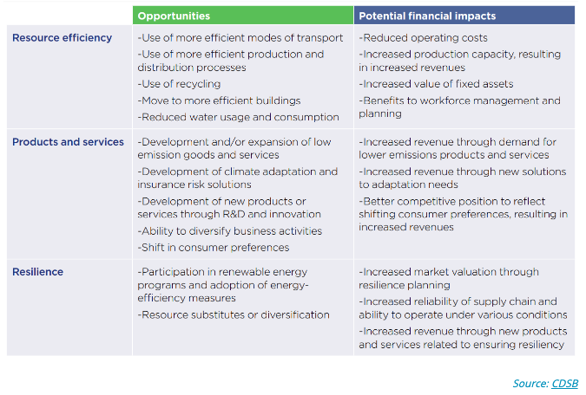
Strategy Disclosures – Risks and Opportunities

Slide 29
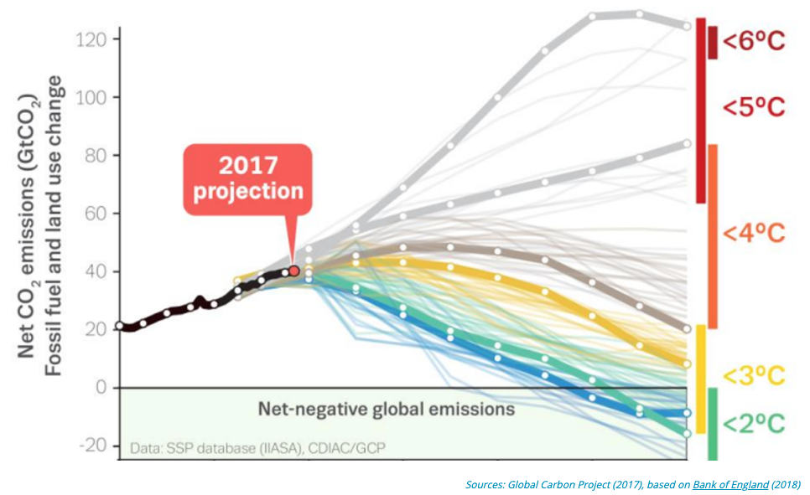
Strategy Disclosures – Scenario Analysis
Exploring a wide variety of futures and adapting accordingly will allow for the most effective and efficient strategies and further build investor confidence.
The TCFD suggests that companies make use of at least a 2°C scenario
Describe the scenarios used, the assumptions (e.g. rate of growth), and timelines

Slide 30
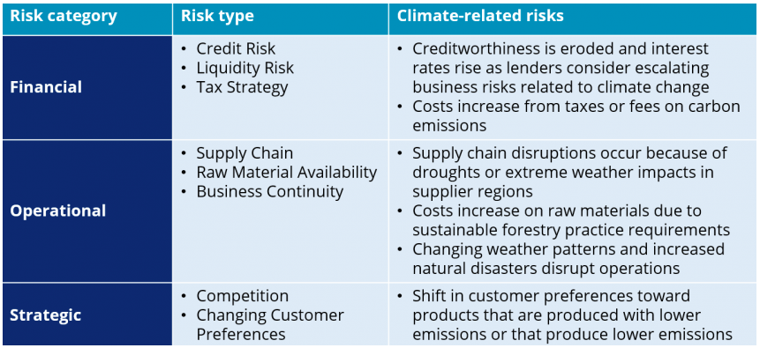
Risk Management Disclosures
Complex characteristics of climate-related risks
Geography and business activities – different scales of impact by local and regional conditions, as well as different business activities
Longer time horizons
New and uncertain
Changing magnitude and non-linear dynamics – important to understand the sensitivities, tipping points and knock-on effects
Interconnected with socioeconomic and financial systems
Climate-related risks are also risk multipliers and driver of other risks

Slide 31
Risk Management Disclosures
Disclosure of climate-related financial risks should include
Description of the risk.
Specific characteristics of the risk
An account of where the risk may materialize (geographical location or business area).
The time horizons that the risk can be expected to materialize and how they might develop over time.
An explanation of its relevance to the company and its operations.
An explanation of where climate-related risks exacerbate other business or environmental risks.
Key principles of integrating climate change into existing risk processes
Interconnections – all relevant functions, departments, and experts
Temporal orientation – short, medium and long term
Proportionality in the context of other risks, materiality and implications for strategy
Consistency of methodology

Slide 32
Metrics and Targets
Metrics used should reflect the policies adopted by the company, and a consistent, comparable, understandable and verifiable manner.
Setting targets
Science-Based Target Initiative (SBTi): science-based emissions reduction targets; link
Align corporate targets to international and national goals
Disclosure of target should include types, indicators, baseline, timeline and connection to overall strategy.
Greenhouse Gas (GHG) Protocol
Scope 1: direct emission
Scope 2: indirect emission, such as purchased electricity
Scope 3: upstream / downstream activities, such as
The extraction and production of purchased materials and fuels.
Transport-related activities - third party transport-related activities within its supply chain.
Any electricity-related activities not included in scope 2.
Leased assets, franchises, and outsourced activities
Use of sold products and services by consumers.
Waste disposal.

Slide 33
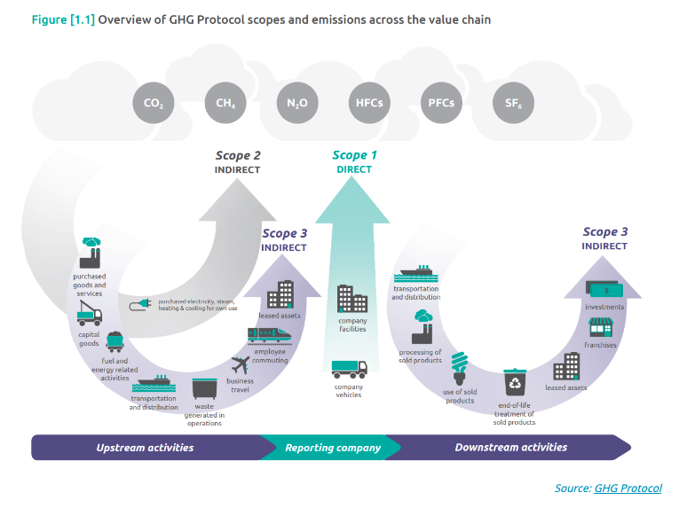
Metrics and Targets – GHG Protocol Scopes

Slide 34
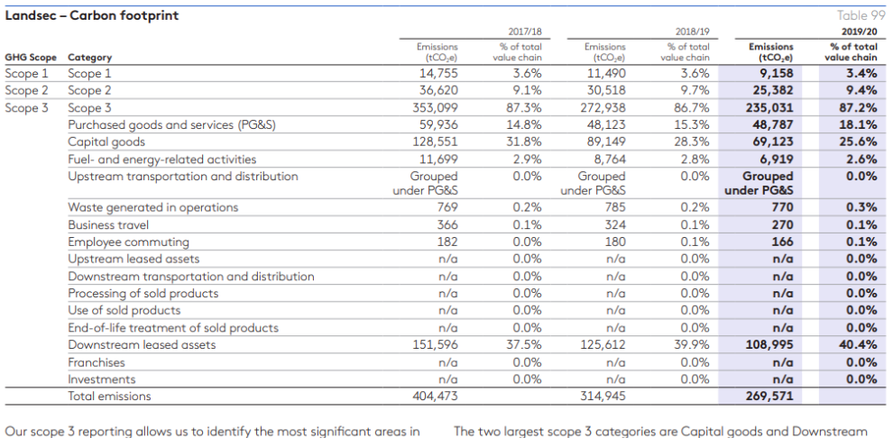
Metrics and Targets – Carbon Footprint
Example – Landsec Securities Group PLC

Slide 35
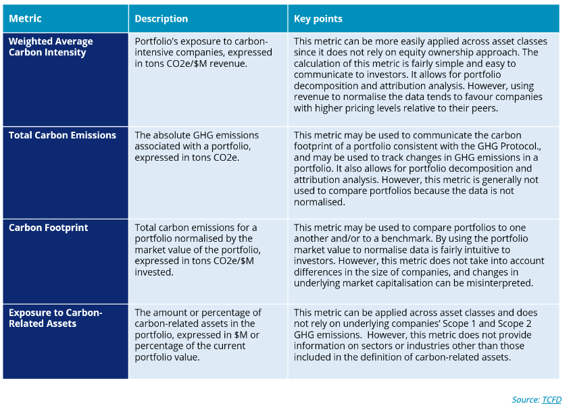
Metrics and Targets – Portfolio Exposure
Asset owners and managers should disclose their portfolio exposure to carbon-intensive companies.

Slide 36
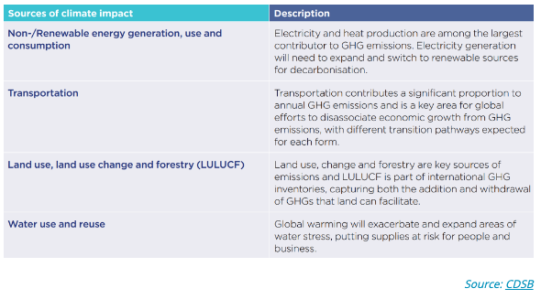
Metrics and Targets – Environmental Metrics
Beyond GHG emissions, companies should also disclose metrics on wider environmental issues, such as:

Slide 37
Metrics and Targets – Forward-looking
Forward-looking metrics can help understand future risks, but there are some challenges:
Lack transparency and comparability
Reliance on assumptions and future uncertainty
Complexity of calculation
Suitability for public disclosure – may be useful in internal decisions but inappropriate for external disclosure
Lack of reliable emissions data
Climate Value at Risk (VaR): future loss to a portfolio attributed to climate-related risks, within a given time horizon and at a particular probability
Implied Temperature Rise (ITR): Estimating the global temperature rise associated with the GHG emissions of a single company
TCFD’s consultation paper on Forward-Looking Financial Sector Metrics: link

Slide 38
Climate-Related Financial Disclosures
Interconnected and Integrated Reporting
Dec 2022

Slide 39
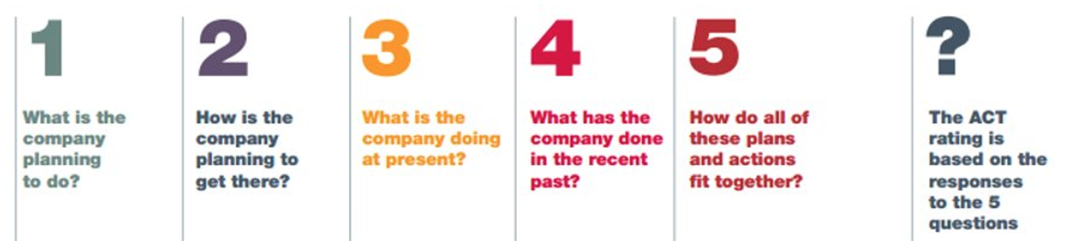
Interconnected Disclosure
The disclosure elements should be interconnected
To provide a holistic picture of the factors and relationships that affect the company’s ability to create value and manage climate- related issues
Assessing Low Carbon Transition (ACT): link
ACT assess companies’ plan and performance to ensure they are on a well-below 2°C compatible pathway and aligned to a low carbon transition
ACT ratings

Slide 40
Integrated Thinking and Reporting
Integrated Thinking encourages companies to draw out connections and relationships across
business areas (e.g., finance and sustainability)
subject matters (e.g., product development and stakeholder relationships)
geographies (e.g., sites of resource extraction and product sale)
timescales (e.g., historical performance and long-term targets)
Integrated Reporting encourage companies to
present a holistic understanding of business operations
to understand and account for their value creation in the short, medium and long-term

Slide 41
Dynamic Materiality
Different reports have different materiality lenses
Sustainability reports: impact-focused
Mainstream reports: financial materiality to determine what sustainability issues to disclose
Materiality can be dynamic, because it took developing knowledge for climate to be understood as posing material financial risks and opportunities.
As a result, companies need to keep abreast of potential changes regularly.

Slide 42
System Thinking – Connect Climate and Wider Sustainability Issues
System Thinking offers companies a means of embedding climate system with other environmental and human systems.
System Thinking goes beyond environmental systems and geographic boundaries.
Findings from system thinking and subsequent actions should be integrated with the existing reporting practices.

Slide 43
Role of Accountant
Accountancy profession is well positioned to provide the skills needed to identify, measure, manage and disclose climate-related financial information.
IFRS – climate-related and other emerging risks
CDSB & IASB: guidance on how to integrate climate-related matters into financial reporting
Presently, most of the climate-related information in included in the narrative sections of the annual report.
Companies are expected to start considering how to quantify and report the financial implications of climate change in financial statements.

Slide 44
International Voluntary Reporting Standards
Most commonly used international voluntary reporting standards
Carbon Disclosure Project (CDP): a platform for companies to report their impact on climate, water and forest
Climate Disclosure Standards Board (CDSB): help organizations to report environmental information in mainstream reports
Global Reporting Initiative (GRI): Envision to enable all organizations to report their ESG impact.
Value Reporting Foundation (IIRC + SASB)
IIRC: integrated reporting – help organization explain how they create value
SASB: help organization to explain material ESG information
Corporate Reporting Dialogue (CRD): envision to create alignment across reporting frameworks

