Slide 1
Consolidators And Rolling Windows

Slide 2
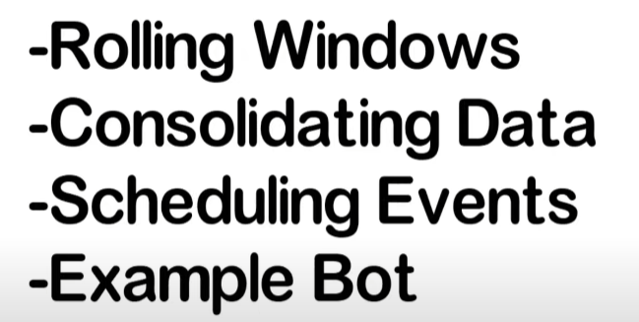

Slide 3
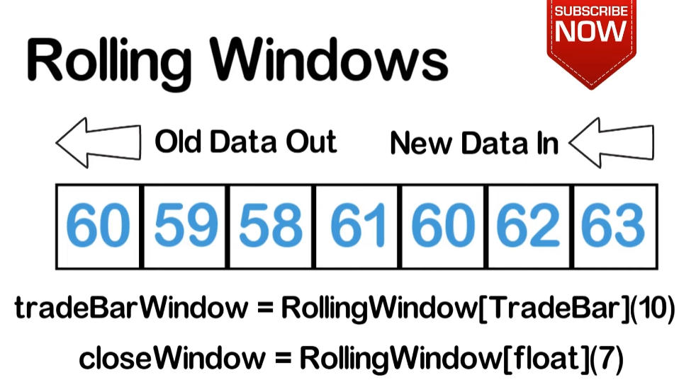


Slide 4
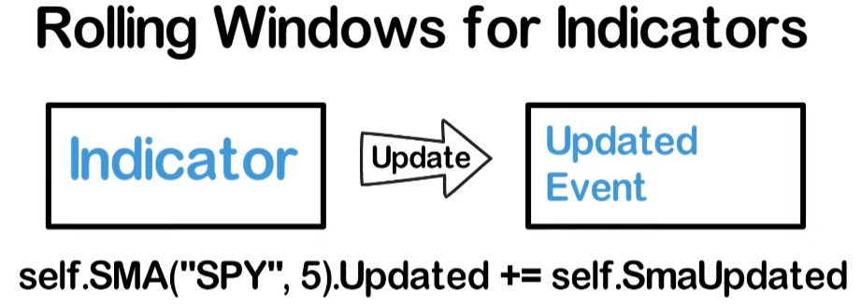


Slide 5
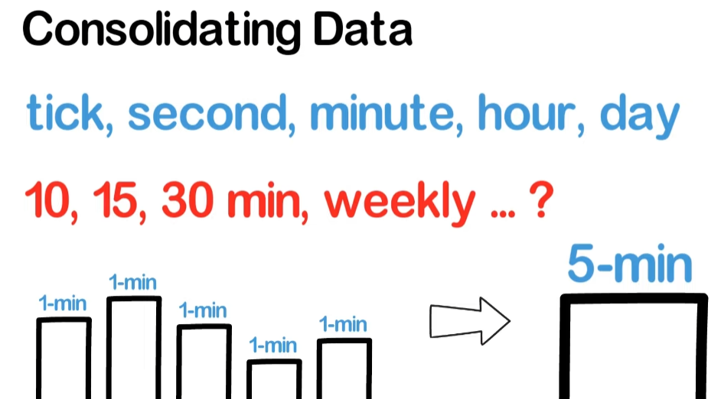

Slide 6
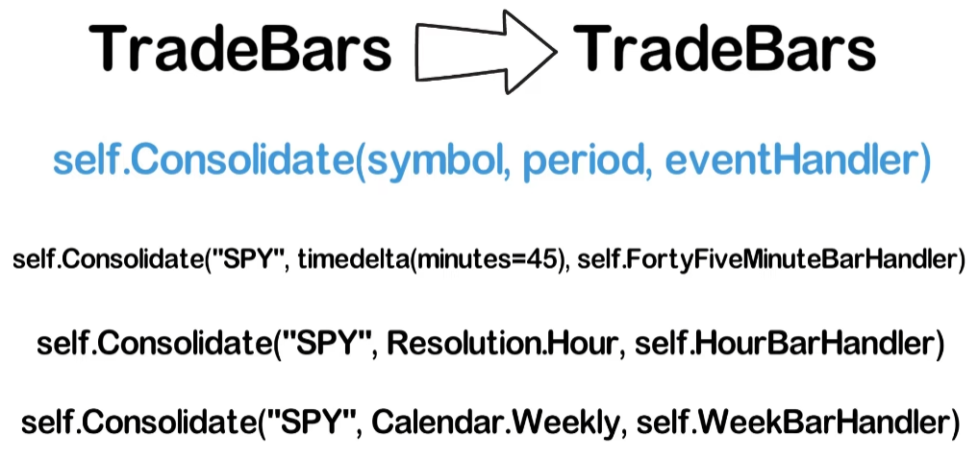



Slide 7
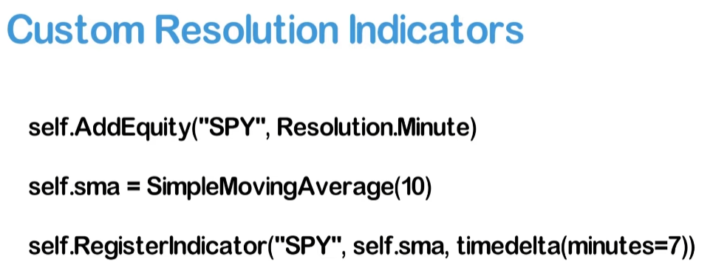

Slide 8
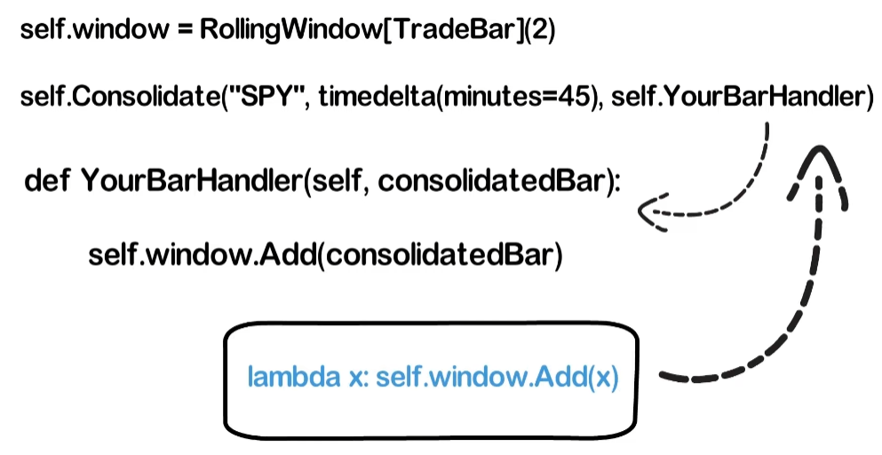

Slide 9
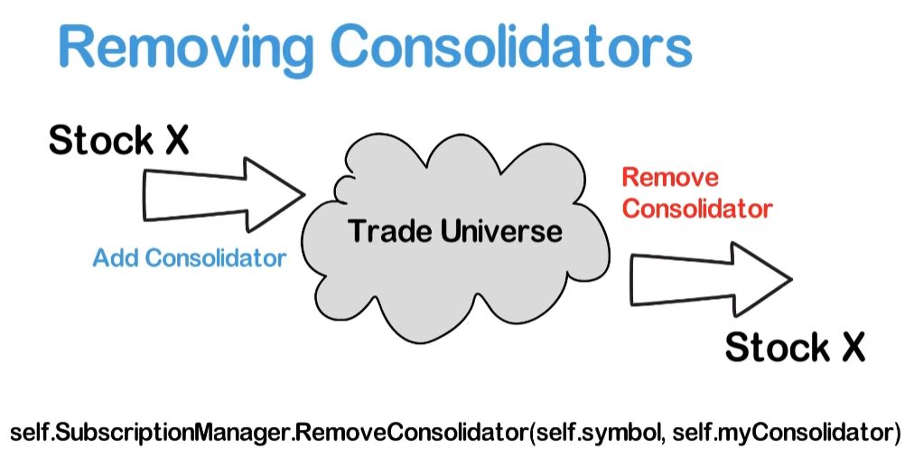
Consolidators consume memory and computation power.
So when removing a security from your universe, you also want to remove the consolidator.

Slide 10
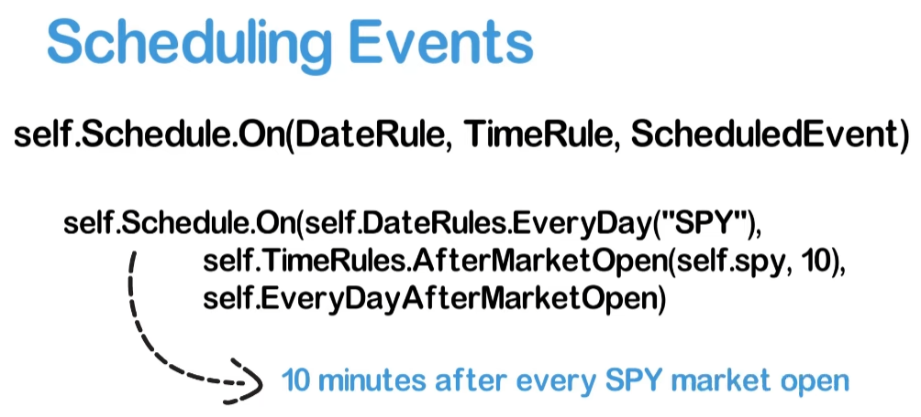


Slide 11
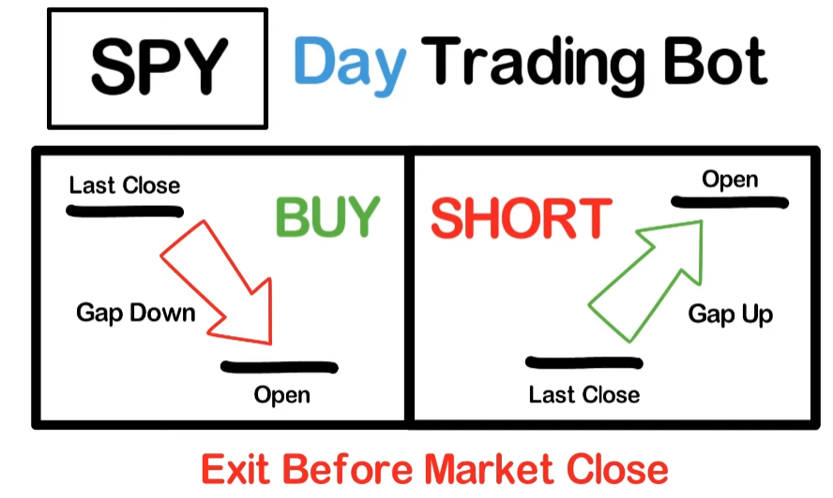

Slide 12
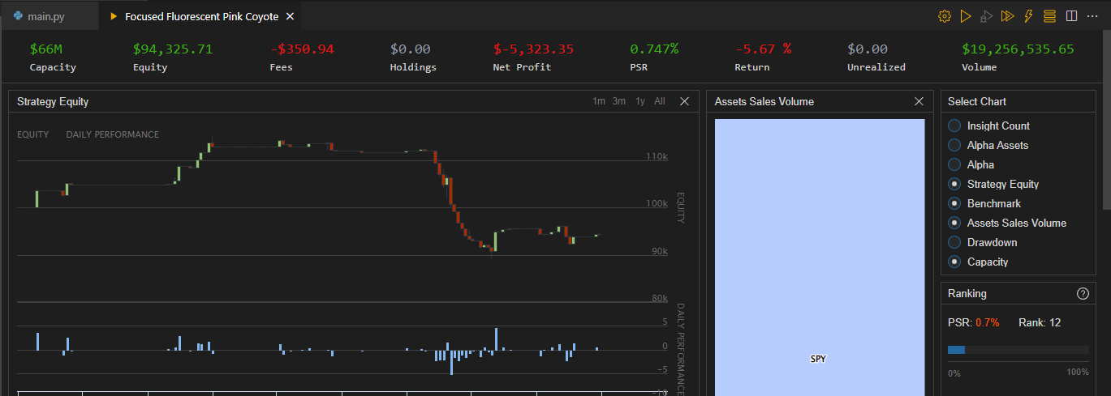

Slide 13
QuantConnect Scheduled Events reference table: https://www.quantconnect.com/docs/v2/writing-algorithms/scheduled-events?ref=v1

